Slide 1
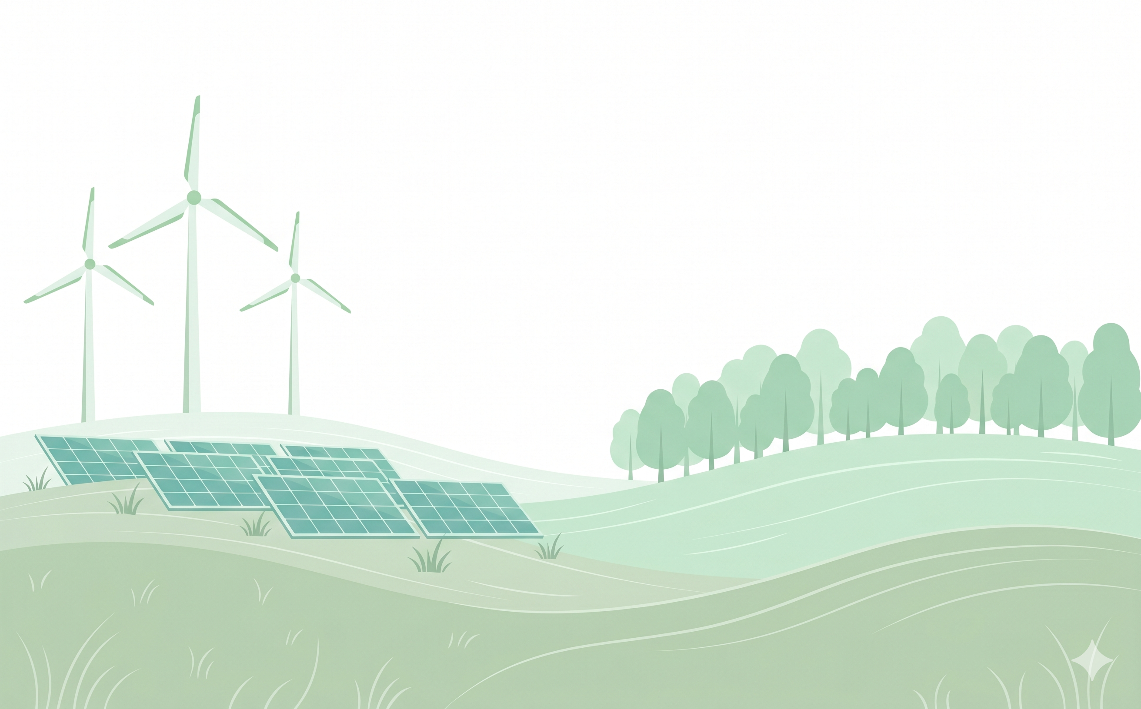
Power Plant Fitness
An IoT-Powered Smart Gym
Notes:
So! My capstone project is for a fictional gym called Power Plant Fitness – so aptly named because the core concept of the gym is
to convert workouts into real usable power through the use of resistance-based exercise machines.

Slide 2


Project Introduction
Power Plant Fitness: A fictional smart gym concept designed as an IoT-integrated business management system
Problem: Gym member dropout rates of 40-65% within the first six months due to insufficient motivational infrastructure¹.
Solution: Exercise machines act as micro-generators, converting physical effort into usable energy that can be redeemed for rewards
Target Users: Gym members (primary) and staff (administrative)
Main Modules:
RFID/NFC Authentication
Machine Interface (touchscreen UI)
Python-based normalization algorithm for calculating reward credit
1. Gjestvang, C., Tangen, E. M., Arntzen, M. B., & Haakstad, L. A. (2023). How do fitness club members differentiate in background characteristics, exercise motivation, and social support? A cross-sectional study. Journal of sports science & medicine, 22(2), 235.
Notes:
The primary goal of this gym is to provide a stronger motivation to attend than personal health and fitness goals alone.
Statistically speaking, almost all gyms face dropout rates of 40-65% within the first six months due to a lack of motivation.
So, my solution is to provide extrinsic motivation by rewarding members for using our gym equipment.
How do we do that?
Well, many modern gym machines like ellipticals, stationary bikes, and rowers already run under their own power
But as the user increases the resistance level and exercises for longer periods of time, the machine is creating more power than it needs to and is essentially wastes it as excess heat.
Instead, my idea is to connect them all onto a local grid within the gym. As the user bikes, runs, lifts, or rows, that excess energy feeds the gym’s battery system.
AND when they do that, we reward them for their effort by crediting the watts they generated into a currency
that they can spend on gym merch, vouchers for local restaurants, coupons to an in-gym juice bar, or even discounts on their membership.
In other words, our gym would offer the same equipment as any other gym, but ours would reward members with cheaper memberships just by being loyal and consistent. It’s a win-win.
At the same time, our members contribute to ecological sustainability by literally producing energy for the gym that would otherwise be drawn from the grid.
Of course, a dozen people on stationary bikes would not be equivalent to a wind turbine; it’s the thought that counts.
This project covers 3 aspects of this IoT solution
The signing-in solution. Users would sign in to each machine individually so that machine telemetry credits them appropriately. They’d do this with an RFID wristband – like the ones they use at Disney Parks.
The machine interface for an elliptical. Each machine would have the same 24 inch touchscreen but would have slightly different options depending on the type of machine
A python-based normalization algorithm to balance the reward crediting. I’ll talk about that more later.

Slide 3
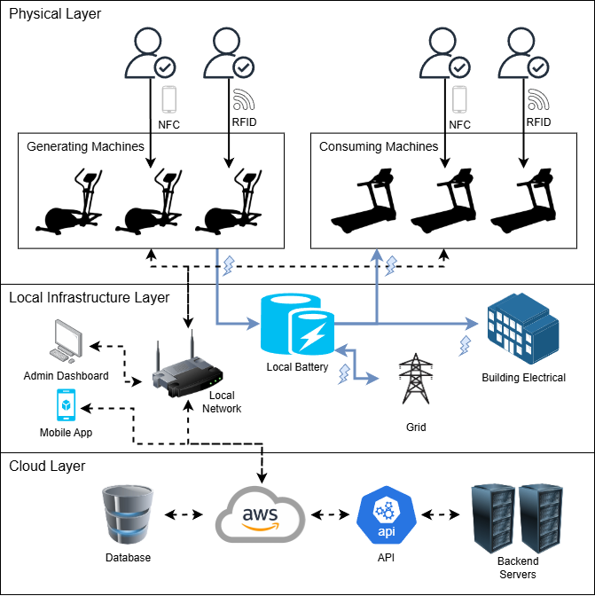
System Architecture Overview
Physical Layer: RFID/NFC authentication connects members to generating and consuming exercise equipment
IoT Layer: Resistance-based machines capture real-time wattage output and transmit telemetry to the cloud backend
Local Infrastructure: On-site battery system stores generated energy and distributes electricity between building appliances and consuming machines (treadmills/stair-steppers)
Cloud Backend: AWS-hosted server manages member accounts, processes wattage credits, and serves the mobile and kiosk interfaces
Database: Database tables store member profiles, session records, telemetry data, and reward transactions
Notes:
The solution is divided into 3 main layers (Physical, Local Infrastructure, and Cloud).
Within the physical layer, users log into machines using an RFID tag and wristband that we’d give to them at the time of enrollment
or through the NFC protocol on their smartphone if they have both a compatible smartphone and the Power Plant Fitness mobile app.
The gym would have two types of machines – generating machines, and consuming machines.
Generating machines (like ellipticals, bikes, rowers, and cable-mechanized strength training machines) will all generate electricity and therefore reward members for using them.
Consuming machines (like treadmills and stair steppers) require a substantial amount of electricity to run, and will not reward members for using them. They are there to give variety to the gym and stay competitive with other gyms.
Similarly, the gym may supply free weights (like dumbbells, kettlebells, and barbells) that are not connected to any kind of machine and will not credit the user for using them.
The generated electricity is stored in a localized battery system, which distributes its power to the consuming machines and the building's electrical (lights/fans/etc.) The grid will chip in if not enough power is generated.
All the machines are connected to the gym network, which periodically sends data to the AWS cloud layer that both the mobile app and staff dashboards read from.

Slide 4
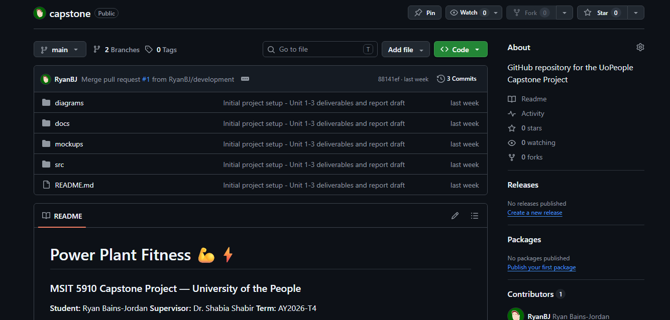
GitHub Repository
Notes:
As per the solution requirements, the project files, documents, and mockups are available in the GitHub repository.
The repository uses two branchs: development and main.
Incrementations are pushed to the development folder for review and testing.
Then a pull request is made to merge it into main when everything is validated.
The link to the repository will be listed on the next slide.

Slide 5
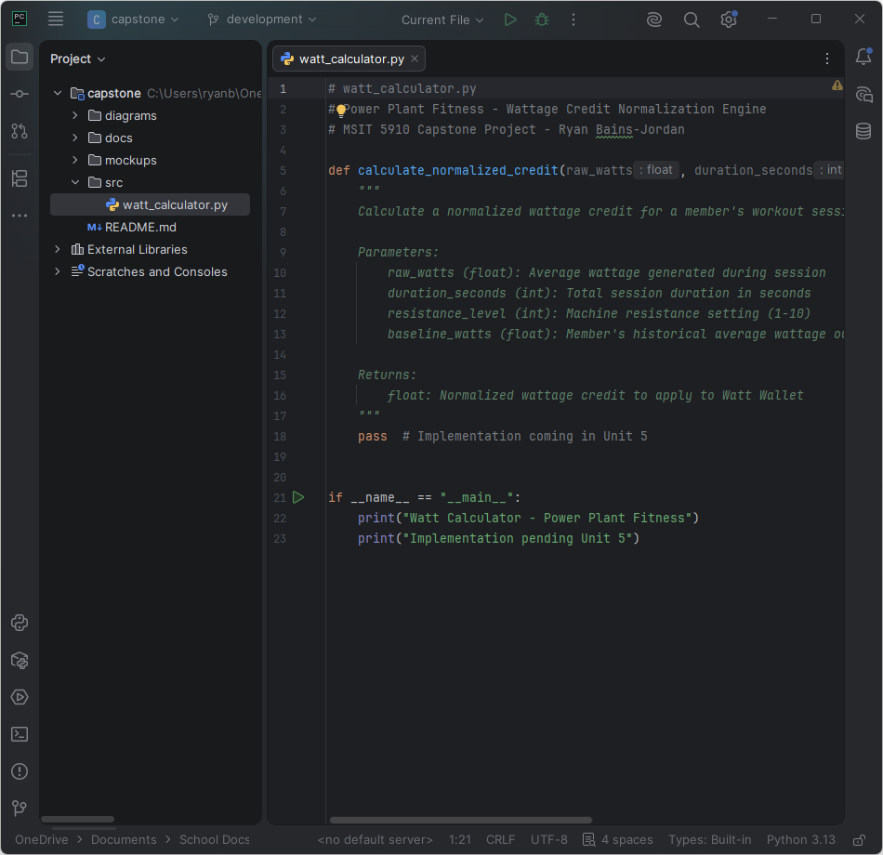
Development Environment
Language: Python 3.x
IDE: JetBrains PyCharm (Education License)
Version Control: Git / GitHub (two-branch workflow)
Repository: https://github.com/RyanBJ/capstone
Dependencies: None – standard Python library only
Structure:
/src: watt_calculator.py (normalization algorithm)
/docs: written assignments and technical report
/diagrams: system architecture exports
/mockups: Figma UI screen exports
Notes:
The code in this project is written in Python.
I decided to use JetBrains PyCharm as the development environment because I am a fan of their products and they provide an education license to use them all.
As mentioned, the code is available in the GitHub repository which is available through that address.
The Python code is for a program called watt_calculator.py which helps normalize the reward system so that it isn’t biased to those who are more physically fit.
I’ll dive into how that will work later in the video.

Slide 6
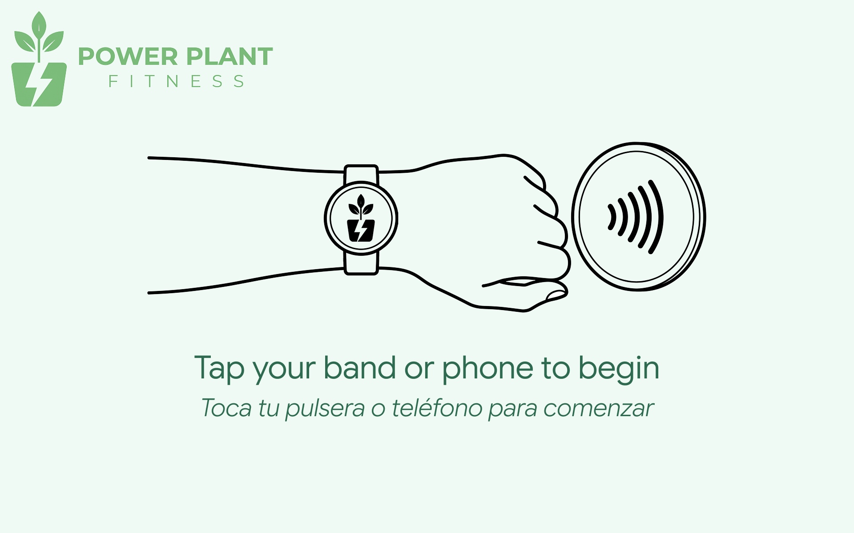
UI — Tap-In Screen
Notes:
If you can picture walking up to an elliptical after enrolling in a membership at this gym, picture a large touchscreen dominating the front of the machine.
On that touchscreen will show something like this, instructing the user to tap their wristband or phone to a receiver somewhere on the machine.
Doing this, will sign them into the machine automatically.
They won’t have to type anything or remember a password. All that is stored on the encrypted RFID tag.

Slide 7
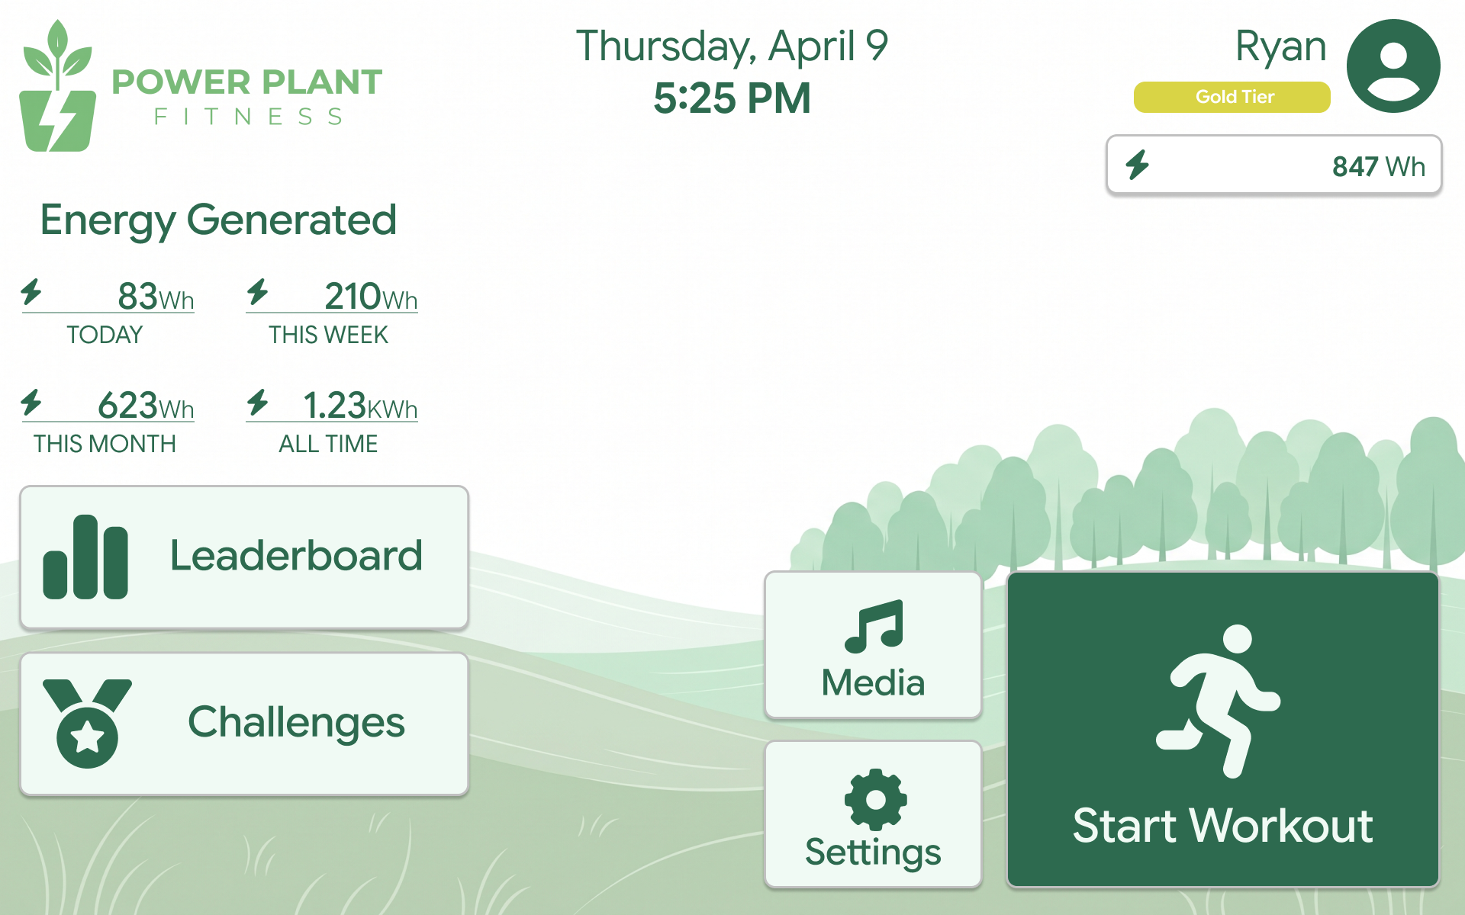
UI — Home Screen
Notes:
Once signed in, they would see a screen like this. This is the ellipticals’ home screen and there are a variety of things the user can do on it.
For example, they can see a few statistics on how much energy they generated while at the gym.
They can also enroll in weekly challenges and compete in leaderboards.
They can also visit the gym store by tapping their balance below their profile. This balance accumulates as they continue to use a generating machine at the gym.
The currency in this case is in the form of wattage. For example, a lanyard may cost 450watts and this user has 847 in their “Watt Wallet” to spend.
They can also stream from popular music and streaming services right from the machine
And of course, they can start workingout.

Slide 8
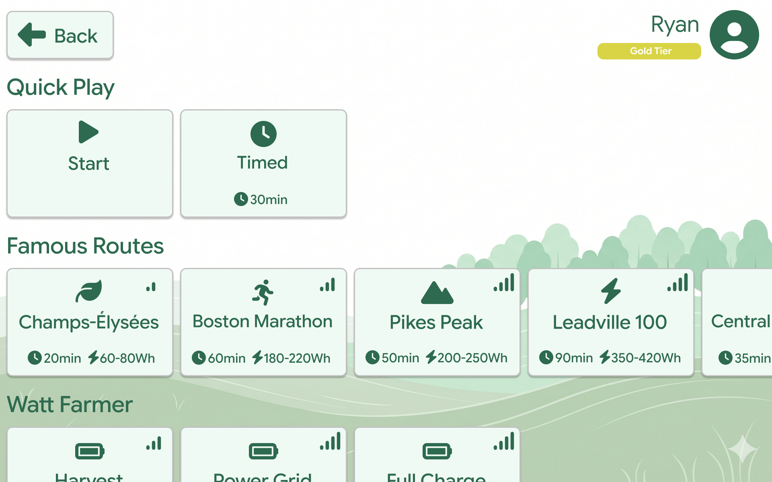
UI — Workout Screen
Notes:
If the user taps “Start Workout” they would get to this screen.
This gives them the opportunity to select a pre-defined workout or click “Start” to start pedalling right away.
They will still earning credit right away based on how long they use the machine and which resistance level, among other things.
The icons in each of the pre-defined workouts show the intensity level, how long it would take, and roughly how many watts the user can generate from doing it.
Watt-Farmer workouts are intense workouts intended for those who want to maximize their rewards while on the machine.

Slide 9
UI — Home Screen
Notes:
Let’s go back to the home screen.

Slide 10
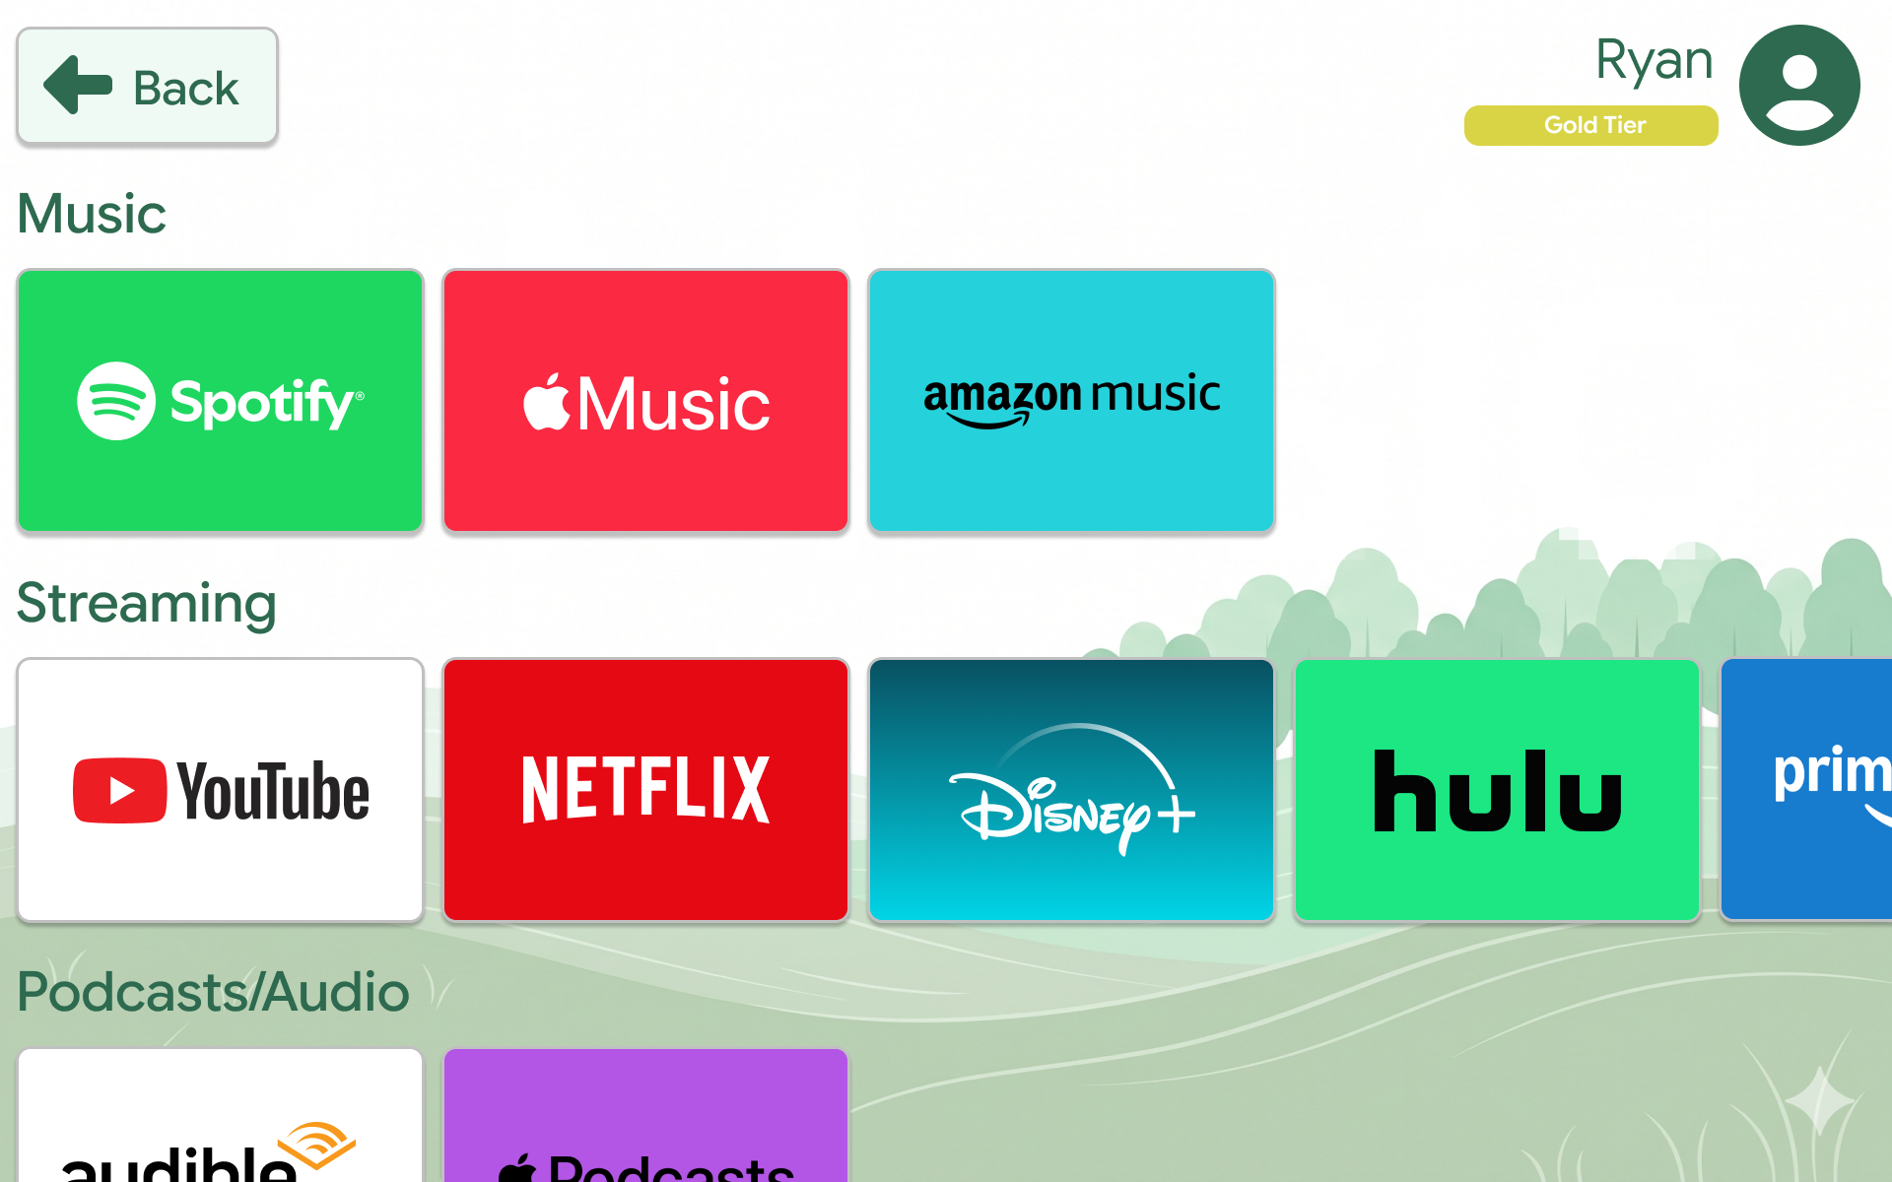
UI — Media Screen
Notes:
If the user taps the “Media” button they will be shown this screen where they can pick from a variety of music, streaming, and audio services to watch or listen to while they are working out.
The plan is for a single-sign-on experience where the user will only need to sign-on to their favorite app once…and they will stay logged in even when switching machines.

Slide 11
Python — Watt Calculator
# watt_calculator.py # Power Plant Fitness - Wattage Credit Normalization Engine # MSIT 5910 Capstone Project - Ryan Bains-Jordan def calculate_normalized_credit(raw_watts, duration_seconds, resistance_level, baseline_watts): """ Calculate a normalized wattage credit for a member's workout session. Parameters: raw_watts (float): Average wattage generated during session duration_seconds (int): Total session duration in seconds resistance_level (int): Machine resistance setting (1-10) baseline_watts (float): Member's historical average wattage output Returns: float: Normalized wattage credit to apply to Watt Wallet """ pass # Implementation coming in Unit 5 if __name__ == "__main__": print("Watt Calculator - Power Plant Fitness") print("Implementation pending Unit 5")
Output
Watt Calculator - Power Plant Fitness
Implementation pending Unit 5
Process finished with exit code 0
Notes:
Now let’s look at the code for the watt calculator.
One ethical problem that arises when rewarding currency for generating wattage energy on a 1:1 level is that those who are physically fit will earn far more credit than someone who is just starting.
This system tends to favor those who are already fit, which becomes demotivating for those who are trying to become healthier and more physically active.
The solution is not to reward users with wattage credits on a 1-to-1 basis, but instead to calculate a fair reward based on several metrics.
In this case, the gym will look at 4 things to calculate a suitable reward:
How much wattage that the user generated
How long they were actively exercising on the machine
Which resistance level they set on the machine
A historical average of how many watts they generated over a pre-determined amount of time.
There may also be another metric that measures the frequency of visits later in development
This future algorithm should balance effort so that someone who is consistently going to the gym several times a week and working hard will achieve similar rewards to someone who is doing a power-workout once a week to maximize credit.
Right now the algorithm hasn’t been developed yet, but it will be for Unit 5.

Slide 12
Architecture Guided Implementation
The three-layer architecture (Physical, Local Infrastructure, Cloud) guided all design decisions from the ground up
The modular component design directly shaped each deliverable
Security and ethics were embedded at the design stage rather than added as afterthoughts
The normalization algorithm was designed to reflect the fairness principle established in the system’s ethical framework
Git’s two-branch workflow mirrors the architecture’s separation of stable (main) and active development (development) environments
Notes:
As shown earlier, there are three layers to this system: Physical, Local Infrastructure, and Cloud
These layers essentially guided all of the decisions on how devices would communicate to each other quickly and effectively
The module designs that I set out to create shaped how each deliverable was created.
For example, the RFID/NFC authentication module helped me design the tap-in screen
The reward calculation module became watt_calculator.py and so on
Security and ethics were built into the design of the modules instead of considering it as an after thought
As an example, the normalization algorithm is there specifically to make the reward system more ethical and fair
Finally the Git two-branch architecture mirrors real commercial workflows and they were integrated into this project all the same

Slide 13


Thank You & What’s Next
Finish the mockup for the elliptical machine interface
Implement and demonstrate the full wattage normalization algorithm
Assemble an integration, performance evaluation & deployment planning document
Write up technical documentation
Run system tests and establish a system maintenance plan
Assemble the final report and present
Notes:
So that’s my project so far.
In the next few units, I will
finish the mockups for the elliptical machine interface
Finish the wattage normalization algorithm
Develop an integration plan, run some evaluation metrics on the algorithm and document it all
I’ll also later run some system tests and develop a maintenance plan
Finally, when all is said and done, I will assemble all of the pieces into a final report and present it
Thank you for watching!

