Slide 1
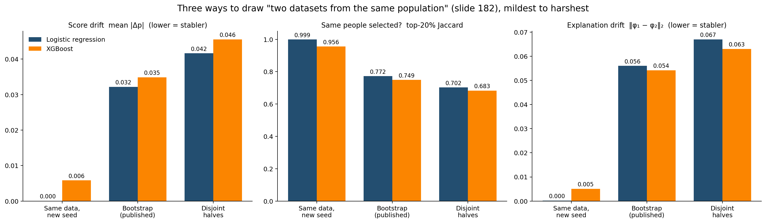
STABILITY · STRUCTURAL
Intro · Features · Models · Interpretability · Fairness · Stability · Demo
Would a different sample give the same model?
Model | Mean |Δp| | Top-20% Jaccard
Logistic | 0.032 | 0.77
XGBoost | 0.035 | 0.75
TabICLv2 | 0.035 | 0.78
13%
COURSE DEFINITION (SLIDE 182)
“Two datasets from the same population should induce approximately the same model.” We test it three ways: new seed → bootstrap → two disjoint halves.
of the people offered support change per refit (logistic) — not 23%
Logistic vs XGBoost (8 bootstrap refits): lower drift in 28/28 pairs, steadier selection in 26/28; ahead in 10/10 disjoint-half splits.
Source: stability_summary.csv · stability_pairs.csv · study results/stability_by_regime_summary.csv
Team 11 · Trustworthy Recidivism Forecasting
17
Notes:
[P6 · 11:10 · 45s] The course defines stability simply: two datasets from the same population should give approximately the same model. We tested that three ways, from mildest to harshest. Changing only the random seed barely moves logistic regression; XGBoost already swaps about 2% of the people it selects. With eight bootstrap refits — the same eight for all three models — a person's risk moves by about three points, and about 13% of the people offered support change. Not 23%: Jaccard is not the share that changed. With two completely separate halves of the data, it's about 18%. In every test, logistic is more stable than XGBoost, and TabICL matches logistic on who gets selected.

Slide 2
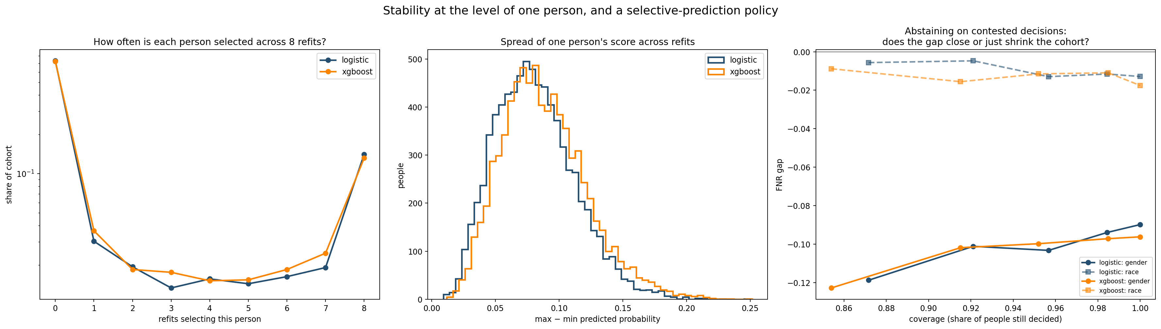
STABILITY · INDIVIDUAL
Intro · Features · Models · Interpretability · Fairness · Stability · Demo
Stability for one person: abstaining is not fairness-neutral
≈13%
0.822 → 0.846
−0.090 → −0.119
47% vs 30%
of decisions are contested across refits; 32% of those selected sit at that margin
precision when keeping only unanimous decisions (8/8)
gender FNR gap: abstention widens it
of selected women vs men sit at the margin
Contested decisions all sit near the cut (98% within 10 percentile points). Without gang affiliation the asymmetry disappears: 33% vs 33% (backup A13).
Source: individual_stability.png · individual_stability_summary.csv · abstention_curve.csv · study results/no_gang_*.csv
Team 11 · Trustworthy Recidivism Forecasting
18
Notes:
[P6 · 11:55 · 45s] Now one person. Across the eight refits, about one decision in eight is contested — some refits select the person, others don't — and all of them sit close to the cut. The natural fix is to send contested cases to a human. That raises precision from 0.822 to 0.846. But the gender gap widens, from minus 0.090 to minus 0.119, because the few women we select sit at the margin far more often than men: 47% against 30%. So abstaining is not fairness-neutral — and that asymmetry comes from gang affiliation: without it, women and men are equally often at the margin.

Slide 3
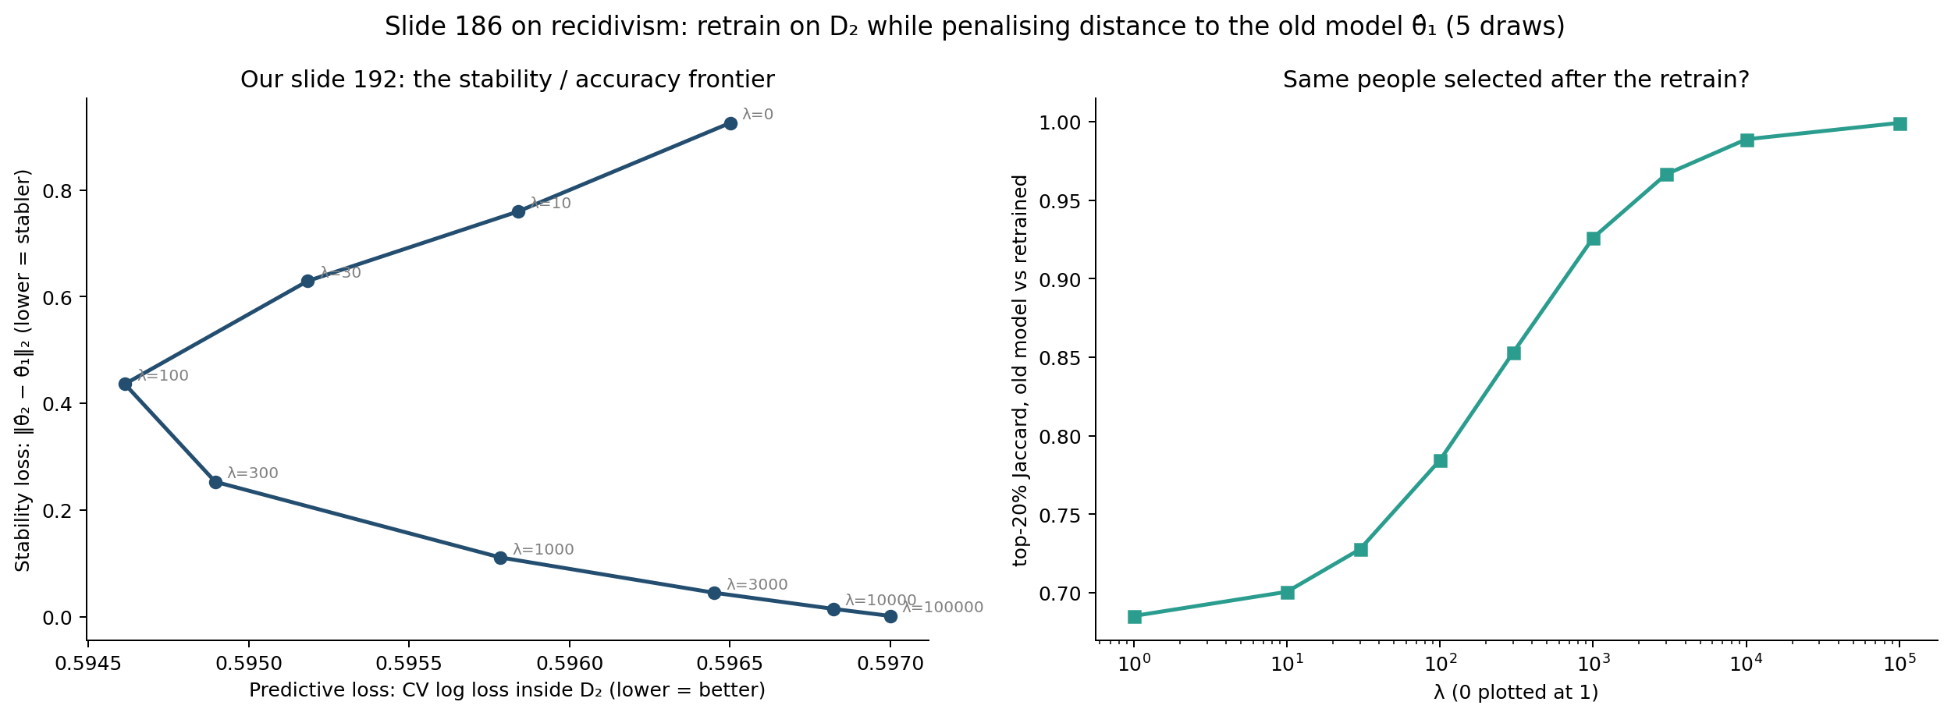
STABILITY · RETRAINING (COURSE SLIDE 186)
Intro · Features · Models · Interpretability · Fairness · Stability · Demo
Retraining without reshuffling: the course's stability constraint
COURSE SLIDE 186 ON OUR DATA
19% → 12%
−53%
No AUC loss
θ_new = argmin L(θ; new data) + λ · ||θ − θ_old||², λ chosen by cross-validation. Retrain on new data, pay a price for moving away from the old model.
of the people offered support reshuffled by a retrain
coefficient movement ||θ_new − θ_old||
CV AUC 0.731 → 0.733, in 5 of 5 draws
REPRODUCIBILITY (SLIDES 210–215)
Same model, same data, another machine:
Logistic: 0 decisions change
XGBoost: 80 change
Slide 186 needs a parameter vector θ, so it works for logistic, not directly for XGBoost.
Source: study results/course_slide186_*.csv (5 draws; old data 40%, new data 60%) · results/run_info.json · course slides 186, 192, 215
Team 11 · Trustworthy Recidivism Forecasting
18b
Notes:
[P6 · 12:40 · 35s] The course also shows how to fix this. When you retrain on new data, penalise the distance to the previous model, with lambda chosen by cross-validation. We implemented it for our logistic regression. A naive retrain reshuffles 19% of the people offered support; with the constraint, 12%. The coefficients move half as much, and accuracy doesn't drop. It needs a parameter vector, so it works for logistic, not XGBoost. And reproducibility: the same XGBoost on another machine changed 80 decisions; logistic changed none.

Slide 4
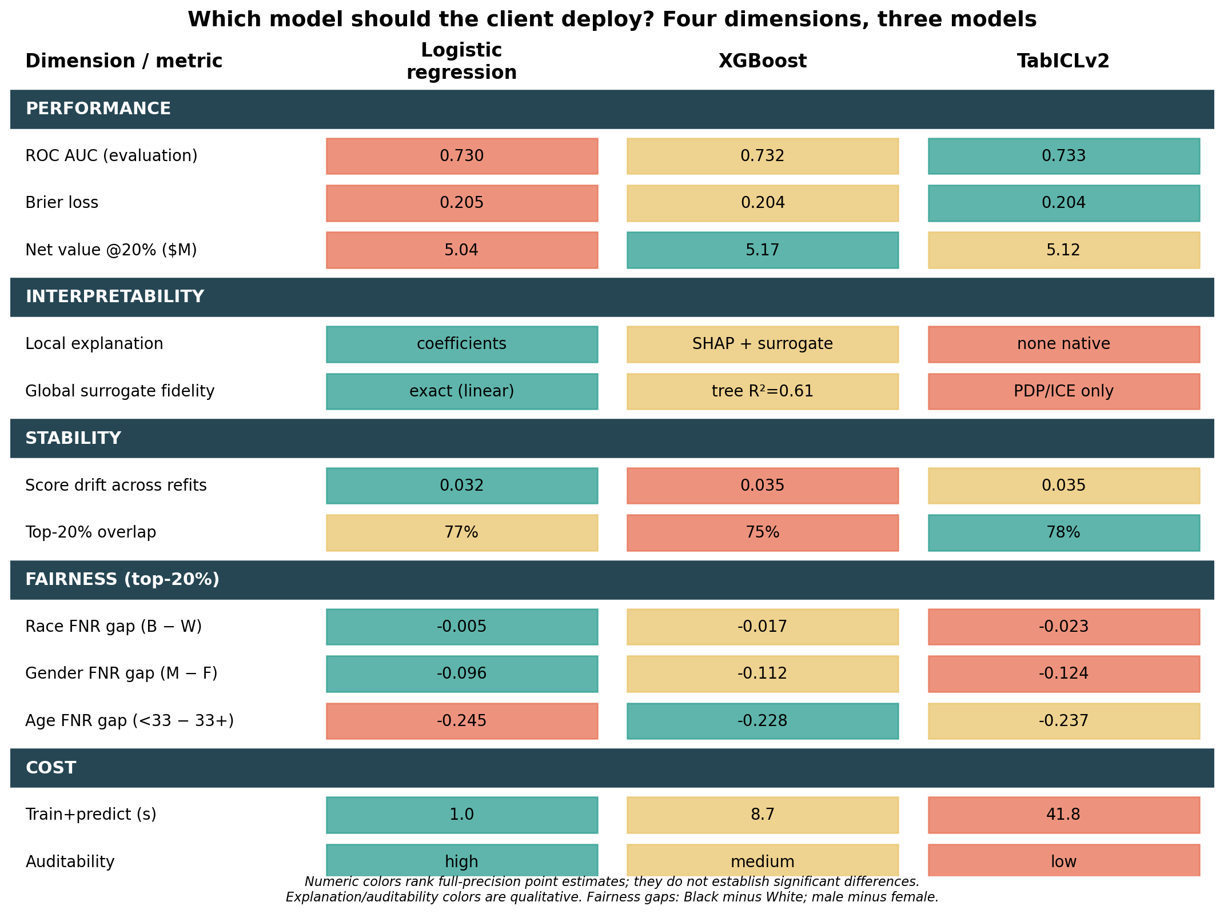
CONCLUSION · TRADE-OFFS
Intro · Features · Models · Interpretability · Fairness · Stability · Demo
Pilot logistic regression; run XGBoost as the challenger
RECOMMENDATION
L1 logistic regression for a prospective shadow pilot; XGBoost as challenger.
Same people: Jaccard 0.850, only 254 differ; captured re-arrest difference CI includes 0.
More stable (28/28 refit pairs), same decisions on any machine, directly interpretable, ~9× faster.
Fairness: equivalent within ±5 pts (TOST); calibration: no detectable difference — not reasons to choose.
Second arm without gang affiliation (A11): logistic still the more stable model.
WHAT WOULD REVERSE IT
Scores quoted numerically to supervisees, or a scale where a few extra captured events matter.
Limits: evaluation set inspected repeatedly; no temporal or external validation; no evidence yet that the support programme helps.
Source: tradeoff_matrix.png · selected_set_overlap.csv · calibration_paired_tests.csv · stability_pairs.csv · A11
Team 11 · Trustworthy Recidivism Forecasting
19
Notes:
[P6 · 13:15 · 55s] So, across the four dimensions. Performance: XGBoost's edge is real but small — the two models select 85% of the same people, and the difference in re-arrests captured includes zero. Fairness doesn't separate them: the gap difference is equivalent within five points. Calibration shows no detectable difference. What does separate them is stability, reproducibility, direct interpretability and cost — and all four favour logistic. So we recommend a shadow pilot of L1 logistic regression, with XGBoost as the challenger, plus a second arm without gang affiliation, where logistic is still the more stable model. The choice reverses if scores are quoted to people as probabilities, or at a scale where a dozen extra captured re-arrests matter. And no model allocates real support until the pilot shows the programme helps. Over to the demo.

Slide 5
A12 · STABILITY EXTRAS
The course's stability toolkit, applied to recidivism
Test (course slide) | Logistic | XGBoost
New seed, same data — top-20% Jaccard (207) | 0.999 | 0.956
8 bootstrap refits — Jaccard (deck, 182) | 0.772 | 0.747
Two disjoint halves — Jaccard (182) | 0.702 | 0.683
50% sample → full data — Jaccard (187, 191) | 0.830 | 0.813
Importance distance ||φ1 − φ2||, bootstrap (193) | 0.056 | 0.054
Decisions changed on another machine (215) | 0 | 80
HONEST READING
Logistic's advantage is in who gets selected and in reproducibility. On explanation stability (||φ1 − φ2||) XGBoost ties or is slightly ahead.
SLIDE 43–44 CHECK: WHICH PENALTY?
Ridge moves coefficients ~10% less; elastic net is sparsest and most sign-stable. Who is selected is the same for L1, L2 and elastic net (Jaccard ≈ 0.77).
Seed and machine effects are tiny next to data effects. Under the course's literal test (disjoint halves) logistic is ahead in 10 of 10 splits.
Source: study results/stability_by_regime_summary.csv · course_retrain_50pct_vs_full.csv · course_penalty_stability.csv · run_info.json
Team 11 · Trustworthy Recidivism Forecasting
A12

Slide 6
A13 · NO-GANG ARM
Slides 17–18 without gang affiliation (published protocol)
 | Logistic with | Logistic without | XGBoost with | XGBoost without
Mean |Δp| between refits | 0.032 | 0.032 | 0.035 | 0.035
Top-20% Jaccard between refits | 0.772 | 0.754 | 0.749 | 0.723
Contested decisions | 12.8% | 13.9% | 14.6% | 16.4%
Selected women / men at the margin | 47% / 30% | 33% / 33% | 54% / 34% | 36% / 42%
Abstention: gender FNR gap | −0.090 → −0.119 | 0.004 → −0.002 | −0.096 → −0.127 | −0.010 → 0.016
Abstention: precision | 0.822 → 0.846 | 0.808 → 0.824 | 0.828 → 0.850 | 0.801 → 0.839
Without gang affiliation, abstention no longer widens the gender gap: selected women and men sit at the margin equally often. Slide 18's asymmetry comes from the field that is never recorded for women.
Same 8 resamples (seed 7) and model seed 42 as slide 17; with-gang logistic reproduces slides 17–18 exactly. XGBoost recomputed on CPU (third-decimal differences from the published run). FNR gaps: point estimates on a few hundred women, no CI.
Source: study results/no_gang_stability_summary.csv · no_gang_contested_by_gender.csv · no_gang_abstention_curve.csv
Team 11 · Trustworthy Recidivism Forecasting
A13

