Slide 1
TRUSTWORTHY AI / RECIDIVISM
0.60 → 0.73
Forecasting risk,
examining trade-offs
Incumbent score vs our models (ROC AUC)
3 model families
1 deployment recommendation
For a risk-assessment software vendor: which three-year re-arrest model to ship, judged on performance, interpretability, stability and fairness
Team 11 · HEC Paris · Fall 2026

Slide 2
01 · ENGAGEMENT
Our client, and the decision they sell
• Client: a vendor selling risk-assessment tools to US state community-supervision agencies
• Deliverable: a three-year re-arrest score to allocate limited, voluntary re-entry support
• Used only to expand help — never sanctions, detention or surveillance
• Judged as a trustworthy AI system, not on accuracy alone
HEC Paris · ISAF · 2026
2

Slide 3
02 · DATA DESIGN
Original split, with explicit validation limits
18,028
7,807
29
57.4%
TRAIN
EVALUATION
BASELINE FIELDS
TEST TARGET RATE
• Post-release variables excluded; race, gender and geography retained only for audit
• Found and fixed a representation leak: missing gang affiliation exactly marked women; mode-fill plus a regression audit now blocks it
• Evaluation data were repeatedly inspected during development; fresh validation is still needed
HEC Paris · ISAF · 2026
3

Slide 4
03 · MODEL DESIGN
Three model families, one comparison
LOGISTIC
XGBOOST
TABICLv2
White-box anchor
CV-tuned L1, C=0.2154
Signed, inspectable effects
Nonlinear workhorse
Ordinal counts + 5-fold CV tuning
Fast operational scoring
Foundation model
16-member GPU ensemble
Training-only size sweep; no native attribution implemented
Same eligible fields · Same held-out people · Same metrics
HEC Paris · ISAF · 2026
4

Slide 5
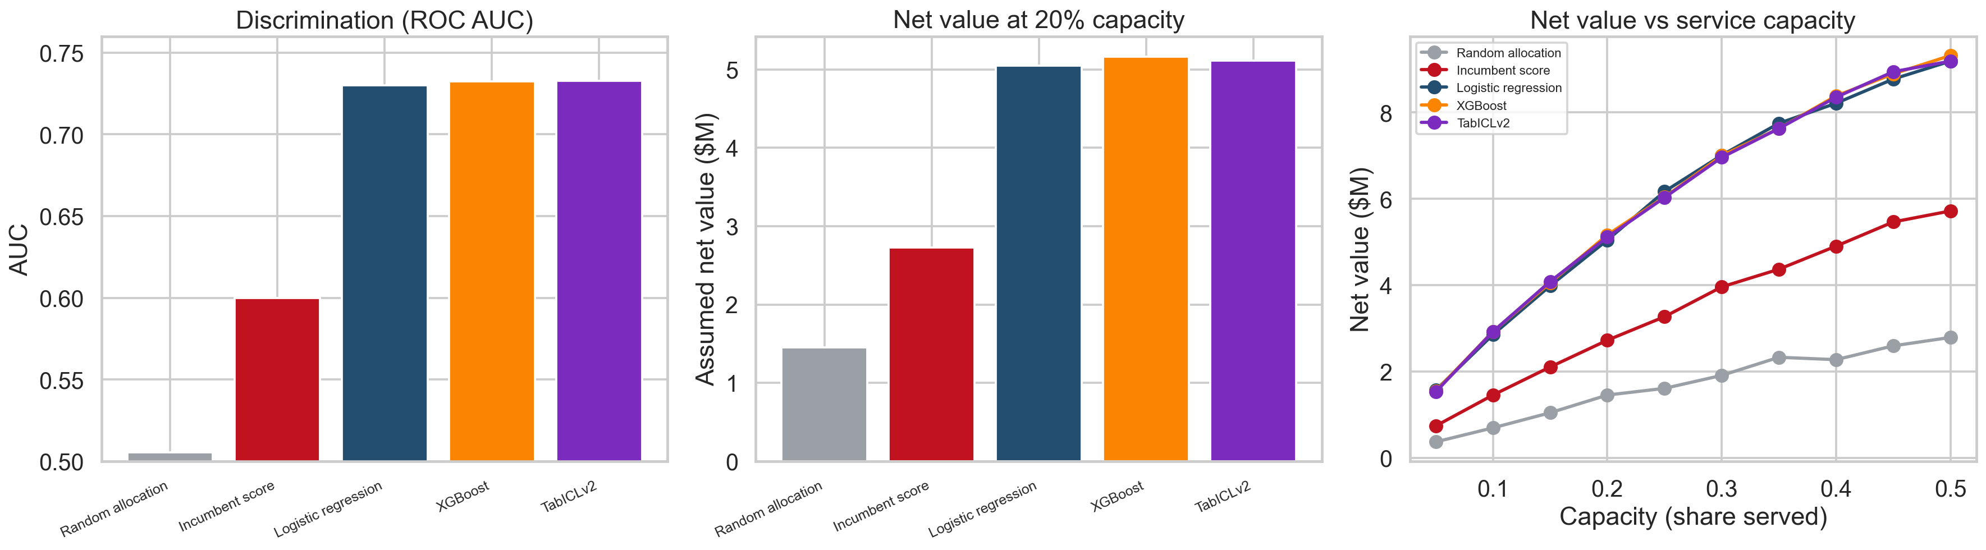
04 · THE CLIENT'S REAL QUESTION
Comparison with the historical recorded score
0.60
INCUMBENT AUC
0.73
OUR MODELS AUC
+$2.3M
NET VALUE GAIN
recommended logistic model
This historical comparison does not establish superiority to current agency products. Dollar gains are scenarios.
HEC Paris · ISAF · 2026
5

Slide 6
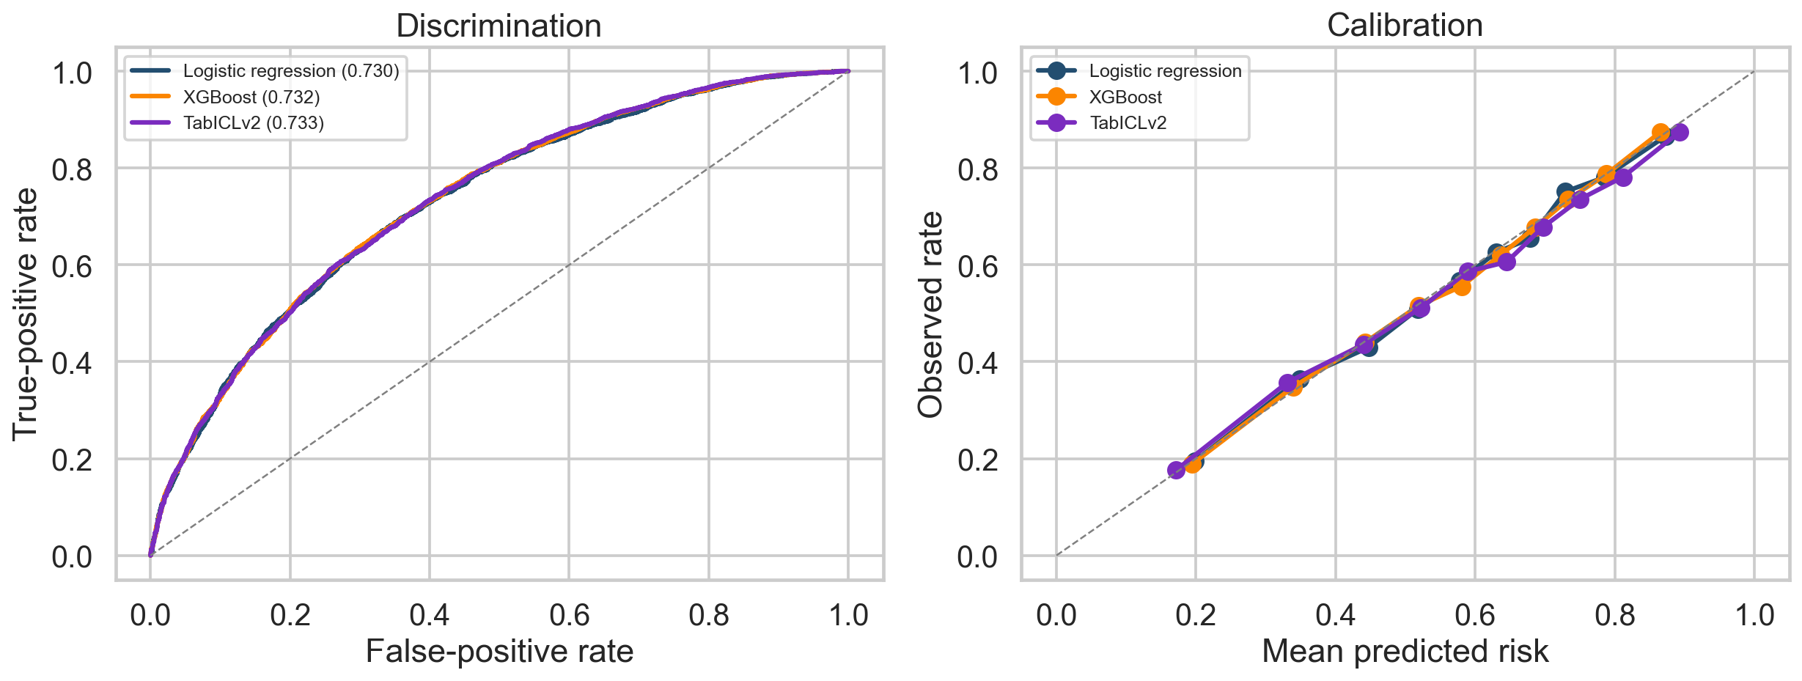
05 · PREDICTIVE PERFORMANCE
Compare ranking, probability loss and calibration
0.7328
AUC · TABICL
0.2044
BRIER · TABICL
+0.0025
AUC GAP · XGB − LOGIT
paired bootstrap: significant, small
All three models are within ~0.003 AUC; ECE differences are not significant. Performance alone cannot pick the model.
HEC Paris · ISAF · 2026
6

Slide 7
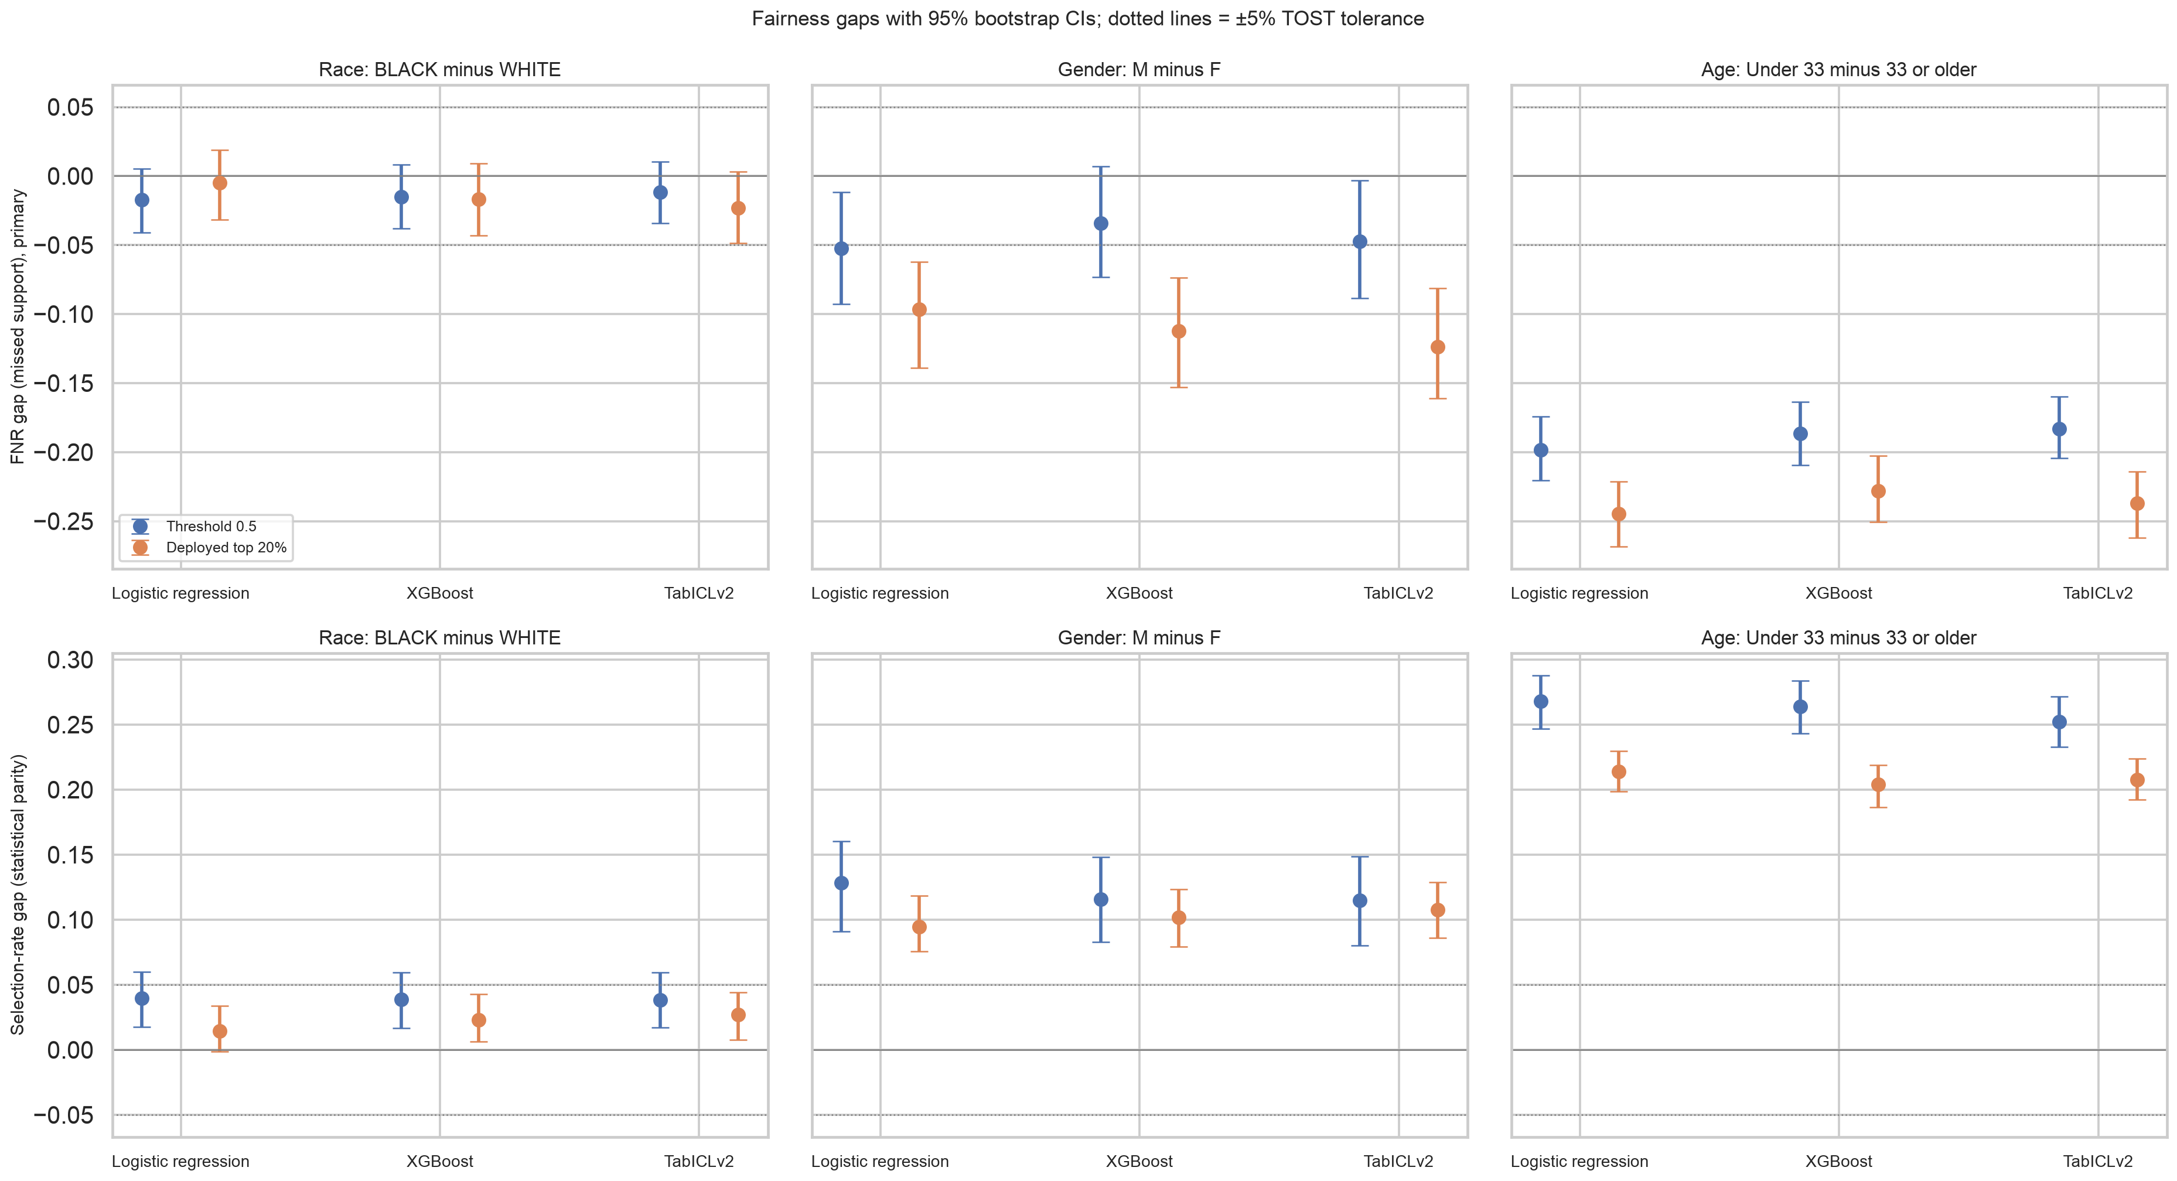
06 · SUBGROUP AUDIT
Fairness at the proposed allocation rule
-0.10 to -0.12
GENDER FNR GAP (M − F)
women miss support more · all significant
3 / 3 models
RACE: EQUIVALENT ±5 PTS
TOST on errors · AUC Black 0.72 vs White 0.75
-0.23 to -0.24
AGE FNR GAP (<33 − 33+)
persists with age fixed: carried by prior record
Selection = support offered, so the harm is a missed offer: FNR is primary. Not significant ≠ fair; we test equivalence.
HEC Paris · ISAF · 2026
7

Slide 8
07 · FAIRNESS, SHARPENED
Fairness: probability scores and allocation rules
SCORE CALIBRATION
ALLOCATION ERRORS
Women are over-predicted by every model: mean score 0.52 vs observed 0.45
Yet they are selected less at the top 20%
For support, over-prediction helps women: recalibrating would widen the FNR gap
FPR, TPR and selection rates depend on policy
Changing thresholds leaves probabilities unchanged
Our threshold frontier uses evaluation labels: illustrative, not validated
HEC Paris · ISAF · 2026
8

Slide 9
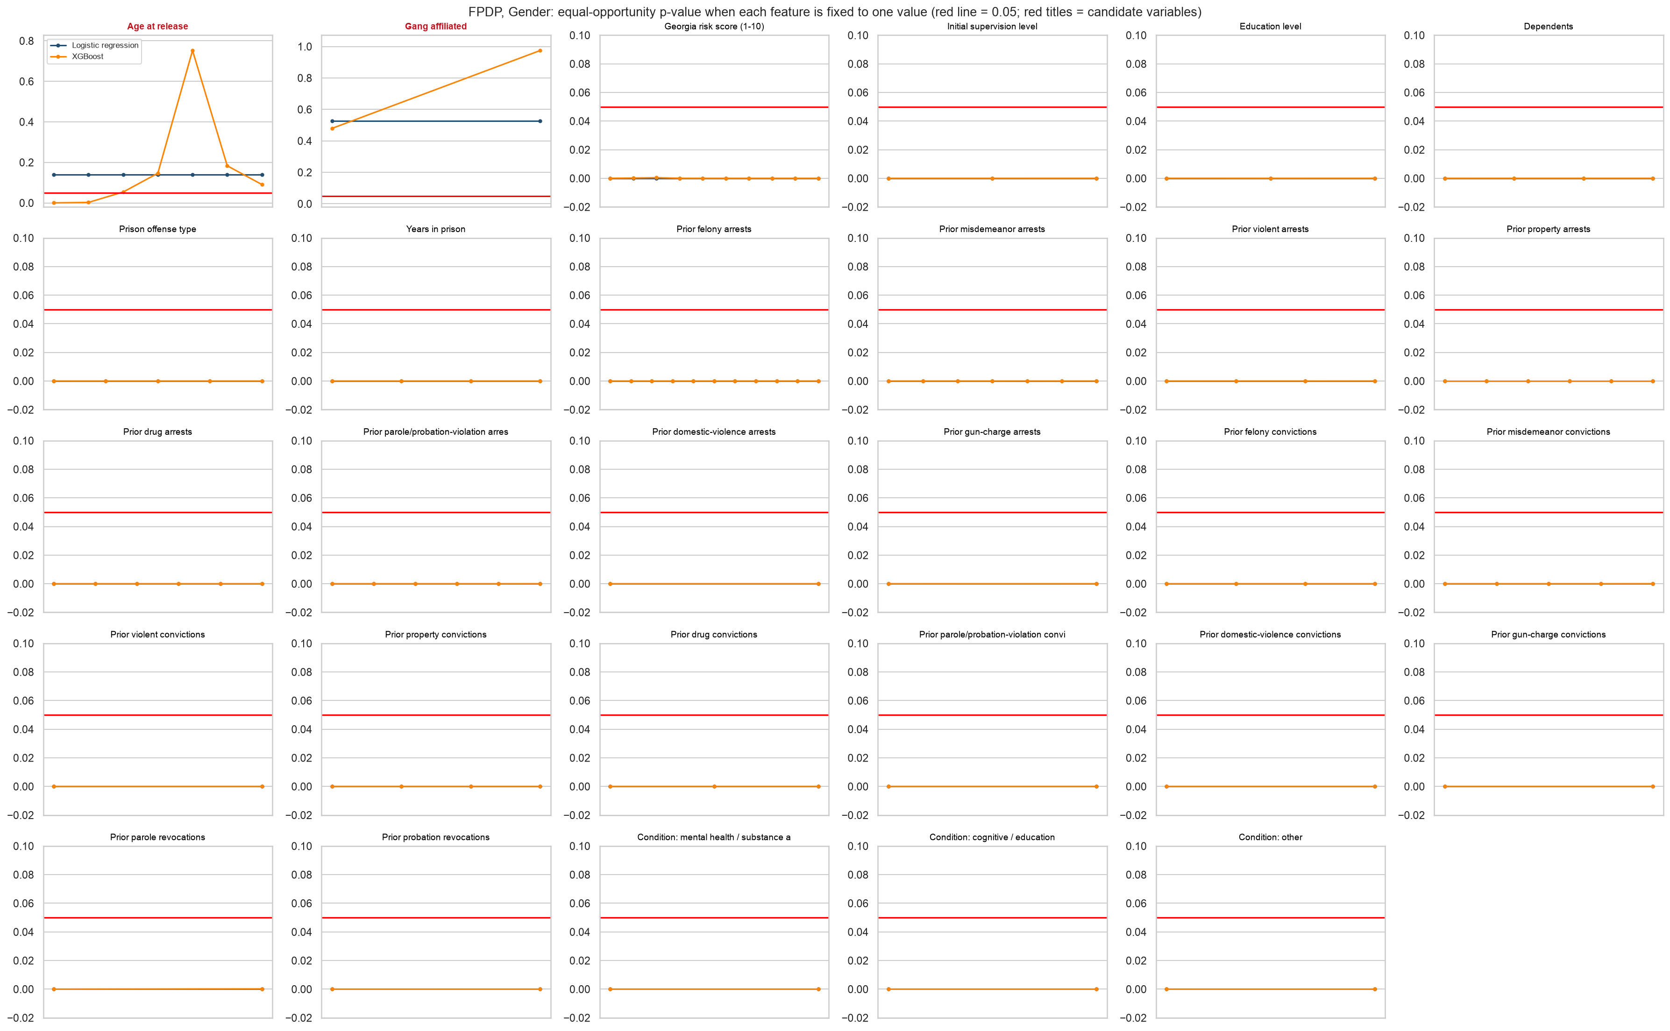
08 · FAIRNESS INTERPRETABILITY (FPDP)
Where does the gender gap come from?
CANDIDATE: GANG
Never recorded for women; imputed as "No"
Drop + re-estimate (logistic): FNR gap -0.096 → +0.000
Women FNR 0.80 → 0.72; men 0.70 → 0.72
AUC −0.014; 27 fewer re-arrests captured
Logistic FPDP is flat under a top-20% rule (a constant shifts every score equally), so it measures removing the feature, not a value.
HEC Paris · ISAF · 2026
9

Slide 10
09 · MITIGATION, VALIDATED
Selecting and testing the fix on different data
IN-SAMPLE
OUT-OF-FOLD
Candidate chosen AND scored on the same cohort
Equal-opportunity p 0.000 → 1.00
An upper bound, not evidence of generalisation
Candidate re-selected inside each training fold, scored on held-out folds
Same variable selected in 100% of folds
Gender FNR gap -0.122 → -0.035 · AUC -0.010
The evaluation cohort is never touched. About 70% of the gap closes out of fold, for roughly one AUC point.
HEC Paris · ISAF · 2026
10

Slide 11
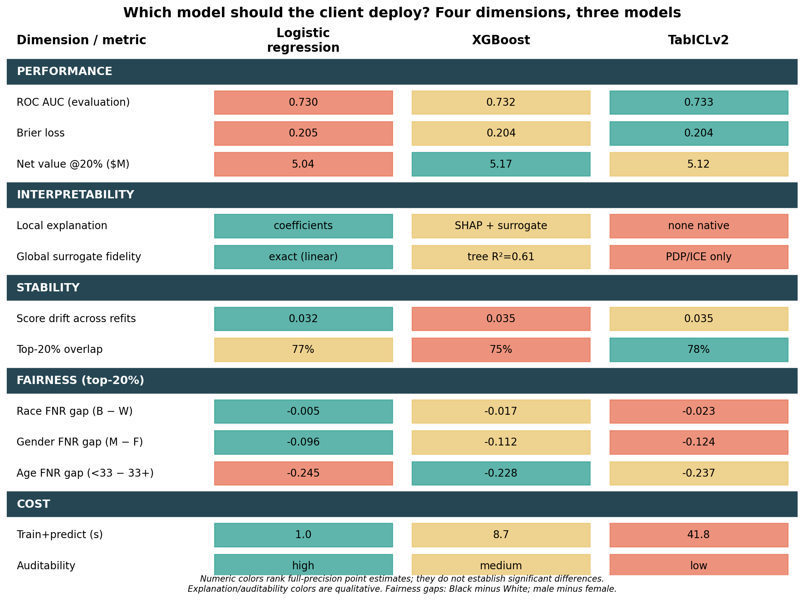
10 · TRADE-OFFS ACROSS FOUR DIMENSIONS
Which model should the client deploy?
HEC Paris · ISAF · 2026
11

Slide 12
11 · RECOMMENDATION
Pilot logistic regression; run XGBoost as the challenger
WHY LOGISTIC
WHAT WE GIVE UP
WHAT REVERSES IT
Native, coefficient-level explanations
Lowest refit drift
Smaller gender FNR gap (-0.096 vs -0.112)
No significant race gap · fastest
XGBoost AUC edge +0.0025
Best calibration (ECE 0.011 vs 0.013)
+12 captured re-arrests per 1,561 offers
Detectable, operationally small
The score is quoted numerically to supervisees
Capacity large enough that +12 offers matters
A feature set that widens the margin
Then: promote the challenger
The gap the mitigation closes (0.08) dwarfs the gap between the two models (0.016): disparity is a feature-set property, not an estimator choice.
HEC Paris · ISAF · 2026
12

Slide 13
12 · CLIENT EXPERIENCE
The application makes every trade-off testable
ASSESS
AUDIT
Score one person, all 3 models + SHAP
Race, gender, age at the deployed point + FPDP
COMPARE
SIMULATE
Incumbent, learning curve, matrix
Costs, capacity, sensitivity
streamlit run app.py
HEC Paris · ISAF · 2026
13

Slide 14
APPENDIX
Supporting evidence
for questions
Learning curve · economic sensitivity · interpretability methods · explanation disagreement · LIME fidelity · stability · process log

Slide 15
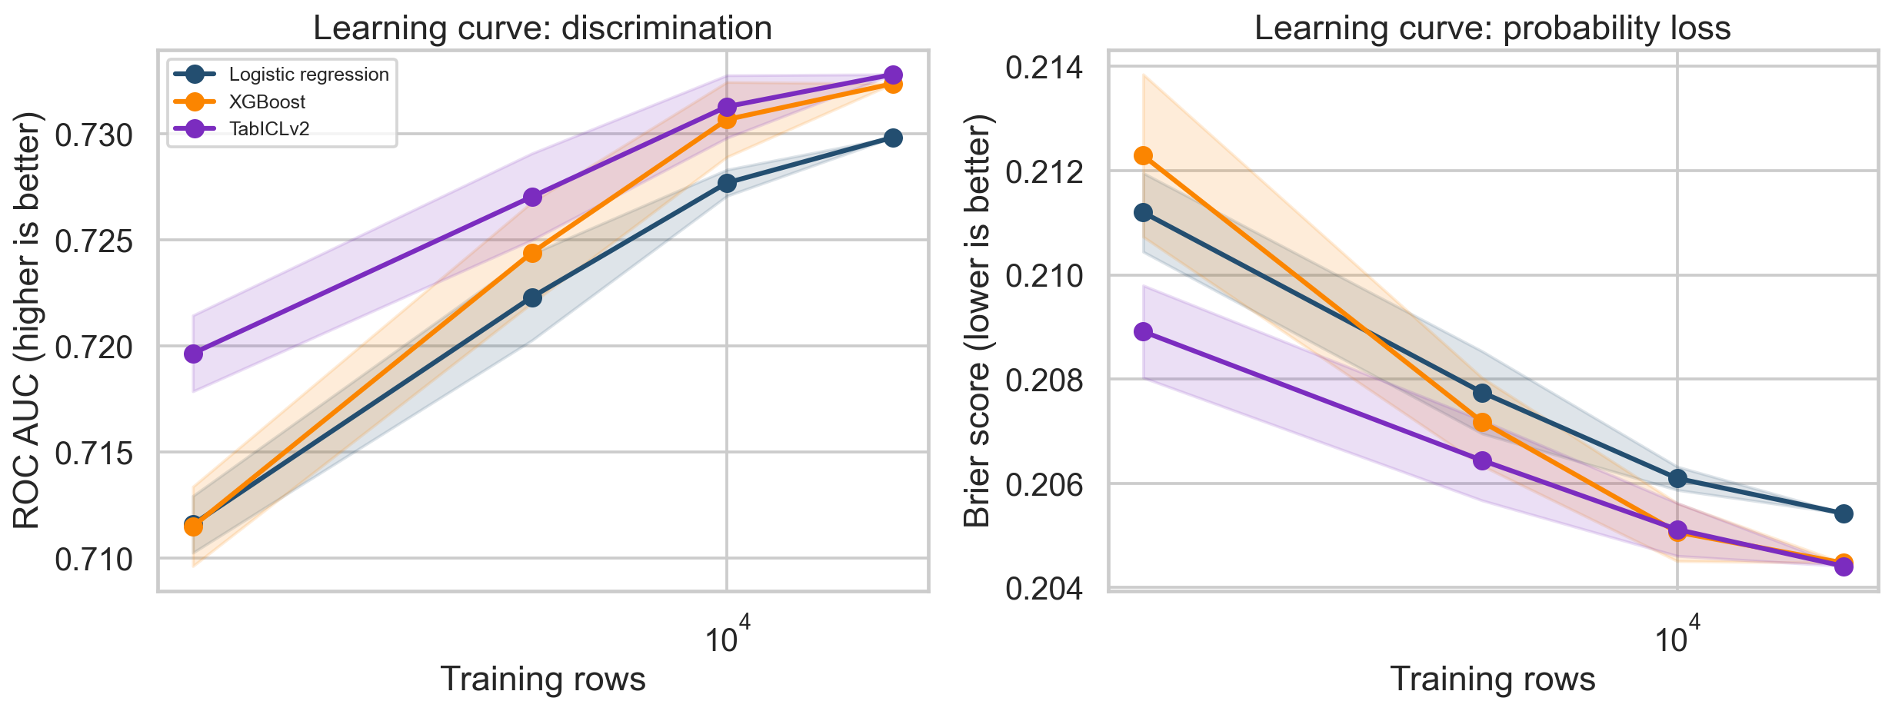
A1 · LEARNING CURVE
Which model for which agency size?
Subsamples of one Georgia cohort test sample-size sensitivity; they do not validate transfer to other agencies.

Slide 16
A2 · ECONOMIC PERFORMANCE
Model value is a scenario, stress-tested
20%
$5.04M
$2.73M
$1.46M
SERVICE CAPACITY
LOGISTIC NET
INCUMBENT NET
RANDOM NET
XGBoost $5.17M
• $5,000 support cost · $50,000 event cost · 20% assumed effectiveness — all editable in the app
• Models beat the incumbent at every capacity from 5% to 50% (sensitivity sweep)
• A randomized or quasi-experimental pilot must estimate real intervention impact

Slide 17
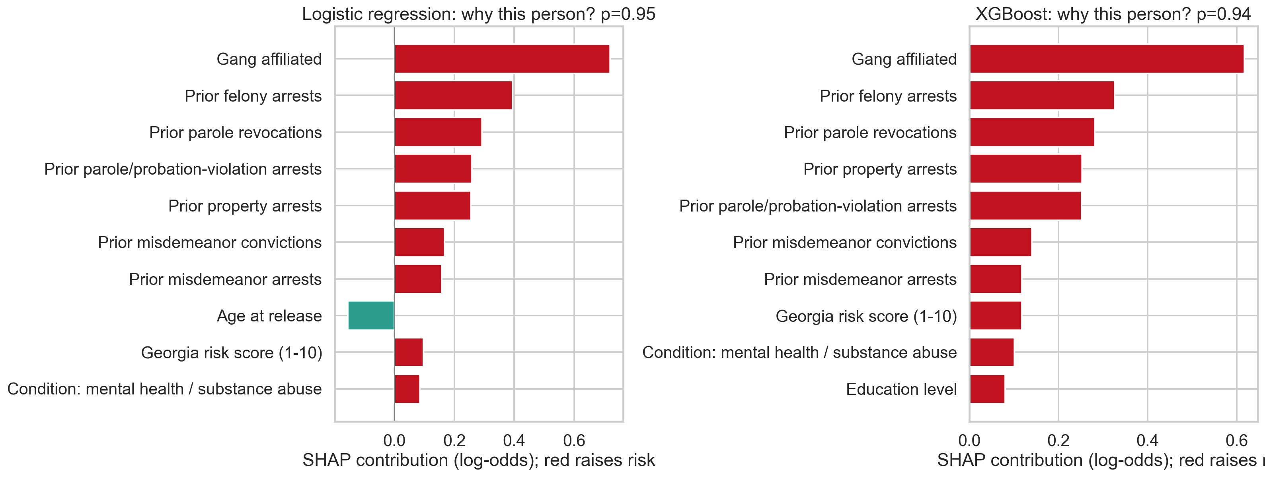
A3 · INTERPRETABILITY
Prediction explanations and their limits
METHODS
SHAP + LIME (local)
XPER on AUC (Pérignon)
Global surrogate: imperfect fidelity
PDP/ICE for all three
TabICLv2 has no native explanation path — a real deployment cost, covered only by model-agnostic PDP/ICE.

Slide 18
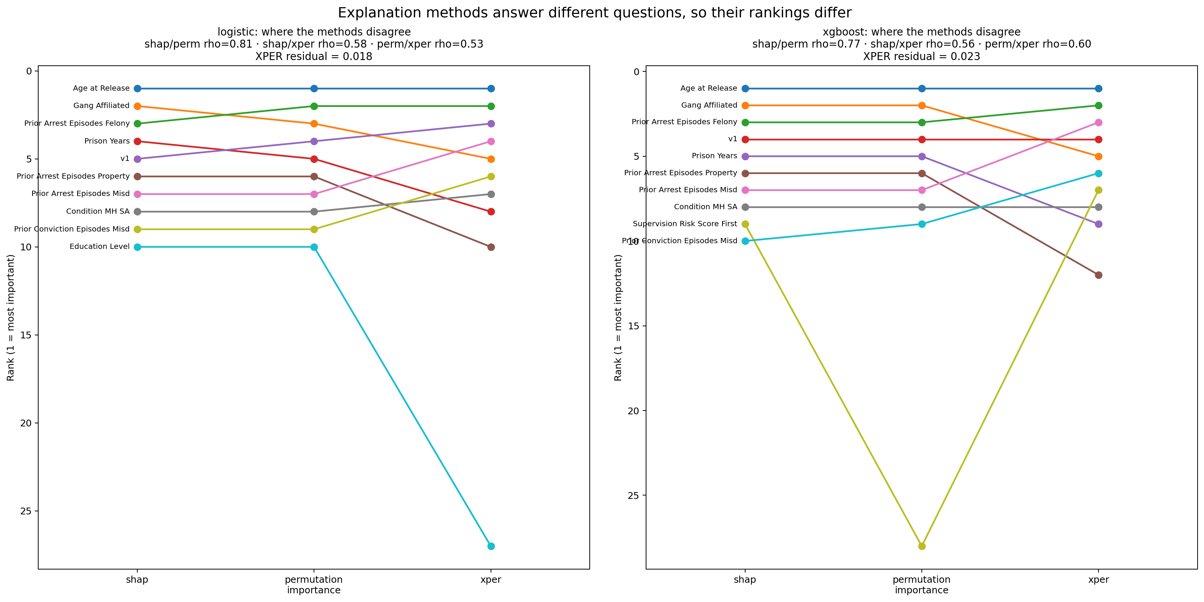
A4 · EXPLANATION DISAGREEMENT
SHAP, permutation importance and XPER rank differently
WHY
SHAP explains the prediction
Permutation importance explains loss
XPER decomposes AUC
Different questions, so different rankings
Top-10 sets largely coincide; ordering is method-dependent. Quote the set, not the rank.

Slide 19
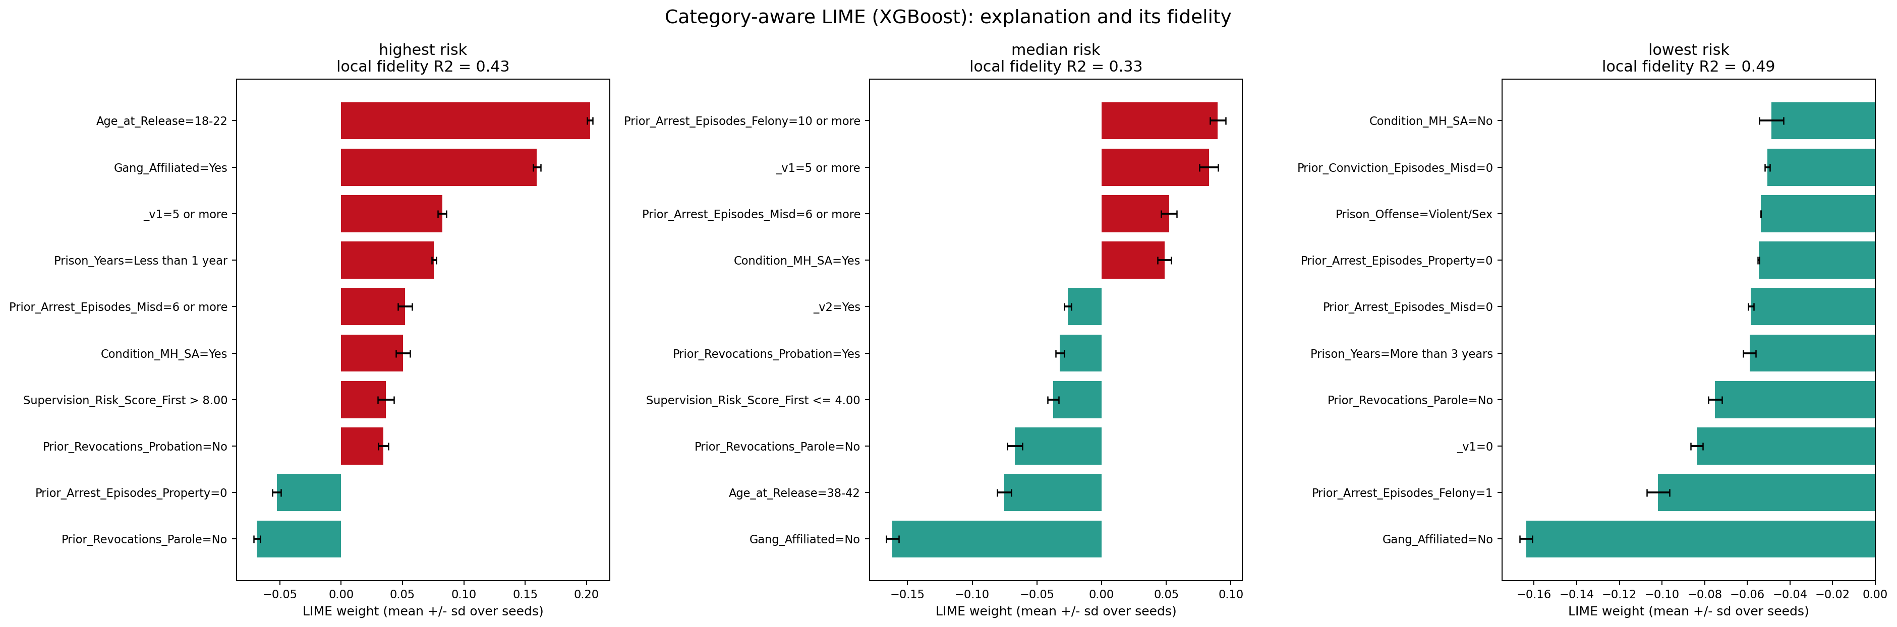
A5 · LIME FIDELITY
Is the local explanation faithful?
Category-aware perturbation raised local fidelity from R² 0.25 to ≈0.41. Three fixed cases × three seeds; every condition keeps its sign.

Slide 20
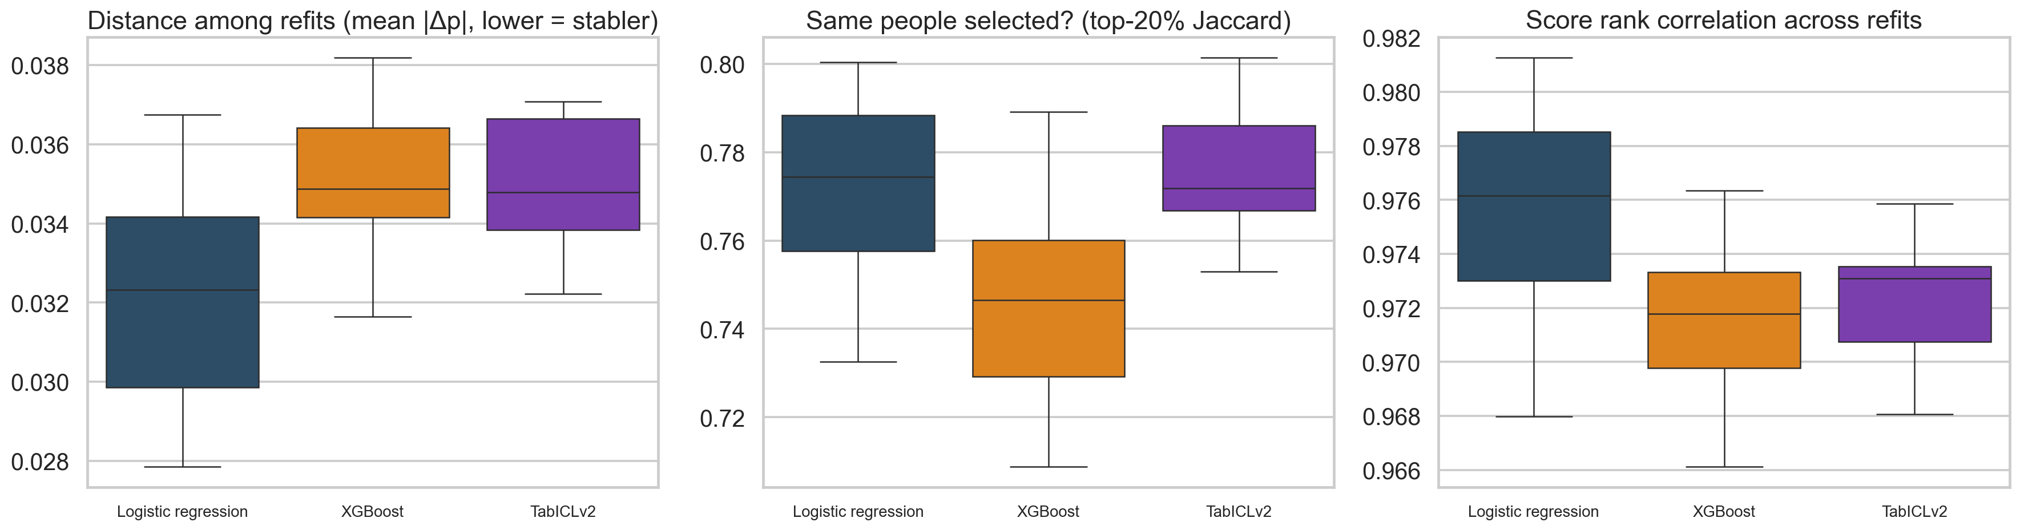
A6 · STABILITY
Structural stability across refits on resampled data
0.032
SCORE DRIFT · LOGISTIC
lowest · XGB 0.035 · TabICL 0.035
75%–78%
TOP-20% JACCARD
logit 0.772 · XGB 0.747 · TabICL 0.776
Jaccard is intersection / union, not the share of people switching. Refit sensitivity is not temporal validation.

Slide 21
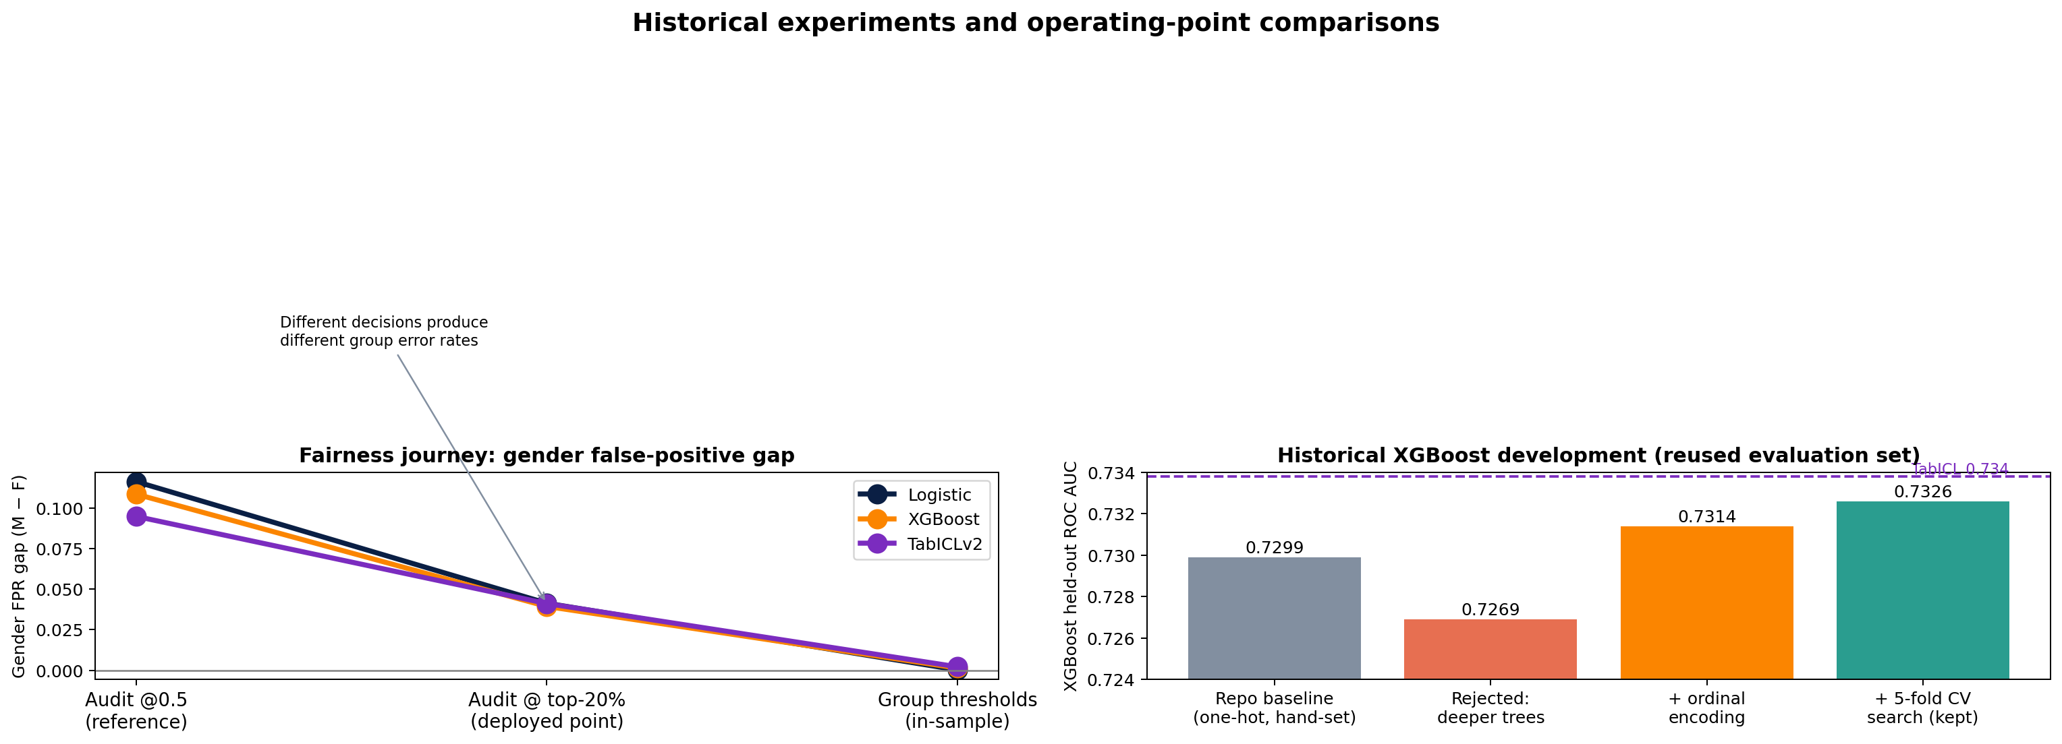
A7 · PROCESS
How we got here: what we tried, where we landed
Full log in JOURNEY.md — every step measured, including the attempts we rejected.

