Slide 1
Cloth Simulation

Slide 2
Overview
In most games today there is some variation of cloth physics. We see it in all kinds of objects such as..
Capes
Tarps
Flags
Clothing
Grand Theft Auto V Clothing Physics

Slide 3
Overview
We will be going over simulating cloth in real time by manipulating a system of particles. Those particles will be connected by systems of spring dampers
Once we have those systems implemented we will discuss the realistic simulation of cloth, affected by aerodynamic forces. (wind)

Slide 4
Particles
Properties of a particle
r : position – position in the world
v : velocity – rate of motion in a specific direction
a : acceleration – change in velocity with respect to time
m : mass - the quantity of matter in a body regardless of its volume or any forces acting on it. (not weight)
f : force – sum of all forces acting on the object

Slide 5
Particles
Calculating the force
Before we can begin to move the object we need to calculate the sum of all forces acting on the particle
These forces being applied to the object will be calculated by spring damper, aerodynamic triangles, and gravity
Once we have the sum of all forces we can now begin to move our object

Slide 6
Particles
Moving the particle
To begin moving the particle we need to first calculate the acceleration
acceleration = force * mass
Your mass should always be at least 1.
Next we can calculate our new velocity
v` = v + aΔt
The new velocity (v`) is the current velocity (v) plus the acceleration (a) multiplied by the change in time (Δt).
This new velocity will be our new direction we are traveling in
Finally we calculate our new position
r` = r + vΔt
The new position (r`) is the current position (r) plus the velocity (v)
This will give us our new position in the world

Slide 7
Gravity
The gravitational force is what will make our cloth pull toward the ground
f_{gravity} = mg₀
g₀ = [0, -9.81, 0]

Slide 8
Spring Damper
The spring damper is what will connect the particles in our system.
It will ensure that the particles remain at a specified distance.
Hooke’s law: F = -k_{s}l_{o}
Do rubber bands follow Hooke’s law?

Slide 9
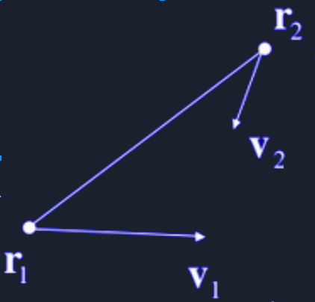
Spring Damper
Properties of a spring damper
k_{s} : Spring Constant
K_{d} : Damping Factor
l_{o} : Rest Length
p₁ : Particle One
p₂ : Particle Two

Slide 10
Spring Damper
Computing the spring force
Convert all the 3D distances and Velocities into 1D
Compute the spring force in 1D
Turn the 1D force into a 3D force
Good Luck

Slide 11
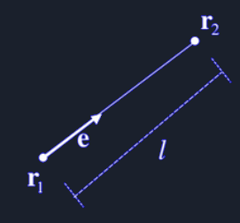
Spring Damper
Computing the spring force
Calculate the unit length vector between the two particles
e* = r₂ – r₁
Calculates the difference between the two particles
l = |e*|
l = magnitude of the difference between the two particles
e = e* / l
e = unit length vector
Be sure to normalize e*

Slide 12
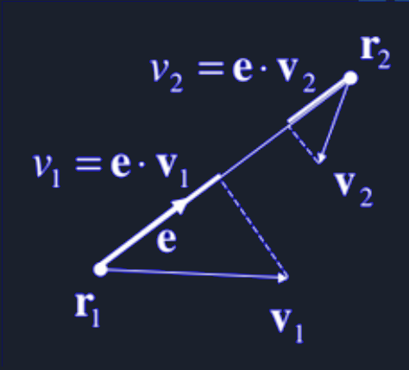
Spring Damper
Computing the spring force
Calculate the 1D velocities
V₁ = particle one velocity
V₂ = particle two velocity
V₁ = dot(e, v1)
V₂ = dot(e, v2)

Slide 13
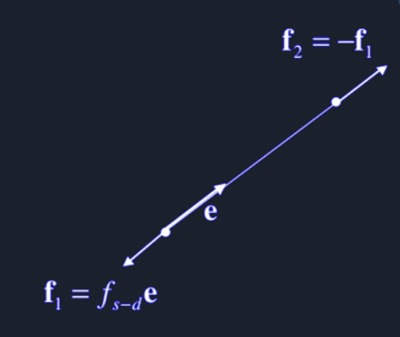
Spring Damper
Computing the spring force
Convert from 1D to 3D
f_{s-d} = -k_{s}(l₀ – l) – k_{d}(v₁ – v₂)
f₁ = f_{s-d}e
f₂ = -f₁

Slide 14
Cloth Simulation
Steps:
Compute Forces
For each particle: Apply Gravity
For each spring-damper: Compute & apply forces
For each triangle: Compute and apply aerodynamic forces
Integrate Motion
For each particle: Apply forward euler integration
Repeat

Slide 15

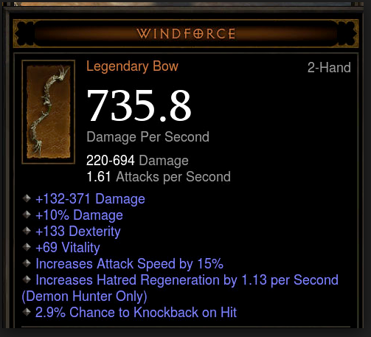
Aerodynamic Force
The aerodynamic force or wind force will simulate a behavior that resembles “floating in the wind”
yes
no

Slide 16
Aerodynamic Force
Properties of aerodynamic force
p : density of the air (or water)
c_{d} : coefficient of drag for the object
a : cross sectional area of the object
e : unit vector in the opposite direction of the velocity
r₁ : particle 1
r₂ : particle 2
r₃ : particle 3
Notes:
Add faero = .5 * p * |v|^2 * Cd * a * e

Slide 17
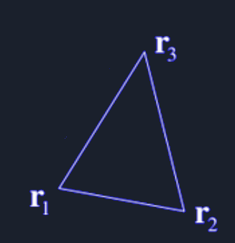
Aerodynamic force
The aerodynamic force is calculated with 3 particles that form a triangle.

Slide 18
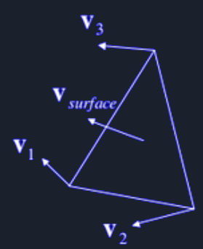
Aerodynamic Force
Calculating the aerodynamic force
Calculate the average velocity of the particles
v₁ = particle 1 velocity
v₂ = particle 2 velocity
v₃ = particle 3 velocity
v_{surface} = (v₁ + v₂ + v₃) / 3
v = v_{surface} – v_{air}
v_{air} = density

Slide 19
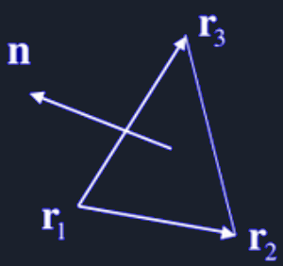
Aerodynamic Force
Calculating the aerodynamic force
Calculate the normal of triangle
n = ((r₂ – r₁) x (r₃ – r₁)) / | ((r₂ – r₁) x (r₃ – r₁))|

Slide 20
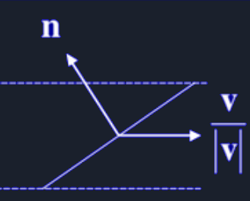
Aerodynamic Force
Calculating the aerodynamic force
Calculate the area of the triangle
a_{o} = 1/2 |(r₂ – r₁) x (r₃ – r₁)|
a = a_{o} = (dot(v, n) / |v|)
a₀ = area of triangle
a = area of the triangle exposed to the air flow
Notes:
Ao = .5 * |(r2 - r1) X (r3 - r 1)|

Slide 21
Aerodynamic Force
Calculating the aerodynamic force
Calculate the total force being applied to the triangle
n* = (r₂ – r₁) x (r₃ – r₁)
|v|²an = ((|v|dot(v, n*)) / (2|n*|))n*
Apply force to each particle
Divide the total force by 3 and apply it to each particle

Slide 22
Bending Springs
With the current system we have in place will be fine for simulating cloth but the cloth is very bendy at this point meaning it can bend over it self.
If we were to incorporate a system of bending springs this would prevent this and allow us to mimic more stiffer materials.
The bending springs are just like the spring dampers but instead of connecting two neighboring particles it connects to the next particle over from its neighbor

Slide 23
Further Reading
Steve Rotenburg, 2005. Cloth Simulation, CSE169: Computer Animation

