Slide 1

CAPSTONE TOPIC PROPOSALS
Ryan McDonald – Data Scientist
#DATASCIENCE

Slide 2
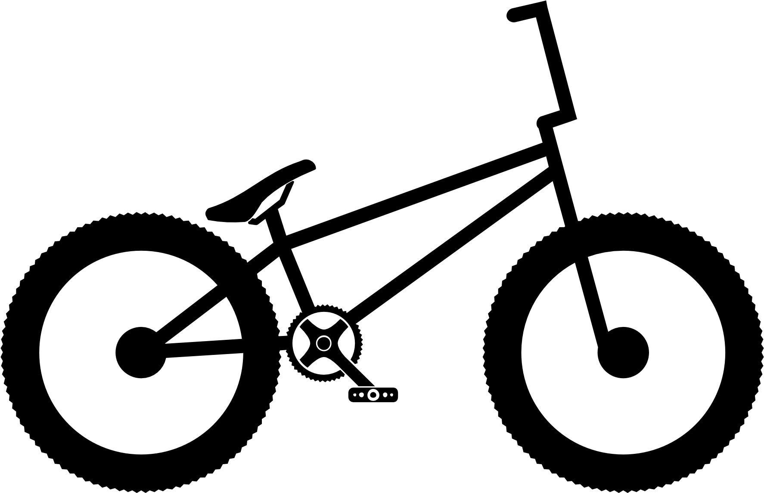


Just send it! – Trail Recommender System
Data will be collected from:
Singletracks API
TrailForks API (pending)
STRAVA API
My MVP is: A GUI with recommendations
User inputs features,
My stretch goals include:
User Location-Based results
Previous riding statistics-based results
GUI!!!
My observations will be various trail statistics and my target will be a specific trail the user should try
I will use trail-based features data
to build a recommender system_
that predicts relevant trails to ride
in order to give users who do not have experience riding in a certain area more motivation and less excuses.

Slide 3
Proposal #1 Notes
Some potential roadblocks are:
Still waiting on second API access
Having to utilize 2 different APIs may prove challenging
Something I want to research more is:
GUIs! GUIs! GUIs!
What’s a recommender engine?
I’m not sure if I can even accomplish: Depending on the depth/breadth of recommendations, this could get out of hand quickly!
If anyone has recommendations on intuitive GUI developers please let me know!

Slide 4

The one with the puffy tail… - Dog Breed Identification
Data will be collected from:
Petfinder RESTful API
Stanford Dogs Dataset
My MVP is: Input a picture of a dog… return the breed.
My stretch goals include:
Once breed is identified, link to Petfinder for dogs of that breed available for adoption.
Take in a user photo for breed identification
My observations will be pictures of dogs with a target variable of that dogs ‘breed’.
I will use image data
to build a CNN_
that predicts dog breed_
in order to resolve dog breed identification arguments between my wife and me (and perhaps help shelters quickly identify incoming animals)_.

Slide 5
Proposal #2 Notes
Some potential roadblocks are:
What’s a CNN??!!.
Something I want to research more is:
Efficient image processing, remote servers
How to pull up-to-date info from the Petfinder website
I may be reaching out to identify your dogs’ breed (if my stretch goal becomes reality)

Slide 6

What’s Your Poison? – Craft Beer Classification
Data will be collected from:
Kaggle.com (multiple sources)
BrewersAssociation.org
My MVP is: Which beer style are you most likely to get nearby
Model takes in location and displays style of beer most prevalent in the area
My stretch goals include:
Provide directions to nearest brewery
Customer reviews on style of beer (or specific brew if possible)
My observations will be user location and my target will be a specific style of beer most prevalent in the area
I will use beer and brewery data
to build a multi-classification model_
that predicts local favorite beer style_
in order to provide users with a quick reference to what the area does best for beers.

Slide 7

Proposal #3 Notes
Some potential roadblocks are:
I’d like to incorporate more into this, will need time to further develop.
Something I want to research more is:
GUIs! GUIs! GUIs!
Additional datasets on user reviews to incorporate
Do I need any additional functionality? If there enough ‘meat on the bones’ for this project?
If I can find enough data, I’d like to investigate doing something similar with coffee.

Slide 8
Conclusion
All ideas subject to change! And, I’m open to feedback suggestions!
Very excited to see how the application learned for these projects can be applied to a variety of other topics!

