Slide 1
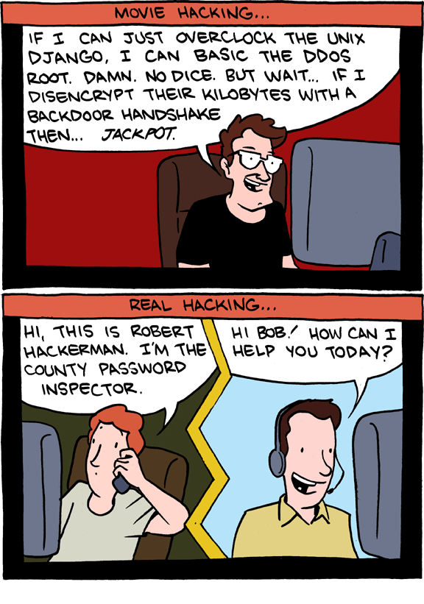

Slide 2
CSS 337: Secure Systems
Introduction
Course Overview

Slide 3
Introductions
Who am I?
Who are you?
Why are you taking this class?
  Your expectations for this class
Do you have any security background?

Slide 4
Syllabus Discussion
Course syllabus on canvas page!

Slide 5
What is security?
System correctness
  If user supplies expected input, system generates desired output
Security
  If attacker supplies unexpected input, system does not fail in certain ways

Slide 6
What is security?
System correctness
  Good input ⇒ Good output
Security
  Bad input ⇒ Bad output

Slide 7
How Security Fails – Policy Factors
Overly strict policy – people circumvent strict policies and hide the evidence
No enforcement – policies without consequences
Lack of specifics – don’t do bad stuff
Policy that can’t be managed
No solution guidance – security team only knows how to say no

Slide 8
How Security Fails - Misconfiguration
Defaults might not be secure
‘temporary’ accounts and passwords
Not understanding what information is valuable to an attacker

Slide 9
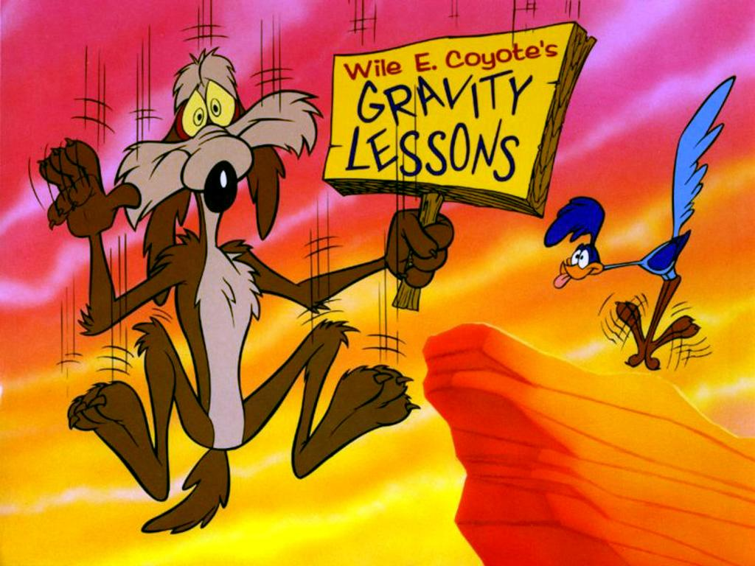
How Security Fails – Poor Assumptions
Why would anyone do that?
But we’re on a trusted network
Not understanding attackers

Slide 10
How Security Fails – Patch Management
Patch Management can be hard
Core OS
Network devices
Not keeping yourself up to date

Slide 11
Some Required Questions
What are you securing? Why?
  Securing my current location has different requirements than securing a web server
How much is it worth to you?
  Don’t spend $1,000,000 on security products to secure your pet’s Facebook page
What is the threat model?
  Securing a system against script kiddies is different than securing it against the NSA.

Slide 12
Thinking about Security
Security is the result of holistic design
Sprinkling crypto or policies doesn’t make something secure
Attackers don’t follow the rules

Slide 13

Models

Slide 14
Models
These might be more useful to us
Security Models
  A scheme for defining and enforcing security policies
    Only the teacher can change grades
    Students can only view grade assigned to them
Threat Models
  Defines what an attacker wants to do and what the attacker can do to accomplish that
    The attacker wants to launch a DoS attack with less than 1,000,000 bots
    The student wants to change her grade without stealing the teacher’s password

Slide 15
Everything is Secure
Original systems were concerned with Safety/Correctness
  Given good input, get good output
Why?
  Their threat model was mistakes, not attackers
Everything is secure if your threat model is weak.

Slide 16
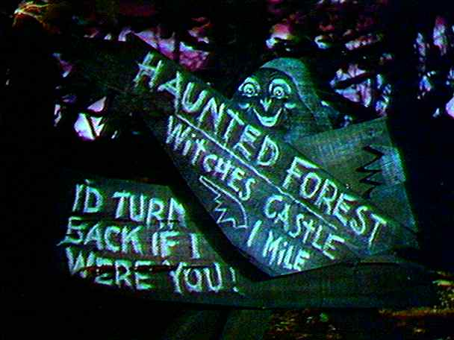
Nothing is Secure
Given infinite time or resources
  No encryption does any good
  Somebody will make a mistake
Abandon all hope.
The art of war teaches us to rely not on the likelihood of the enemy’s not coming,
but on our own readiness to receive him; not on the chance of his not attacking,
but rather on the fact that we have made our position unassailable.
—The Art of War, Sun Tzu

Slide 17
The Players
Attacker
  Has value for various abilities to control other people’s assets
    Learn about where you live
    Steal credit card info
    Shutdown uranium enrichment facility
Defender
  Protect assets
  Prevent attacker from gaining value?

Slide 18
Security Goals/Properties (The CIA)
Confidentiality
  Information should not be available to people who shouldn’t know it
    Alice can’t see Bob’s grades
Integrity
  Information cannot be modified by people who shouldn’t be able to modify it
    Bob can’t change his own grades
Availability
  Information must be available when needed
    Bob can always check his grades

Slide 19


General picture
System
Alice
Attacker
Security is about
  Honest user (e.g., Alice, Bob, …)
  Dishonest Attacker
  How the Attacker
    Disrupts honest user’s use of the system (Integrity, Availability)
    Learns information intended for Alice only (Confidentiality)

Slide 20
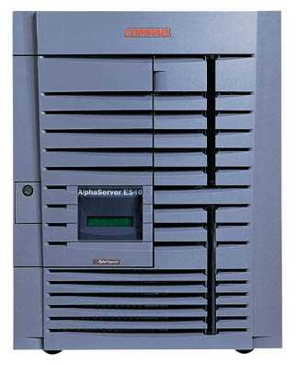
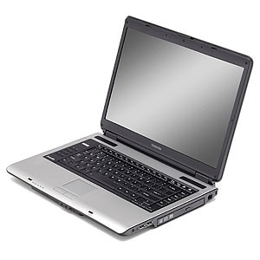
Network security
Network Attacker
Intercepts and controls network communication
System
Alice

Slide 21
Web security
System
Web Attacker
Sets up malicious site visited by victim; no control of network
Alice

Slide 22
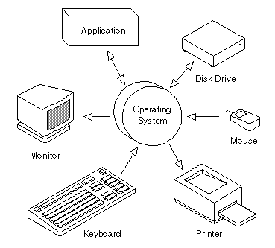
Operating system security
OS Attacker
Controls malicious files and applications
Alice

Slide 23
System
Alice
Attacker
Confidentiality: Attacker cannot learn Alice’s secrets
Integrity: Attacker cannot undetectably corrupt system’s function for Alice
Availability: Attacker cannot keep system from being useful to Alice

Slide 24
Tradeoffs
What is security worth?
  Performance?
  Usability?
  Money?
  Time?

Slide 25
The Relationships
Vulnerabilities
Threats
Countermeasures
Attacks

Slide 26

Spam service
Rent-a-bot
Cash-out
Pump and dump
Botnet rental

Slide 27
Underground goods and services
Rank | Last | Goods and services | Current | Previous | Prices
1 | 2 | Bank accounts | 22% | 21% | $10-1000
2 | 1 | Credit cards | 13% | 22% | $0.40-$20
3 | 7 | Full identity | 9% | 6% | $1-15
4 | N/R | Online auction site accounts | 7% | N/A | $1-8
5 | 8 | Scams | 7% | 6% | $2.50/wk - $50/wk (hosting); $25 design
6 | 4 | Mailers | 6% | 8% | $1-10
7 | 5 | Email Addresses | 5% | 6% | $0.83-$10/MB
8 | 3 | Email Passwords | 5% | 8% | $4-30
9 | N/R | Drop (request or offer) | 5% | N/A | 10-50% of drop amount
10 | 6 | Proxies | 5% | 6% | $1.50-$30
Credit: Zulfikar Ramzan

Slide 28
Current Trends

Slide 29
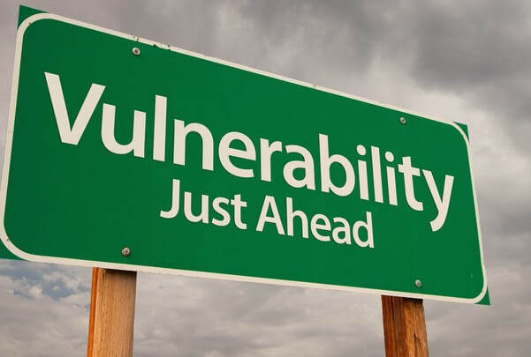
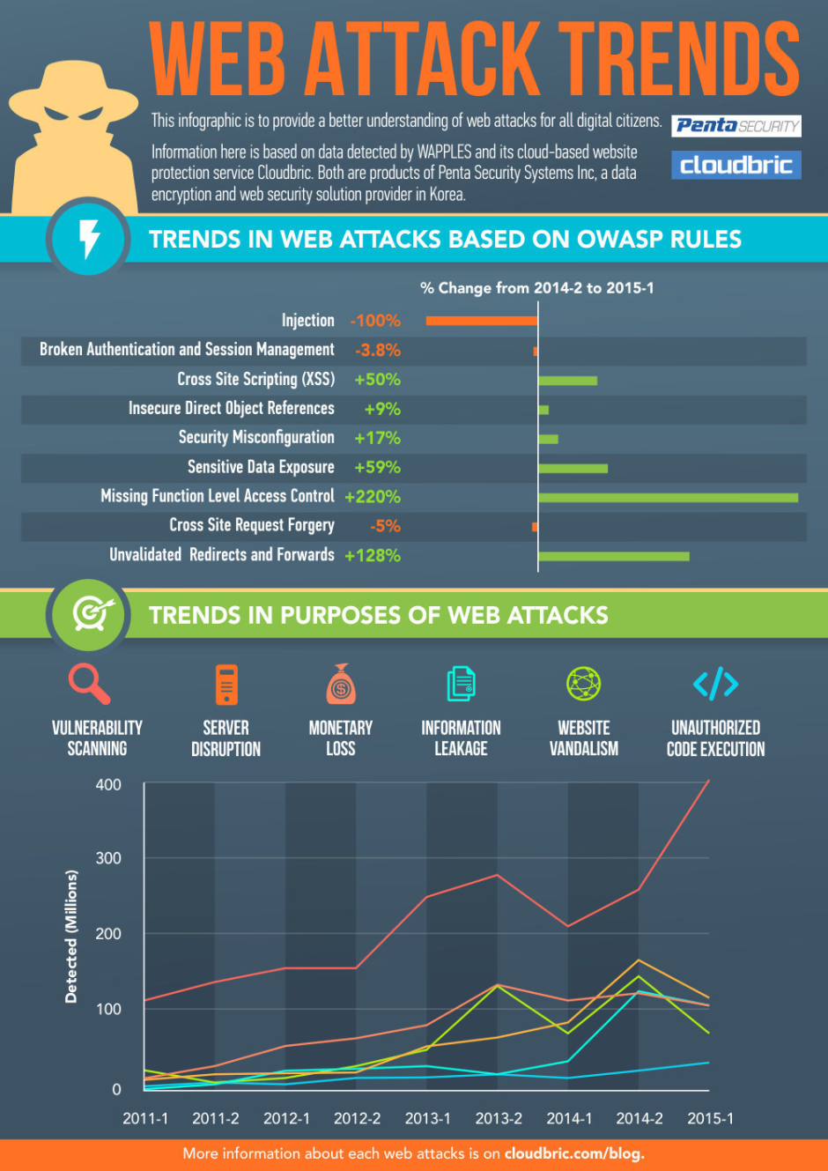
Do you know 96% of tested
web applications have vulnerabilities?
https://www.riskbasedsecurity.com/2017/11/no-shock-worst-year-for-vulnerabilities-already-only-through-q3-2017/

Slide 30

Hospitals vulnerable to cyber attacks on just about everything
https://nakedsecurity.sophos.com/2016/02/26/hospitals-vulnerable-to-cyber-attacks-on-just-about-everything/

Slide 31

Pirates hacked shipping company to steal info for efficient hijackings
https://nakedsecurity.sophos.com/2016/03/07/pirates-hacked-shipping-company-to-steal-info-for-efficient-hijackings/

Slide 32
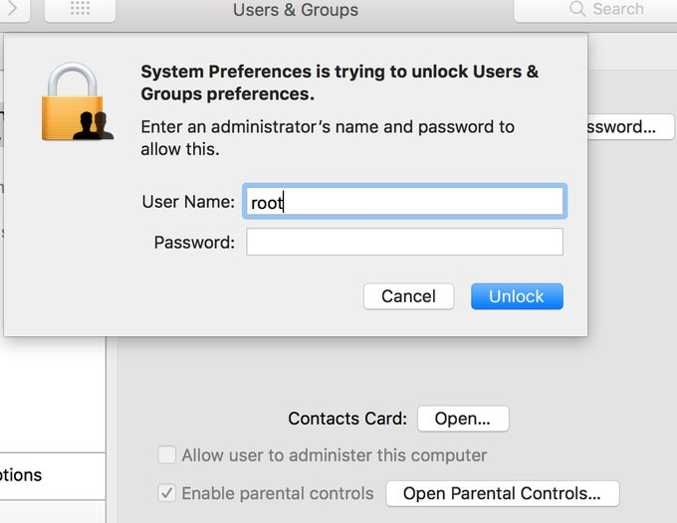
Major Apple Vulnerability Lets Anyone Log Into Macs Running Its Latest Operating System
http://fortune.com/2017/11/28/apple-security-flaw-vulnerability-bug-mac-high-sierra-root-password/

Slide 33
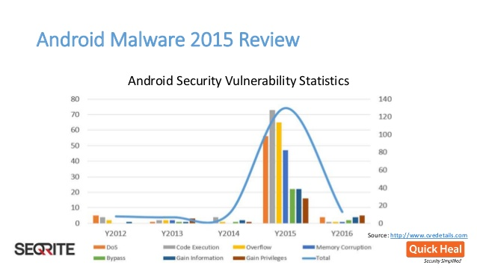
More IoT insecurity: The surveillance camera that anyone can log into
https://nakedsecurity.sophos.com/2016/02/18/more-iot-insecurity-the-surveillance-camera-that-anyone-can-log-into/

Slide 34
Why are there security vulnerabilities?
Lots of buggy software...
  Why do programmers write insecure code?
  Awareness is the main issue
Some contributing factors
  Few courses in computer security
  Programming text books do not emphasize security
  Few security audits
  Programmers have many other things to worry about
  Legacy software (some solutions, e.g. Sandboxing)
  Consumers do not care about security
  Security is expensive and takes time

Slide 35
If you remember only one thing from this course:
A vulnerability that is “too complicated for anyone to ever find” will be found !
I hope you remember more than one thing ☺

Slide 36
What do you do if you find a vulnerability?
1) Find vulnerability
2) ????????
Profit!!!
Unfortunately ??????? Often includes some jail time

Slide 37
Ethical use of security information
We discuss vulnerabilities and attacks
  Most vulnerabilities have been fixed
  Some attacks may still cause harm
  Do not try these at home or anyplace else
In this class, you will
  Learn to prevent malicious attacks
  Use knowledge for good purposes

Slide 38
Don’t do bad stuff
Pretty much anything you learn can be used for good, bad or neutral.
People are really sensitive about cybersecurity stuff right now though, so they make me tell you not to do bad stuff.
If you want to test out the attacker side of some of the things we learn in this class, do it on an isolated machine/network or you could end up in jail or sued.
  UW does not pay me well enough to bail you out

Slide 39
Law enforcement
Sean Smith
  Melissa virus: 5 years in prison, $150K fine
Ehud Tenenbaum (“The Analyzer”)
  Broke into US DoD computers
  6 mos service, suspended prison, $18K fine
Dmitry Sklyarov
  Broke Adobe ebooks
  Prosecuted under DMCA

Slide 40
Ethical Vulnerability Research
Disclose research intent
Seek legal counsel before beginning
If the vulnerability is systemic, seek a solution
Disclose vulnerabilities to those best able to correct them. Sometimes this may mean taking them public (though often not with specific details) if a company will not acknowledge the issue

Slide 41
What is this class?
Security principles, solutions
Breadth, not Depth
Ways to think about security

Slide 42
What is this class not?
How to run security tools
How to “hack”

