Slide 1
Cryptography: Encryption Algorithms,
Hashing and Digital Signatures

Slide 2
Symmetric and Asymmetric Cryptography Overview
Modern cryptographic methods use a key to control encryption and decryption
Two classes of key -based encryption algorithms
  symmetric (secret-key)
  asymmetric (public-key)
Symmetric:
  Same key used for both encryption and decryption
Asymmetric:
  Different keys are used for encryption and decryption.

Slide 3
Symmetric Cryptography
Also known as secret key or private key encryption
Requires sender, receiver know shared secret key
Problem : Key distribution
how to agree on key in first place (particularly if never “met”)?
How to securely transmit the keys ?

Slide 4
Asymmetric Cryptography
Most significant new development in cryptography in the last 300-400 years
The encryption key is public, decryption key is kept secret (or private)
  anyone can encrypt a message but only the one who knows the corresponding private key can decrypt it

Slide 5
Symmetric Encryption Methods
Symmetric ciphers can be divided into two methods of encryption
  stream ciphers and
  block ciphers
Stream Cipher
  can encrypt a single bit of plaintext at a time
Block ciphers
  take a number of bits and encrypt them as a single unit

Slide 6
Stream Cipher
Stream Cipher: Each bit of the data is sequentially encrypted using one bit of the key
Key: a random bit string of length n
Stream ciphers:
  Use Pseudo Random Number Generator
  PRNG: {0,1}^{s} → {0,1}^{n}
    expand a short (e.g., 128-bit) random seed into a long (e.g., 10⁶ bit) string that “looks random”
  Secret key is the seed
  E_{seed}[M] = M ⊕ PRNG(seed)

Slide 7
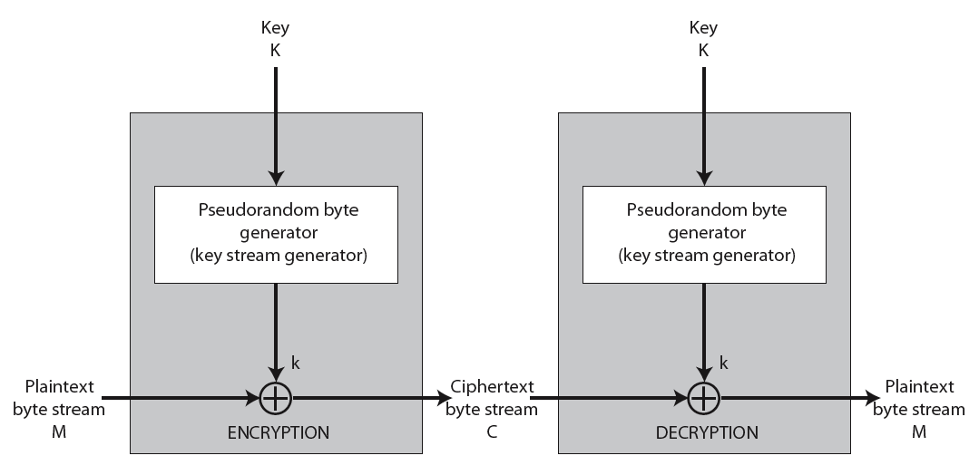
Stream Cipher

Slide 8
Example
Let + denote the XOR operation
 |  | XOR
0 | 0 | 0
0 | 1 | 1
1 | 0 | 1
1 | 1 | 0
Suppose A wishes to send a message M=0110111, and suppose they have previously established a shared secret key:
K =1011011
The cipher text is formed by exclusive-oring the message with the key:
C = M ⊕ K = 1101100
Decryption is trivial: the message could be obtained by the same process, i.e. by addition of K to C
M = C ⊕K = 0110111

Slide 9
Fundamental Weaknesses of Stream Ciphers
Does not have perfect secrecy
  security depends on PRNG
If the same stream is used twice ever, then easy to break.

Slide 10
Block Cipher
Block ciphers encrypt data in chunks of a specific size.
A block cipher specification identifies
  how much data should be encrypted on each pass (called a block)
  what size key should be applied to each block
1-to-1 mapping is used to map k-bit block of plaintext to k-bit block of ciphertext
Example with k=3:
input output
000 110
001 111
010 101
011 100
input output
100 011
101 010
110 000
111 001
What is the ciphertext for 010110001111 ?
Solution: 101 000 111 001

Slide 11
Block Cipher: Example
plaintext: The only thing we have to fear is fear itself
plaintext blocks: Theonlyt hingweha vetofear isfearit selfXend
ciphertext blocks: tylnoehT ahewgnih raefotev tiraefsi dneXfles
ciphertext: tylnoehTahewgnihraefotevtiraefsidneXfles
5 blocks
Key size: 8 characters in each block

Slide 12
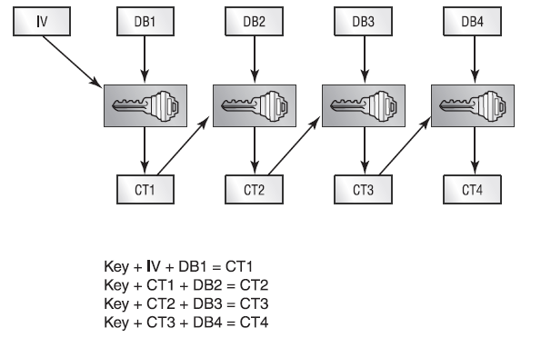
Block Cipher
An initialization vector (IV) is added to the beginning of the data to ensure that all blocks can be properly ciphered.
The IV is simply a random character string to ensure that two identical messages will not create the same ciphertext.
To create your first block of ciphertext (CT1), you mathematically combine the crypto key, the first block of data (DB1), and the initialization vector (IV).

Slide 13
Symmetric encryption algorithms

Slide 14
Popular Symmetric Encryption Algorithms
DES
3DES
AES
IDEA
CAST
Rivest
Blowfish
IDEA
Notes:
This is a summary of the slides to follow, briefly describing features of each.

Slide 15
Data Encryption Standard (DES)
The Data Encryption Standard (DES) is a symmetric-key block cipher published by the National Institute of Standards and Technology (NIST)
Developed in 1973, adopted as a federal standard in 1976
Widely used symmetric algorithm
  Block cipher
  The block size is 64 bits—64 bits of plaintext gives you 64 bits of ciphertext.
  56-bit key length
  Performs a substitution and permutation (a form of transposition) based on the key 16 times on every 64 bit block.
While DES has been a common business standard for 20 years, modern computing power has made the key breakable.
Challenge first broken in 1997, took 14000 PCs four months, in 1998 in under a day
Notes:
Security + Objective 5.3a DES
NBS (Now called NIST) received an algorithm called Lucifer, originally developed by IBM.
The NBS and the NSA worked together to analyze the algorithm’s security, and eventually DES was adopted as a federal standard in 1976.
NBS specified that the DES standard had to be recertified every five years.
Passed without a hitch in 1983, not in 1987. Forced to recertify in 1993.
NIST has now certified the Advanced Encryption Standard (AES) to replace DES.
Over the years that DES has been a cryptographic standard, some problems have been encountered.
Weak keys are keys that are less secure than the majority of keys allowed in the keyspace of the algorithm.
In the case of DES, because of the way the initial key is modified to get the subkey, certain keys are weak keys.
The weak keys equate in binary to having all 1’s or all 0’s.
Semiweak keys, with which two keys will encrypt plaintext to identical ciphertext, also exist, meaning that either key will decrypt the ciphertext. The total number of possibly weak keys is 64, which is very small relative to the 2⁵⁶ possible keys in DES.

Slide 16
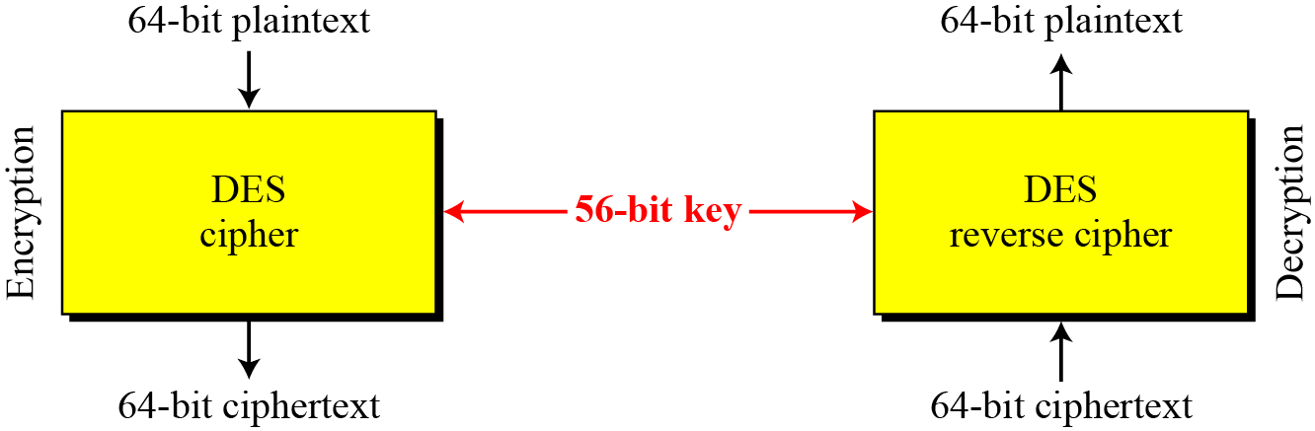
Data Encryption Standard (DES)
Encryption and decryption with DES

Slide 17
Triple DES (3DES)
Triple DES (3DES) is a variant of DES.
  Depending on the variant, it uses either two or three keys.
  Multiple encryption – goes through the DES algorithm three times.
3DES is stronger than DES but has similar weakness.
The longer key length makes it more resistant to brute force attacks.
3DES is a good interim step before the new encryption standard, AES.
Notes:
Security + Objective 5.3b 3DES
Multiple encryption can be performed in several different ways.
The simplest method of multiple encryption is just to stack algorithms on top of each other.
—Taking plaintext, encrypting it with DES, then encrypting the first ciphertext with a different key, and finally encrypting the second ciphertext with a third key.
In reality, this technique is less effective than the technique that 3DES uses, which is to encrypt with one key, then decrypt with a second, and then encrypt with a third.
This greatly increases the number of attempts needed to retrieve the key and is a significant enhancement of security.
The additional security comes with a price, however. It can take up to three times longer to compute 3DES than to compute DES.
While this is the case, advances in memory and processing power in today’s electronics should make this problem irrelevant in all devices except for very small low-power handhelds.

Slide 18
Triple DES: 3-DES
The major criticism of DES regards its key length.
  This means that we can use double or triple DES to increase the key size.
Triple DES (3DES) is the block cipher, which applies the Data Encryption Standard (DES) cipher algorithm three times to each data block.
Triple DES (3DES) with two keys
  C = E_{K1}(D_{K2}(E_{K1}(P)))
  Triple DES (3DES) with three keys
  C = E_{K3}(D_{K2}(E_{K1}(P)))

Slide 19
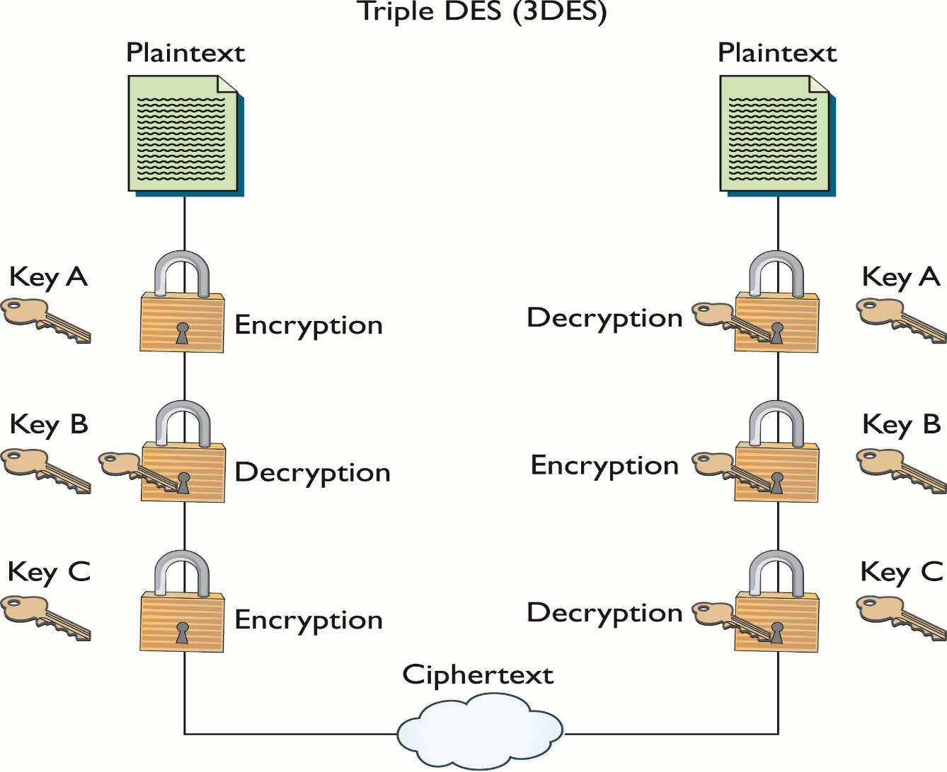
3 DES (with three different keys)

Slide 20
AES (Rijndael) : Advanced Encryption Standard
(Nov. 2001) symmetric-key NIST standard, replacing DES
Designed by Belgian cryptographers Rijmen and Daemen
processes data in 128 bit blocks
128, 192, or 256 bit keys
brute force decryption (try each key) taking 1 sec on DES, takes 149 trillion years for AES
Can operate over a variable-length block using variable-length keys
Iterated block cipher
  meaning that the initial input block and cipher key undergoes multiple rounds of transformation before producing the output

Slide 21
AES (Advanced Encryption Standard)
AES is a block cipher that separates data input into 128-bit blocks.
  Can also be configured to use blocks of 192 or 256 bits.
AES can have key sizes of 128, 192, and 256 bits, with the size of the key affecting the number of rounds used in the algorithm.
  Longer key versions are known as AES-192 and AES-256, respectively.
No efficient attacks currently exist against AES.
Notes:
Security + Objective 5.3f AES
Because of the advancement of technology and the progress being made in quickly retrieving DES keys, NIST put out a request for proposals for a new Advanced Encryption Standard (AES). It called for a block cipher using symmetric key cryptography and supporting key sizes of 128, 192, and 256 bits. After evaluation, the NIST had five finalists:
MARS IBM
RC6 RSA
Rijndael John Daemen and Vincent Rijmen
Serpent Ross Anderson, Eli Biham, and Lars Knudsen
Twofish Bruce Schneier, John Kelsey, Doug Whiting, David Wagner, Chris Hall, and Niels Ferguson
In the fall of 2000, NIST picked Rijndael to be the new AES. It was chosen for its overall security as well as its good performance on limited-capacity devices. Rijndael’s design was influenced by Square, also written by John Daemen and Vincent Rijmen. Like Square, Rijndael is a block cipher that separates data input into 128-bit blocks.
For a more in-depth description of AES, see the NIST document http://csrc.nist.gov/publications/fips/fips197/fips-197.pdf.

Slide 22
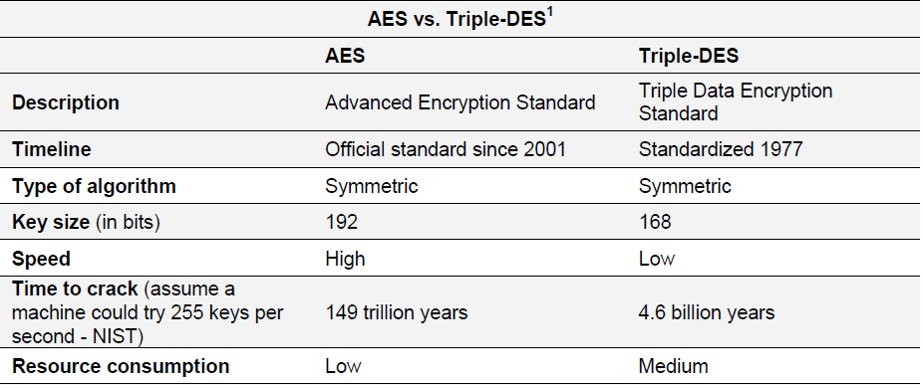
3-DES or AES ??
AES can encrypt data much faster than Triple-DES, a DES enhancement which essentially encrypts a message or document three times.
¹ Source: NetworkWorldFusion, Resource Links/Encyclopedia

Slide 23
Other secret Key Algorithms
CAST
International Data Encryption Algorithm (IDEA)
  DES-like 64-bit block cipher using 128-bit keys
RC5
  a block-cipher supporting a variety of block sizes, key sizes, and number of encryption passes over the data
Blowfish
  symmetric 64-bit block cipher. Key lengths can vary from 32 to 448 bits in length
Twofish
  128-bit block cipher using 128-, 192-, or 256-bit keys

Slide 24
Asymmetric Encryption
Asymmetric encryption
RSA
Diffie-Hellman
ElGamal
ECC

Slide 25
RSA
Ron Rivest, Adi Shamir, and Leonard Adleman (RSA)
One of the first public key cryptosystems invented.
  Published in 1997
  Used for encryption and digital signatures
  Uses the product of two very large prime numbers (between 100 and 200 digits long and of equal length)
While a simple algorithm, it has withstood the test of more than 20 years of analysis.
Does not replace symmetric encryption because RSA is 100 times slower than DES!
Asymmetric encryption is used to exchange symmetric keys.
Notes:
Security + Objective 5.3c RSA
Considering the effectiveness of RSA’s security and the ability to have two keys, why are symmetric encryption algorithms needed at all?
The answer is speed. RSA in software can be 100 times slower than DES, and in hardware it can be even slower.
RSA can be used to perform both regular encryption and digital signatures. Digital signatures try to duplicate the functionality of a physical signature on a document using encryption. Typically, RSA and the other public key systems are used in conjunction with symmetric key cryptography. Public key, the slower protocol, is used to exchange the symmetric key (or shared secret), and then the communication uses the faster symmetric key protocol. This process is known as electronic key exchange.
Since the security of RSA is based upon the supposed difficulty of factoring large numbers, the main weaknesses are in the implementations of the protocol. Until recently, RSA was a patented algorithm, but it was a de facto standard for many years.

Slide 26
Diffie-Hellman
Created in 1976 by Whitfield Diffie and Martin Hellman
The protocol is one of the most common encryption protocols in use today.
Used for:
  Electronic key exchange method of the Secure Sockets Layer (SSL) protocol
  TLS, SSH, and IPsec protocols
  Enables the sharing of a secret key between two people who have not contacted each other before.
Diffie-Hellman is still in wide use.
Notes:
Security + Objective 5.4a SSL/TLS
Uses large prime numbers to work. Two users agree to two numbers, P and G, with P being a sufficiently large prime number and G being the generator.
Both users pick a secret number, a and b.
Then both users compute their public number:
Diffie-Hellman is still in wide use.
It remains very effective because of the nature of what it is protecting—a temporary, automatically generated secret key that is good only for a single communication session.

Slide 27
Introduction to Hash Functions
Hash functions are mathematical computations that take in a relatively arbitrary amount of data as input and produce an output of fixed size.
The output is always the same when given the same input.
The inputs to a hash function are typically called messages, and the outputs are often referred to as message digests.

Slide 28
Example of Hash Function
An example of a simple hash function would be the following:
Hash function H accepts messages of any length, and outputs a fixed length digest of one-bit.
H returns 0 as the message digest if the input has an even number of characters, and returns 1 if the output has an odd number of characters

Slide 29
Hash Functions Example
In the example function, knowing that the output is 1 does not reveal any information about the input other than it has an odd number of digits.
For example, if an attacker was given the fact that a message has a digest of “1”, the original message could have been “102”, “xqpr3”, or any input of odd length.
The attacker has no way of determining what the original message was by being given the digest.
This property makes this hash functions a one-way function, meaning that it is difficult, if not impossible to deduce the input for a given output.

Slide 30
Cryptographic Hash
A "hash" (also called a "digest", and informally a "checksum") is a kind of "signature" for a stream of data that represents the contents.
Cryptographic hash functions have another property that most hash functions do not; the property that it is very difficult to find two different messages that produce the same message digest.
Example: md5sum program in UNIX
md5sum program : reads a stream of data and produces a fixed, 128-bit number that summarizes that stream using the popular "MD5" method.
In the example (see next slide) : the "streams of data" are "files" (two of which we see directly, plus one that's too large to display).

Slide 31
Cryptographic Hash
$ cat smallfile This is a very small file with a few characters
$ cat bigfile This is a larger file that contains more characters. This demonstrates that no matter how big the input stream is, the generated hash is the same size (but of course, not the same value). If two files have a different hash, they surely contain different data.
$ ls -l empty-file smallfile bigfile linux-kernel
-rw-rw-r-- 1 steve steve 0 2004-08-20 08:58 empty-file
-rw-rw-r-- 1 steve steve 48 2004-08-20 08:48 smallfile
-rw-rw-r-- 1 steve steve 260 2004-08-20 08:48 bigfile
-rw-r--r-- 1 root root 1122363 2003-02-27 07:12 linux-kernel
$ md5sum empty-file smallfile bigfile linux-kernel d41d8cd98f00b204e9800998ecf8427e empty-file 75cdbfeb70a06d42210938da88c42991 smallfile 6e0b7a1676ec0279139b3f39bd65e41a bigfile
c74c812e4d2839fa9acf0aa0c915e022 linux-kernel
This shows that all input streams yield hashes of the same length

Slide 32
Cryptographic Hash
Avalanche effect: is the term used when even very small changes to the input yields sweeping changes in the value of the hash.
Example:
  T -> (in ASCII) 0x54 -> (in Binary) 0 1 0 1 0 1 0 0
  t -> (in ASCII) 0x74 -> (in Binary) 0 1 1 1 0 1 0 0
This single bit of change in the input produces a very large change in the output: (See difference between file1 and 2 below)
$ cat file1 This is a very small file with a few characters
$ cat file2 this is a very small file with a few characters
$ md5sum file?
  75cdbfeb70a06d42210938da88c42991 file1
  6fbe37f1eea0f802bd792ea885cd03e2 file2

Slide 33
Hashing Functions
A hashing function is a special mathematical function that performs one-way encryption.
Once the algorithm is processed, there is no feasible way to use the ciphertext to retrieve the plaintext.
There is no feasible way to generate two different plaintexts that compute to the same hash value.
Two popular hash algorithms are the Secure Hash Algorithm (SHA) series and Message Digest (MD) hash of varying versions (MD2, MD4, MD5).

Slide 34
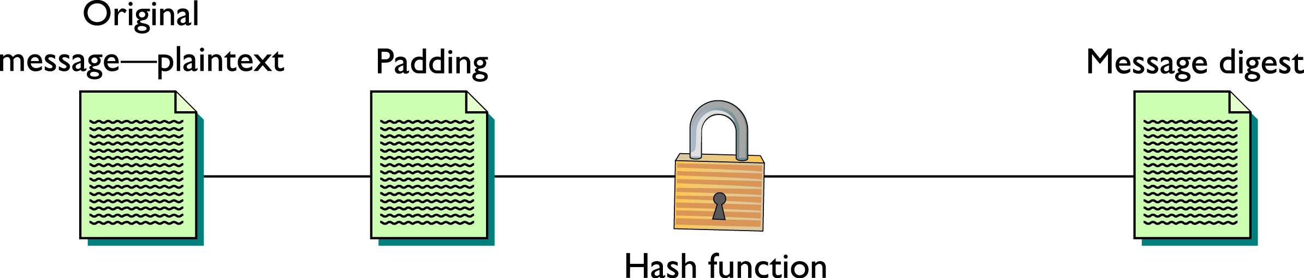
Hash Function

Slide 35
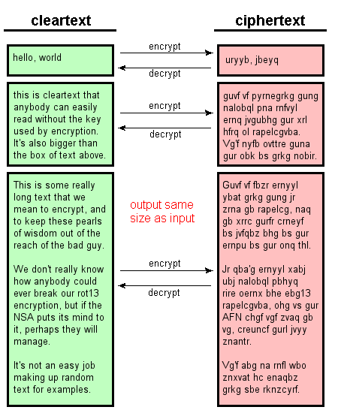
Difference between Hashing and Encryption
Encryption transforms data from a cleartext to ciphertext and back (given the right keys),
the two texts should roughly correspond to each other in size:
  big cleartext yields big ciphertext, and so on.
"Encryption" is a two-way operation.

Slide 36
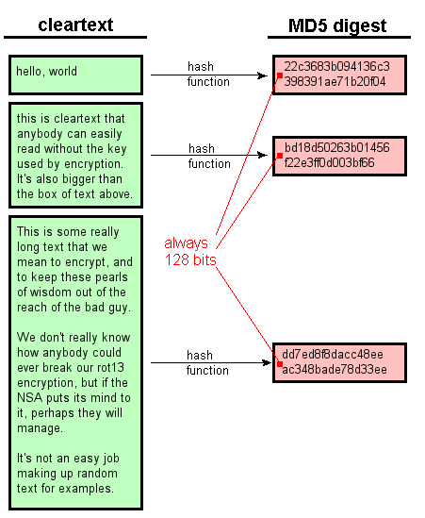
Hashing vs. Encryption
Hashes, on the other hand, compile a stream of data into a small digest
Hashes are strictly a one way operation.
All hashes of the same type – (this example shows the "MD5“) - have the same size no matter how big the inputs are.

Slide 37
Common Uses of Hashing Functions
Hashing functions are used to
  Store computer passwords
  Ensure message integrity
Hashing produces a unique value that corresponds to the data entered.
The hash value is also reproducible by anyone else running the same algorithm against the same data.
This means you can
  Create a file.
  Get its hash value.
  Send the file and the hash to someone.
  They can run the file and get its hash value as well.
  If the hashes match, the file is in complete tact.

Slide 38
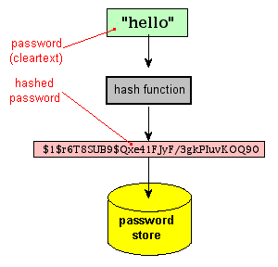
Hashing passwords
  Bad idea for computer systems to store passwords in clear text
    Can be easily compromised
  A more secure way is to store a hash of the password, rather than the password itself.
  Since these hashes are not reversible, there is no way to find
  out for sure "what password produced this hash?"
  The consequence of a compromise is much lower.

Slide 39
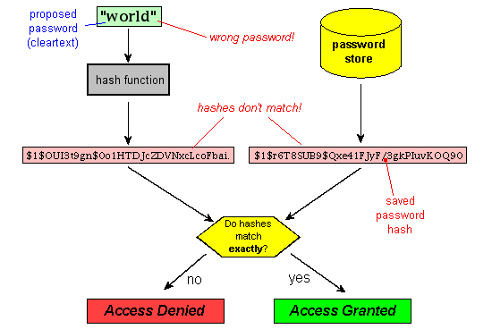
Testing a proposed password against the stored hash

Slide 40
SHA
SHA stands for secure hash algorithm.
Refers to four hash algorithms published by the National Institute of Standards and Technology (NIST) and the National Security Agency (NSA).
  Federal Information Processing Standards (FIPS)
  180-2
Applies compression function to data input.
  Accepts up to 2⁶⁴ bits or less and then compresses it down to a smaller number of bits
    i.e. – 160 bits for SHA-1
Notes:
Security + Objective 5.2a SHA
These algorithms are included in the SHA standard Federal Information Processing Standards (FIPS) 180-2.
The individual standards are named SHA-1, SHA-256, SHA-384, and SHA-512. The latter three variants are occasionally referred to collectively as SHA-2.

Slide 41
Block Method
Most algorithms use block mode to process data to create the hash.
They break the data into sets of bits (blocks) such as 512.
If a file were 1400 bits long, it would create three blocks with the third one being padded with zeros.
  2x512 is 1024, the third block would be 376 bits of the message and 136 bits of zeros.
Notes:
Security + Objective 5.2a SHA

Slide 42
Four Variants of SHA
SHA-1, SHA-256, SHA-384, SHA-512
SHA-1 was one of the more secure hash functions.
  But it has been found to be vulnerable to a collision attack.
These longer versions are referred to as SHA-2.
  SHA-256, SHA-384, and SHA-512
  All have longer hash results, and are more difficult to attack successfully.
SHA-2 does require more processing power to compute the hash.
Notes:
Security + Objective 5.2a SHA

Slide 43
Message Digest
Message digest (MD) is the generic version of one of several algorithms that are designed to create a message digest or hash from data input into the algorithm.
MD algorithms work in the same manner as SHA:
  They use a secure method to compress the file and generate a computed output of a specified number of bits.
The MD algorithms were all developed by Ronald L. Rivest of MIT.
  MD2
  MD4
  MD5

Slide 44
MD2 and MD4
MD2
  Developed in 1989; an early version of MD5
  It takes a data of any length and produces a hash output of 128 bits.
  MD2 is optimized for 8-bit machines.
    MD4, MD5 are optimized for 32-bit machines.
MD4
  Developed in 1990; optimized for 32-bit computers
  It is a fast algorithm, but it is subject to more attacks than more secure algorithms such as MD5.
  It has been shown to be vulnerable to collision.
  As such, most people use MD5 instead.
Notes:
MD4
An extended version of MD4 computes the message in parallel and produces two 128-bit outputs—effectively a 256-bit hash.
Even though a longer hash is produced, security has not been improved because of basic flaws in the algorithm.
Cryptographer Hans Dobbertin has shown how collisions in MD4 can be found in under a minute using just a PC.
This vulnerability to collisions applies to 128-bit MD4 as well as 256-bit MD4.
Most people are moving away from MD4 to MD5 or a robust version of SHA.
Security+ objective 5.2b MD5

Slide 45
MD5
Developed in 1991 and is structured with additional security to overcome the problems in MD4.
Very similar to the MD4 algorithm, only slightly slower and more secure.
Creates a 128-bit hash of a message of any length and segments the message into 512-bit blocks.
Notes:
Security + Objective 5.2 MD5
MD5 creates a 128-bit hash of a message of any length.
Like MD4, it segments the message into 512-bit blocks and then into sixteen 32-bit words.
First, the original message is padded to be 64 bits short of a multiple of 512 bits.
Then a 64-bit representation of the original length of the message is added to the padded value to bring the entire message up to a 512-bit multiple.
After padding is complete, four 32-bit variables, A, B, C, and D, are initialized. A, B, C, and D are copied into a, b, c, and d, and then the main function begins. This has four rounds, each using a different nonlinear function 16 times. These functions operate on three of a, b, c, and d, adding the result to the fourth variable, the fourth variable being a sub-block of the text and a constant, and then rotating the result of that addition to the right a variable number of bits, specified by the round of the algorithm. After adding the result of this operation to one of a, b, c, and d, that sum replaces one of a, b, c, and d. After the four rounds are completed, a, b, c, and d are added to A, B, C, and D, and the algorithm moves on to the next block. After all blocks are completed, A, B, C, and D are concatenated to form the final output of 128 bits.

Slide 46
Digital Signatures
Digital signature is a process that guarantees that the contents of a message have not been altered in transit.
It is touted as the key to truly paperless document flow.
When you, the server, digitally sign a document, you add a one-way hash (encryption) of the message content using your public and private key pair.
  Digital signatures are based on both hashing functions and asymmetric cryptography.
Both encryption methods play an important role in signing digital documents.
Provides integrity and non repudiation

Slide 47
Nonrepudiation
The message sender cannot later deny that they sent the message.
This is important in electronic exchanges of data, especially when you are unable to meet face-to-face.
Nonrepudiation is tied to asymmetric cryptography and cannot be implemented with symmetric algorithms.
Notes:
Security + Objective 5.1g Non-repudiation
An item of some confusion, the concept of nonrepudiation is actually fairly simple. Nonrepudiation means that the message sender cannot later deny that they sent the message. This is important in electronic exchanges of data, because of the lack of face-to-face meetings. Nonrepudiation is based upon public key cryptography and the principle of only you knowing your private key. The presence of a message signed by you, using your private key, which nobody else should know, is an example of nonrepudiation. When a third party can check your signature using your public key, that disproves any claim that you were not the one who actually sent the message. Nonrepudiation is tied to asymmetric cryptography and cannot be implemented with symmetric algorithms.

Slide 48
Digital Signatures
Your client can still read it, but the process creates a "signature" that only the server's public key can decrypt.
The client, using the server's public key, can then validate the sender as well as the integrity of message contents.
Whether it's
  an email
  an online order
  or a watermarked photograph on eBay
If the transmission arrives but the digital signature does not match the public key in the digital certificate, then the client knows that the message has not been altered.

Slide 49
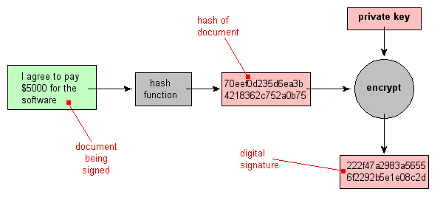
Example of Digital signature at Client end
Second goes through asymmetric encryption
First goes through Hashing

Slide 50
Notes:
Figure 2.7 is a generic model of the process of making and using digital signatures.
All of the digital signature schemes in FIPS 186-4 have this structure. Suppose
Bob wants to send a message to Alice. Although it is not important that the message
be kept secret, he wants Alice to be certain that the message is indeed from him.
For this purpose, Bob uses a secure hash function, such as SHA-512, to generate a
hash value for the message. That hash value, together with Bob’s private key, serve
as input to a digital signature generation algorithm that produces a short block that
functions as a digital signature. Bob sends the message with the signature attached.
When Alice receives the message plus signature, she (1) calculates a hash value for
the message; (2) provides the hash value and Bob’s public key as inputs to a digital
signature verification algorithm. If the algorithm returns the result that the signature
is valid, Alice is assured that the message must have been signed by Bob. No one else
has Bob’s private key, and therefore no one else could have created a signature that
could be verified for this message with Bob’s public key. In addition, it is impossible to
alter the message without access to Bob’s private key, so the message is authenticated
both in terms of source and in terms of data integrity.
The digital signature does not provide confidentiality. That is, the message being
sent is safe from alteration, but not safe from eavesdropping. This is obvious in the
case of a signature based on a portion of the message, because the rest of the message
is transmitted in the clear. Even in the case of complete encryption, there is no
protection of confidentiality because any observer can decrypt the message by using
the sender’s public key.

Slide 51
Collision Attack
A collision attack is used to compromise a hash algorithm.
It occurs when an attacker finds two different messages that hash to the same value.
This attack is very difficult and requires generating a separate algorithm that attempts to find a text that will hash to the same value of a known hash.
This must occur faster than simply editing characters until you hash to the same value, which is a brute-force type attack.
Hash functions that suffers from collisions lose integrity.
An attacker that can make two different inputs hash to the same value, can trick people into running malicious code.

Slide 52
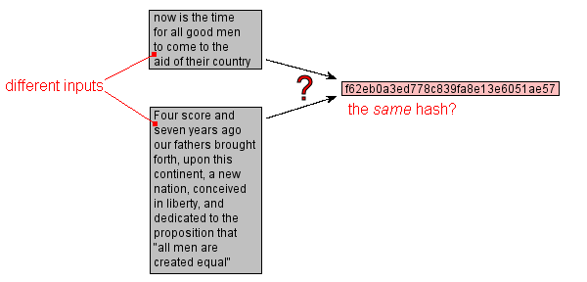
Hash Collisions – Hypothetical Example
When different chunks of data produce the same hash value, this is known as a collision.
If the hash algorithm is properly designed and distributes the hashes uniformly over the output space, "finding a hash collision" by random guessing is exceedingly unlikely

