Slide 1
Networking Basics

Slide 2
What’s a protocol?
network protocols:
machines rather than humans
all communication activity in Internet governed by protocols
human protocols:
“what’s the time?”
“I have a question”
introductions
… specific msgs sent
… specific actions taken when msgs received, or other events
protocols define format, order of msgs sent and received among network entities, and actions taken on msg transmission, receipt

Slide 3



What’s a protocol?
a human protocol and a computer network protocol:
Hi
TCP connection
request
Hi
TCP connection
response
Got the
time?
Get http://www.awl.com/kurose-ross
2:00
<file>
time

Slide 4
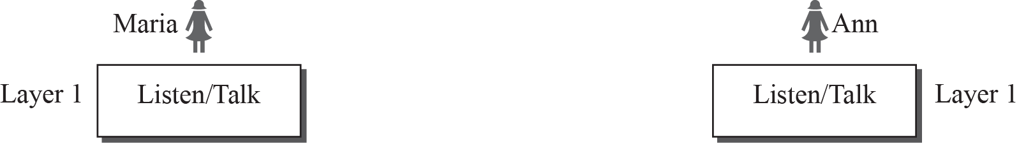
Protocol Layering
A protocol defines the rules that both the sender and receiver and all intermediate devices need to follow to be able to communicate effectively.
When communication is simple, we may need only one simple protocol; when the communication is complex, we need a protocol at each layer, or protocol layering

Slide 5
Organization of air travel
a series of steps
ticket (purchase)
baggage (check)
gates (load)
runway takeoff
airplane routing
ticket (complain)
baggage (claim)
gates (unload)
runway landing
airplane routing
airplane routing

Slide 6
Layering of airline functionality
ticket (purchase)
baggage (check)
gates (load)
runway (takeoff)
airplane routing
ticket (complain)
baggage (claim
gates (unload)
runway (land)
airplane routing
ticket
baggage
gate
takeoff/landing
airplane routing
airplane routing
airplane routing
departure
airport
intermediate air-traffic
control centers
arrival
airport
layers: each layer implements a service
  via its own internal-layer actions
  relying on services provided by layer below

Slide 7
Why layering?
Dealing with complex systems:
explicit structure allows identification, relationship of complex system’s pieces
  layered reference model for discussion
modularization eases maintenance, updating of system
  change of implementation of layer’s service transparent to rest of system
  e.g., change in gate procedure doesn’t affect rest of system
layering considered harmful?

Slide 8
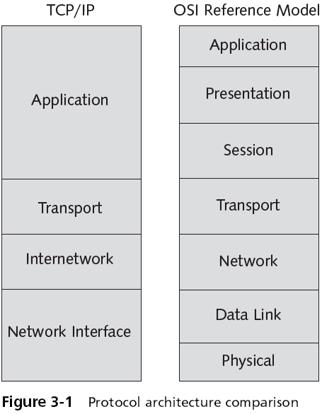

Slide 9
TCP/IP Protocol Suite
TCP/IP is a protocol suite used in the Internet today. It is a hierarchical protocol made up of interactive modules, each of which provides a specific functionality.
The term hierarchical means that each upper level protocol is supported by the services provided by one or more lower level protocols.
The original TCP/IP protocol suite was defined as four software layers built upon the hardware.
Today, however, TCP/IP is thought of as a five-layer model.

Slide 10
Layers in the TCP/IP protocol suite

Slide 11
Application Layer
An application-layer protocol is distributed over multiple end systems, with the application in one end system using the protocol to exchange packets of information with the application in another end system.
Communication is between two processes (two programs)
Protocols at the TCP/IP Application layer include:
  Hypertext Transfer Protocol (HTTP) – web access
  Simple Mail Transfer Protocol (SMTP) - transfer of e-mail messages
  File Transfer Protocol (FTP) – transfer files from one host to another
  Terminal emulation protocol (telnet) – remote access
  Domain Name System (DNS) – find network address
Packets in Application layer are called Messages

Slide 12
Transport Layer
Performs end-to-end packet delivery, reliability, and flow control
Responsible for providing services to the application layer
Application layer message encapsulated in transport layer packet (segment or user datagram)
Protocols:
  TCP provides reliable, connection-oriented communications between two hosts
    Requires more network overhead
    Provides flow control, error control, congestion control
  UDP provides connectionless datagram services between two hosts
    Faster but less reliable
    Reliability is left to the Application layer

Slide 13
Internet/ Network Layer
Responsible for connection between the source host and destination host
Communication at the network layer is host-to-host
Routers in the path between source and destination responsible for determining the best route for each packet
Four main protocols function at this layer
  Internet Protocol (IP) - responsible for addressing and routing
  Internet Control Message Protocol (ICMP) – report problems with routing a packet
  Address Resolution Protocol (ARP) – translate IP address to link layer address of a host or router
  Reverse Address Resolution Protocol (RARP)
Packets in network layer are called Datagrams

Slide 14
Network Interface Layer
Plays the same role as the Data Link and Physical layers of the OSI model
Responsible for taking the datagram and moving it across the link
Link can be wired LAN with a link layer switch, wireless LAN, wired WAN or wireless WAN
Packets in datalink layer are called Frames
The MAC address, network card drivers, and specific interfaces for the network card function at this level
No specific IP functions exist at this layer
  Because the layer’s focus is on communication with the network card and other networking hardware

Slide 15
Physical Layer
Responsible for carrying individual bits in a frame across the link
Two devices are connected by a transmission medium (cable, air)

Slide 16
Protocols Involved in a day in the Life of a Web Page Request

Slide 17
DHCP (Dynamic host configuration protocol)

Slide 18
IP addresses: how to get one?
Q: How does a host get IP address?
hard-coded by system admin in a file
  Windows: control-panel->network->configuration->tcp/ip->properties
  UNIX: /etc/rc.config
DHCP: Dynamic Host Configuration Protocol: dynamically get address from a server
  “plug-and-play”

Slide 19
DHCP: Dynamic Host Configuration Protocol
goal: allow host to dynamically obtain its IP address from network server when it joins network
  can renew its lease on address in use
  allows reuse of addresses (only hold address while connected/“on”)
  support for mobile users who want to join network (more shortly)
DHCP overview:
  host broadcasts “DHCP discover” msg [optional]
  DHCP server responds with “DHCP offer” msg [optional]
  host requests IP address: “DHCP request” msg
  DHCP server sends address: “DHCP ack” msg

Slide 20


DHCP client-server scenario
DHCP
server
223.1.1.0/24
223.1.1.1
223.1.2.1
223.1.1.2
Arriving DHCP
client needs
address in this
network
223.1.1.4
223.1.2.9
223.1.3.27
223.1.2.2
223.1.1.3
223.1.2.0/24
223.1.3.1
223.1.3.2
223.1.3.0/24

Slide 21
DHCP client-server scenario
DHCP server: 223.1.2.5
DHCP discover
arriving
client
src : 0.0.0.0, 68
dest.: 255.255.255.255,67
yiaddr: 0.0.0.0
transaction ID: 654
Broadcast: is there a DHCP server out there?
DHCP offer
src: 223.1.2.5, 67
dest: 255.255.255.255, 68
yiaddrr: 223.1.2.4
transaction ID: 654
lifetime: 3600 secs
Broadcast: I’m a DHCP server! Here’s an IP address you can use
DHCP request
src: 0.0.0.0, 68
dest:: 255.255.255.255, 67
yiaddrr: 223.1.2.4
transaction ID: 655
lifetime: 3600 secs
Broadcast: OK. I’ll take that IP address!
DHCP ACK
src: 223.1.2.5, 67
dest: 255.255.255.255, 68
yiaddrr: 223.1.2.4
transaction ID: 655
lifetime: 3600 secs
Broadcast: OK. You’ve got that IP address!

Slide 22
DHCP: more than IP addresses
DHCP can return more than just allocated IP address on subnet:
  address of first-hop router (default gateway) for client
  name and IP address of DNS sever
  network mask (indicating network versus host portion of address)

Slide 23
DNS (Domain name system)

Slide 24
Example: User requests the URL www.someschool.edu/index.html
User machine runs the client side of the DNS application.
The browser extracts the hostname, www.someschool.edu, from the URL and passes the hostname to the client side of the DNS application.
The DNS client sends a query containing the hostname to a DNS server.
The DNS client eventually receives a reply, which includes the IP address for the hostname.
Once the browser receives the IP address from DNS, it can initiate a TCP connection to the HTTP server process located at port 80 at that IP address.

Slide 25
DNS: a distributed, hierarchical database
Root DNS Servers
…
…
com DNS servers
org DNS servers
edu DNS servers
yahoo.com
DNS servers
pbs.org
DNS servers
poly.edu
DNS servers
umass.edu
DNS servers
amazon.com
DNS servers
client wants IP for www.amazon.com;
client queries root server to find .com DNS server
client queries .com TLD DNS server to get amazon.com DNS server
client queries amazon.com authoritative DNS server to get IP address for www.amazon.com

Slide 26
TLD, authoritative servers
top-level domain (TLD) servers:
  responsible for com, org, net, edu, aero, jobs, museums, and all top-level country domains, e.g.: uk, fr, ca, jp
  Network Solutions maintains servers for .com TLD
  Educause for .edu TLD
authoritative DNS servers:
  organization’s own DNS server(s), providing authoritative hostname to IP mappings for organization’s named hosts
  can be maintained by organization or service provider

Slide 27
Local DNS name server
Does not strictly belong to hierarchy
Each ISP (residential ISP, company, university) has one
  also called “default name server”
When host makes DNS query, query is sent to its local DNS server
  has local cache of recent name-to-address translation pairs (but may be out of date!)
  acts as proxy, forwards query into hierarchy
Comic Description: https://howdns.works/ep1/

Slide 28
DNS name resolution example
root DNS server
2
host at cis.poly.edu wants IP address for gaia.cs.umass.edu
3
TLD DNS server
4
5
iterated query:
Contacted server replies with name of server to contact
“I don’t know this name, but ask this server”
local DNS server
dns.poly.edu
7
6
1
8
authoritative DNS server
dns.cs.umass.edu
requesting host
cis.poly.edu
gaia.cs.umass.edu

Slide 29




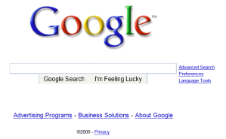
A day in the life: scenario
browser
DNS server
00:16:D3:23:68:8A
Comcast network
68.80.0.0/13
school network
68.80.2.0/24
00:22:6B:45:1F:1B
web page
web server
Google’s network
64.233.160.0/19
64.233.169.105

Slide 30
A day in the life… connecting to the Internet
Connecting laptop needs to get its own IP address, address of first-hop router, address of DNS server: use DHCP
DHCP
DHCP
UDP
IP
Eth
Phy
DHCP
DHCP
DHCP
DHCP
DHCP request encapsulated in UDP, encapsulated in IP, (destination address 255.255.255.255 and a source IP address of 0.0.0.0) encapsulated in 802.3 Ethernet
DHCP
DHCP
UDP
IP
Eth
Phy
DHCP
DHCP
DHCP
DHCP
router
(runs DHCP)
Ethernet frame broadcast (dest: FFFFFFFFFFFF; source: MAC addr of laptop 00:16:D3:23:68:8A) on LAN
Router running DHCP server receives broadcast Ethernet frame at its interface 00:22:6B:45:1F:1B
Ethernet demuxed to IP demuxed, UDP demuxed to DHCP

Slide 31
A day in the life… connecting to the Internet
DHCP
UDP
IP
Eth
Phy
DHCP server formulates DHCP ACK containing client’s IP address, IP address of first-hop router for client, name & IP address of DNS server
DHCP
DHCP
DHCP
DHCP
DHCP
DHCP
UDP
IP
Eth
Phy
Encapsulation at DHCP server, frame forwarded (switch learning – source MAC: 00:22:6B:45:1F:1B destination MAC: 00:16:D3:23:68:8A )
DHCP
DHCP
DHCP
router
(runs DHCP)
DHCP
DHCP client receives DHCP ACK reply
Client now has IP address, knows name & addr of DNS
server, IP address of its first-hop router

Slide 32
A day in the life… ARP (before DNS, before HTTP)
DNS
UDP
IP
Eth
Phy
before sending HTTP request, need IP address of www.google.com: DNS
DNS
DNS
DNS
ARP
ARP query
DNS query created, encapsulated in UDP, encapsulated in IP, encapsulated in Eth. To send frame to router, need MAC address of router interface: ARP
ARP
ARP reply
Eth
Phy
router
(runs DHCP)
ARP query broadcast, received by router, which replies with ARP reply giving MAC address of router interface
client now knows MAC address of first hop router, so can now send frame containing DNS query

Slide 33
A day in the life… using DNS
DNS
UDP
IP
Eth
Phy
DNS
DNS server
DNS
UDP
IP
Eth
Phy
DNS
DNS
DNS
DNS
DNS
DNS
DNS
DNS
Comcast network
68.80.0.0/13
IP datagram forwarded from campus network into comcast network, routed (tables created by RIP, OSPF, IS-IS and/or BGP routing protocols) to DNS server
router
(runs DHCP)
IP datagram containing DNS query forwarded via LAN switch from client to 1st hop router
demux’ed to DNS server
DNS server replies to client with IP address of www.google.com

Slide 34
A day in the life…TCP connection carrying HTTP
HTTP
HTTP
TCP
IP
Eth
Phy
SYNACK
SYN
SYNACK
SYN
SYNACK
SYN
SYN
to send HTTP request, client first opens TCP socket to web server
router
(runs DHCP)
TCP SYN segment (step 1 in 3-way handshake) inter-domain routed to web server
TCP
IP
Eth
Phy
SYNACK
SYN
SYNACK
SYN
SYNACK
SYNACK
SYN
web server responds with TCP SYNACK (step 2 in 3-way handshake)
web server
64.233.169.105
TCP connection established!

Slide 35
A day in the life… HTTP request/reply
HTTP
HTTP
TCP
IP
Eth
Phy
web page finally (!!!) displayed
HTTP
HTTP
HTTP
HTTP
HTTP
HTTP
HTTP
HTTP
HTTP request sent into TCP socket
router
(runs DHCP)
IP datagram containing HTTP request routed to www.google.com
HTTP
HTTP
TCP
IP
Eth
Phy
HTTP
HTTP
HTTP
web server responds with HTTP reply (containing web page)
HTTP
web server
64.233.169.105
IP datagram containing HTTP reply routed back to client

