Slide 1
Public-key Cryptography:
RSA and Diffie-Hellman Key Exchange Algorithms

Slide 2
RSA Public-Key Encryption Algorithm
RSA is a block cipher in which the plaintext and ciphertext are integers between 0 and n -1 for some n
Encryption and decryption are of the following form for some plaintext
block M and ciphertext block C:
C = Me mod n
M = C^{d} mod n
= (Me)^{d} mod n
= M^{ed} mod n

Slide 3
RSA Public-Key Encryption Algorithm
Both sender and receiver must know the values of n and e, and only the receiver knows the value of d.
This is a public-key encryption algorithm with
  a public key of KU = {e, n} and
  a private key of KR ={d, n}
For this algorithm to be satisfactory for public-key encryption, the following requirements must be met.
1. It is possible to find values of e, d, n such that M^{ed} mod n = M for all M < n.
2. It is relatively easy to calculate Me and C^{d} for all values of M< n.
3. It is infeasible to determine d given e and n (can be met for large values of e and n.)

Slide 4
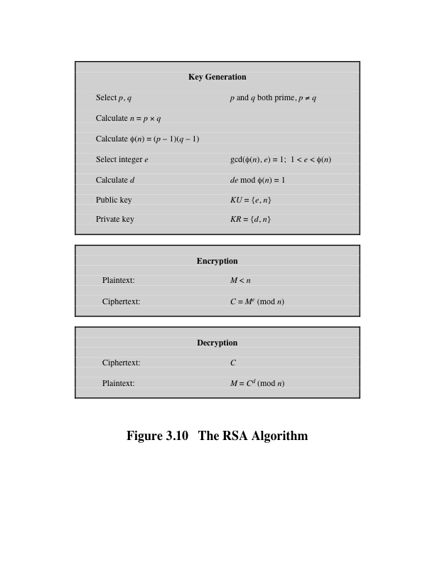
RSA Algorithm

Slide 5
Example
1. Select two prime numbers, p 17 and q 11.
2. Calculate n = pq = 17 × 11 = 187
3. Calculate Ø(n) = (p -1)(q -1) = 16 × 10 = 160.
4. Select e such that e is relatively prime to Ø (n) = 160 and less than Ø (n); we choose e = 7.
5. Determine d such that de mod 160 = 1 and d < 160.
The correct value is d 23, because 23 × 7 =161 =(1 × 160) + 1
The resulting keys are public key PU {7, 187} and private key PR {23, 187}.

Slide 6
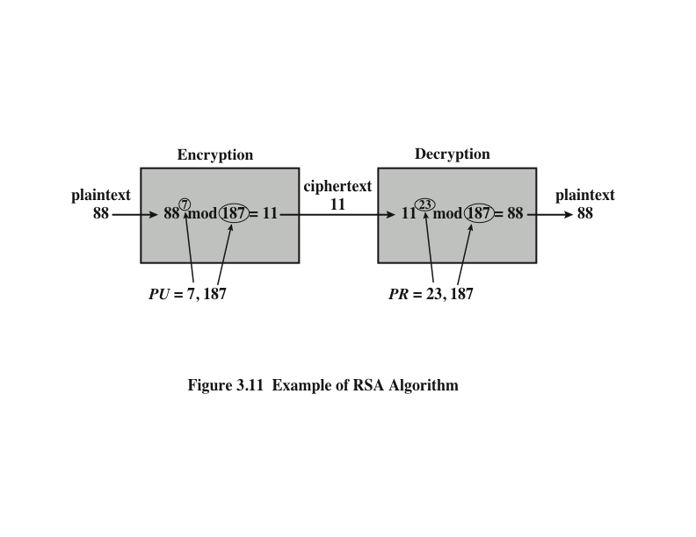
Example: plaintext input of M = 88

Slide 7
Example: Encryption
88⁷ mod 187 [(88⁴ mod 187) × (88² mod 187) × (88¹ mod 187)] mod 187
88¹ mod 187 = 88
88² mod 187 =7744 mod 187 = 77
88⁴ mod 187 = 59,969,536 mod 187 =132
88⁷ mod 187 =(88 × 77 × 132) mod 187 =894,432 mod 187 =11

Slide 8
Example: Decryption
For decryption, we calculate M =11²³ mod 187:
11²³ mod 187 = [(11¹ mod 187) × (11² mod 187) × (11⁴ mod 187) ×
(11⁸ mod 187) × (11⁸ mod 187)] mod 187
11¹ mod 187 = 11
11² mod 187 = 121
11⁴ mod 187 = 14,641 mod 187 = 55
11⁸ mod 187 = 214,358,881 mod 187 = 33
11²³ mod 187 = (11 × 121 × 55 × 33 × 33) mod 187
79,720,245 mod 187 = 88

Slide 9
Diffie-Hellman Key Exchange
The purpose of the algorithm is to enable two users to exchange a secret key securely that then can be used for subsequent encryption of messages.
The algorithm itself is limited to the exchange of the keys.
The Diffie-Hellman algorithm depends for its effectiveness on the difficulty of computing discrete logarithms.
First, we define a primitive root of a prime number p as one whose powers generate all the integers from 1 to p-1.
  if a is a primitive root of the prime number p, then the numbers a mod p, a² mod p, . . ., a^{p-1} mod p are distinct and consist of the integers from 1 through p-1 in some permutation
For any integer b less than p and a primitive root a of prime number p, one can find a unique exponent i such that
b = a^{i} mod p ; 0 <= i <= (p 1)
The exponent i is referred to as the discrete logarithm, or index, of b for the base a, mod p.

Slide 10
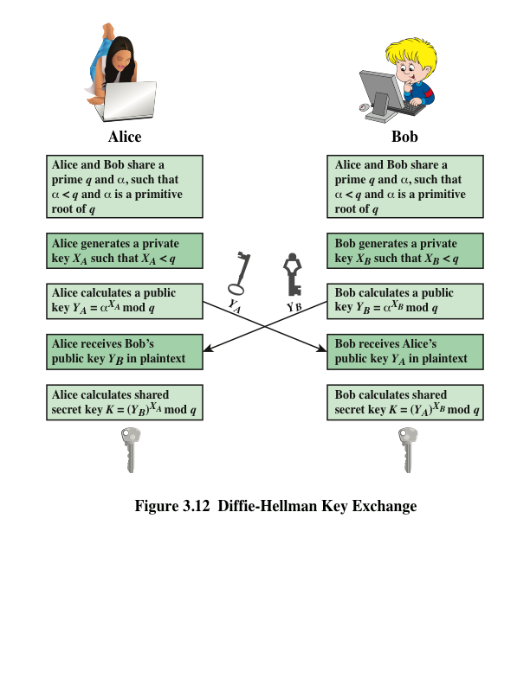
Notes:
The Diffie–Hellman key exchange is summarized in Figure 3.12.

Slide 11
Example
Key exchange is based on the use of the prime number q = 353 and a primitive root of 353, in this case α = 3.
A and B select secret keys X_{A} = 97 and X_{B} = 233, respectively.
Each computes its public key:
  A computes Y_{A} = 3⁹⁷ mod 353 = 40.
  B computes Y_{B} = 3²³³ mod 353 = 248.
After they exchange public keys, each can compute the common secret key:
A computes K (Y_{B}) ^{XA} mod 353 = 248⁹⁷ mod 353 = 160.
B computes K (Y_{A}) ^{XB}mod 353 = 40²³³ mod 353 =160

