Slide 1
Introduction to Cryptography

Slide 2

Cryptography
The art of secret writing.
The art of mangling information into apparent unintelligibility
in a manner allowing a secret method of unmangling.

Slide 3
Cryptography Definitions
Messages:
  Plaintext
  Ciphertext
Ingredients:
  Algorithm(s)
  Key(s)
Players:
  Cryptographer: invents clever algorithms
  Cryptanalyst: breaks clever algorithms

Slide 4
Cryptography Terms
Plaintext: (the original message) Message or data which are in their normal, readable (not cryptic) form
Encryption: Encoding the contents of the message in such a way that hides its contents from outsiders
  Ciphertext: the encoded or encrypted message
  Decryption: The process of retrieving the plaintext back from the ciphertext.
Key – a sequence of characters or bits used by an algorithm to encrypt or decrypt a message

Slide 5
Cryptography
Algorithm
Key(s) = secret value(s)
OK for good algorithm to be public
  Not OK to use bad algorithm
  “Sunlight is the best disinfectant”
  Algorithm without key does not help unmangle the information

Slide 6
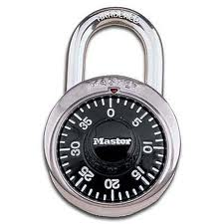
Computational Issues
Algorithm should be reasonably efficient
Security depends on how hard it is to break
Combination lock
  3 number sequence (2R, 1L, 0R), #s between 1-40
    Possible combinations:

Slide 7
Computational Issues
Algorithm should be reasonably efficient
Security depends on how hard it is to break
Combination lock
  3 number sequence (2R, 1L, 0R), #s between 1-40
    Possible combinations: 40³ = 64,000
    10 seconds per sequence: 178 hours (/ 2 = 89)

Slide 8
Computational Issues
Algorithm should be reasonably efficient
Security depends on how hard it is to break
Combination lock
  3 number sequence (2R, 1L, 0R), #s between 1-40
    Possible combinations: 40³ = 64,000
    10 seconds per sequence: 178 hours (/ 2 = 89)

Slide 9
Computational Issues
Algorithm should be reasonably efficient
Security depends on how hard it is to break
Combination lock
  3 number sequence, #s between 1-40
    Possible combinations: 40³ = 64,000
    10 seconds per sequence: 178 hours (/ 2 = 89)
  4 number sequence, 13 seconds per sequence

Slide 10
Computational Issues
Algorithm should be reasonably efficient
Security depends on how hard it is to break
Combination lock
  3 number sequence (2R, 1L, 0R), #s between 1-40
    Possible combinations: 40³ = 64,000
    10 seconds per sequence: 178 hours (/ 2 = 89)
  4 number sequence, 13 seconds per sequence
    40⁴ = 2,560,000
    9,244 hours

Slide 11

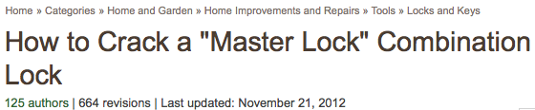
Computational Issues
Algorithm should be reasonably efficient
Security depends on how hard it is to break
Combination lock
  3 number sequence (2R, 1L, 0R), #s between 1-40
    Possible combinations: 40³ = 64,000
    10 seconds per sequence: 178 hours (/ 2 = 89)
  4 number sequence, 13 seconds per sequence
    40⁴ = 2,560,000
    9,244 hours

Slide 12
Publication Issues
Public or secret algorithms?

Slide 13
Publication Issues
Public or secret algorithms:
  OK for good algorithm to be public
  “Sunlight is the best disinfectant”
  Reverse engineering, leaks
  “Free consulting” by cryptanalysts
Generally:
  Commercial: public
  Military: secret

Slide 14
Secret Codes
Caesar cipher
  Substitute letter 3 letters further on
    DOZEN → GRCHQ

Slide 15
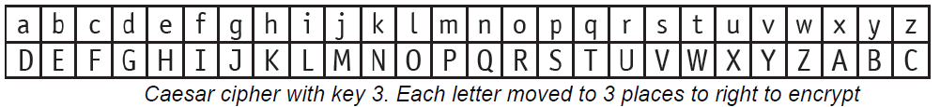
Ceasar’s Encryption (Key =3)
Plaintext
h | i | d | d | e | n
K | L | G | G | H | Q
Ciphertext

Slide 16
Caesar’s Encryption & Decryption
What is the clumsiest bee?
Key = 1
Plain text = ???
A BUMBLING BEE
Cipher Text is
B C V N C M J O H C F F

Slide 17
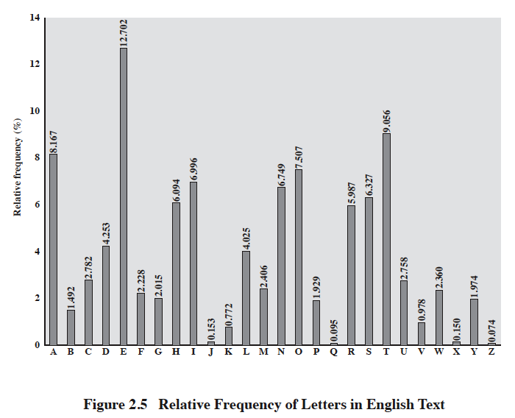
[from Stallings, Cryptography & Network Security]

Slide 18
Breaking an Encryption Scheme
Ciphertext only
  Try all possible keys, look for intelligibility
  Need sufficiently long ciphertext
  XYZ = ?
Known plaintext
  (plaintext, ciphertext) pair(s)
Chosen plaintext
  Have plaintext encrypted, compare expected values

Slide 19
Types of Cryptography
Public Key
  Two keys: public & private
Symmetric Key (aka “Secret Key”)
  One key: secret (but possibly shared)
Hash Functions
  No keys

Slide 20
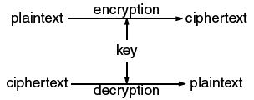
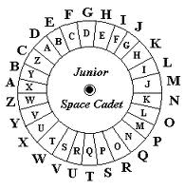
Symmetric Key Cryptography
AKA secret key cryptography
AKA conventional cryptography

Slide 21
Notes:
A symmetric encryption scheme has five ingredients (Figure 2.1):
• Plaintext: This is the original message or data that is fed into the algorithm as
input.
• Encryption algorithm: The encryption algorithm performs various substitutions
and transformations on the plaintext.
• Secret key: The secret key is also input to the encryption algorithm. The exact
substitutions and transformations performed by the algorithm depend on the
key.
• Ciphertext: This is the scrambled message produced as output. It depends on
the plaintext and the secret key. For a given message, two different keys will
produce two different ciphertexts.
• Decryption algorithm: This is essentially the encryption algorithm run in
reverse. It takes the ciphertext and the secret key and produces the original
plaintext.

Slide 22
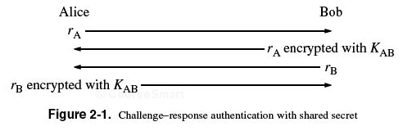
Symmetric Key Applications
Transmission over insecure channel
  Shared secret (transmitter, receiver)
Secure storage on insecure media
Authentication
  Strong authentication: prove knowledge
  without revealing key

Slide 23
A simple example
K_{AB} = +3 (Caesar cipher), known by Alice & Bob
r_{A} = “marco”
  r_{A} encrypted with K_{AB}:
r_{B} = “polo”
  r_{A} encrypted with K_{AB}:

Slide 24
A simple example
K_{AB} = +3 (Caesar cipher), known by Alice & Bob
r_{A} = “marco”
  r_{A} encrypted with K_{AB}: “pdufr”
r_{B} = “polo”
  r_{A} encrypted with K_{AB}: “sror”

Slide 25
A simple example
K_{AB} = +3 (Caesar cipher), known by Alice & Bob
r_{A} = “marco”
  r_{A} encrypted with K_{AB}: “pdufr”
r_{B} = “polo”
  r_{A} encrypted with K_{AB}: “sror”
(“marco”, “pdufr”), (“polo”, “sror”)

Slide 26
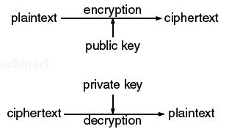
Public Key Cryptography
AKA asymmetric cryptography
AKA unconventional cryptography (?)
Public key: published, ideally known widely
Private key (NOT “secret key”): not published

Slide 27
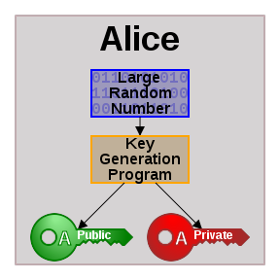
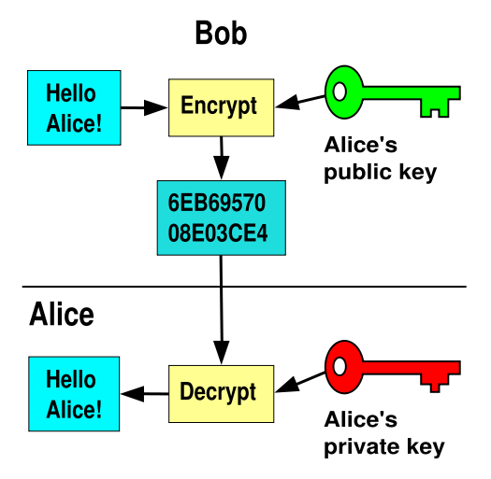
Public Key Cryptography
http://en.wikipedia.org/wiki/Public_key_cryptography

Slide 28
Public Key Cryptography
Sender (Alice) and Receiver (Bob) each have two keys:
  Public Key KP_{A} (Alice) and KP_{B} (Bob)
  Private Key KS_{A} (Alice) and KS_{B} (Bob)
Each keep their secret (private) key to themselves but publish their public keys (Everybody knows everybody else’s public key)
If Alice wants to send a message (M) to Bob
  Alice obtains Bob’s public key (KP_{B})
  Alice applies Bob’s public key to M to create a ciphertext C =P_{B}(M)
  Alice then sends the ciphertext to bob
  Bob can then decode the message using the secret key to compute S_{B}(C)
  Even if adversary knows C and KP_{B} , it cannot decode the message without KS_{B}, which only Bob knows

Slide 29
Public Key Cryptography Issues
Efficiency
  Public key cryptographic algorithms are orders of magnitude slower than symmetric key algorithms
Hybrid model
  Public key used to establish temporary shared key
  Symmetric key used for remainder of communication

Slide 30
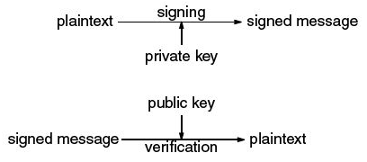
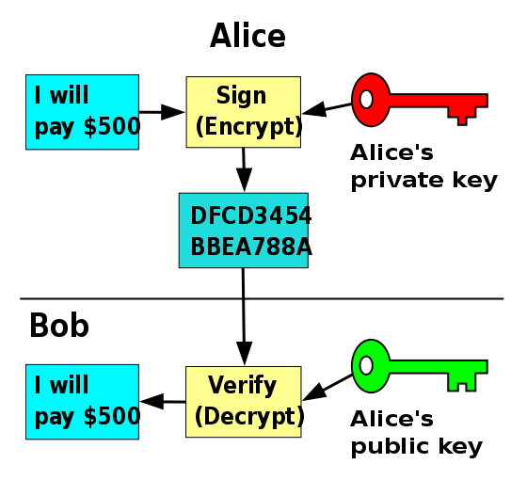
Digital Signatures
Asymmetry:
Signature can only be generated by owner/knower of private key
Signature can be verified by anyone via public key
Non-repudiation:
Sender cannot prove message (signature) was not sent
Key may have been stolen

