Slide 1
Cryptography & Network Security : Topic Seminar
RSA ALGORITHM
Description & Analysis
Madhava.N
1RV06SCN05
2nd Semester M.Tech CNE
RVCE

Slide 2
Agenda
What we already know?
Public Key Cryptosystems?
Overview of the Algorithm
Description of the Algorithm
RSA Key Setup
Analysis
Sample C Program
Examples & Exercises

Slide 3
What we already know?
Cryptography is the science and art of designing ciphers
Cryptanalysis is the science of breaking them
A cryptosystem is a method of secret communication over public channels (key technology for protecting distributed systems)
General cryptosystems
  Bob wants to send a msg x to Alice using an encryptor E such that y=xE
  Bob sends y to Alice who uses de decryptor D such that x = yD = (xE)D

Slide 4
Public Key Cryptosystems
No need to share keys?
2 pairs of keys : public & private
Public key known to all & Private known only the person of the public key owner
Based on the idea of “TRAPDOOR”
  Defined as f : X -> Y
  f is one-to-one, easy to compute & is public
  f⁻¹ is difficult to compute

Slide 5
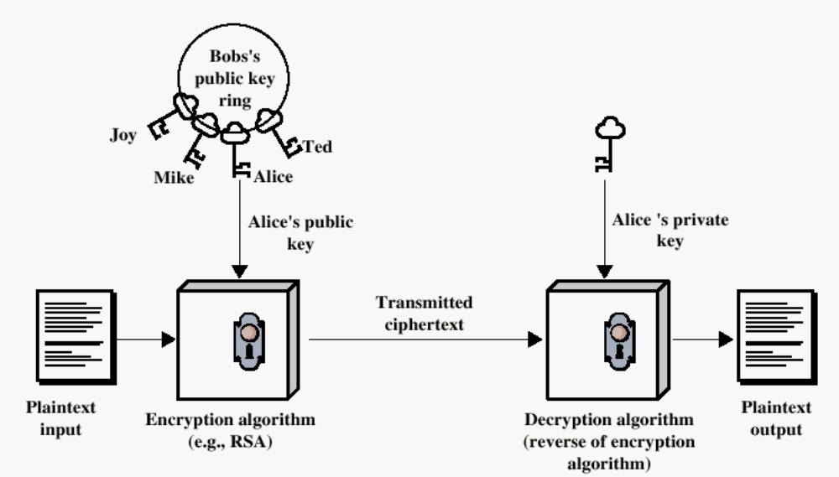
Public Key Cryptosystems

Slide 6
Overview of the Algorithm
Initial paper on PKC by Diffie & Hellman [DIFF76b] in 1976.
Immediate response by Ron Rivest, Adi Shamir, & Len Adleman in 1977
Hence the name RSA
Paper first published in 1978 [RIVE78]
RSA scheme is a block cipher in which plaintext & ciphertext are integers between 0 & n-1 for some n
Best known & widely used public-key scheme

Slide 7
Some background on the Algorithm
Based on exponentiation in a finite field over integers modulo a prime
  exponentiation takes O((log n)³) operations (easy)
uses large integers (eg. 1024 bits)
security due to cost of factoring large numbers
  factorization takes O(e ^{log n log log n}) operations (hard)

Slide 8
Some background on the Algorithm
Let a = (q * n) + r then :
  r is the reminder, q is quotient, when we divide a by n
Examples of modulo Arithmetic
  a = 11; n=7; then 11 = 1 * 7 + 4 r = 4
  a = -11; n=7; then 11 = (-2) * 7 + 3 r = 3

Slide 9
Description of the Algorithm
Plaintext is encrypted in blocks, each block have a value < n
Which mean block size is <= log₂(n)
Block size is 2^{k} bits. 2^{k} < n <= 2^{k+1}
To encrypt a message M the sender:
  obtains public key of recipient KU={e,N}
  computes: C=Me mod N, where 0≤M<N
To decrypt the ciphertext C the owner:
  uses their private key KR={d,p,q}
  computes: M=C^{d} mod N

Slide 10
Description of the Algorithm
Both sender & receiver know value of “n”
Sender knows the value of “e” and the receiver knows the value of “d”
Satisfactory Conditions
  It is possible to find values of e, d, and n such that M^{ed} = M mod n for all M < n
  It is relatively easy to calculate Me and C^{d} for all values of M < n
  It is unfeasible to determine d given e and n

Slide 11
RSA Key Setup
Select 2 large prime numbers very large in magnitude say “p” & “q”
Calculate n = p * q
Calculate φ(n) = (p-1) * (q-1)
Select “e” such that it is relatively prime to φ(n) & e < φ(n)
Calculate “d” such that (e*d) – 1 mod φ(n) = 0 or d = e⁻¹ mod φ(n)
Public Key : KU = {e,n}
Private Key: KR = {d,n}

Slide 12
RSA Key Setup
This key setup is done once (rarely) when a user establishes (or replaces) their public key.
The exponent e is usually fairly small, just must be relatively prime to ø(N).
Need to compute its inverse to find d. It is critically important that the private key KR={d,n} is kept secret, since if any part becomes known, the system can be broken.
Note that different users will have different moduli N

Slide 13
Analysis
EULER’S TOTIENT FUNCTION
  φ(n) : No of non-negative integers less than “n” and relatively prime to “n”
n | φ(n)
1 | 1
2 | 1
3 | 2
4 | 2
5 | 4
6 | 2
7 | 6
8 | 4

Slide 14
Analysis
Euler’s Theorem a^{φ(n)} = 1 mod n
  a = 3; n=10; φ(10) = 4; 3⁴ = 81 = 1 mod 10
  a = 2; n=11; φ(11) = 10; 2¹⁰ = 1024 = 1 mod 11
And its corollary represented as
  For given 2 primes “p” & “q” with n = p * q, 0 < m < n
  m^{φ(n)+1} = m^{(p-1)(q-1)+1} = m mod n
And alternative corollary
  m^{kφ(n)+1} = m^{k(p-1)(q-1)+1} = m mod n for some integer k

Slide 15
Analysis
Based on this Euler’s Theorem we can say that
  ed = kφ(n) + 1 OR
  ed = 1 mod φ(n) & d = e⁻¹ mod φ(n)
e & d are multiplicative inverses of each other

Slide 16
Sample C Program
#include<stdio.h>
int me;
int cd;
int M[50],C[50],E,D,N,Z;
int num,res,temp;
int i,j,k,l;
char data[50],enc[50],dec[50];
//Function to Calculate the Value of Decryption key “D”
void getd(){
int x,res;
for(D=1;D<Z;D++){
x=E*D;
res=x-1;
if(res%Z==0)
break;
}
printf("\nD = %d\n",D);
}

Slide 17
Sample C Program
//Encryption Function C=Me mod N
void memodn(){
me=M[i];
for(j=1;j<E;j++){
me=me*M[i];
me=me%N;
}
C[i]=me;
}
//Decryption Function M=C^{d} mod N
void cdmodn(){
cd=C[i];
for(j=1;j<D;j++){
cd=cd*C[i];
cd=cd%N;
}
M[i]=cd;
}

Slide 18
Sample C Program
void main(){
E=11,Z=60,N=77; //p=11 q=7
//N=p * q Z = (p-1) * (q-1)
getd();
printf("\nEnter The Message : ");
gets(data);
for(i=0,j=0;i<strlen(data);i++){
M[i]=(int)data[i]-50;
memodn();
enc[i]=(char)(C[i]);
}
for(i=0,j=0;i<strlen(enc);i++){
C[i]=(int)enc[i];
cdmodn();
dec[i]=(char)(M[i]+50);
}
printf("\n\nEntered text = %s",data);
printf("\n\n\t\tEncoded text = %s",enc);
printf("\n\nDecoded text = %s",dec);
}

Slide 19
Example
p = 7 & q = 17
n = p * q => 7 * 17 => 119
φ(n) = (p – 1) * (q – 1) => 6 * 16 => 96
e is relatively prime to φ(n) e = 5
d chosen such that e * d = 1 mod 96 d = 77 (77*5 = 4*96) + 1
KU = {5,119}
KR = {77,119}

Slide 20
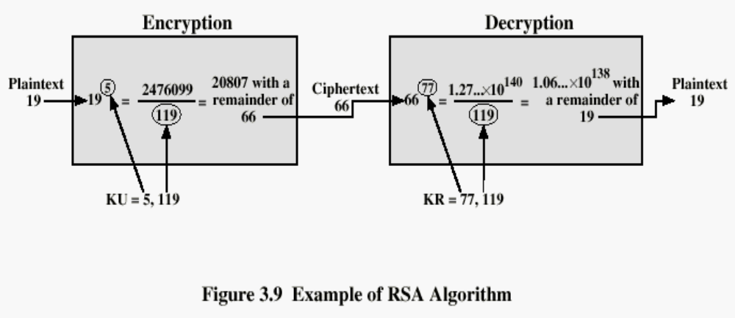
Example

Slide 21
Exercise
p = 5, q = 11, e = 3, M = 9
Solution :
C = Me mod n M = C^{d} mod n
n = p * q = 55 & φ(55) = 40
d is chosen such that (e*d) – 1 mod φ(55) = 0, therefore
d = 27
C = 9³ mod 55 = 14
M = 14²⁷ mod 55 = 9

Slide 22
Exercise
p = 7, q = 11, e = 17, M = 8
Solution :
C = Me mod n M = C^{d} mod n
n = p * q = 77 & φ(77) = 60
d is chosen such that (e*d) – 1 mod φ(77) = 0, therefore
d = 53
C = 8¹⁷ mod 55 = 57
M = 57⁵³ mod 55 = 8

Slide 23
Exercise
p = 11, q = 13, e = 11, M = 7
Solution :
C = Me mod n M = C^{d} mod n
n = p * q = 143 & φ(143) = 120
d is chosen such that (e*d) – 1 mod φ(143) = 0, therefore
d = 11
C = 7¹¹ mod 143 = 106
M = 106¹¹ mod 143 = 7

Slide 24
Exercise
p = 17, q = 31, e = 7, M = 2
Solution :
C = Me mod n M = C^{d} mod n
n = p * q = 527 & φ(527) = 480
d is chosen such that (e*d) – 1 mod φ(527) = 0, therefore
d = 343
C = 2⁷ mod 527 = 128
M = 128³⁴³ mod 527 = 2

Slide 25
Exercise
Given C = 10, e=5, n=35 what is D?
Solution :
C = Me mod n M = C^{d} mod n
n=35 means that, φ(35) can be 24 (7-1) * (5-1)
d is chosen such that (e*d) – 1 mod φ(35) = 0, therefore

Slide 26
Exercise
Given e = 31 and n=3599, what is the private key
Solution :
C = Me mod n M = C^{d} mod n
First we need to find the prime factors of 3599, then we calculate φ(3599) then from that we calculate D which will form the private key

Slide 27
QUESTIONS ?

