Slide 1
Network Reconnaissance
Tools

Slide 2
Outline
Introduction to Reconnaissance
Passive Reconnaissance
  Google Hacking
  Harvester
  Whois
  Netcraft
Active Reconnaisance
  DNS Recon
    Host
    Nslookup
    Dig
    Fierce

Slide 3
Reconnaissance/Footprinting
Phase 1: Information gathering
more information = higher probability of successful attack
Valuable skill for pen testers and hackers
Conducting thorough search of public information
  Open-Source Intelligence (OSINT)
  Gather as much information as possible
  Create a list of attackable IP addresses or URLs
Difference between black hat and white hat – authorization
  Malicious hackers are not bound by scope or authorization

Slide 4
Reconnaissance
Active Recon – actively interact with target
  Target may record your IP address and log activity
  Higher likelihood of being detected
Passive Recon – makes use of vast amount of information available on the web
  No interaction with target
  Target has no way of knowing, recording or logging your activity
NOTE: Do not attempt Active Recon without permission!!!

Slide 5

Real Example
Pentester registered a no-ip domain (stamps.no-ip.com) and collected some stamp images from Google images.
Embedded some nasty HTML containing exploit code for the latest Internet Explorer security hole (MS05-001 at the time), and proceeded to call David on his cellular phone
David visited malicious website in order to see the “stamps”.
While browsing the site, the exploit code on the visited website downloaded and executed Netcat on his local machine, sending the pentester a reverse shell.

Slide 6
Google Hacking
Huge amounts of data leaking into the web and, even worse, leaking into the Google cache
Introduced by Johnny Long
General Idea: use special search operators in Google in order to narrow down our search results and find very specific files, usually with a known format
Basic Usage:
http://www.google.com/help/basics.html
Advanced Google Operators
http://www.google.com/help/operators.html

Slide 7
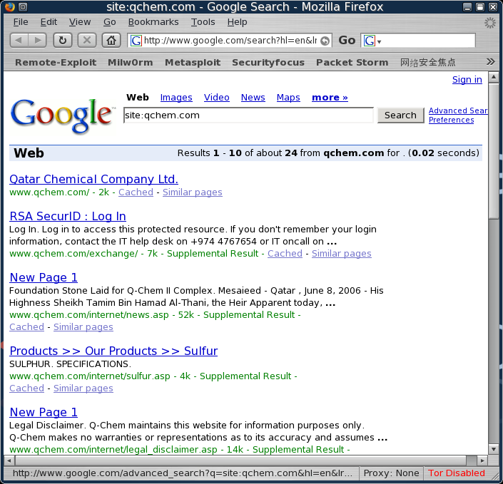
Google Hacking
Example: Searching within a domain
site: operator restricts the results to websites in a given domain
site:qchem.com
all the results come
from the target site

Slide 8
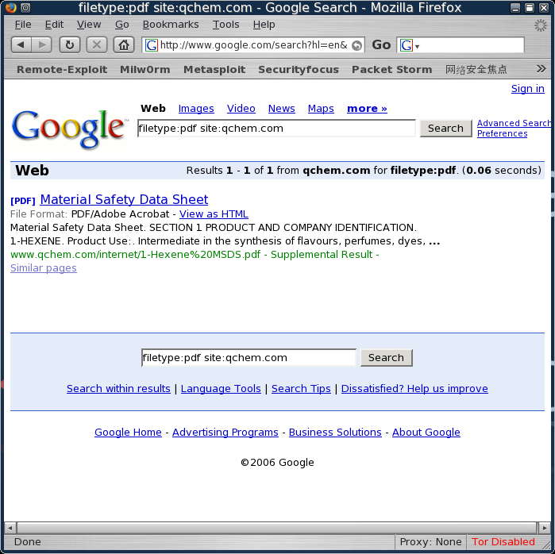
Example: Searching within a domain
filetype:pdf site:qchem.com
search will show us all the PDF files in the qchem.com site
Note: Old example
Company has now
removed the pdf ☺

Slide 9
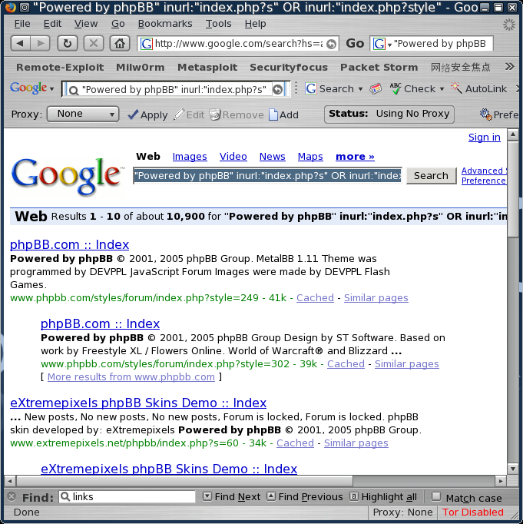
Example: Finding Vulnerable Servers using Google
In Febuary 2006, a phpBB (popular open source forum software) vulnerability was found.
Google was quickly used in order to identify all the web sites running phpBB, and those sites were targeted for attack.
"Powered by phpBB" inurl:"index.php?s" OR inurl:"index.php?style“
Note the massive amount of sites
found – 10,900 !

Slide 10
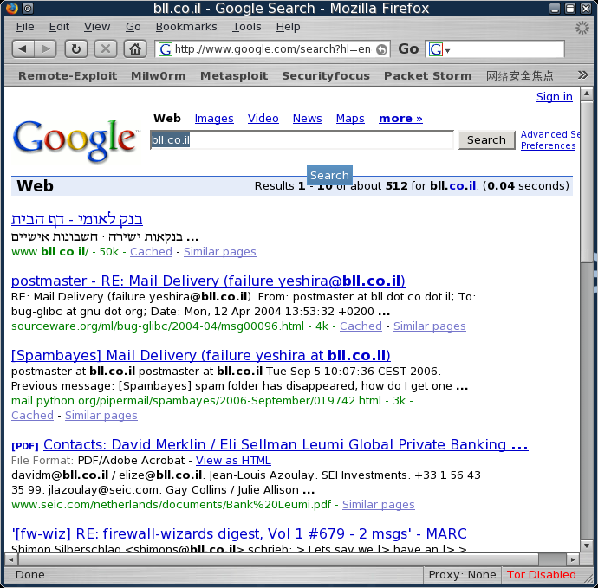
Example: Email Harvesting

Slide 11
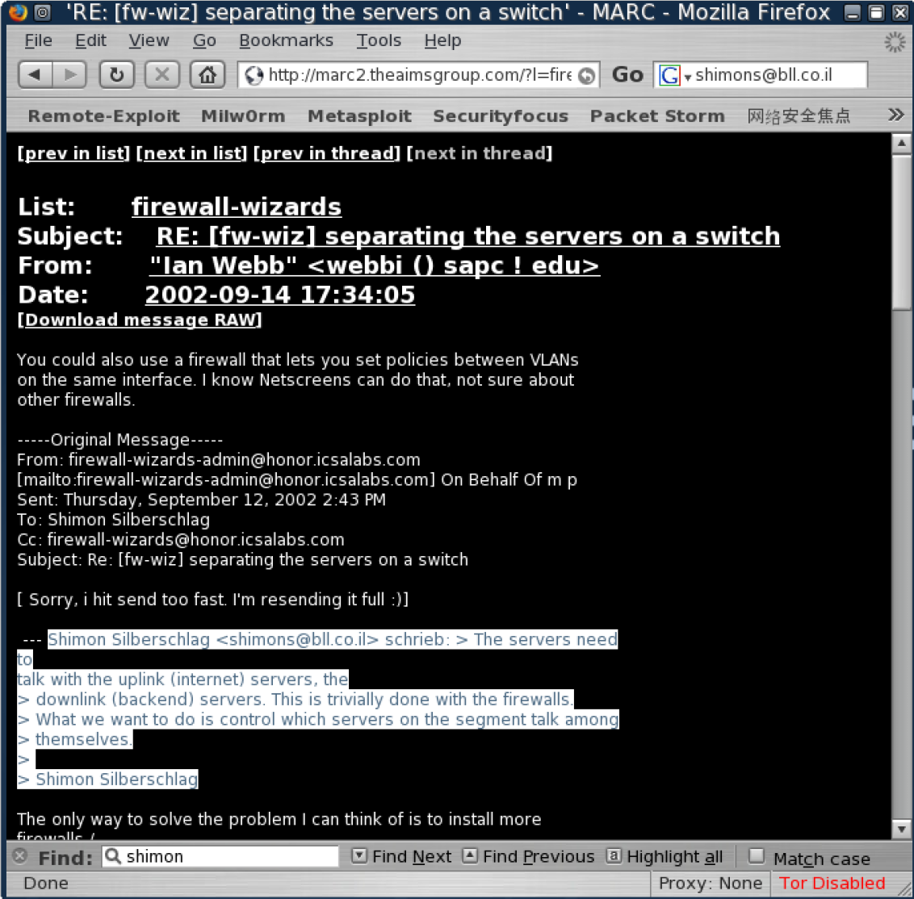
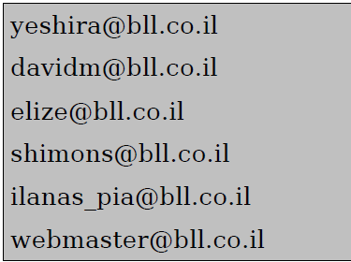

Slide 12
Google Hacking Resources
Google Hacking Database
https://www.exploit-db.com/google-hacking-database/

Slide 13
Passive Recon Tools
THE HARVESTER: Discovering and Leveraging E-mail Addresses
TheHarvester has been developed in Python by Christian Martorella.
It is a tool which provides us information of about e-mail accounts, user names and hostnames/subdomains from different public sources like search engines and PGP key server.

Slide 14
Recon Tools
If you are using kali linux, go to the terminal and use the command theharvester.
In case, it is not available in your distribution, then you can easily download it from http://code.google.com/p/theharvester/downlaod, simply download it and extract it.
Provide execute permission to the theHarvester.py by [chmod 755 theHavester.py]
After getting in to that, simply run. /theharvester, it will display version and other option that can be used with this tool with detailed description.
NOTE: Can use command > locate theharvester to figure out the directory

Slide 15
Recon Tools
theHarvester -d [url] -l 20 -b [search engine name]
-d [url] will be the remote site from which you wants to fetch the juicy information.
-l will limit the search for specified number.
-b is used to specify search engine name. (like google)
Example:
#theHarvester -d sixthstartech.com -l 300 -b all

Slide 16
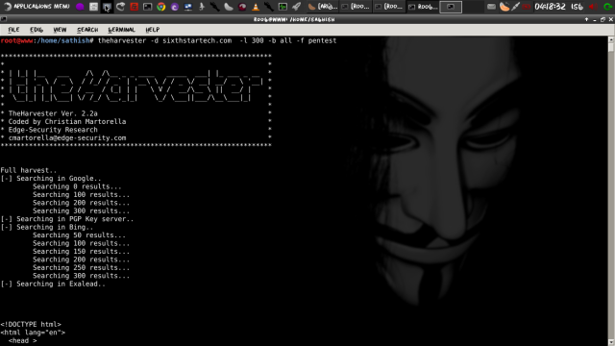
Example: the harvester
Save the result in HTML file. Command:
#theHarvester -d sixthstartech.com -l 300 -b all -f pentest

Slide 17
Netcraft
NetCraft
Free online tool to gather information about webservers including both the client and server side technologies.
  used to indirectly find out information about web servers on the internet, including the underlying operating system, web server version, uptime graphs, etc.
Visit http://www.netcraft.com/
Start by searching for target in “What’s that site running” textbox
or
Visit http://toolbar.netcraft.com/site_report/
and type the domain name.

Slide 18
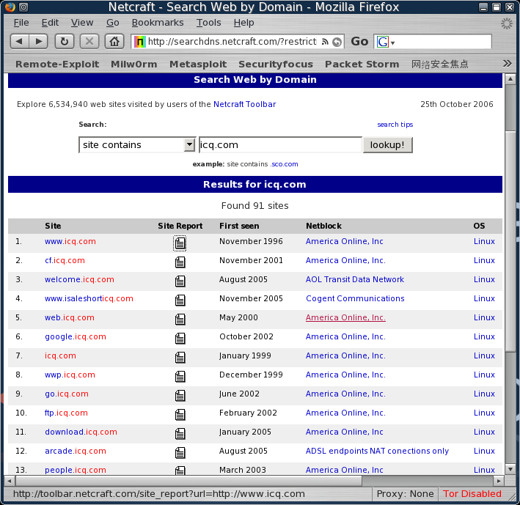
Netcraft
http://searchdns.netcraft.com/

Slide 19
Whois Reconnaissance
Simple but effective means for collecting additional information on target
name for a TCP service, a tool and a database
Whois databases contain nameserver, registrar, and in some cases full contact information about a domain name.
Each registrar must maintain a Whois database containing all contact information for the domains they 'host'.
Allows to access specific information about the target including the IP addresses or host names of the company’s DNS servers and contact information (address/phone number etc.)
Linux command
#whois target_domain

Slide 20
Whois Reconnaissance
Whois is also often made accessible over a web interface.
The following are some of the most comprehensive Whois web interfaces available:
https://whois.net/
http://whois.domaintools.com/
http://www.internic.net
Console output and the web interface output contains identical information

Slide 21
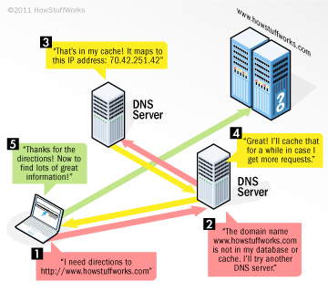
DNS Reconnaissance
Extracting information from DNS
DNS offers a variety of information about public (and sometimes private!) organization servers, such as IP addresses, server names and server functions.
DNS Servers – excellent target for hackers and pen testers
Focus on DNS servers that belong to the target
  Can get access to full listing of internal IP addresses and host names that belong to the target
  Often misconfigured and unpatched

Slide 22
DNS Reconnaissance
Interacting with a DNS server
Can interact with DNS servers using various DNS clients
  host
  nslookup
  dig
  fierce, etc

Slide 23
Forward lookup bruteforce
Try to guess valid names of organizational servers.
Try to resolve a given name.
If it resolves then the server exists
Use host command
Type in Kali
# host target_hostname
Example: host ns1.dreamhost.com
Can also use the command in reverse
# host IP_address

Slide 24
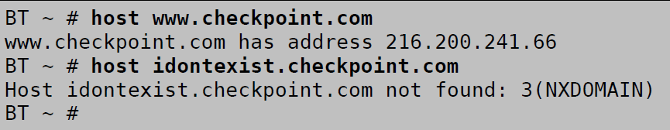
DNS Recon Tools
host

Slide 25
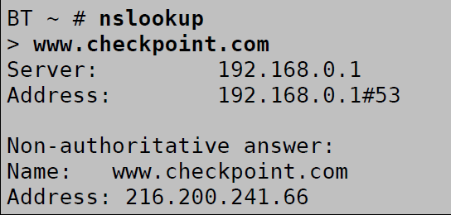
DNS Recon Tools
nslookup
nslookup is an useful command to find the information about DNS server including IP addresses, MX records etc.
Older and limited

Slide 26
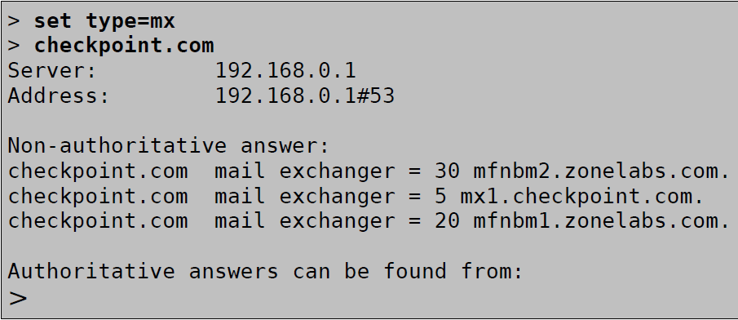
DNS Recon Tools
In order to identify the MX server (Mail Servers) belonging to an organization, we can simply ask the DNS server to show us all the MX records available for that domain:
> set type = mx (for mail server records) or “any” for complete records

Slide 27
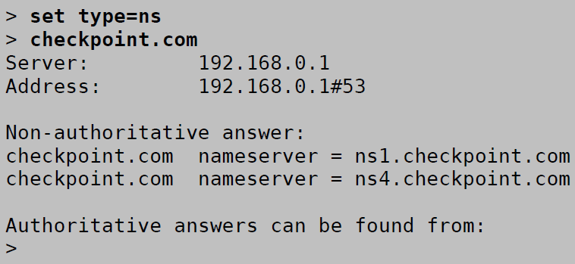
DNS Recon Tools
NS queries: identify all the DNS servers authoritative for a domain

Slide 28
DNS Recon Tools
Dig
When a DNS zone transfer is allowed, you should get a complete listing of all DNS entries that have been made in the DNS server for this domain.
If the DNS server doesn't allow it, you will get an error indicating that the Zone transfer didn't work.
#dig @target_ip
Example of Zone transfer using dig:
#dig @192.168.1.23 example.com –t AXFR
→ If zone transfers are allowed, you will be presented with a listing of host and IP address from target server

Slide 29
DNS Recon Tools
Fierce –Effective method for uncovering additional targets.
The main feature of fierce is that it can be used to locate noncontiguous IP space and hostnames against specified domains.
# fierce -h
This will display the usage instructions on your screen.
Example: # fierce -dns google.com

