Slide 1
Busses, Tri-State Logic, & the Evolution of Assembly
Instructor: Rob Nash
Readings: See schedule
“Spaghetti code? Consider a fully connected graph and you can see the rats nest of wires that we would have.”
A bus: a group of like signals, related by some feature

Slide 2
First…
A Review of Building Up
We use AND, OR, and NOT gates to make everything
  Specific gates like NAND and NOR are all you need
We can make a simple and stateless circuit
  Some things need no memory, like a sliding glass door at a store
    Just input and an output based on this; “hardwired”
We can also make a circuit with memory
  A.k.a. feedback loop

Slide 3
One Gate -> Sets of Gates (Combinatorial Circuits)
AND, OR, NOT to NAND, NOR, XOR, XNOR
  NAND, NOR to build everything (all other circuits)
Combinations of gates produce
  Comparators (equality)
  A Decoder/Encoder
    An operation or function chooser
    A memory location picker
    An enabler or disabler (say, of floating-point hardware)
  A Mux/Demux
    one Skype line sharing fam-2-fam
  Half-Adders, Full-adders (ripple carry adders, etc.)
Even more advanced combinations of gates
  1-bit ALU, which combines an adder and logic units
  N-bit ALU
From one to many, combined

Slide 4
Circuits-> Feedback Circuits (Sequential Circuits)
Gates that have feedback can remember their state
  This is memory
From a simple feedback loop, we can make
  SR latches, clocked
  JK latches, both synchronized and asynchronous
  SR Master-Slave latches to address race condition, level triggered
  JK flip-flops that are edge-triggered using the inverter delay
  JK Master-Slave flip-flops that solve the race condition
  D flip-flops that unite the J and K inputs
    Any of these except for the RC latches can be built to toggle

Slide 5
Feedback Circuits & Organization
-> Sequential Logic Components
A.k.a. Pieces to build a Finite State Machine.
  Components to state-step through computation.
  We’ll build these components together and black box them later (as usual)
From the D-style Flip-Flop, we can build:
  A1-bit storage register
    An n-bit storage register
  A shift register
    For serial to parallel data communications
  A ripple counter
    Also a frequency-divide-by-two clock reducer
  FIFO Queue in parallel
Notes:
State Machine

Slide 6
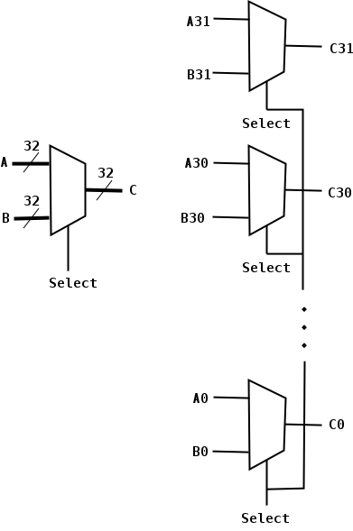
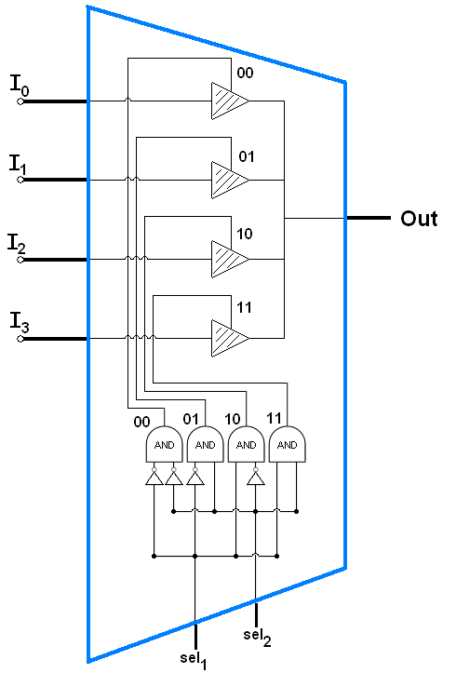
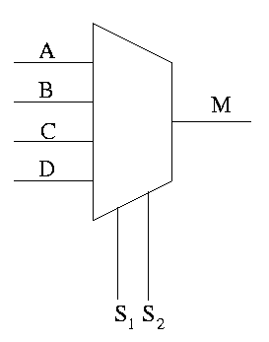
Mux/DeMux
Final Black Box
Selectors might be part of a control bus, similar to f0,f1
Circuit
Image Sources: http://cs.nyu.edu/~gottlieb/courses/2000s/2007-08-fall/arch/lectures/lecture-03.html
http://en.wikipedia.org/wiki/Multiplexer

Slide 7
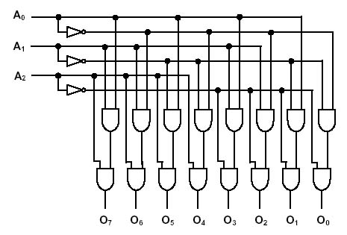
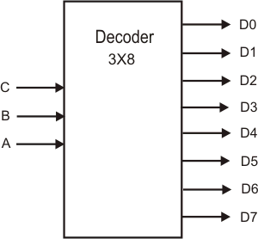
Decoder
“Macro”
A₀,A₁,A₂ would be part of an address bus
(C,B,A to the right)
Notes:
Image sources: Instructables.com, cpuville.com

Slide 8
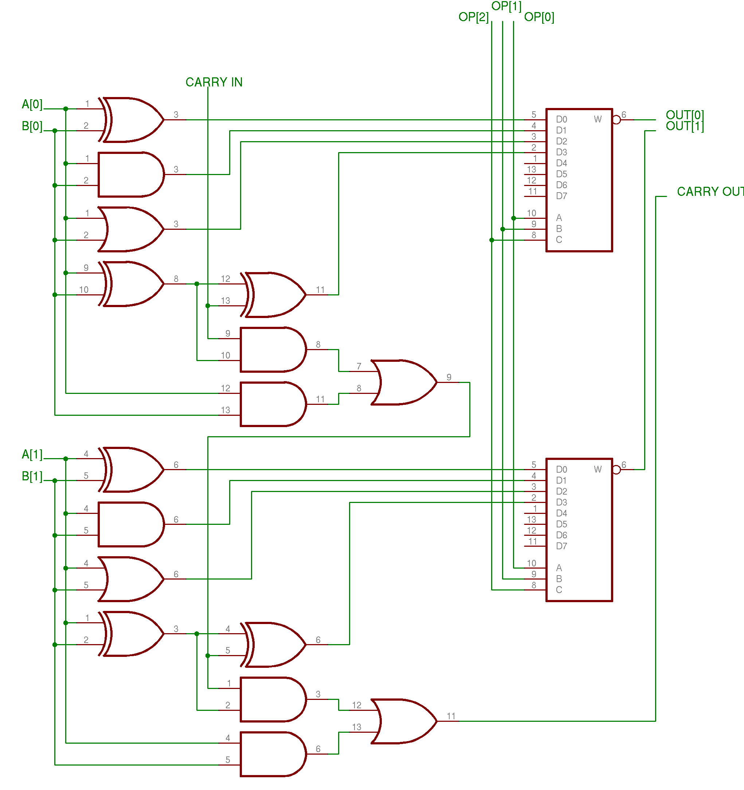
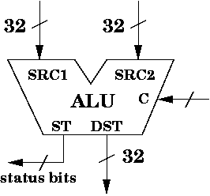
ALU
A₀,B₀,Out₀ would be part of a data bus
“Abbreviate”
Image Source: cs.umd.edu

Slide 9
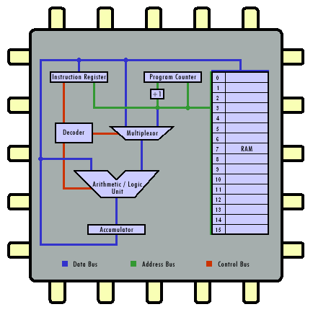
Combine the CCs we just observed with Memory…
RAM(D-ffs)
FUs/CCs
A High-Level, Abstract, Conceptual View of a Machine
Image source: http://courses.cs.vt.edu/csonline/MachineArchitecture/Lessons/CPU/cpu_circuit.gif

Slide 10
Iterate Again…
But Shorter Clock Cycle
And, closer to professional design of RISC, CISC chips

Slide 11
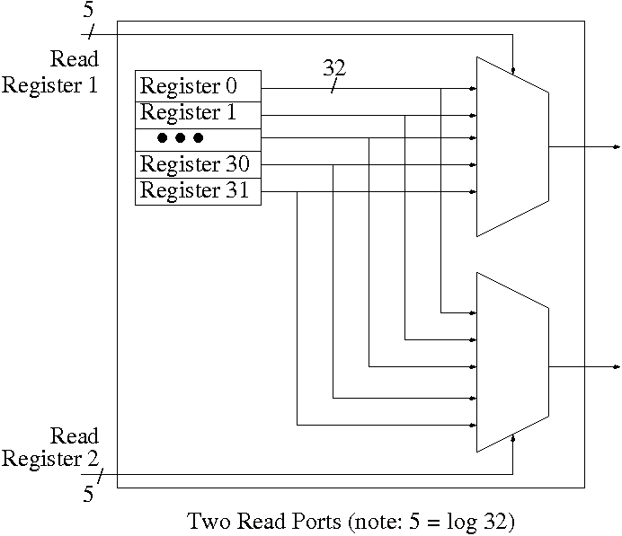
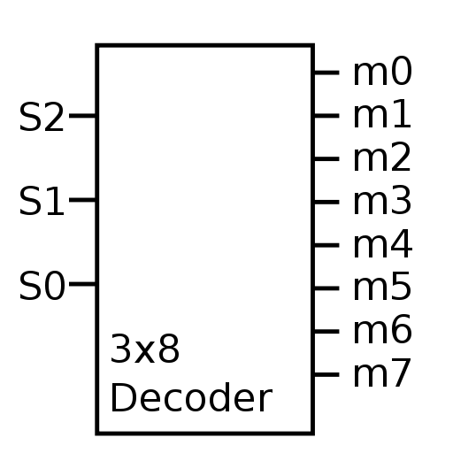
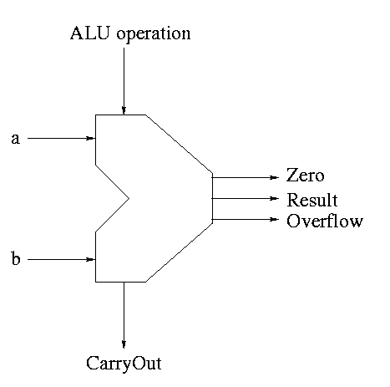
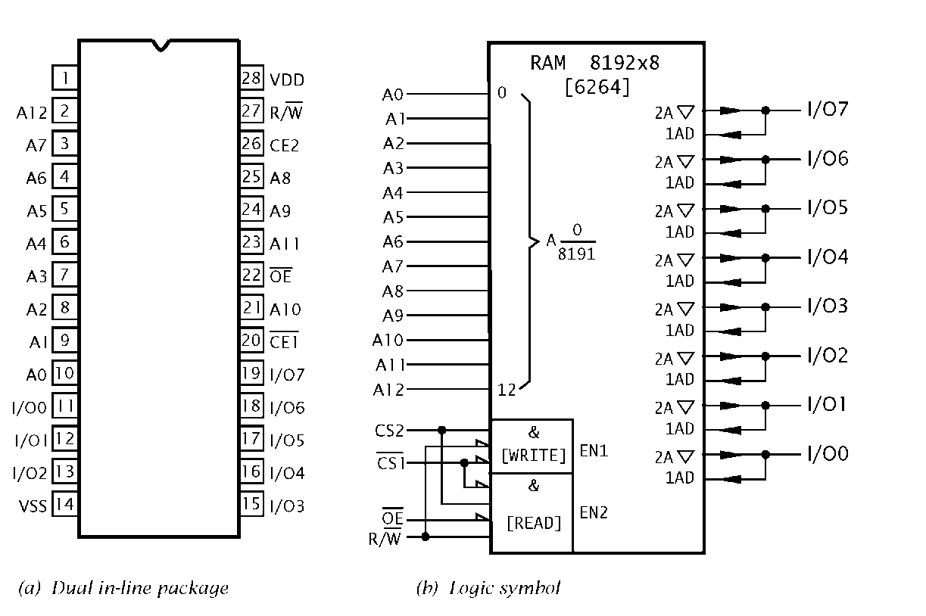
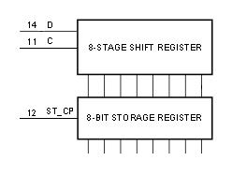
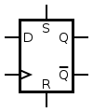
Summary of L2 & L3 Abstractions
32
24
Week 3 & 4, HW3
4
Week 1
HW1 & Week 2
2
1
Lab 1 & HW2
3
5
Image sources: http://cs.nyu.edu/~gottlieb/courses/2000s/2007-08-fall/arch/lectures/diagrams/read-ports.png
Notes:
So, you think you can handle a real computer?

Slide 12
We built all of that so we could make one of these
RAM(D-ffs)
FUs/CCs
A Simple RISC-Style Machine for Computation
Image source: http://courses.cs.vt.edu/csonline/MachineArchitecture/Lessons/CPU/cpu_circuit.gif

Slide 13
Bus Motivation
Consider Only 6 Units
Memory1
CPU
FlashDrive
HardDriveA
SoundCard
NetworkCard
For only one bit

Slide 14
Consider Only 6 Units
Talking Unidirectionally
Memory1
CPU
FlashDrive
HardDriveA
SoundCard
NetworkCard
For only one bit
Notes:
TODO; Make double arrows single arrows, since they’re not IO paths

Slide 15
Now Input & Output (1 b)
Memory1
CPU
FlashDrive
HardDriveA
SoundCard
NetworkCard
Just 2 bits of bandwidth?
  One per I and O

Slide 16
…4 Bits
But is this “Rats Nest” really a solution?
Point to point connections are complex, costly, heat & die expensive
Idea: Each FU could have a 5-to-1 Mux per input (so 6 Muxes x 6 FUs)
  Complex and costly, consider the control & coordination logic
    Still, getting closer to a (tri-state, bus-based) solution here
Memory1
CPU
FlashDrive
HardDriveA
SoundCard
NetworkCard

Slide 17
Bus Organization
Busses were invented to simplify the organization and flow of data internally
  Busses allow many devices to connect to the same data path
    Allow for efficient exchange of data between devices
Question: How do I connect outputs together and not get a short circuit?
BUS
1
AND
Gate 1
1 (5V)
0 (0V)
AND
Gate 2
1
1
0
“In fact, we might actually damage the circuit elements because each one is trying to force the other to change…
sort of like when I first got married. But that’s another story “
Short circuit (bus contention)
Actual result will be an indeterminate logic level

Slide 18
Bus Organization
Answer: All logic devices that connect to a bus are actually divided into two parts: Logic functional block and bus interface unit
Input(s) d,e,f
Logical
Function
2
Connected to bus
Bus
Interface
Input(s) a,b,c
Logical
Function
1
Isolated from bus
Bus control
Close the switch > output connected
Open the switch > output disconnected
BUS

Slide 19
(The Wheels On) The Bus & Arbiter
Electronic “Switch”
Memory1
CPU
FlashDrive
Data Write
HardDriveA
SoundCard
NetworkCard

Slide 20
4-b Width
Tri-State Buffer
Memory1
CPU
FlashDrive
Bus Stride Notation
4
HardDriveA
SoundCard
NetworkCard

Slide 21
Bus Structure: Tri-State
Output Enable INPUT OUTPUT
Truth table for Bus Interface Gate
0
1
1
0
0
0
1
1
Hi Z
Bus Interface Gate
1
0
Hi Z
INPUT
Hi Z: removing the gate
from the circuit
1 or 0
1 or 0 or HiZ
Logic
Gate
OUTPUT
Output Enable is 0 to activate. Why?
Output
Enable

Slide 22
Packaged (Augmented) “D” Flip-Flop
A single bit memory cell
DATA In AND Out
(bidirectional bus)
D
Q
Note the new control logic which we’ll
need when building Buses and Memory
W(rite)
CLK
Flip-flop core
(without S,R and Q)
OE
Tri-state Buffer Portion

Slide 23

Types of Busses
Data Bus: Between Processor, Memory, and IO
  Read and Write
    Bi-directional IO
  Homogenous (all signals are considered together)
Address Bus: From Processor to Memory
  Read-only, unidirectional
  Homogenous
Status/Control Bus: “Housekeeping”
  Clock, Chip enable, Output enable, Write enable
  Heterogenous
  Some unidirectional, some bi-directional signals
    WE, READ/WRITE, OE
    Interrupt, Bus req, bus ack, clock

Slide 24
Bus Organization
32
Bus Stride Notation
D0
represents
32-bit register
D31
D0 D31
32-bit Storage Register

Slide 25
Data Stride
Summary of various bus widths:
  4,8 bits - Appliances, modems, simple applications
  16 bits - Industrial controllers, automotive
  32 bits - Telecomm, laser printers, high-performance apps
  64 bits - PC’s, UNIX workstations, games
  128, 256 bits (VLIW) - Next generation
Internal and external data paths may differ in size
  Narrower memory is more economical, (but typically slower?)
  MC68000: 32-bit internal/16-bit external
  80C188: 16-bit internal/8-bit external
(Original Source: Arnie Berger)

Slide 26
Expanding Memory Stride
D0 D1 D2 D3 D4 D5 D6 D7 D8 D9 D10 D11 D12 D13 D14 D15
A0
W
D0
A1
D1
A2
A3
A4
D2
A5
A6
D3
A7
A8
D4
A9
A10
D5
A11
A12
D6
A13
A14
D7
OE
CE
A0
W
D0
A1
D1
A2
A3
A4
D2
A5
A6
D3
A7
A8
D4
A9
A10
D5
A11
A12
D6
A13
A14
D7
OE
CE
16-bit data bus, D0..D15
Q: How many bins (mappable locations) per chip? (word=16b)
Q: How many bytes total?
Notes:
A: 2^15
A: since both chips are in use to make a 16 bit bus, still 2^15

Slide 27
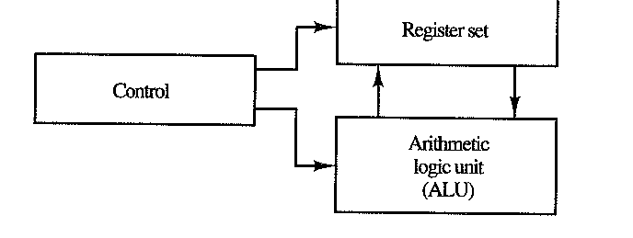
ALU <-> MEMORY via Bus & Control
The components in CPU is connected with an internal bus. (fast, expensive)
We’ll build this; we’ll add this register file to our ALU (HW1) in the next slides
Major Components of CPU, Simplified
Courtesy of Arnie Berger

Slide 28
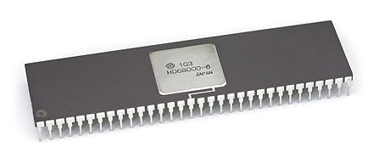
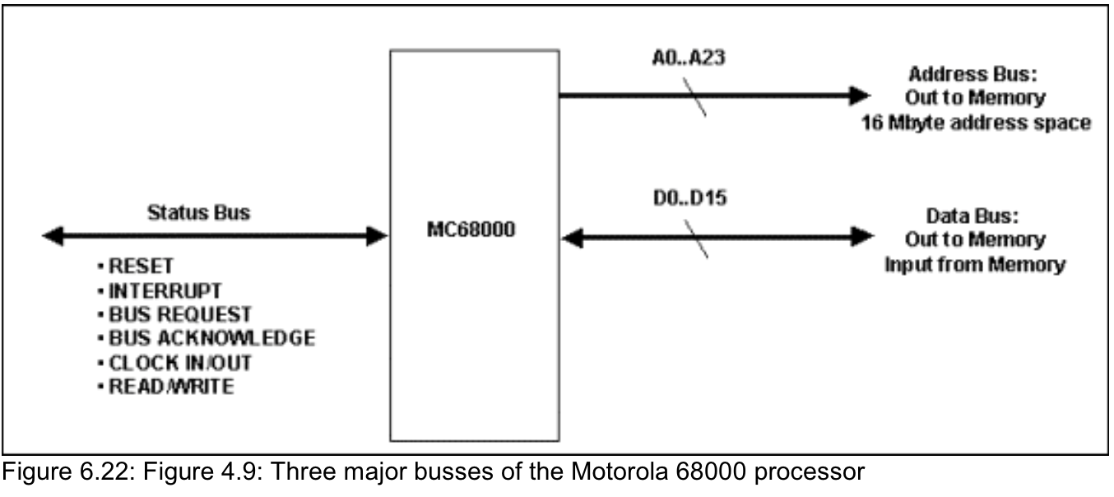
Motorola 68K Black Box
Stride
16b external data bus
  This will define the “word” size
32b internal data bus
  This is a double word or long
24b address bus limits memory space
Uses a status/control bus and a Status Register
(Next Slide)

Slide 29
The Status Bus & M68K
Provides control and synchronization
  The clock
Informs of interrupts
Mediates bus accesses
Knows if a carry occurred
For the MC68K:
  RESET
  INTERRUPT
  BUS REQ, ACK
  CLOCK IO
  READ/WRITE
  (STATUS REGISTER)

Slide 30
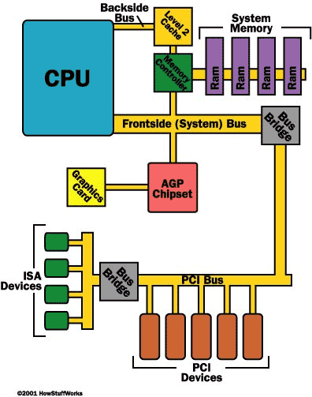
A “Modern” PC Bus Set
Internal Bus
External Bus
(USB, etc.)
Source: howstuffworks.com

Slide 31
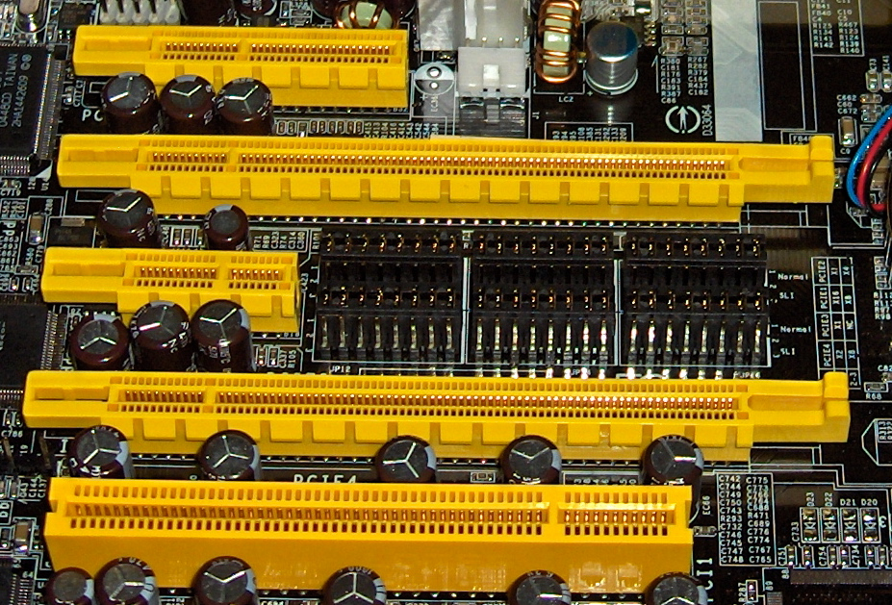
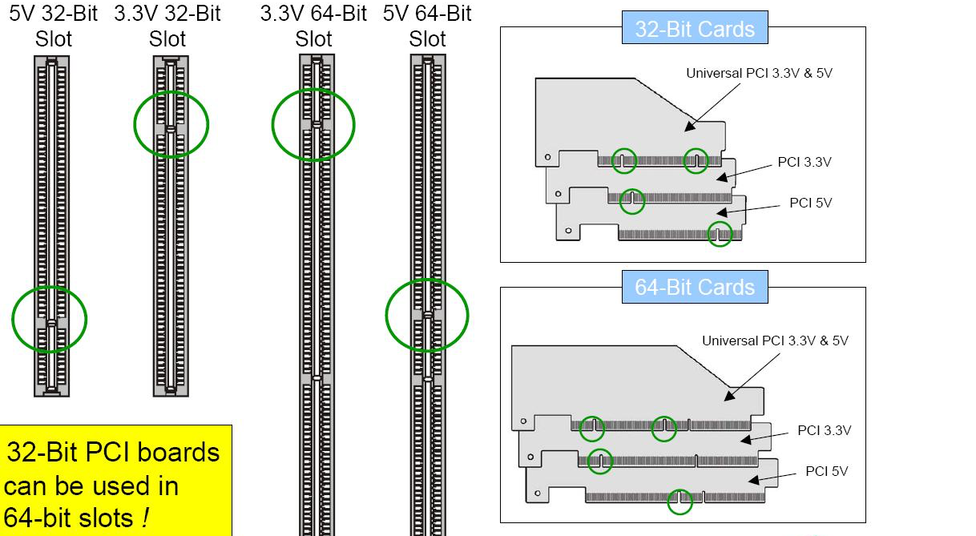
External PC Busses
Peripheral Component Interconnect
Source, go to : http://networking.ringofsaturn.com/PC/slottypes.php,

Slide 32
RAM OK: What’s in the Box?
DB0
DB1
DB2
DB3
A0
D
Q
D
Q
D
Q
D
Q
CLK
OE
CLK
OE
CLK
OE
CLK
OE
A1
(W0)D0..D3
(OE0)D0..D3
CS
D
Q
D
Q
D
Q
D
Q
Memory decoding logic
CLK
OE
CLK
OE
CLK
OE
CLK
OE
(W1)D0..D3
R / W
(OE1)D0..D3
D
Q
D
Q
D
Q
D
Q
CLK
OE
CLK
OE
CLK
OE
CLK
OE
(W2)D0..D3
(OE2)D0..D3
D
Q
D
Q
D
Q
D
Q
More Controls Q: What do they do?
CLK
OE
CLK
OE
CLK
OE
CLK
OE
(W3)D0..D3
(OE3)D0..D3
Q: More Black Boxes Above – explain each of them.
Notes:
A:Just a decoder with some D-FFs and control wires to turn on and off certain chips
CS == chip select, R/W is read and write, or OE, WE,RD, etc.

Slide 33
How Many Control Wires?
DB0
DB1
DB2
DB3
A0
D
Q
D
Q
D
Q
D
Q
CLK
OE
CLK
OE
CLK
OE
CLK
OE
A1
(W0)D0..D3
(OE0)D0..D3
CS
D
Q
D
Q
D
Q
D
Q
Memory decoding logic
CLK
OE
CLK
OE
CLK
OE
CLK
OE
(W1)D0..D3
R / W
(OE1)D0..D3
D
Q
D
Q
D
Q
D
Q
CLK
OE
CLK
OE
CLK
OE
CLK
OE
(W2)D0..D3
(OE2)D0..D3
More Complex Controls
Q: How to design the MDL?
D
Q
D
Q
D
Q
D
Q
CLK
OE
CLK
OE
CLK
OE
CLK
OE
(W3)D0..D3
(OE3)D0..D3
A: This is just a decoder with some D-FFs and control wires to turn on & off certain chips or enable writing; note the increased control logic complexity.

Slide 34
ROM Contrast
Less Control Wires
Ground 0V
Vcc
DB0
DB1
DB2
DB3
A0
1
0
0
0
A1
(OE0)D0..D3
…
CS
Memory decoding logic
(OE1)D0..D3
Simple Control Wiring to Enable/Select the Chip
(OE2)D0..D3
1
1
1
1
(OE3)D0..D3
“Hard Coded” ➔ “Hard Wired”

Slide 35
Busses Working With Memory
Notice the (2-3) busses here?
Next: Design the SRAM (64K x 16) memory system using 256K bit ( 32K x 8 ) SRAM chips
Address Bus: A0..A14
To uP
W
A0
W
D0
A0
W
D0
A1
A1
D1
A2
D1
A2
OE
A3
A3
A4
D2
A4
D2
A15
?
A5
A5
A6
D3
A6
D3
A7
A7
A8
D4
A8
D4
A9
A9
A10
D5
A10
D5
What bus would these belong to?
A11
A11
A12
D6
A12
D6
A13
A13
A14
D7
A14
D7
ADDRESS DECODE LOGIC
OE
CE
OE
CE
Data Bus: D0..D15
RD
CE0
A0
W
D0
A0
W
D0
WR
A1
D1
A1
D1
A2
A2
CE1
A3
A3
A4
D2
A4
D2
A5
A5
A6
D3
A6
D3
To uP
A7
A7
A8
D4
A8
D4
A9
A9
A10
D5
A10
D5
A11
A11
A12
D6
A12
D6
A13
A13
A14
D7
A14
D7
OE
CE
OE
CE

Slide 36
Random 422 Query:
Binary HW Counter V.S. ALU
One is a “hardware-level”, dedicated counter
  Less hardware components (gates) than a complete full-adder + logic
    Cheaper, less power
The other is guided by control signals
  Software & hardware
  More flexible in operations that just +1
    ADD arbitrary, AND, OR, NOT
What other pros & cons?

Slide 37
Evo of ASM & Adding Registers to our ALU
Part 2 of “BussesAndEvo”

Slide 38
Evolution of ASM for Hardware
Machine language is 100110…signals on a wire
  F0 signal, F1 signal, enableA, invertA
    Put a zero on F0 and a 1 on F1 for the logical AND operaton, etc.
    All part of the control bus
We’re getting swamped in a sea of binary
  control wires everywhere to pick…
    which operation
    which input (or its inverse)
  Address wires to pick registers out of a register file
  Data wires to hold the memory values that came from the register
We need to level up or we’ll never scale beyond simple CPUs/ALUs

Slide 39
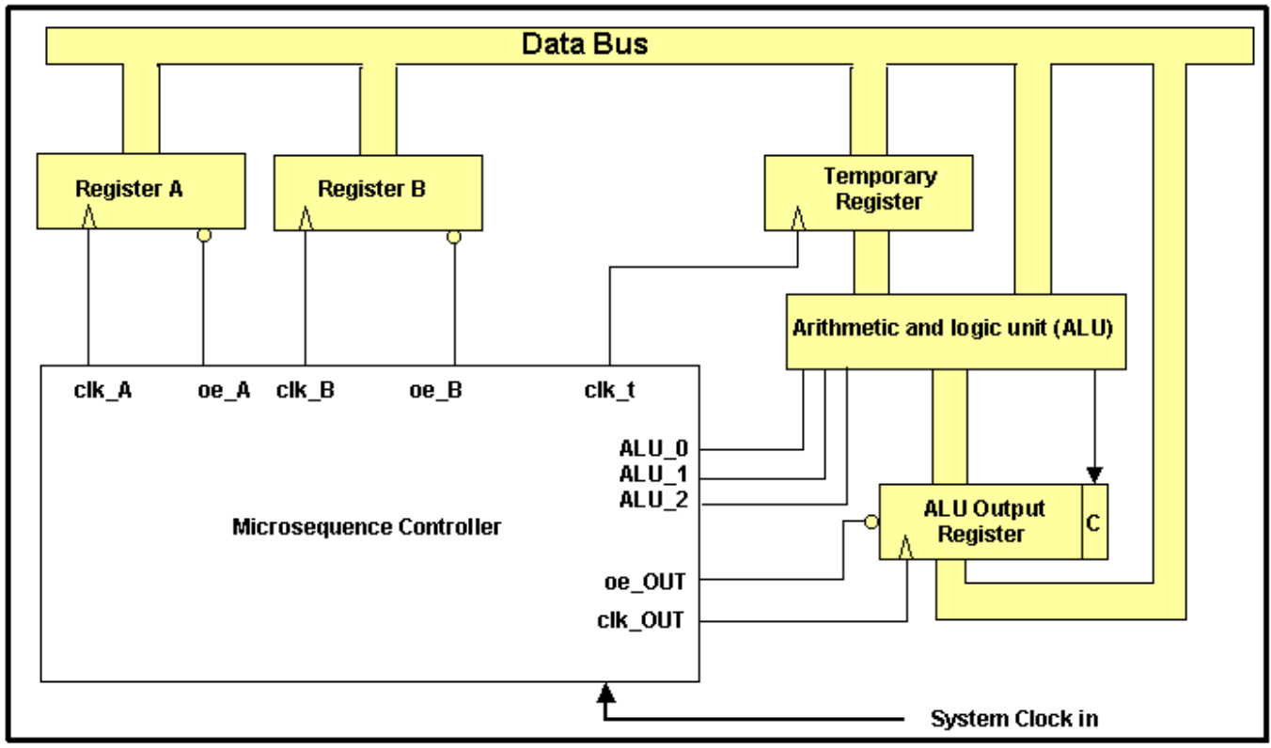
CPUs: Unification & Organization
TODO: Add 2 registers (A,B) to HW1 (pictured below) to approach this design (the 68K!)
How? If the ALUs was built with gates, build your registers with gates too, and add a clk
What’s left? Add a data bus and a status bus.

Slide 40
Q: How to ADD A & B?
Q/A: How did we do it in HW1?
Everything is all set to march in lockstep, but…
March where? In which direction? What should we do? FSMs?
This is much like me baking a cake, when the panic sets in:
What do I do? Which step is first? Why me?
Idea: Google a recipe or algorithm for baking the cake
And, just dump the “operations” into the ROM and be done
  this would be an “instruction memory”
Ada Asks: We need a better method than just poking values on wires to enable a function… “how can we control this in a repeatable, regular and simple way?”

Slide 41
First, in English: (a.k.a. motivation for shorthand)
F0F1
Clock Pulse | High-Level Actions in English
1 | There is a high to low transition of the Register A (!OE). This will put Register A’s data on the bus
2 | We save the bus data in a temporary ALU input register (!W goes low)
3 | We pulse a high to low transition for the output enable of Register B to our bus, also pulsing F0,F1 on the ALU so that it performs an add using the bus and the temp input register at the same timestep
4 | We save the output of the ALU back to a register C on the clock edge
Optimization; soon pipelining
Notes:
So it seems that some actions will take longer than one clock cycle!

Slide 42
Clock Pulse | High-Level Actions in Words English
1 | There is a high to low transition of the Register A (!OE). This will put Register A’s data on the bus
2 | We save the bus data in a temporary ALU input register
3 | We pulse a high to low transition for the output enable of Register B to our bus, also pulsing F0,F1 on the ALU so that it performs an add using the bus and the temp input register
4 | We save the output of the ALU back to a register C on the clock edge
Control Signals
Clock Pulse | Low-Level Actions in the Circuitry
1 | A0 <- 0, A1<-0, assert low: !OE_R0 <-0 (so all else is blocked from the bus with tri-state)
2 | !WE_ALU_TEMP <-0 (Register file and R0 still owns the bus)
3 | !OE_R0 <-1 (R0 loses the bus), !OE_R1 <-0 (R1 now is on the bus for ALU) A0 <- 0, A1<-1, assert low to pull R1 from the reg file to the bus F0<-0, F1<-0 (Async add operation for ALU)
4 | !OE_R1 <-1 (R1 frees the bus) !OE_ALU <-1 (ALU output gets the bus) A1<-1, A0<-0 assert low: !WE_R2 <-0 so R2 (row “three” in our RAM) pulls data off the bus
In Control Signals
Notes:
So it seems that some actions will take longer than one clock cycle!

Slide 43
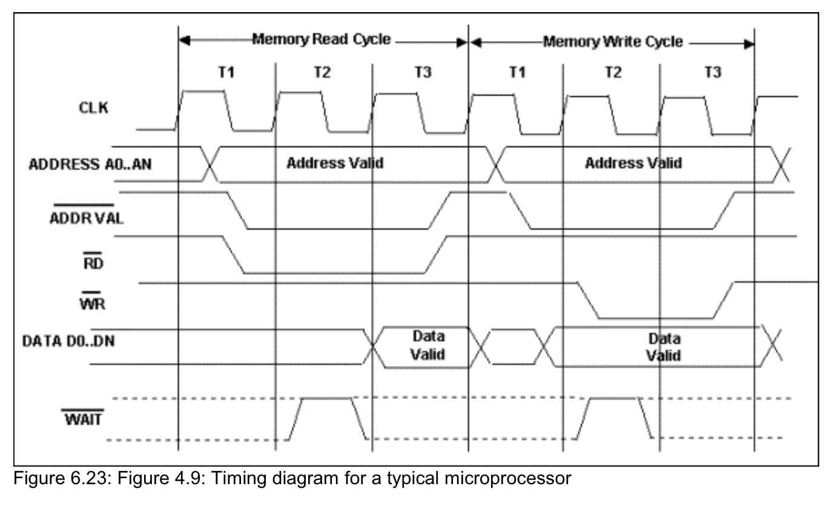
Actual Control Signal Timing Diagram
Only after we’ve stabilized the Addr bus do we assert low !ADDR_VAL
And note we need !ADDR_VAL for both reads and writes
Q: Describe the delay between the time we signal !ADDR_VAL and !RD or !WR
From the text: “We’ve omitted MANY additional signals that may be present (or absent!?) in various processors to restrict our discussion to the bare essentials.”
Introducing !ADDR_VAL & !WAIT to help with the Proc-to-Memory Interface

Slide 44
HW1 Extended
With 4 Storage Registers
R0: 00000001
R1: 00000101
00 //ADD
01 //AND
10 //OR
11 //NOT
Names for Registers?
  Foo1, r1, Ex, Dx,
R2: 00000000
R3: 00000110
Register File (4x8)
A0
ALU
A1
Q: What is this “Black Box” Register File?
Q: What are F0, F1?
Q: What are control wires?
D0-D7
F0 F1
A: A simple chain of D-ffs to store 8 bits
A: F0, F1 are control wires to choose the op
A: Part of the Status/Control bus
Notes:
To perform an ADD, put 00 on F0, F1 and to use R0 as the source for A, you’d pick R0 by asserting low on A0 and A1
To pick another register for B, we’d have to ask the register file for, say R1 by asserting a 0 and a 1 on A0 & A1 respectively
To store this in yet a third register, we have to access the register file again and pick a 3rd register

Slide 45
R/W Control Signals for Register File
General Read Control Signals:
  !CS_{wholeChip} is low, !OE_{somePage} is low, !WE_{somePage} is high
General Write Control Signals:
  !CS is low, !OE is high, !WE is low
    Never do we see both !OE and !WE low at the same time – why?
Read from the first page/row requires what else?
  General Read signals above and then what else?
    A0 <- 0, A1 <-0 and we assert low !OE_{pageOne} while !WE_{pageOne} is high.
Q: A write to the third page/row requires what?
A1 | A0_{lsb} | !OE | !WE | !CS
0 | 0 | 0 | 1 | 0
1 | 1 | 1 | 0 | 0

Slide 46
Now That You’ve Mastered Controlling Memory…
Unify & Organize: Add it to HW1
R0: 00000001
00 //ADD
01 //AND
10 //OR
11 //NOT
Names for Registers?
  Foo1, r1, Ex, Dx,
R1: 00000101
R2: 00000000
R3: 00000110
ALU
A0
Register File (4x8)
A1
Want to perform in hardware:
C = A + B; //R3 = R0 + R1
Q: What circuit does F0,F1 or A0,A1 realize?
Q: What would we do with F0,F1, A0,A1?
F0 F1
Notes:
What are the steps, in any order?

Slide 47
HW1 Extended
To perform an ADD:
put zeroes on F0, F1
To use R0 as the source for A, you’d pick R0 by asserting low on A0 and A1
To pick another register for B, we’d have to ask the register file for, say R1 by asserting a 0 and a 1 on A0 & A1 respectively
To store results in yet a third register, we have to access the register file again and pick a 3rd register
  Q: But in what order? (number these steps)
  Q: And, do we just manually change wire voltages!?
R0: 00000001
00 //ADD
01 //AND
10 //OR
11 //NOT
R1: 00000101
R2: 00000000
R3: 00000110
ALU
A0
Register File (4x8)
A1
F0 F1
Notes:
Note: usually LOAD and STORE refer to RAM, a much slower memory
How to know when to use the data on the Register File bus for A, and later for B? Implies order and synchronization.

Slide 48
Assert low on A0 and A1 to choose R0 (source), assert OE
  One clock cycle to load this into a temp ALU register
Assert a 0 and a 1 on A0 & A1 to select R1 (source), assert OE
  Another cycle to ready the data for direct ALU use
Put zeroes on F0, F1 to select the ADD function, deassert OE
  ADD costs one clock cycle
    After which the output is ready on bus
Assert high on A0, low on A1 to choose R2 (dest), assert WE
  Simple, right? Order of Ops and just control signals.
A: One high-level “action” on the previous slide was composed of many sub-steps that the hardware must orchestrate sequentially
(micro-operations, microcode)
A: Use macros to represent control wire voltages at different steps
  We’ll call this code: “asm”
R0: 00000001
00 //ADD
01 //AND
10 //OR
11 //NOT
R1: 00000101
R2: 00000110
R3: 00000110
ALU
A0
Register File (4x8)
A1
C = A + B;
(c++ op)
ADD A,B,C
(MIPS)
F0 F1
Load R0(A) to a temp reg
Load R1(B) to the ALU
Go low on F0,F1 (ADD)
Store ALU result in R2 (C)
Abbreviate these steps as “ADD “, rather than 00, 01, 00, 10…
Notes:
(Note: usually LOAD and STORE refer to RAM, a much slower memory)

Slide 49
Clock Pulse | High-Level Actions in Words English
1 | There is a high to low transition of the Register A (!OE). This will put Register A’s data on the bus
2 | We save the bus data in a temporary ALU input register
3 | We pulse a high to low transition for the output enable of Register B to our bus, also pulsing F0,F1 on the ALU so that it performs an add using the bus and the temp input register
4 | We save the output of the ALU back to a register C on the clock edge
Too Vague
Not Enough Details
Yet Lengthy English
We Welcome Assembly Language:
Shorthand macros or abbreviations for a series of steps
Brief
Explicitly defines a discrete operation
(Possibly in multiple sub-steps)
Control Signals
Clock Pulse | Low-Level Actions in the Circuitry
1 | A0 <- 0, A1<-0, assert low: !OE_R0 <-0 (so all else is blocked from the bus with tri-state)
2 | !WE_ALU_TEMP <-0 (Register file and R0 still owns the bus)
3 | !OE_R0 <-1 (R0 loses the bus), !OE_R1 <-0 (R1 now is on the bus for ALU) A0 <- 0, A1<-1, assert low to pull R1 from the reg file to the bus F0<-0, F1<-0 (Async add operation for ALU)
4 | !OE_R1 <-1 (R1 frees the bus) !OE_ALU <-1 (ALU output gets the bus) A1<-1, A0<-0 assert low: !WE_R2 <-0 so R2 (row “three” in our RAM) pulls data off the bus
Too Specific
Too Much Detail to Scale,
Unclear Abbreviations
Even Lengthier?
Clearly Architecture Specific!
In Control Signals
ADD A,B
AHA Moment: 1011 1100 --> ADD A,B
Someone woke up and wondered: “what if I DIDN’T have to poke at each wire every clock cycle, but I could instruct the machine to manage these control wires for me during an ADD?”
1011 1100
Notes:
So it seems that some actions will take longer than one clock cycle!

Slide 50
ADD A,B,C
00 //ADD
01 //AND
10 //OR
11 //NOT
R0: 00000001
R1: 00000101
R2: 00000000
R3: 00000110
F0 | F1 | Source #1 A1 | Source #1 A0 | Source #2 A1 | Source #2 A0 | Dest A1 | Dest A0
0 | 0 | 0 | 0 | 0 | 1 | 1 | 0
0 | 1 | 0 | 0 | 0 | 1 | 1 | 0
?
?
Q: What do the following lines of Machine Language do?
Q: Which one corresponds to the ASM instruction above?

Slide 51
ADD A,B,C
00 //ADD
01 //AND
10 //OR
11 //NOT
R0: 00000001
R1: 00000101
R2: 00000000
R3: 00000110
F0 | F1 | Source #1 A0 | Source #1 A1 | Source #2 A0 | Source #2 A1 | Dest A0 | Dest A1
0 | 0 | 0 | 0 | 0 | 1 | 1 | 0
0 | 1 | 0 | 0 | 0 | 1 | 1 | 0
Machine language of an ADD instruction encoded in binary: “x06”
Q: What does the second “line of code” do?

Slide 52
AND A,B,C
00 //ADD
01 //AND
10 //OR
11 //NOT
R0: 00000001
R1: 00000101
R2: 00000000
R3: 00000110
F0 | F1 | Source #1 A0 | Source #1 A1 | Source #2 A0 | Source #2 A1 | Dest A0 | Dest A1
0 | 0 | 0 | 0 | 0 | 1 | 1 | 0
0 | 1 | 0 | 0 | 0 | 1 | 1 | 0
Machine Language representation of AND A,B,C is “x46”

Slide 53
00 //ADD
01 //AND
10 //OR
11 //NOT
R0: 00000001
To HW1 (Adder), we added
Registers (memory)
Clock & Synchronization
Data, Addr, Control Busses
Data Bus
R1: 00000101
R2: 00000000
R3: 00000110
Control Bus
Address Bus
F0 | F1 | Source #1 A0 | Source #1 A1 | Source #2 A0 | Source #2 A1 | Dest A0 | Dest A1
0 | 0 | 0 | 0 | 0 | 1 | 1 | 0
0 | 1 | 0 | 0 | 0 | 1 | 1 | 0
“ADD A,B,C” is assembled/compiled to the corresponding control signals above.
Control signals (binary patterns, “0x46”) are directly accepted by the machine.
Our Assembly Language is directly accepted by a human.
The Alpha abstraction is our own (custom to our HW) programming language!
Q: Given the increase in complexity, how do we rise up above the binary controls?
These additions require complex control (via the Control Bus), and so for even greater flexibility and control, we finally add…macros? Abbreviations?

Slide 54
“ADD A, B, C”
Assembler (Compiler) for HW1
“HW4 Assembly”
Human Code (New)
Disassemble
Assemble
“HW1 Binary”
Machine Code (Old)
0 0
0 0
0 1
1 0
A0,A1 values fed to the register memory unit for destination operand C (Register 02)
F0,F1 values piped to the ALU, found on the Control Bus
A0,A1 values fed to the register memory unit for source operand A (Register 00) (Omitted: Control Wire ~W==1)
A0,A1 values fed to the register memory unit for source operand B (Register 01)
To Assemble == To Decode == To Compile == Machine Binary to Human Words
To Disassemble == To Reverse Assemble == To Reverse Compile == Final Project
Notes:
Who is responsible? You might think the Address bus, but for register selection, it could be the control bus too

Slide 55
Instruction Set Architecture Unifies HW & SW
SW Layers
HW4-6, Final Project all in Assembly
…
Decoding ASM Instructions into Machine Language
ISA: Alpha Coding Interface to Hardware
HW Layers
Busses
Control/Status
(Hetero)
Data
(Bi)
Address
(Uni)
Sequential Logic (Gate Combinations That Remember)
Flip-Flops
Adders, Muxes, Decoders, Parity Generators
Gates (AND, OR, NOT, NAND, XOR, …)

Slide 56
Decoding ASM on a Real Architecture: 68K & MOVE
Refer the 68K manual
Recall that the MOVE instruction format was shown as:
We can decompose this further to:
Opcode word: MOVE.B D3, D0
opcode
dst EA
src EA
15 12 11 6 5 0
0 0
SIZE
DESTINATION
REGISTER
DESTINATION
MODE
SOURCE
MODE
SOURCE
REGISTER
15 14 13 12 11 10 9 8 7 6 5 4 3 2 1 0
MSB
LSB
Dest = D0
Source = D3

Slide 57
Decomposing the MOVE instruction
Refer the 68K manual
Recall that the MOVE instruction format was shown as:
We can decompose this further to:
Opcode word: MOVE.B D3, D0
1003
opcode
dst EA
src EA
15 12 11 6 5 0
0 0
SIZE
DESTINATION
REGISTER
DESTINATION
MODE
SOURCE
MODE
SOURCE
REGISTER
15 14 13 12 11 10 9 8 7 6 5 4 3 2 1 0
MSB
LSB
Dest = D0
Source = D3
0 | 0 | 0 | 1 | 0 | 0 | 0 | 0 | 0 | 0 | 0 | 0 | 0 | 0 | 1 | 1

Slide 58
Too Vague
Not Enough Details
Yet Lengthy
Clock Pulse | High-Level Actions in English
1 | There is a high to low transition of the Register A (!OE). This will put Register A’s data on the bus
2 | We save the bus data in a temporary ALU input register
3 | We pulse a high to low transition for the output enable of Register B to our bus, also pulsing F0,F1 on the ALU so that it performs an add using the bus and the temp input register
4 | We save the output of the ALU back to a register C on the clock edge
We Welcome Assembly Language:
Shorthand macros or abbreviations for a series of steps
Brief
Explicitly defines a discrete operation
(Possibly in multiple sub-steps)
Clock Pulse | Low-Level Actions on the Circuit
1 | A0 <- 0, A1<-0, assert low: !OE_R0 <-0 so all else is blocked from the bus with tri-state
2 | !WE_ALU_TEMP <-0 (Register file and R0 still owns the bus)
3 | !OE_R0 <-1 (R0 loses the bus) A0 <- 0, A1<-1, assert low: !OE_R1 <-0 (R1 now is on the bus) F0<-0, F1<-0 (Async add operation for ALU)
4 | !OE_R1 <-1 (R1 frees the bus) !OE_ALU <-1 (ALU output gets the bus) A0<-1, A1<-0 assert low: !WE_R2 <-0 so R2 pulls from the bus
In Control Signals
ADD A,B
AHA Moment:
1011 1100
Too Specific
Too Much Detail to Scale
Even Lengthier?

Slide 59
Custom Memory Chips & Features
Is Byte-Selection the responsibility of the Address Bus
  Older
OR is Byte-Selection the responsibility of the Control Bus?
  Newer, “additional features”

