Slide 1
CSS 422 Hardware and Computer Organization
Sequential circuit
Ver. 1
Senior Lecturer: Rob Nash
The slides are re-produced by the courtesy of Dr. Arnie Berger and edited by Wooyoung Kim and Rob Nash

Slide 2
Before we start
Turn off your phone or at least sound off
Do not open your laptop, or turn on your computer unless you are asked to do
  Computers for class notes ONLY. Otherwise, I will consider you are distracting the class, and ask you to leave
  I tend to ask the students with the laptop open, just to see if you are following my lecture
No talk with your friends unless I ask to discuss
If I think you are distracting this class, I will ask you to leave the class
Warning: You will see this slide in EVERY class, because you keep forgetting to do so

Slide 3
Topic
Sequential Circuit
  Chapter 4, 5 by Berger
  Chapter 11 by Stallings
  Flip-Flop
  Excitation table and K-maps
  Design registers

Slide 4
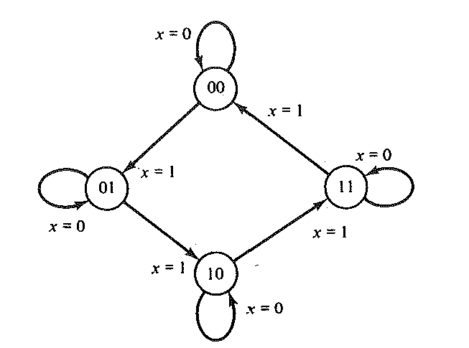
Ex) 2-binary counter
Want to design a 2-binary counter system with logic gates.
2-binary counter:
  Input: one control bit
  The 2 bits are stored in the system
  If input is 0 then the 2 bits are unchanged
  If input is 1 then the 2 bits are counted up and if it reaches the maximum, then it resets to 0
Can we make with combinational logic gates?
What is it that the combinational circuit does not have, to design this system?

Slide 5
Combinational vs. Sequential circuit
Combinational circuit
  The current output state depends only on the input states. It does not provide memory or state information, except ROM
Sequential circuits
  The current output depends on the current input, and on the past history of inputs
  The most common type of sequential circuit is the synchronous type
  Non-clocked Latch: asynchronous sequential circuit
  Edge-triggered flip-flop : synchronous sequential or clocked sequential circuit
  Interconnection of flip-flops and gates
Notes:
So far, we have seen combinational circuits

Slide 6
Asynchronous vs. synchronous
Asynchronous logic
  So far, we have seen asynchronous logic circuits.
  The change in the state depends on the input variables.
Synchronous logic
  With millions of logic gates, we need to synchronize the change of logic state with some master signal (clock).
  Suppose we need to move a data from a memory to register to do arithmetic addition. How the computer will know the sequence of the work?
  We need a system that works according to the order of tasks as time goes→ synchronous sequential circuit design

Slide 7
Clocks and time
The clock in a digital system is an electronic analog of the pendulum which synchronizes the circuits in a computer system
  The master control signal
  Changes occur on the rising or falling edges of a clock pulse
Frequencies are the inverse of time (speed)
  Hz = the number of cycles per second: how to compute the time per each cycle?
  1 kilohertz ( KHz ) = 10³ Hz ( cycle per second )
  1 megahertz (MHz ) = 10⁶ Hz
  1 gigahertz (GHz) = 10⁹ Hz
  1 terahertz (THz ) = 10¹² Hz
Today the maximum PC clock frequencies are around 3.7 GHz

Slide 8
Clocks and pulses
Clocks are continuous streams of pulses
Duty cycle = t_{PH} / (t_{PH} + t_{PL}) x 100%
  The clock signal shown above has a 50% duty cycle
  The clock signal shown below has a 25% duty cycle
  Period: The time to complete one clock cycle
    Period = t_{cycle}
  Frequency: The inverse of the period, f = 1/period
t_{PH}
t_{PL}
t_{cycle}

Slide 9
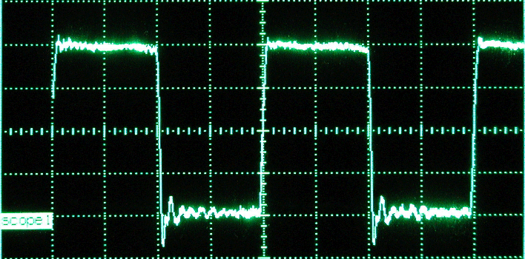
A real clock
Note that signal fidelity is not an issue. As long as the logic 1 is greater than 2.5 volts and logic 0 is less than 1 volt, the pulse will be properly interpreted
Logic 1
1V
Not Defined
Logic 0

Slide 10
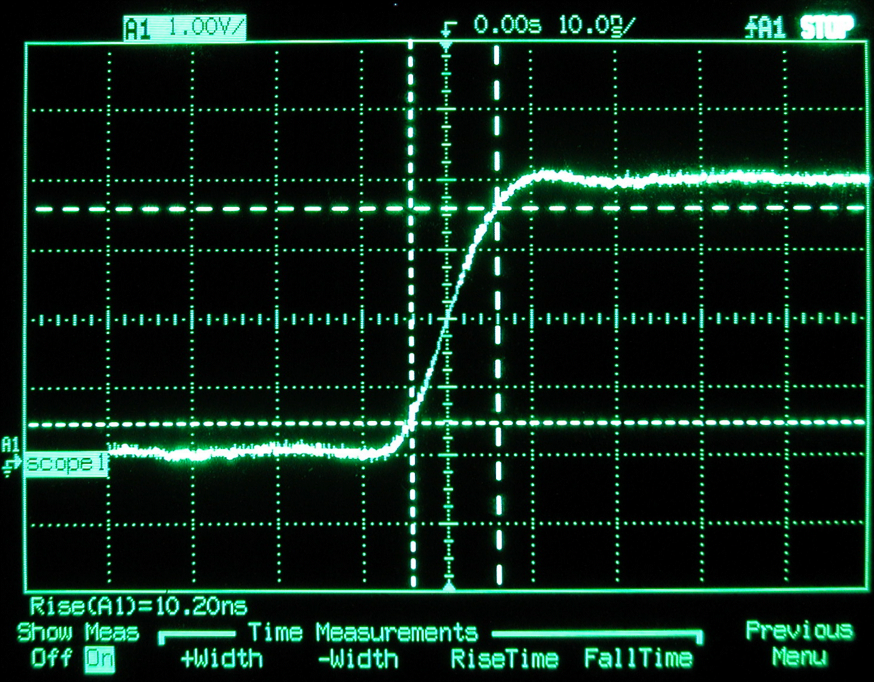
Pulse rise time measurement

Slide 11
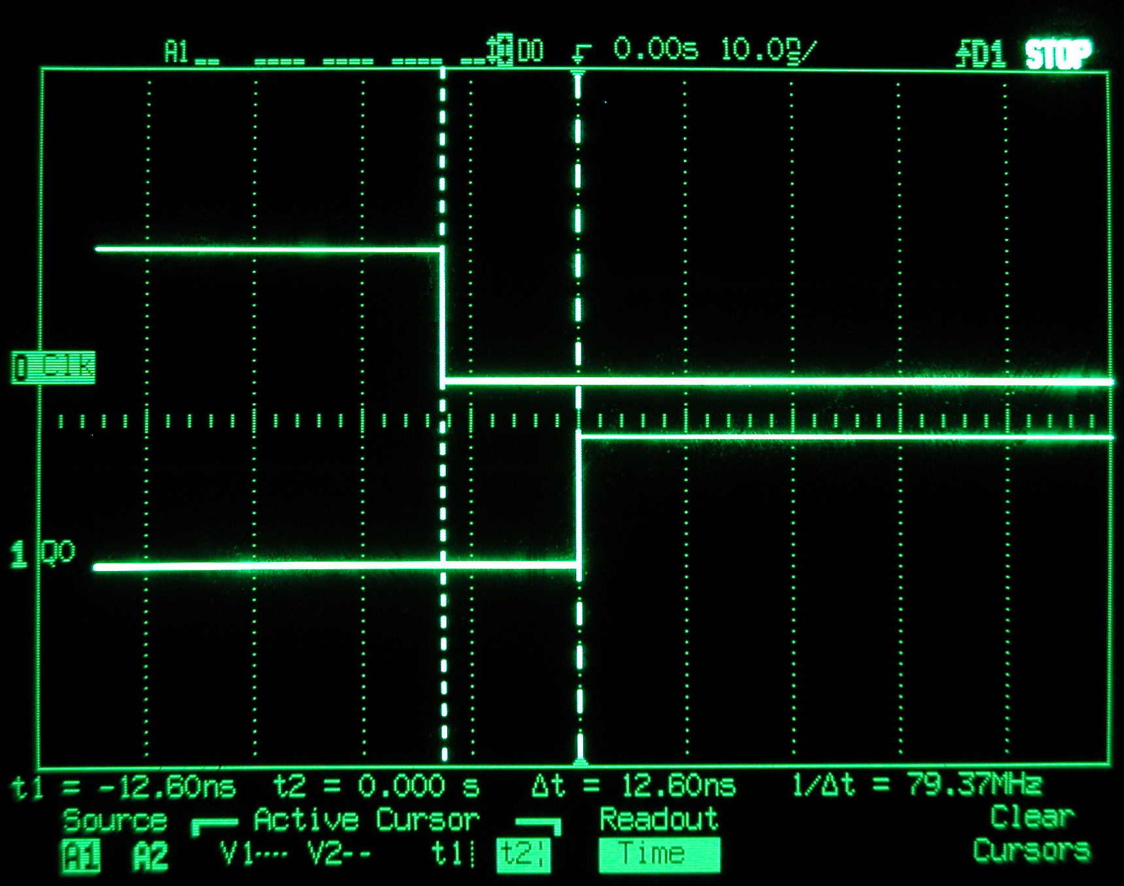
Propagation delay
Why can’t we simply rev-up the clock on your PC to 2 GHz, or higher?
  Answer: Gates require a finite amount of time to switch state when their inputs change
Consider the inverter gate, below:
The propagation delay (time delay from input change to output change),
Δt = 12.60ns

Slide 12
Basic units for sequential circuit
Like the logic gates are the building blocks of combinational circuit, flip-flops are the building blocks of sequential circuit.
Flip-flops are built with logical gates
Before we study flip-flops, let’s start with a latch
Latch: Use feedback functionality
  Feedback: Bringing the output back to an input
  Locks the gate pair into a new state
  Transition is triggered by the application of the input pulse

Slide 13
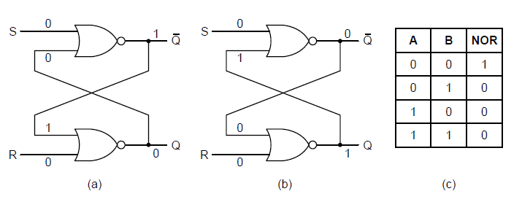
Latches
Need a circuit that remembers previous input values (states)
S-R Latch : has two stable states. (set/reset)
Regardless of previous states,
  When S is 1, Q becomes 1.
  When R is 1, Q becomes 0
  What if R=S=1, simultaneously? (race condition)
Notes:
Assume Q=0, ~Q=1
Change R to 1, NOR out to Q becomes 0
Change R and S to 1, NOR out to ~Q becomes 1 and NOR out to Q is also 1? Bad logic, both hi
Then when RS go low, whichever signal actually goes low last will set the final value in the gate (hi or low, which is bad)

Slide 14
Class exercise
Can you make a state table with the circuit diagram?
What is the characteristic table?
State table: truth table containing inputs and current state
  “Outputs” are the next state
Characteristic (state) table: Given the input lines and current state, determine next state (ie, next state is “output”)
  Excitation table: Start and end states are fixed; determine the signals required for the control lines to facilitate that transition (i.e. output is R,S signals)

Slide 15
SR Latch

Slide 16
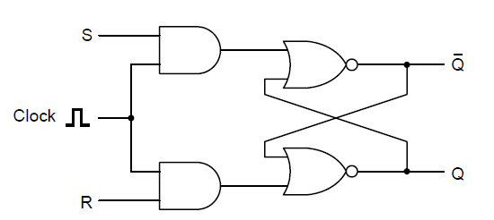
Clocked SR Latches
SR Latch is an asynchronous operation, yet
Preventing the latch from changing state except at certain specific time.
  Only when Clock is 1, the latch is sensitive to S or R.
  How to resolve the undefined race condition for S=R=1?

Slide 17
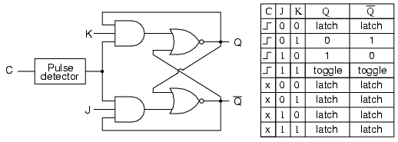
Clocked JK Latch
Avoid the SR latch’s instability by preventing the inputs being 1 at the same time.
In this case all possible combinations of input values are valid
Notes:
Another useful flip-flop is the J–K flip-flop. Like the S–R flip-flop, it has two inputs. However, in this case all possible combinations of input values are valid. Figure 11.26 shows a gate implementation of the J–K flip-flop.

Slide 18
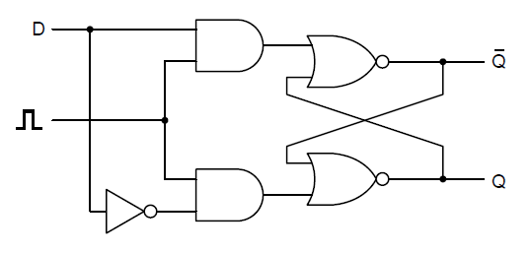
Clocked D Latches
Avoid the SR latch’s instability by giving R as the inverse of S.
Stored value is available at Q
To load the current value of D, just give a positive pulse on the clock line.
What if D changes while the clock stays in HIGH (active)?

Slide 19
Flip-Flops
Sometimes FF and latches are used as same in many books.
Flip-Flop: State transition occurs when the clock transition from 0 to 1 or from 1 to 0
Called a Flip-flop because the output Q is flip back and forth
Latch lacks a mechanism to shift control to the clock edge. The states change when the clock is active: called level-triggered
Take the JK clocked latch as an example. If J=K=1, and the clock is enabled, then it will flip continuously, and it is not we can control easily.
So, make the states change at the moment that the clock changes: called edge-triggered

Slide 20
Latches and flip-flops
Basic components for sequential circuit design
They are bi-stable devices. It is in one of two states.
Without inputs, they remain in that state.
They have two outputs which are always the complements of each other.
Latch is level triggered while FF is edge triggered.
How to design the functionality of edge-trigger?

Slide 21
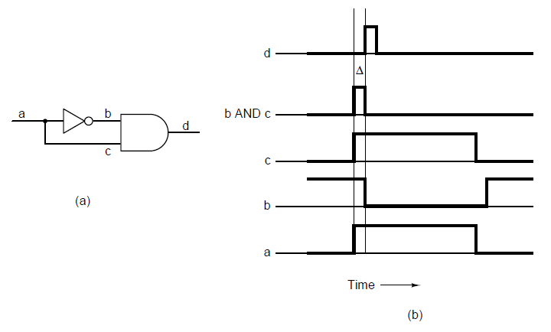
Flip-Flops – cont’d
Delay in the inverter makes the circuit work.

Slide 22
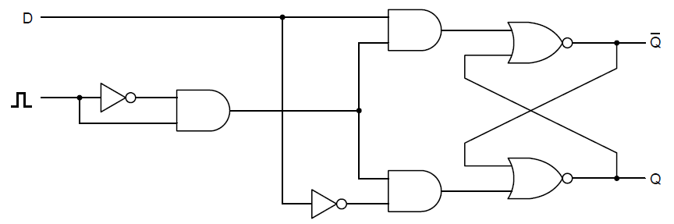
Flip-Flops – cont’d
Standard D flip-flop.

Slide 23
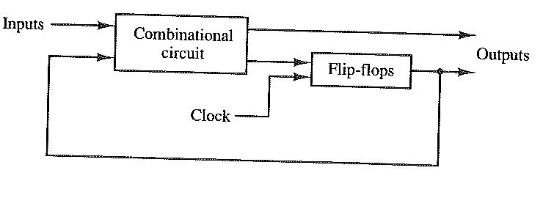
Sequential circuit design
A sequential circuit can be a combination of combinational circuit and flip-flops
Because the sequential circuit involves state transition, we have different types of tables for this circuit
State table: Based on the input and current state, give the next state information (like truth table)
Characterization table: Give the state transition information based on inputs
Excitation table: Inputs are current and next state, and outputs are signals (S, R, J, K)→ why do we need this table?
Block diagram of sequential circuit

Slide 24
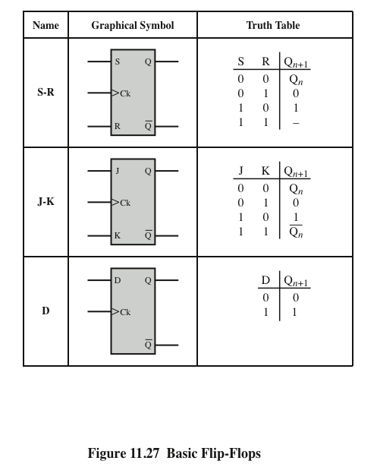
Characteristic table for FF
Characteristic Table
Basic Flip-Flops and the characteristic table

Slide 25
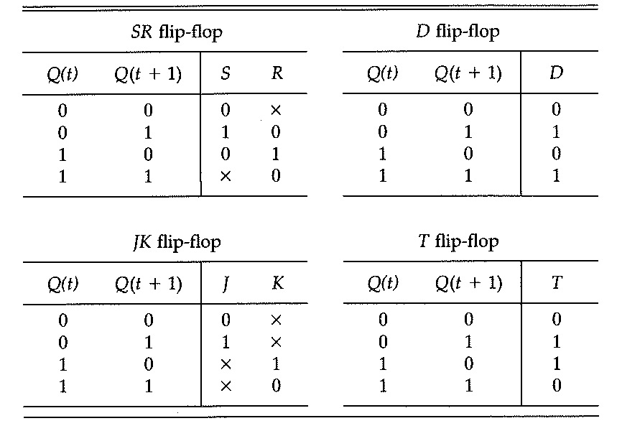
Excitation table for FF

Slide 26
Excitation table
Excitation table (inverted characteristic table)
  input : a current state and next state
  output : S R or J K or D
Why we need this table?
FF is a feedback system. The transition information goes back to the states for inputs (S,R, etc)
Block diagram of sequential circuit

Slide 27
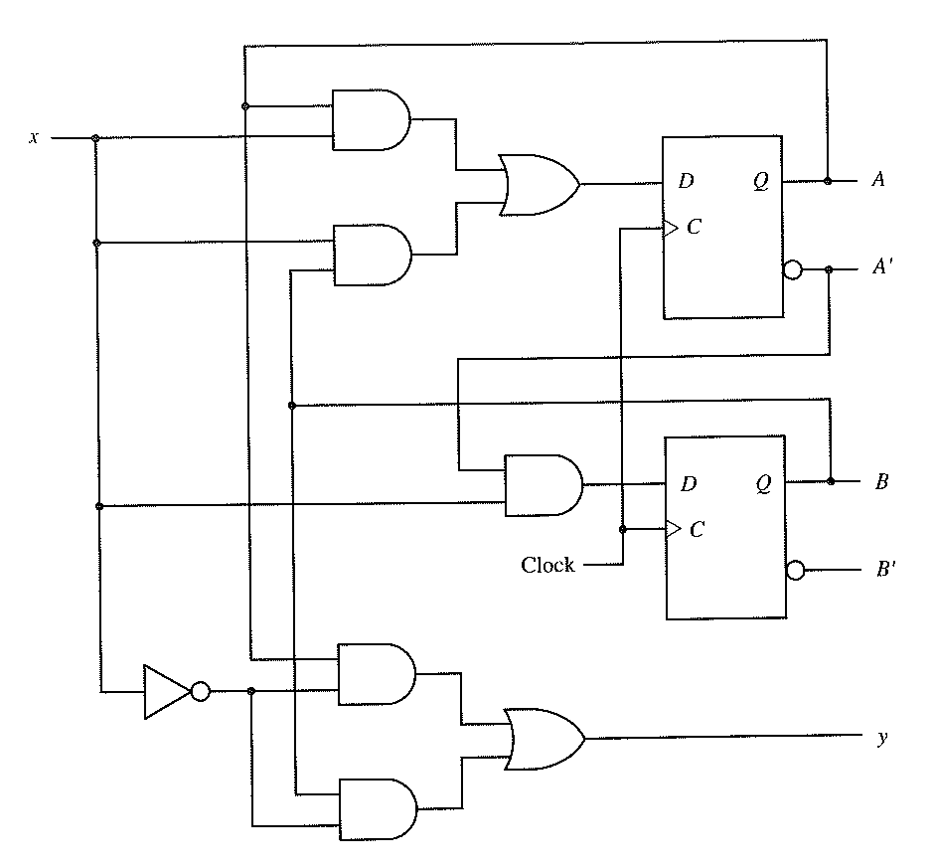
Example of sequential circuit
Notes:
If x is low, we OR A and B and output this as y
If x is high, we OR A and B and store this in DF(A) and store ~A in DF(B)

Slide 28
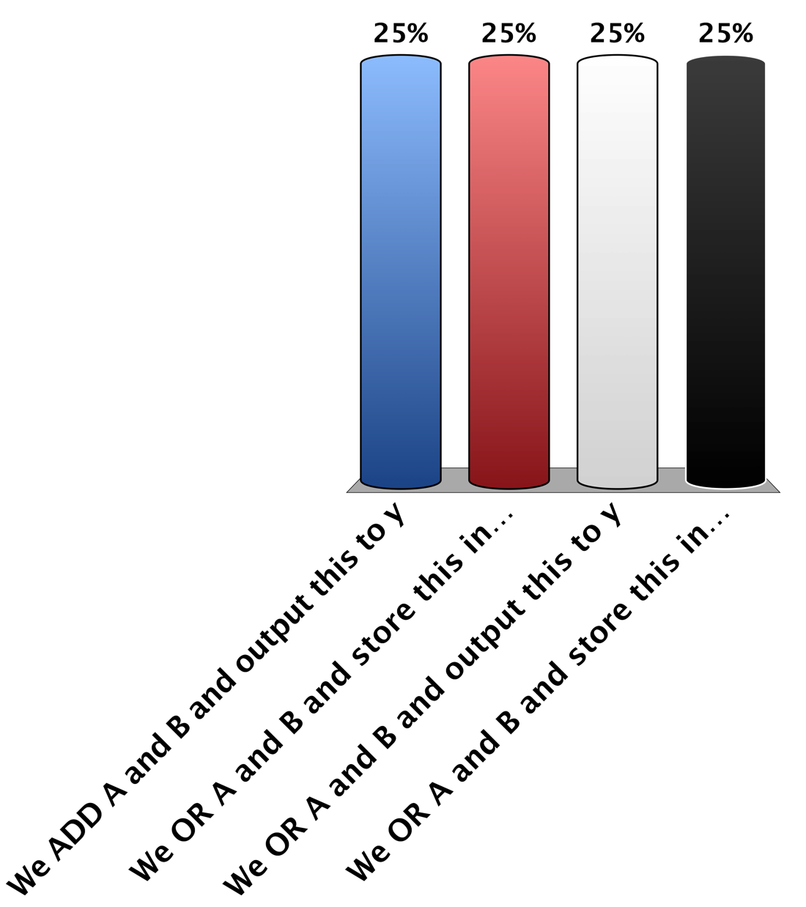
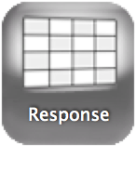
When x is Low What Happens?
We ADD A and B and output this to y
We OR A and B and store this in D-FF(A)
We OR A and B and output this to y
We OR A and B and store this in D-FF(B)

Slide 29

When x is High What Happens?
We OR A and B and store this in D-FF(B) and store ~A in D-FF(A)
We OR A and B and output this to y
We ADD A and B and store this in D-FF(A)
We OR A and B and store this in D-FF(A) and store ~A in D-FF(B)

Slide 30
State Table
From the sequential circuit, can we build a state table?
A(t) | B(t) | (input) X | (output) Y | A(t+1) | B(t+1)
0 | 0 | 0 | 0 | 0 | 0
0 | 0 | 1 | 0 | 0 | 1
0 | 1 | 0 | 1 | 0 | 0
0 | 1 | 1 | 0 | 1 | 1
1 | 0 | 0 | 1 | 0 | 0
1 | 0 | 1 | 0 | 1 | 0
1 | 1 | 0 | 1 | 0 | 0
1 | 1 | 1 | 0 | 1 | 0
When you get output?
In present? or in the next state?

Slide 31
State Machine/Diagram
From the state table, can we build a state machine?
  States will be AB pairs
  Edges will be transitions based on input and describe I/O pairs
A(t) | B(t) | (input) X | (output) Y | A(t+1) | B(t+1)
0 | 0 | 0 | 0 | 0 | 0
0 | 0 | 1 | 0 | 0 | 1
0 | 1 | 0 | 1 | 0 | 0
0 | 1 | 1 | 0 | 1 | 1
1 | 0 | 0 | 1 | 0 | 0
1 | 0 | 1 | 0 | 1 | 0
1 | 1 | 0 | 1 | 0 | 0
1 | 1 | 1 | 0 | 1 | 0

Slide 32
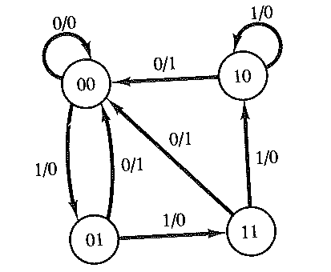
State Machine/Diagram
From the state table, can we build a state machine?
  States will be AB pairs
  Edges will be transitions based on input and describe I/O pairs
A(t) | B(t) | (input) X | (output) Y | A(t+1) | B(t+1)
0 | 0 | 0 | 0 | 0 | 0
0 | 0 | 1 | 0 | 0 | 1
0 | 1 | 0 | 1 | 0 | 0
0 | 1 | 1 | 0 | 1 | 1
1 | 0 | 0 | 1 | 0 | 0
1 | 0 | 1 | 0 | 1 | 0
1 | 1 | 0 | 1 | 0 | 0
1 | 1 | 1 | 0 | 1 | 0

Slide 33
Design a sequential circuit
Design a sequential circuit
Draw a state diagram (state machine)
Figure out the input and outputs
Build a state table and derive an excitation table
Boolean function equation using K-map
A sequential circuit
Let’s design a 2-bit binary counter.
A sequence of repeated binary states 00, 01, 10, 11 whenever the input is 1.

Slide 34
Let’s design a 2-bit binary counter.
A sequence of repeated binary states 00, 01, 10, 11 whenever the input is 1.
Notice how the output is embedded in the current state
  A Moore Machine
We could encode output on edge transitions, too
  A Mealy Machine
00
01
11
10

Slide 35
2- bit binary counter - state diagram

Slide 36
2- bit binary counter – input/output
Present state (t) |  | Input | Next state (t+1)
A | B | x | A | B
0 | 0 | 0 | ? | ?
0 | 0 | 1 | ? | ?
0 | 1 | 0
0 | 1 | 1
1 | 0 | 0
1 | 0 | 1
1 | 1 | 0
1 | 1 | 1
Input (control signal): x
# of FF: 2 (2 bits)
Suppose we are using JK FFs.
Then we need two J’s and two K’s
In the state machine, you can build a state table
The next states connected to JK’s
So, we need extended table→ excitation table

Slide 37
2- bit binary counter – input/output
Present state (t) |  | Input | Next state (t+1)
A | B | x | A | B
0 | 0 | 0 | 0 | 0
0 | 0 | 1 | 0 | 1
0 | 1 | 0 | 0 | 1
0 | 1 | 1 | 1 | 0
1 | 0 | 0 | 1 | 0
1 | 0 | 1 | 1 | 1
1 | 1 | 0 | 1 | 1
1 | 1 | 1 | 0 | 0
Input (control signal): x
# of FF: 2 (2 bits)
Suppose we are using JK FFs.
Then we need two J’s and two K’s
In the state machine, you can build a state table
The next states connected to JK’s
So, we need extended table→ excitation table

Slide 38
2- bit binary counter – excitation table
Given our present state, input, and all possible next states, what wires do I need to assert to accomplish this?
  Note our FSM/ASM defines the set of next states for a given state
Q(t) | Q(t+1) | J | K
0 | 0 | 0 | x
0 | 1 | 1 | x
1 | 0 | x | 1
1 | 1 | x | 0
Present state (t) |  | Input | Next state (t+1) |  | Flip-flop inputs
A | B | x | A | B | J_{A} | K_{A} | J_{B} | K_{B}
0 | 0 | 0 | 0 | 0
0 | 0 | 1 | 0 | 1
0 | 1 | 0 | 0 | 1
0 | 1 | 1 | 1 | 0
1 | 0 | 0 | 1 | 0
1 | 0 | 1 | 1 | 1
1 | 1 | 0 | 1 | 1
1 | 1 | 1 | 0 | 0

Slide 39
2- bit binary counter – excitation table
Q(t) | Q(t+1) | J | K
0 | 0 | 0 | x
0 | 1 | 1 | x
1 | 0 | x | 1
1 | 1 | x | 0
Present state (t) |  | Input | Next state (t+1) |  | Flip-flop inputs
A | B | x | A | B | J_{A} | K_{A} | J_{B} | K_{B}
0 | 0 | 0 | 0 | 0 | 0 | x | 0 | x
0 | 0 | 1 | 0 | 1 | 0 | x | 1 | x
0 | 1 | 0 | 0 | 1 | 0 | x | x | 0
0 | 1 | 1 | 1 | 0 | 1 | x | x | 1
1 | 0 | 0 | 1 | 0 | x | 0 | 0 | x
1 | 0 | 1 | 1 | 1 | x | 0 | 1 | x
1 | 1 | 0 | 1 | 1 | x | 0 | x | 0
1 | 1 | 1 | 0 | 0 | x | 1 | x | 1
You cannot control the next state: So, not an input nor an output

Slide 40
J_{a}=Bx
Present state (t) |  | Input | Next state (t+1) |  | Flip-flop inputs
A | B | x | A | B | J_{A} | K_{A} | J_{B} | K_{B}
0 | 0 | 0 | 0 | 0 | 0 | x | 0 | x
0 | 0 | 1 | 0 | 1 | 0 | x | 1 | x
0 | 1 | 0 | 0 | 1 | 0 | x | x | 0
0 | 1 | 1 | 1 | 0 | 1 | x | x | 1
1 | 0 | 0 | 1 | 0 | x | 0 | 0 | x
1 | 0 | 1 | 1 | 1 | x | 0 | 1 | x
1 | 1 | 0 | 1 | 1 | x | 0 | x | 0
1 | 1 | 1 | 0 | 0 | x | 1 | x | 1
J_{a} | ~A~B | ~AB | AB | A~B
~x |  |  | x | x
x |  | 1 | x | x
J_{b} | ~A~B | ~AB | AB | A~B
~x
x
K_{a}=Bx
K_{a} | ~A~B | ~AB | AB | A~B
~x | x | x
x | x | x | 1
K_{b} | ~A~B | ~AB | AB | A~B
~x
x

Slide 41
J_{a}=x
Present state (t) |  | Input | Next state (t+1) |  | Flip-flop inputs
A | B | x | A | B | J_{A} | K_{A} | J_{B} | K_{B}
0 | 0 | 0 | 0 | 0 | 0 | x | 0 | x
0 | 0 | 1 | 0 | 1 | 0 | x | 1 | x
0 | 1 | 0 | 0 | 1 | 0 | x | x | 0
0 | 1 | 1 | 1 | 0 | 1 | x | x | 1
1 | 0 | 0 | 1 | 0 | x | 0 | 0 | x
1 | 0 | 1 | 1 | 1 | x | 0 | 1 | x
1 | 1 | 0 | 1 | 1 | x | 0 | x | 0
1 | 1 | 1 | 0 | 0 | x | 1 | x | 1
J_{b} | ~A~B | ~AB | AB | A~B
~x |  | x | x
x | 1 | x | x | 1
K_{a}=x
K_{b} | ~A~B | ~AB | AB | A~B
~x | x |  |  | x
x | x | 1 | 1 | x

Slide 42
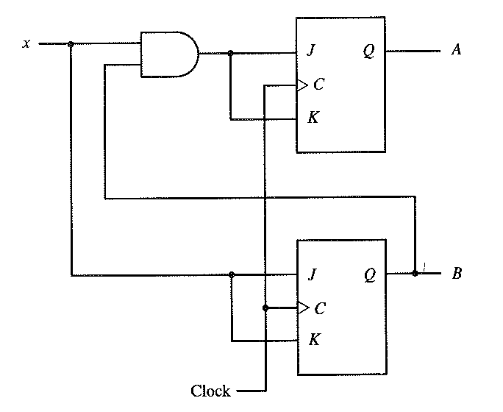
2- bit binary counter-sequential circuit

Slide 43
Examples of sequential circuit

Slide 44
The “D” FF as a counting element
A 16-bit binary ripple counter
  Given the name because the pulses “ripple” through the circuit
Q₀
Q₁
Q₂
Q₃
1
D
S
D
S
D
S
D
S
Q
Q
Q
Q
Clock in
CLK
Q
CLK
Q
CLK
Q
CLK
Q
R
R
R
R
RESET
Each “D” FF divides the incoming clock frequency by 2X
RESET sets all Q output to 0 without a clock signal (asynchronous)
Counts as fast as the first stage can toggle, but cannot be read until the count has rippled through to the last stage
Can build counter/dividers of any length, any binary divisor
  Clock frequency at output Q₃ equals f_{Clock in} ÷ 16

Slide 45
“D” FF as a shift register
Q₀
Q₁
Q₂
Q₃
1
Shift data in
S
S
S
S
Shift data out
D
Q
D
Q
D
Q
D
Q
CLK
Q
CLK
Q
CLK
Q
CLK
Q
R
R
R
R
RESET
Clock in
Shift register moves data through successive stages on each clock pulse
Used for serial data communications, multiplication ( why ?), image processing
Basis for UART ( Universal Asynchronous Receiver/Transmitter )
Data can be read in serially and then read out in parallel
Serial data communications limits the number of signal wires needed to transmit bytewide
data ( Example shown here is a nibble )

Slide 46
“D” flip-flop as a storage register
D0 D1 D2 D3 D4 D5 D6 D7
D0 D1 D2 D3 D4 D5 D6 D7
D0
D
Q
Q0
D1
D
Q
Q1
D2
D
Q
Q2
D3
D
Q
Q3
D4
D
Q
Q4
D5
D
Q
Q5
D6
D
Q
Q6
D7
D
Q
Q7
INPUT DATA
Clock in
OUTPUT DATA

Slide 47
An 8-bit storage register
D0 D1 D2 D3 D4 D5 D6 D7
D0 D1 D2 D3 D4 D5 D6 D7
D0
Q0
D1
Q1
D2
Q2
D3
8-bit
Storage
Register
Q3
D4
Q4
D5
Q5
D6
Q6
D7
Q7
Clock in
INPUT DATA
OUTPUT DATA

Slide 48
The storage register with busses
D0..D7
8
D0
D1
D2
D3
D4
D5
D6
D7
Q0
Q1
Q2
Q3
Q4
Q5
Q6
Q7
BUS: A grouping of “like” signals
Here we have Data In bus ( D0..D7)
and Data out bus ( Q0..Q7)
Busses are usually drawn with heavier
lines to differentiate them from
individual signal wires
Clock in
8-bit
storage
register
8
Q0..Q7

Slide 49
More on storage registers
The storage register provides a stable location to store data moving along busses
  Data on busses are transitory
  Storage register width typically matches the width of the data path
    May be 4, 8, 16, 32, 64 or 128 bits wide
  Registers interface data between a computer and the outside world
  Registers are the key data holders in computers and microprocessors
    A computer’s architecture is often defined by organization of the storage registers
Two variety of storage registers: “D” type and Latch
  Latch is level sensitive, output follows input when control is 0, output is latched ( locked ) when control is 1 ( or vice versa )

Slide 50
First in-first out ( FIFO ) data storage
Input bus
DATA FLOW
Output Bus
D0
D0
16-bit
Latch
Stage
1
16-bit
Latch
Stage
2
16-bit
Latch
Stage
3
16-bit
Latch
Stage
N-1
16-bit
Latch
Stage
N
D15
D15
Latch controls
Control logic
Clock in
Clock out
FIFO FULL
FIFO EMPTY

Slide 51
Summary
Gate is a fundamental building block of all digital systems
Flip-flop is a basic unit for sequential circuit, which are built using gates and a clock
Design a sequential circuit system
  Draw a state diagram
  Draw a state table
  Build K-maps to derive Boolean equations
  Draw a circuit diagram based on the equations

Slide 52
Next lecture
Bus organization and memory design
  Chapter 6 by Berger
  Chapter 3.4 by Stallings

