Slide 1
K-Maps For Boolean Algebra
“Car–now maps” are shortcuts for Boolean reductions
  But, did Maurice steal from Marquand?
Senior Lecturer: Rob Nash
Optimal reduction in 4 or less input variables
  For 5 or more, you need a map of maps
“Using identities can be difficult because no rules are given on how or when to use [them], and there is no well-defined set of steps to follow” //Null
“I have neither the time nor inclination to complete truth tables with more than 4+ inputs”

Slide 2
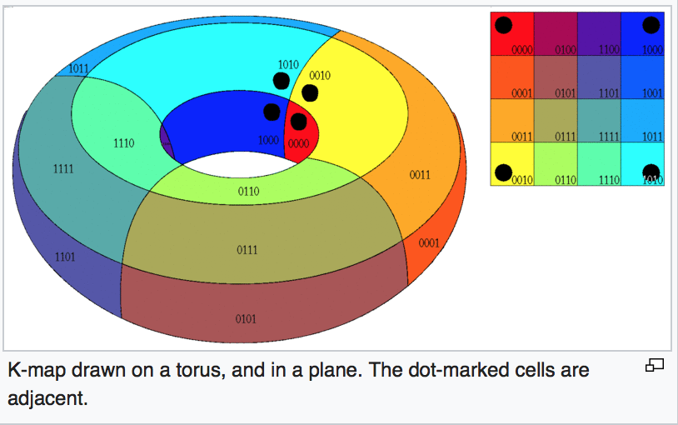
Karnaugh Maps
Reduce Boolean Functions Visually
K-Map for 3 input variables
K-Map for 4 input variables
AB AB AB AB
AB AB AB AB
CD
CD
CD
CD
C
C
K-Map for 5 input variables
ABC ABC ABC ABC ABC ABC ABC ABC
#of Minterm Cells = 2^{num_vars}
DE
DE
DE
DE
Notes:
1: Colored lines are adjacent (torus)
2: The corner cells are adjacent
3: Only one variable changes as you go from cell to cell in both x and y, including the opposite ends {~A~B,~AB,…}
4: No diagonals (they aren’t adjacent)
Image Source: https://en.wikipedia.org/wiki/Karnaugh_map

Slide 3
A Simple Example KMap
X | Y | F_{out}
0 | 0 | 0
0 | 1 | 1
1 | 0 | 1
1 | 1 | 1
From TT to BE
From BE to KMap
From TT to KMap
F(x,y) = x + y
= x(y+!y) + y(x+!x) = xy + xy + x!y + !xy
//built from BEs or the output rows with 1’s
KMap | !X | X
!Y | 0 | 1
Y | 1 | 1
Draw Loops (powers of 2) around the 1s, greedy. (Trumpish)
Do this until no 1 is left behind (out of the loop)
Q: Which is easier? Boolean Identities or pictures?

Slide 4
Forms of Logic Standardization:
S.O.P. and P.O.S.
We seek a canonical form (GUID) to uniquely express our logic equations
  So we can find an all-encompassing hardware framework that can uniquely express any logic equation
  Since all logic reduces to AND, OR, and NOT…
    A set of AND gates
    A second set of OR gates
  To do this, we need a normalized or regular form
Sum of products is a standard form (S.O.P. V.S. P.O.S.)
  Same with product of sums, and like negative/positive logic we’ll pick one
This is a canonical, unique signature of any set of AND, OR operations…
  Establishes a two-Level hardware array that can represent any logic function.

Slide 5
Representing Boolean Functions in
Standardized (Sum-of-Products )Form
Why establish a standardized form?
  Useful for implementing a relationship between a general form of logic and a general hardware array format
S.O.P.: Useful for offering a unique, standardized, configurable (programmable) logic as a 2D array of (AND, OR) operations
  Inner operations are ANDS
    So an array of ANDS, with one for each product term
  Outer operations are ORs
    And a second array of ORs, fed by the ANDs, one for each sum
All negations (or inversions) are on individual lines/variables
E(A,B,C) = ( A * B * !C ) + ( !A * B * C ) //a Boolean Function

Slide 6
Two-Level Logic & Minterms
Each product (or minterm) consists of only ANDs
Each outer operation on two minterms consists of ORs
We can build the hardware analog explicitly as a collection of ANDS then fed into ORs
  As the minterms are evaluated first and then fed to the output ORs
Or, we can build a general array of ORs (enough for all of our maxterms)
  And feed this to a general array of ANDS for the output
    Both can be realized “in the field” as a PLA with two levels
      Flexibility and RAP(RAD) at the cost of speed

Slide 7
Sum of Products & Truth Tables
A | B | X_{out}
0 | 0 | 0
0 | 1 | 1
1 | 0 | 1
1 | 1 | 0
We can build any SOP formula given a truth table
  Same for a Boolean Equation (BE), & vice versa
Each entry for which the function’s output is true(1) produces a (min)term.
  The final function is the sum (OR) of each of the terms
Said another way, only those entries for which the function is true generate terms in our equation
  Q: So, what is the S.O.P. form for X_{out}(a,b)?
We can easily generate a gate-level implementation to realize any set of logic functions in this form.

Slide 8
Karnaugh Maps (are K-Maps)
A method for simplifying redundant hardware required to implement a truth table.
For any give table, we set up a K-Map for each output
  Dependent on the inputs.
Goal: Try to make “loops”
  A loop will remove terms (thus gates)
Rule #1: Loops must be (greedy) powers of 2, so 2, 4, 8, 16, etc.
Rule #2: Number of cells == # of possible combinations of inputs (2^{n})
Rule #3: Toggle only one variable per row or column transition.
  The x and y axes are labeled such that only one variable changes from complemented to un-complemented as you go across or down.

Slide 9
K-Map Example
We’ll start with systems with 2,3, and 4 input variables
  3D K-Maps for 5 or more variables are for simulators
F(x,y) | !X | X
!Y | 1 | 1
Y | 0 | 0
Not an Arbitrary Axis Setup
F(x,y,z) | !X!Y | !XY | XY | X!Y
!Z | 0 | 0 | 0 | 0
Z | 0 | 1 | 1 | 0
ProTip: Follow my convention here or risk losing points via tired TAs

Slide 10
K-Map Intro
Start with some problem definition and produce a…
  Truth Table == Boolean Equation == Circuit == KMap
  F(x,y,z) = !x!yz + !xyz + x!yz + xyz
    Q: Anyone care to take a whack at this using laws?
    Q: Who wants to build an 8 row TT? 16 row?
A: Build a K-Map for every output variable (just F here)
  With a 1 for every minterm where F outputs a 1
    Pull this data from the TT? or use the equivalent B.E. above?
(Needs Simplification)
Not an Arbitrary Axis Setup
Output F | !X!Y | !XY | XY | X!Y
!Z | ? | ? | 0 | ?
Z | ? | ? | 1 | ?
Output F | !X!Y | !XY | XY | X!Y
!Z | 0 | 0 | 0 | 0
Z | 1 | 1 | 1 | 1
Notes:
This is out of Null’s 3A section – great practice problems

Slide 11
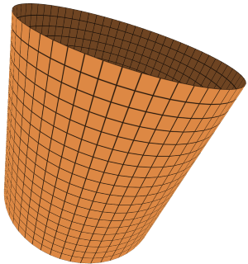
K-Map First Try
  F(x,y,z) = !x!yz + !xyz + x!yz + xyz
  Step 1: Make loops, observing the following rules
    Up/Down and Left/Right wraparounds are legal
      Imagine this table as a wrapped cylinder
        Diagonals are illegal, inline or wrapped
    Loops must be powers of 2 (greedy)
      Largest contiguous loops trump lesser loops
  Step 2: Remove/Reduce variables across columns
    ABC + !ABC =(A+!A)BC = BC //distributive then inverse laws
(Needs Simplification)
  Q: What’s wrong with the loops below?
K-Map for one output variable (F) given 3 input variables x,y,z
Output F | !X!Y | !XY | XY | X!Y
!Z | 0 | 0 | 0 | 0
Z | 1 | 1 | 1 | 1
F(x,y,z) = z //Q: How many Bothans were saved?
Notes:
This is out of Null’s 3A section – great practice problems

Slide 12
Karnaugh Maps (are K-Maps)
A method for simplifying redundant expressions and thus hardware
For any give table, we set up a K-Map for each output
  Dependent on the inputs.
Goal: Try to make “loops”
  A loop will remove terms (thus gates)
Rule #1: loops must be powers of 2, so 2, 4, 8, 16, etc.
Rule #2: Number of cells == # of possible combinations of inputs (2^{n})
Rule #3: Remove redundant loops.
  A loop is redundant if it is completely contained in another loop
    Meaning: Loops must have at least one non-overlapping minterm
Bootstraps: when building the K-Map, toggle only one variable
  per row or column transition.
  The x and y axes are labeled such that only one variable changes from complemented to un-complemented as you go across or down.

Slide 13
Q: What’s the problem with this K-Map reduction?
  Write out the F(x,y,z) to see it hasn’t reduced to z
#1
Output F | !X!Y | !XY | XY | X!Y
!Z | 0 | 0 | 0 | 0
Z | 1 | 1 | 1 | 1
Q: What’s the problem with this K-Map reduction?
  Q: Aren’t wraparounds legal?
  Write out the F(x,y,z) to see it hasn’t reduced to z
#2
Output F | !X!Y | !XY | XY | X!Y
!Z | 0 | 0 | 0 | 0
Z | 1 | 1 | 1 | 1
Q: What’s the problem with this K-Map reduction?
  Write out the F(x,y,z), but how?
#3
Output F | !X!Y | !XY | XY | X!Y
!Z | 1 | 0 | 0 | 1
Z | 0 | 1 | 1 | 1
Notes:
#1 & #2) Not the biggest groupings, wraparound is legal
#3a) No diagonals
#3b) Must be powers of 2

Slide 14
A_{in} | B_{in} | C_{in} | X_{out}
0 | 0 | 0 | 1
0 | 0 | 1 | 0
0 | 1 | 0 | 0
0 | 1 | 1 | 0
1 | 0 | 0 | 1
1 | 0 | 1 | 0
1 | 1 | 0 | 1
1 | 1 | 1 | 1
K Maps
An Arbitrary Circuit encoded as a TT? No problem. Now you try!
  Pen-and-paper mode engaged.
Q: What is the (unreduced) Boolean Formula using the TT: ?
  (Hint: S.O.P., so “add” (+) minterms (look for 1s in the output))

Slide 15
A_{in} | B_{in} | C_{in} | X_{out}
0 | 0 | 0 | 1
0 | 0 | 1 | 0
0 | 1 | 0 | 0
0 | 1 | 1 | 0
1 | 0 | 0 | 1
1 | 0 | 1 | 0
1 | 1 | 0 | 1
1 | 1 | 1 | 1
K Maps
Unreduced Boolean Formula: ~A~B~C + A~B~C+AB~C+ABC
Q: Build an empty K-Map
  Use ~A~B to start the row and ~C to start the col
  Below will get you started, but it’s the wrong dimensions!
X_{out} | ~A~B | ? | ? | ?
~C
?

Slide 16
A_{in} | B_{in} | C_{in} | X_{out}
0 | 0 | 0 | 1
0 | 0 | 1 | 0
0 | 1 | 0 | 0
0 | 1 | 1 | 0
1 | 0 | 0 | 1
1 | 0 | 1 | 0
1 | 1 | 0 | 1
1 | 1 | 1 | 1
K Maps
Unreduced Boolean Formula: ~A~B~C + A~B~C+AB~C+ABC
Q: How many AND, OR, and NOT gates are required here?
Q: Fill out the K map below
X_{out} | ~A~B | ~AB | AB | A~B
~C | ?
C | ?

Slide 17
A_{in} | B_{in} | C_{in} | X_{out}
0 | 0 | 0 | 1
0 | 0 | 1 | 0
0 | 1 | 0 | 0
0 | 1 | 1 | 0
1 | 0 | 0 | 1
1 | 0 | 1 | 0
1 | 1 | 0 | 1
1 | 1 | 1 | 1
K Maps
Unreduced Boolean Formula: ~A~B~C + A~B~C+AB~C+ABC
# of unreduced gates: 8 ANDS + 3 ANDS+ 3 NOTS = 14 gates
Q: How many loops below? Draw them.
X_{out} | ~A~B | ~AB | AB | A~B
~C | 1 |  | 1 | 1
C |  |  | 1

Slide 18
A_{in} | B_{in} | C_{in} | X_{out}
0 | 0 | 0 | 1
0 | 0 | 1 | 0
0 | 1 | 0 | 0
0 | 1 | 1 | 0
1 | 0 | 0 | 1
1 | 0 | 1 | 0
1 | 1 | 0 | 1
1 | 1 | 1 | 1
K Maps
Unreduced Boolean Formula: ~A~B~C + A~B~C+AB~C+ABC
Q: Have we constructed all loops that we could below?
X_{out} | ~A~B | ~AB | AB | A~B
~C | 1 |  | 1 | 1
C |  |  | 1

Slide 19
A_{in} | B_{in} | C_{in} | X_{out}
0 | 0 | 0 | 1
0 | 0 | 1 | 0
0 | 1 | 0 | 0
0 | 1 | 1 | 0
1 | 0 | 0 | 1
1 | 0 | 1 | 0
1 | 1 | 0 | 1
1 | 1 | 1 | 1
K Maps
Unreduced Boolean Formula: ~A~B~C + A~B~C+AB~C+ABC
A: No. See the green loop.
  Also Legal: Notice how one cell is used in multiple loops
Q: Is the loop that wraps around (purple) equivalent to the non-wrapped version?
Q: Are the loops below correct?
X_{out} | ~A~B | ~AB | AB | A~B
~C | 1 |  | 1 | 1
C |  |  | 1

Slide 20
A_{in} | B_{in} | C_{in} | X_{out}
0 | 0 | 0 | 1
0 | 0 | 1 | 0
0 | 1 | 0 | 0
0 | 1 | 1 | 0
1 | 0 | 0 | 1
1 | 0 | 1 | 0
1 | 1 | 0 | 1
1 | 1 | 1 | 1
K Maps
Unreduced Boolean Formula: ~A~B~C + A~B~C+AB~C+ABC
A: No – one loop shares no unique minterm
  Remove this for an optimal solution
Q: What is the reduced formula for X_{out}?
Q: How many gates does it require?
X_{out} | ~A~B | ~AB | AB | A~B
~C | 1 |  | 1 | 1
C |  |  | 1
Notes:
A: NO – one loop shares no unique “1”, and should be removed

Slide 21
A_{in} | B_{in} | C_{in} | X_{out}
0 | 0 | 0 | 1
0 | 0 | 1 | 0
0 | 1 | 0 | 0
0 | 1 | 1 | 0
1 | 0 | 0 | 1
1 | 0 | 1 | 0
1 | 1 | 0 | 1
1 | 1 | 1 | 1
K Maps
Unreduced Boolean Formula: ~A~B~C + A~B~C+AB~C+ABC
X_{out} = AB + ~B~C
  # of gates: 2 ANDs, 1 OR, 2 NOTs == 5 gates vs. 14!
  Q: why not 3 NOT gates?
X_{out} | ~A~B | ~AB | AB | A~B
~C | 1 |  | 1 | 1
C |  |  | 1
Notes:
A: !A never factors into the final reduced formula

Slide 22
Designing Digital Logic Summary
Equal
We can build a Truth Table
  And simplify it via Karnaugh Maps
We can build a Boolean Algebra formula
We can build a circuit diagram directly in Logisim
Establish the problem carefully in terms of inputs and outputs
Build a truth table that reflects all configurations
Convert the table to a Boolean expression (minterms)
Reduce before building via KMaps or BA
Currently: specifying some set of inputs and some set of outputs that are dependent only on those inputs
  Q: What’s missing here?
Notes:
Currently we go places without remembering where we’ve been. Next, we’ll keep track of where we are, and have our behaviour change over time.

Slide 23
K-Map 3A.4 – Do it Again!
F(x,y,z) = !x!y!z + !x!yz + !xyz+ !xy!z + x!y!z + xy!z
  Lets get our Boolean Laws out – who’s with me!? <404>
    Or, who wants to make an 8 row Truth Table!? <404>
      16 rows? (32 and beyond use a simulator) <404>
    Then, lets use a K-Map
      TODO: Build a TT (Q: once an expert, can you skip this step?)
      TODO: K-Map for this formula given the 3 inputs and 1 output F
X | Y | Z | F_{out}
0 | 0 | 0 | 1
0 | 0 | 1 | 1
… | … | … | ….
1 | 1 | 1 | 0

Slide 24
K-Map 3A.4
F(x,y,z) = !x!y!z + !x!yz + !xyz+ !xy!z + x!y!z + xy!z
  TODO: Now add the 1s to it!
X | Y | Z | F_{out}
0 | 0 | 0 | 1
0 | 0 | 1 | 1
… | … | … | ….
1 | 1 | 1 | 0
KMap F_{out} | !X!Y | !XY | XY | X!Y
!Z | …
Z

Slide 25
K-Map 3A.4
F(x,y,z) = !x!y!z + !x!yz + !xyz+ !xy!z + x!y!z + xy!z
  TODO: Now make loops for all 1s
KMap F_{out} | !X!Y | !XY | XY | X!Y
!Z | 1 | 1 | 1 | 1
Z | 1 | 1

Slide 26
K-Map 3A.4
F(x,y,z) = !x!y!z + !x!yz + !xyz+ !xy!z + x!y!z + xy!z
  Q: Done?
KMap F_{out} | !X!Y | !XY | XY | X!Y
!Z | 1 | 1 | 1 | 1
Z | 1 | 1

Slide 27
K-Map 3A.4
F(x,y,z) = !x!y!z + !x!yz + !xyz+ !xy!z + x!y!z + xy!z
  Q: OK, now Done?
KMap F_{out} | !X!Y | !XY | XY | X!Y
!Z | 1 | 1 | 1 | 1
Z | 1 | 1

Slide 28
K-Map 3A.4
F(x,y,z) = !x!y!z + !x!yz + !xyz+ !xy!z + x!y!z + xy!z
  A: No! The right loop was too small!
  Q: Now what is the reduced Boolean formula?
KMap F_{out} | !X!Y | !XY | XY | X!Y
!Z | 1 | 1 | 1 | 1
Z | 1 | 1

Slide 29
K-Map 3A.4
F(x,y,z) = !x!y!z + !x!yz + !xyz+ !xy!z + x!y!z + xy!z
  A: F_{out}= !z + !x
  Q: How many gates were reduced?
KMap F_{out} | !X!Y | !XY | XY | X!Y
!Z | 1 | 1 | 1 | 1
Z | 1 | 1

Slide 30
K-Map 3A.4
F(x,y,z) = !x!y!z + !x!yz + !xyz + !xy!z + x!y!z + xy!z
  A: 2*6 AND gates plus 5 OR gates plus 3 NOTs = 20
  A: Versus !x + !z, which is 1 OR and 2 NOTs = 3 gates
KMap F_{out} | !X!Y | !XY | XY | X!Y
!Z | 1 | 1 | 1 | 1
Z | 1 | 1
Note the error here in Null’s text, 4th Edition

Slide 31
K-Map Gotchas: Corners
 | !X!Y | !XY | XY | X!Y
!A!B | 1 |  |  | 1
!AB |  | 1
AB
A!B | 1 |  |  | 1
Q: Biggest loop above?
A: No reductions above
A: 2 loops of 2
A: 1 loop of 4
A: 2 loops of 4

Slide 32
Solution: Find Largest Loop
(Edges Wrap Like a Torus)
 | !X!Y | !XY | XY | X!Y
!A!B | 1 |  |  | 1
!AB |  | 1
AB
A!B | 1 |  |  | 1
A: No reductions above
A: 2 loops of 2
A: 1 loop of 4
A: 2 loops of 4

Slide 33
K-Map Gotchas:
“Duplicate” Loops are Redundant
A duplicate here is a loop with no unique minterm
No unique 1 in a loop will introduce redundancy
X_{out} | ~A~B | ~AB | AB | A~B
~C | 1 |  | 1 | 1
C |  |  | 1
Notes:
A duplicate here is a loop with no unique minterm, like below

Slide 34

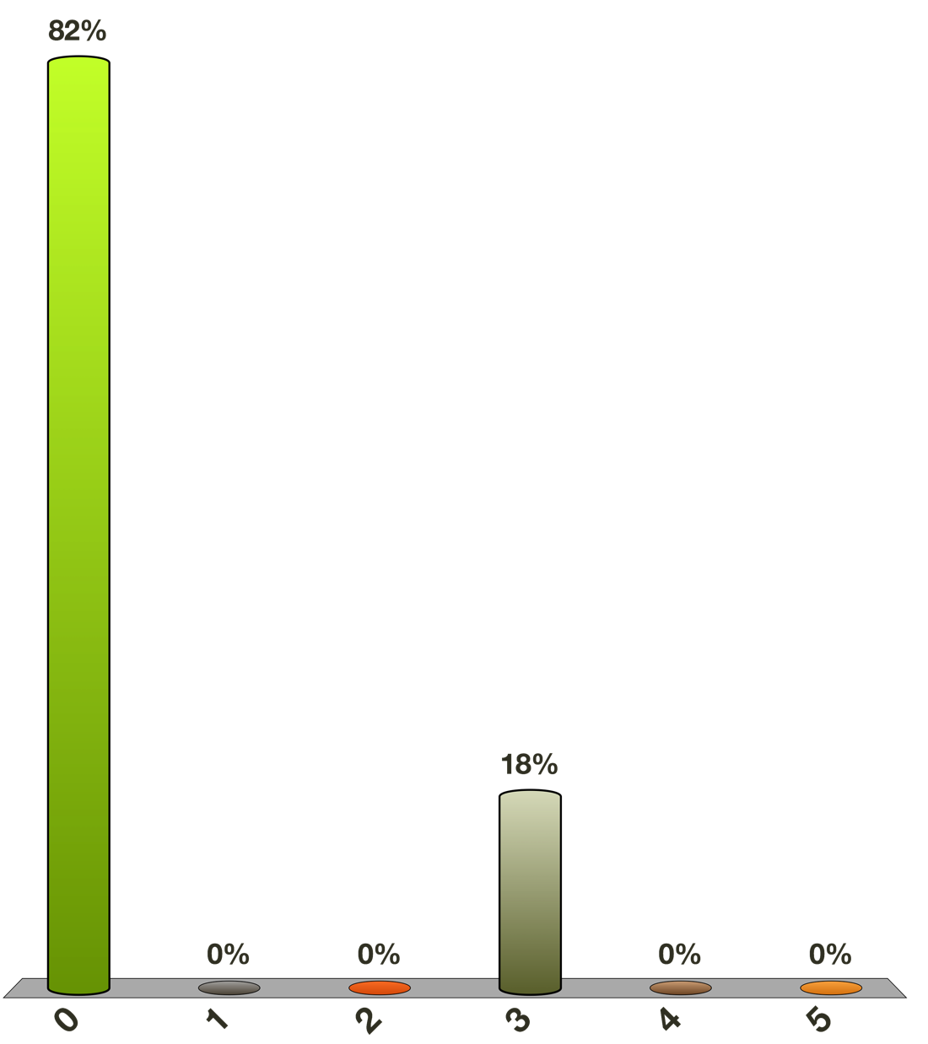
This K-Map Has How Many Loops?
0
1
2
3
4
5
AB AB AB AB
CD
CD
CD
CD
1 |  | 1
 | 1 |  | 1

Slide 35
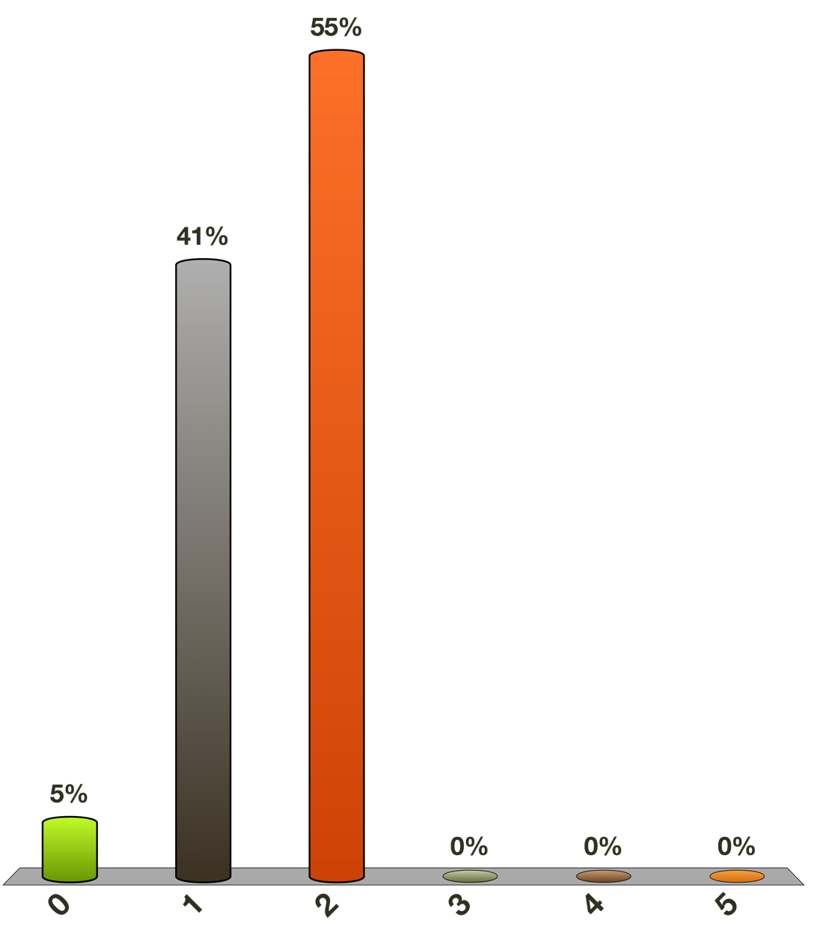
This K-Map Has How Many Loops?
0
1
2
3
4
5
AB AB AB AB
CD
CD
CD
CD
1 |  |  | 1
 |  |  | 1

Slide 36
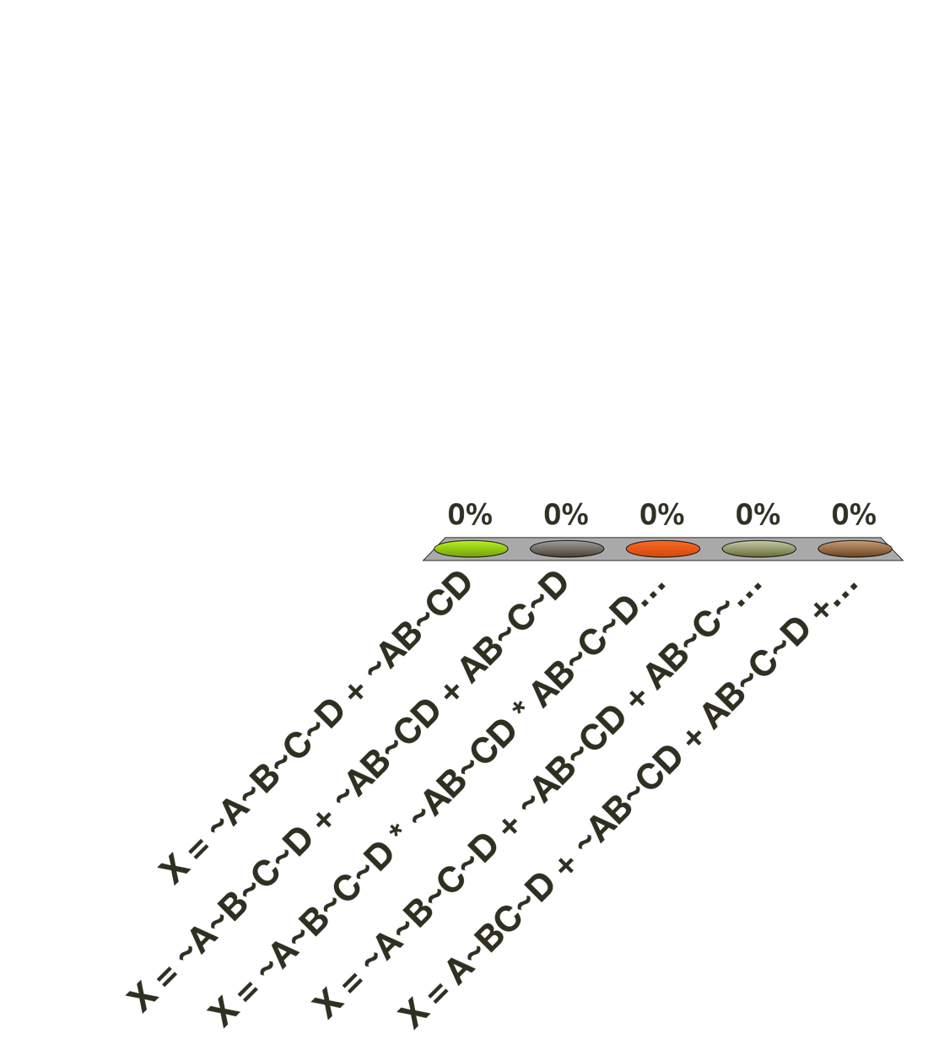
This K-Map Formula is?
X = ~A~B~C~D + ~AB~CD
X = ~A~B~C~D + ~AB~CD + AB~C~D
X = ~A~B~C~D * ~AB~CD * AB~C~D * A~B~CD
X = ~A~B~C~D + ~AB~CD + AB~C~D + A~B~CD
X = A~BC~D + ~AB~CD + AB~C~D + A~B~CD
AB AB AB AB
CD
CD
CD
CD
1 |  | 1
 | 1 |  | 1

Slide 37
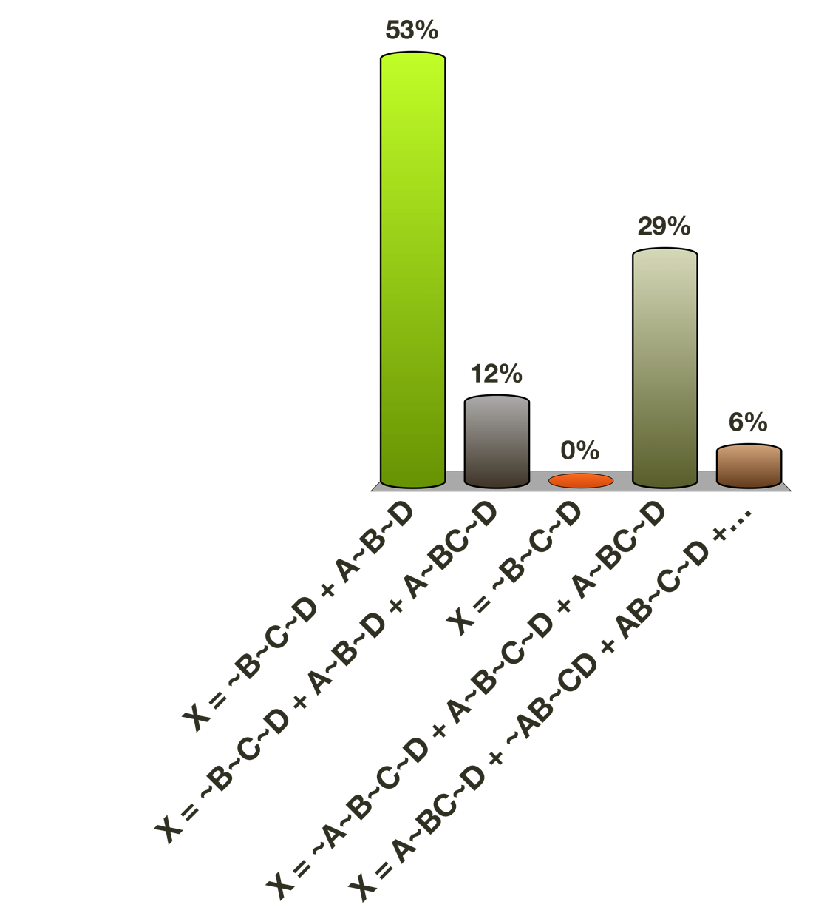
This K-Map Formula is?
X = ~B~C~D + A~B~D
X = ~B~C~D + A~B~D + A~BC~D
X = ~B~C~D
X = ~A~B~C~D + A~B~C~D + A~BC~D
X = A~BC~D + ~AB~CD + AB~C~D + A~B~CD
AB AB AB AB
CD
CD
CD
CD
1 |  |  | 1
 |  |  | 1

Slide 38
K-Map Examples
AB AB AB AB
CD
CD
CD
CD
1 |  | 1
 | 1 |  | 1
This K-Map has no loops
The equation is X = ~A~B~C~D + ~AB~CD + AB~C~D + A~B~CD
AB AB AB AB
CD
CD
CD
CD
1 |  |  | 1
 |  |  | 1
Q: Remembering adjacent corners, this Map has how many loops?
The naïve equation is X = ~A~B~C~D + A~B~C~D + A~BC~D
  Q: Can you reduce this via Boolean Algebra?
The K-Map derived equation is X = ~B~C~D + A~B~D
Boolean Algebra Proof…Preferences?
X= ~A~B~C~D + A~B~C~D + A~BC~D
X = ~A~B~C~D + ( A~B~C~D + A~B~C~D ) + A~BC~D //X + X = X
X= (~A + A)~B~C~D + (C + ~C)A~B~D //by distributive
X = ~B~C~D + A~B~D //by inverse

Slide 39
K-Map Examples
AB AB AB AB
Q: What are the loops?
Q: What is the reduced equation?
CD
CD
CD
CD
1 | 1 |  | 1
1 | 1 |  | 1
 |  | 1
 |  | 1
This K-Map has three loops. Notice that grey
loop is actually adjacent.
The equation is X = ~A*~C + ~B*~C + A*B*C
AB AB AB AB
CD
CD
CD
CD
1 |  |  | 1
1 |  |  | 1
This K-Map first appears to have two loops. The diagonal are not adjacent, but by first rotating the map around the vertical axis and then around the horizontal axis, we can cluster the four terms into a single 2 by 2 loop.
Treat K-Maps like rollable scrolls, in both the x and y.
The equation is X = ~B*~D

Slide 40
More Examples
AB AB AB AB
CD
CD
CD
CD
1 | 1 | 1 | 1
1 | 1 | 1 | 1
This K-Map can be simplified beautifully.
X = ~C
AB AB AB AB
CD
CD
CD
CD
1 | 1 | 1 | 1
 | 1
 | 1
1 | 1 | 1 | 1
Here we have two loops. The blue loop wraps around the top and bottom edges, enclosing 8 terms, and the red loop encloses one column of 4 terms. The equation is
X = ~D + ~A*B

Slide 41
A Boss Battle Appears:
KMaps or Boolean Equation?
f(A,B,C,D) = AB!C!D + A!BC!D +ABC!D+!A!B!CD +
!AB!CD + !A!BCD + !ABCD
K-Maps make this shorter…
Lets do both for completeness!

Slide 42
A Boss Battle Appears
KMaps or Boolean Equation?
1
2
3
4
f(A,B,C,D) = AB!C!D + A!BC!D +ABC!D+!A!B!CD +
!AB!CD + !A!BCD + !ABCD
Follow the color groupings for the Boolean Reductions
5
6
7

Slide 43
A Boss Battle Appears:
KMaps or Boolean Equation?
1
2
3
4
f(A,B,C,D) = AB!C!D + A!BC!D +ABC!D+!A!B!CD +
!AB!CD + !A!BCD + !ABCD
AB!C!D + ABC!D !A!B!CD + !AB!CD !A!BCD+!ABCD
5
6
7
Q
R
P
1
3
4
5
6
7

Slide 44
A Boss Battle Appears:
KMaps or Boolean Equation?
1
2
3
4
f(A,B,C,D) = AB!C!D + A!BC!D +ABC!D+!A!B!CD +
!AB!CD + !A!BCD + !ABCD
AB!C!D + ABC!D !A!B!CD + !AB!CD !A!BCD+!ABCD
AB!D(C + !C) !A!CD(!B+B) !ACD(!B+B)
AB!D !A!CD !ACD
5
6
7
P
Q
R
Next, group Q and R, and group P and 2

Slide 45
A Boss Battle Appears
KMaps or Boolean Equation?
1
2
3
4
f(A,B,C,D) = AB!C!D + A!BC!D +ABC!D+!A!B!CD +
!AB!CD + !A!BCD + !ABCD
AB!C!D + ABC!D !A!B!CD + !AB!CD !A!BCD+!ABCD
AB!D(C + !C) !A!CD(!B+B) !ACD(!B+B)
AB!D + A!BC!D !A!CD !ACD
5
6
7
Lesson: K-Maps will tell you this in 2 seconds!
Do it!
2
A!D(B + !BC)
A!D(B+C)
+
!AD(!C + C)
!AD
P
Q
+
R
X_{out}= A!D(B + C) + !AD

Slide 46
A Boss Battle Appears:
KMaps!
f(A,B,C,D) = AB!C!D + A!BC!D +ABC!D+!A!B!CD +
!AB!CD + !A!BCD + !ABCD
TODO: Memorize this KMap setup for 4 variables and complete this table using the BE above
KMap | !A!B | !AB | AB | A!B
!C!D
!CD
CD
C!D
KMap | !A!B | !AB | AB | A!B
!C!D |  |  | 1₁
!CD | 1₄ | 1₅
CD | 1₆ | 1₇
C!D |  |  | 1₃ | 1₂
?
TODO: make loops and produce the reduced BE
Reduced: F=!AD + AB!D + AC!D == A!D(B + C) + !AD

Slide 47
K-Maps, Part II
First, back to Combinational Circuits
See Exercise2.docx for more practice
  But it’s not enough
Null
  Boolean Algebra
    3.2.3 Examples through 3.6
  K-Maps 3A2
Source: Arnie Berger with edits by Rob Nash

Slide 48
Karnaugh Maps
Reduce Boolean Functions Visually
K-Map for 3 input variables
K-Map for 4 input variables
AB AB AB AB
AB AB AB AB
CD
CD
CD
CD
C
C
K-Map for 5 input variables
ABC ABC ABC ABC ABC ABC ABC ABC
#of Minterm Cells = 2^{num_vars}
DE
DE
DE
DE
Notes:
1: Colored lines are adjacent (torus)
2: The corner cells are adjacent
3: Only one variable changes as you go from cell to cell in both x and y, including the opposite ends {~A~B,~AB,…}
4: No diagonals (they aren’t adjacent)

Slide 49
Simplification using K-Maps
Construct a separate Karnaugh Map for every output variable
Place a “1” in cells with a 1 in the corresponding row of the truth table
Form the largest possible loops of adjacent cells containing 1, 2, 4, 8,16…
Any cell can be involved in any number of loops.
Remove redundant loops and build your newly reduced output:
  Each loop represents a simplified minterm of the logic equation
  Remove any variable that appears in its original & negated form (A, ~A)
X = ABC + ~ABC
X = (A + ~A)BC
X = BC
K-Maps Visually Illustrate this Boolean Reduction Law

Slide 50
Karnaugh Maps
We want to systematic derivations of a Boolean equation from a truth table
The Karnaugh Map (pronounced “car know”) is a graphical method of simplifying the “Sum of Products” (minterm) truth table
Based upon Boolean algebra simplification A*B + A*B = A //toggle
  Why?
    First Distributive Law: A *( B + C ) = (A*B) + (A*C)
    Third Law of Complementation: B + B = 1
    Finally: A*1 = A
Therefore:
A*B + A*B = A * ( B + B ) = A * 1 = A
http://sourceforge.net/projects/k-map/files/k-map/0.4/Kmap-04-setup.exe/download

Slide 51
Karnaugh Maps
For each output, you have to build one k-map.
  For the 3 x 8 line decoder, we need eight k-maps
Rules for building a Karnaugh Map of a truth table
  Rule 1: # cells = # of possible combinations of input variables
    For example,
      3 input variables: A, B, C = 8 cells
      4 input variables: A, B, C, D = 16 cells
      5 input variables: A, B, C, D, E = 32 cells
      The number of cells = 2^{(NUMBER OF INPUT VARIABLES)}
  Rule 2: The horizontal and vertical axes are labeled such that only one variable changes from complemented to un-complemented ( or vice versa) as you go across or down
      The first and last cells in a row or in a column are considered to be adjacent to each other

Slide 52
K-Maps Process, Step-by-Step
Construct a separate Karnaugh Map for every output variable
Place a “1” in cells with a 1 in the corresponding row of the truth table
Form the largest possible loops of adjacent cells containing 1, 2, 4, 8,16…
Any cell can be involved in any number of loops, however:
  Each new loop must contain at one entry that exists in no other loop
Remove redundant loops
  Any loop that is completely enclosed by a larger loop should be removed
  Any loop that contains no unique entries
Each loop represents a simplified minterm of the logic equation
  Minterm == sum of products == S.O.P.
Simplify the final Boolean formula
  Remove any variable that appears in its complemented and un-complemented form (A, ~A)
    X = ABC + ~ABC = (A + ~A)BC = BC

Slide 53
Another Example from the Text
Suppose you have to design a circuit system that produces the output X based on the three A,B, C inputs
Think about the circuit diagram for this system
  How many gates?
    2 ANDS in each of 4 rows == 8 ANDS
      Ex: A*~B*C
    3 NOTS (~A, ~B, ~C)
    1 large OR
Q: Is this a minimal hardware configuration?
A: KMap it
A B C x
0 0 0 1
1 0 0 1
0 1 0 0
Bad Order
1 1 0 1
0 0 1 0
1 0 1 1
0 1 1 0
1 1 1 0
X_{out} | ~A~B | ~AB | AB | A~B
~C | ? | ? | ? | ?
C | ? | ? | ? | ?
X_{out} | ~A~B | ~AB | AB | A~B
~C | 1 | 0 | 1 | 1
C | 0 | 0 | 0 | 1
Q: Reduced BE?
A: !B!C + A(!C+!B)

Slide 54

Batwings Example
A B C x
We’ve looked at designing circuit examples from the book that already exist(traffic lights, etc.)
Next, lets consider some arbitrary, imaginary configuration that is not likely to have been a circuit specification you’ve encountered or designed
Lets prove we can apply our circuit design and minimization techniques to all?
  Concrete and Undiscovered
Suppose you have to design a circuit system that produces the output X based on the three A,B, C inputs
Draw the circuit diagram for this system (Logisim)
  2 ANDS in each of 4 rows == 8 ANDS
    Ex: A*~B*C
  3 NOTS (~A, ~B, ~C)
  1 large OR
Q: Is this a minimal hardware configuration?
A: KMap it.
0 | 0 | 0 | 1
0 | 0 | 1 | 0
0 | 1 | 0 | 0
0 | 1 | 1 | 0
1 | 0 | 0 | 1
1 | 0 | 1 | 1
1 | 1 | 0 | 1
1 | 1 | 1 | 0
Good Order
x = Batman appears!
A: The Bat Signal was flashed
B: Commissioner and cops are present
C: Everything is ok
Notes:
X = Batman comes out to play or destroy
A: The Bat Signal was flashed
B: Commissioner and cops are present
C: Everything is ok
So batman comes out if:
No signal, no cops, but everything isn’t ok
OR the signal was flashed, no cops and things are not ok
OR the signal was flashed with no cops present and things are ok (Awards ceremony for bman)
OR the bat signal was flashed, cops are present, and things are bad
Note that if things are not ok but the cops are there, batman doesn’t lift a finger (the only case where things are not ok but no batman)
He also doesn’t come out if:
No signal, no cops, and things are ok
No signal, cops present, and things are ok (cops are a DC – Don’t care)
No signal, cops are present, and things are NOT OK. (lets the cops handle this)
The signal is on but the cops are there and things are ok (let the cops handle this – this is the least believable bman behaviour)

Slide 55
TODO: Complete the Batwings K-Map
A B C x
AB AB AB AB
0 | 0 | 0 | 1
0 | 0 | 1 | 0
0 | 1 | 0 | 0
0 | 1 | 1 | 0
1 | 0 | 0 | 1
1 | 0 | 1 | 1
1 | 1 | 0 | 1
1 | 1 | 1 | 0
1 | ? | ? | ?
? | ? | ? | ?
C
C
1 | 0 | 1 | 1
0 | 0 | 0 | 1
Q: Draw Loops?
x = ?
x = B*C + A*B + A*C
“Simplified” equation
Q: Can it be further simplified?
A: Yes. K-maps aren’t optimal, but close.
A: x = !B(A + !C) + A!C //saves 1 gate
//We’ll still view the K-Map solution sufficient.

Slide 56
Designing the
Batwings “Simplified” Hardware
A
B *B
C *C
NOT
NOT
B*C
AND
x = B*C + A*B + A*C
A*B
AND
OR
X
A*C
AND
Notice only 7 gates here (7th is hidden by a triple input OR)
TODO: Design this in 6 in Logisim using x = !B( A + !C ) + A!C

Slide 57
Different Process, Same Result
Step 1: x = A*B*C + A*B*C + A*B*C + A*B*C //From Truth Table
Step 2: x = A*B*C + A*B*C + A*B(C + C) // First Law of Distribution
Step 3: x = A*B*C + A*B*C + A*B // Law of Complementation
Step 4: x = A*B*C + A(B*C + B) // First Law of Distribution
Step 5: x = A*B*C + A[(B+C)*(B + B)] // Second Law of Distribution
Step 6: x = A*B*C + A(B+C) // Law of Complementation
Step 7: x = A*B*C + A*B + A*C // First Law of Distribution
Step 8: x = B(A*C + A) + A*C // First Law of Distribution
Step 9: x = B[(A+A)*(C + A)] + A*C // Second Law of Distribution
Step 10: x = B(C + A) + A*C // First Law of Distribution
Step 11: x = B*C + B*A + A*C // First Law of Distribution
Robert Frost, The Mountain Interval…
The Long Path or the Short Path?

Slide 58
Alternate Batwings Proof in Terms of MinTerms
T1
T2
T3
T4
Step 1: x = ~A~B~C + A~B~C + AB~C + A~BC
  From the truth table
Step 2: Swap (A~B~C + A~B~C + A~B~C) for T2 (==A~B~C)
  Identity Law: X + X == X
Step 3: T1 rearranged next to a copy of T2:
  ~A~B~C + A~B~C == (~A+A)~B~C
  Associative Law: (X + Y) + Z = X + (Y + Z)
  Distributive Law: X * (Y + Z) = X*Y + X*Z
Step 4: (~A+A)~B~C == ~B~C
  Inverse Law: (~X + X = 1)
Step 5: You do steps 3 and 4 for T3 and T4

Slide 59
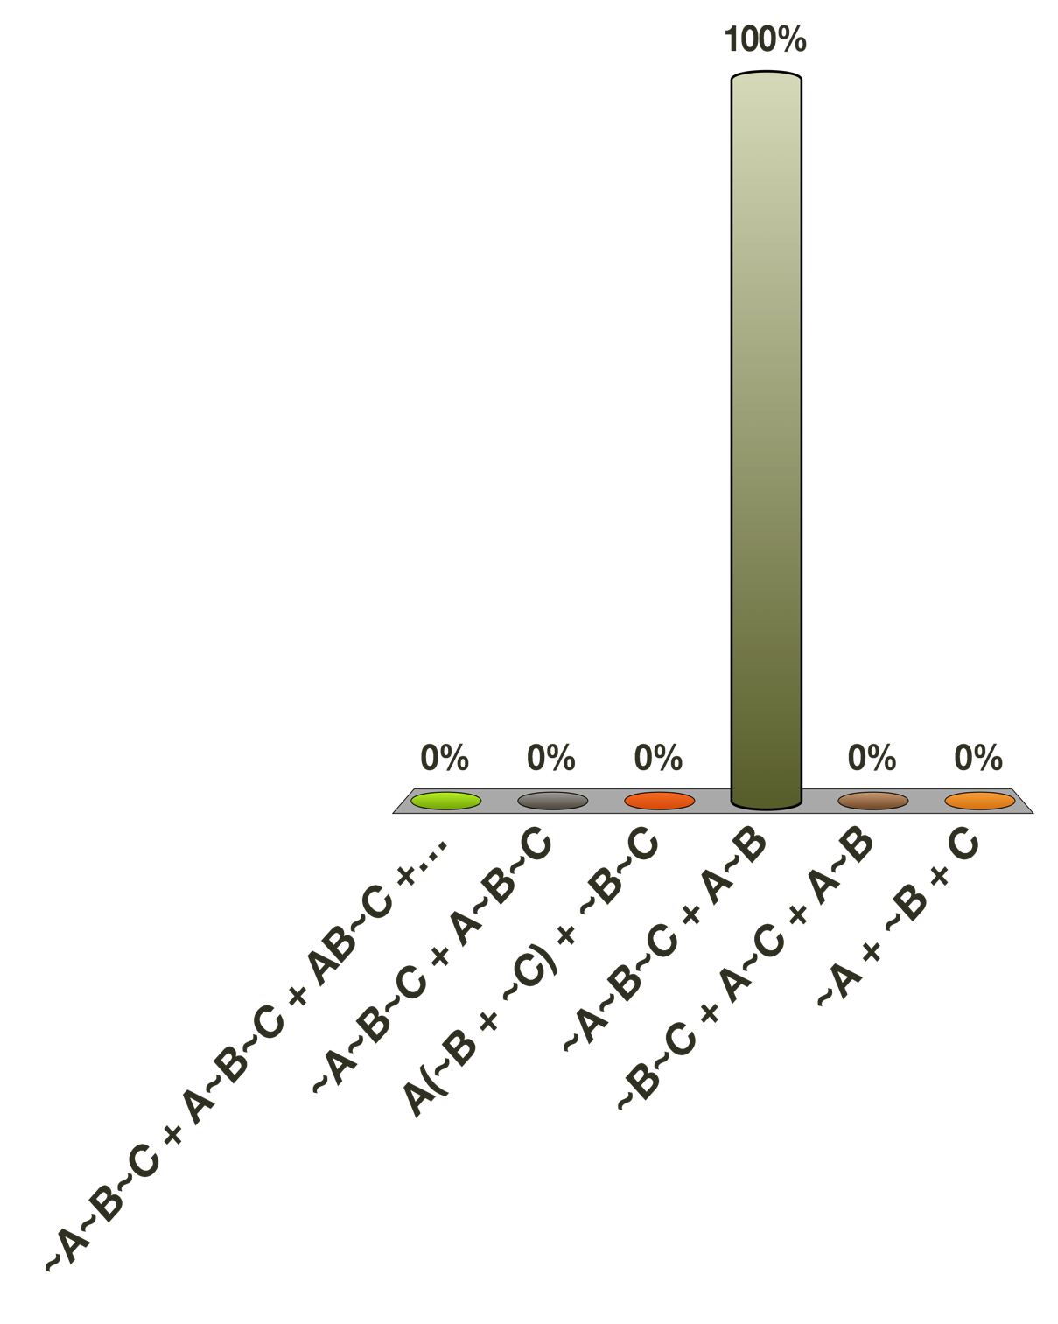
Final Reduced Form is?
~A~B~C + A~B~C + AB~C + A~BC
~A~B~C + A~B~C
A(~B + ~C) + ~B~C
~A~B~C + A~B
~B~C + A~C + A~B
~A + ~B + C

Slide 60
Another Arbitrary Example
A B C D X
X = A*B*~C*~D + A*~B*C*~D + A*B*C*~D + ~A*~B*~C*D + ~A*B*~C*D + ~A*~B*C*D + ~A*B*C*D
Q: Reduce or K-Map?
0 0 0 0 0
1 0 0 0 0
0 1 0 0 0
1 1 0 0 1
0 0 1 0 0
1 0 1 0 1
0 1 1 0 0
1 1 1 0 1
0 0 0 1 1
1 0 0 1 0
AB AB AB AB
0 1 0 1 1
1 1 0 1 0
CD
CD
CD
CD
0 0 1 1 1
1 0 1 1 0
X = ?
0 1 1 1 1
1 1 1 1 0
Notes:
(hint: 3 terms)

Slide 61
AB AB AB AB
CD
CD
CD
CD

Slide 62
Another Arbitrary Example
A B C D X
1- X = A*B*~C*~D + A*~B*C*~D + A*B*C*~D + ~A*~B*~C*D + ~A*B*~C*D + ~A*~B*C*D + ~A*B*C*D
2- X = A*B*~D*( ~C + C ) + A*~B*C*~D + ~A*~C*D* ( ~B+ B )
+ ~A*C*D*( B + ~B )
3- X = A*B*~D + A*~B*C*~D + ~A*D*( C + ~C )
4- X = A*B*~D + A*~B*C*~D + ~A*D
5- X = A*~D*(B + ~B*C) + ~A*D
6- X = A*~D*(C + B) + ~A*D //Second law of Dist.
Q: KMap & Loops & BE?
0 0 0 0 0
1 0 0 0 0
0 1 0 0 0
1 1 0 0 1
0 0 1 0 0
1 0 1 0 1
0 1 1 0 0
1 1 1 0 1
0 0 0 1 1
AB AB AB AB
1 0 0 1 0
AB AB AB AB
Identical?
0 1 0 1 1
1
CD
CD
CD
CD
1 1 0 1 0
CD
CD
CD
CD
0 0 1 1 1
1 1
1 0 1 1 0
X = ~A*D + A*B*~D +A*C*~D
0 1 1 1 1
1 1
1 1 1 1 0
1 1

Slide 63
Advanced K-Maps
Don’t Cares
A B AB AB AB
CD
CD
CD
CD
 |  | x
 | 1 | x
 | x | 1
x |  | 1
x’s above can be 0 or 1
Design this in your favor, as simple as possible.
F = ?

Slide 64
Don’t Cares
A B AB AB AB
CD
CD
CD
CD
 |  | 1
 | 1 | 1
 | 1 | 1
0 |  | 1
X can be 0 or 1
Choose so the expression can be as simple as possible.
F = ?

Slide 65
ROMs
Not the best use of the word “memory”, since
  We’ll define memory dynamically using atomic & universal gates
Not a memory that can be configured, so like a const variable
  Is it technically a variable if it can’t vary?
Programmable ROMs
Erasable Programmable ROMS
  If memory speeds were glue speeds, this is Elmers

Slide 66
ROMS can Encode Logic Directly
As a truth table, removing the need for the hardware!
  Really, this is just an alternate hardware configuration that “remembers” what outputs correspond with what inputs
Box 1
Box 2

Slide 67
Build the Gates or Store in ROM?
A | B | C | 0 | 1 | 2 | 3 | 4 | 5 | 6 | 7
0 | 0 | 0 | 0 | 0 | 0 | 0 | 0 | 0 | 0 | 0
0 | 0 | 1 | 0 | 0 | 0 | 0 | 0 | 0 | 0 | 0
0 | 1 | 0 | 0 | 0 | 0 | 0 | 0 | 0 | 0 | 0
0 | 1 | 1 | 0 | 0 | 0 | 0 | 1 | 0 | 0 | 1
1 | 0 | 0 | 1 | 0 | 0 | 0 | 0 | 0 | 0 | 1
1 | 0 | 1 | 1 | 0 | 0 | 0 | 0 | 0 | 0 | 1
1 | 1 | 0 | 1 | 1 | 0 | 0 | 1 | 0 | 0 | 1
1 | 1 | 1 | 1 | 1 | 0 | 0 | 1 | 0 | 0 | 1
Box 1
Box 2

Slide 68
ROM Memory VS RAM Memory
Primary difference: the ability to change state,
  Mutability, volatility
We’ll discuss SRAM, DRAM shortly and ROMS here
  As a ROM is really just a decoder to pick one bit out of an array of bits
Vcc
*
Addr0: 1
A₀
2-4 Decoder
A₁
*
Addr1: 1
*
Addr2: 0
*
Addr3: 0
Ground
Notes:
Hardcoding -> hardWIRING

Slide 69
Want More Than 4x1 bit?
A₀A₁ | D0 | D1 | D2 | D3
00 | 1 | 0 | 1 | 0
01 | 1 | 1 | 1 | 0
10 | 0 | 1 | 1 | 1
11 | 0 | 0 | 1 | 1
*
0
*
1
Vcc
*
0
*
0
*
1
*
*
1
1
A₀
2-4 Decoder
*
1
*
1
A₁
*
1
*
*
1
1
*
1
*
0
*
0
*
0
Ground

Slide 70
Want More Than 4x1 bit?
Add more AND gates and wire them to ground or current
We now have a decoder that picks one of 4 addressable locations
  Where each slot is now 4 bits rather than just one
  4x1 -> 4x4 memory
  In fact, given the starting 1-bit ROM we could just copy that whole piece to produce 4x4
    We’ll see this recursively!
*
0
*
1
Vcc
*
0
*
0
*
1
*
*
1
1
A₀
2-4 Decoder
*
1
*
1
A₁
*
1
*
*
1
1
*
1
*
0
*
0
*
0
Ground
Punchline: Memory is just a Decoder

Slide 71
Soft END:
Exercise2 &
Great Book Problems
See Exercise2.docx for more practice
  But it’s not enough
Null
  Boolean Algebra
    3.2.3 Examples through 3.6
  K-Maps 3A2

Slide 72
PLAs and PALs
PLA structure is fixed upon creation
PALS can be programmed electronically when in use
  Amenable to dynamic configuration
Both require algorithms specified in SOP or POS form
  Then one level of the array could be NANDS or ANDs
    And the other level NORs or ORs

Slide 73
Product of Sums
How to express as “product-of-sums”?
(hint: Use DeMorgan law)
Express the negation of output as sum of products terms.
  Suppose the output is F. Let’s get ~F as sum of product term
Then F = ~(~F): So, by DeMorgan’s law, product becomes sum, sum becomes product
Example) If ~F = ~AD + AB~D + AC~D,
then F = ~(~F) = ~(~AD+AB~D+AC~D)
= ~(~AD) ~(AB~D) ~(AC~D)
= (A+~D) (~A+~B+D) (~A ~C D)
Notes:
How to express the product of sums with K-map?

Slide 74
P.O.S. Example
Suppose you have a system with 4 inputs and one output F
Then the sum-of-product form for F is,
AB AB AB AB
CD
CD
CD
CD
1
1 1
1 1
F = ~A*D + A*B*~D +A*C*~D
1 1
AB AB AB AB
To express F as a product-of-sums, read ~F as a sum-of-product using K-maps (read only the 0’s)
~F = ~A~D + AD + A~B~C
Now take the negation of ~F to obtain F
Can you prove algebraically?
0 0
0
CD
CD
CD
CD
0 0
0 0
F = (A+D) (~A+~D) (~A + B + C)
0 0
Notes:
How to express the product of sums with K-map?
F = ~A*D + A*B*~D +A*C*~D
~F = ~(~A*D + A*B*~D +A*C*~D)
~F = (A + ~D)(~A+~B+D)(~A+~C+D)
=

