Slide 1
Combinational Logic
“On Combining Atomic Gates”
Rob Nash, Senior Lecturer
Readings: See schedule
Sources: Berger, Null & Lobur, CDA-AQA
“Were it not for the atomic gates, no more complex features such as addition, comparison, or storage would exist.”
“The defining feature of the Von Neumann architecture is its load-and-store interface to RAM. All data must be moved locally to be operated on, then moved back when finished.”
Notes:
ROB!!
Need to finish combinational circuits like Mux, half-adder, adder, ALU (see bergers slides for reference)

Slide 2
More Fun Quotes & Reading With Nash
“We bend this metal, to give it structure and meaning…so that the sum(or combination) of its parts might accomplish far greater things than the singular parts themselves” – Nash
“A soda machine could not be built using only combinational circuits. To understand how a soda machine works, and ultimately how a computer works, we must study [combinations of circuits that include state/memory]”
  So we start by combining basic circuits, build to greater heights
    Next, we consider circuits that contain memory

Slide 3
Memorize & Practice & Master
New Compound Gates : NAND, NOR, XOR, NXOR
Boolean Algebra Laws and Compound Laws
Engineering Notation 2^{x} and 10^{x} for Mega, Giga, Pico, …
  Soon: K-Map maneuvers
Also, practice & to commit to memory:
  Build a simple (half and full) adder using XOR
  Build any arbitrary compound circuit
  Wondering how to practice? Use:
    HW1
    Exercises & Alt Exercises
    End of Chapter Book Exercises

Slide 4
The Multi-Layer Cake *Because Stacks are so Last _____ (in First Out)
Combining Memory and Combinational Circuits
to make Sequential Circuits
(State Machines)
Level 3
Combining Gates to Make Memory
(RAM & ROM as SR Latch, JK FF, DF FF, …)
Level 2
Combining Gates for Combinational Circuits
(half-adders, adders, multiplexors, decoders/encoders,…)
Level 1
Fundamental, Atomic Gates
(AND, OR, NOT, XOR, NAND, NOR)
Build It
Level 0
Lecture Interrupt! First, some setup? Level -1?
Gates Foundation?
Notes:
Gates Foundation? And what level are you?
L0) Yesterday
L1) Today
L2) Tomorrow

Slide 5
Goal is Level 0: Atomic Gates
AND, OR, NOT
Fundamental Gates
AND
OR
NOT
AKA: Primitives, Building Blocks, HW Units, “Atomic” HW operations
Notes:
Gates Foundation?

Slide 6
Build Up to NAND, NOR
Fundamental Gates
Logisim (Alt) Exercises 0 & 2
NAND
NOR
XOR
AND
OR
NOT
Notes:
New teams of 2!

Slide 7
Build Further (All) With Universal Gates
Fundamental Gates
(& Alt Exercises 0 & 2)
AND with NAND
AND with NOR
OR with NAND
OR with NOR
NOT with NAND
NOT with NOR
XOR with NAND/NOR
NXOR
NAND
NOR
XOR
AND
OR
NOT
Notes:
Using the layered/black box approach, we could just borrow the XOR from the previous layer and add a NOT

Slide 8
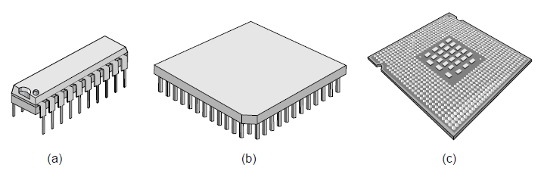
Integrated Circuits
Integrated Circuits (IC) consist of gates
Gate is an electronic circuit: The fundamental building blocks of digital systems.
Simple gates are combined to create more complex functions
Notes:
Source: Arnie Berger’s digital logic slides

Slide 9
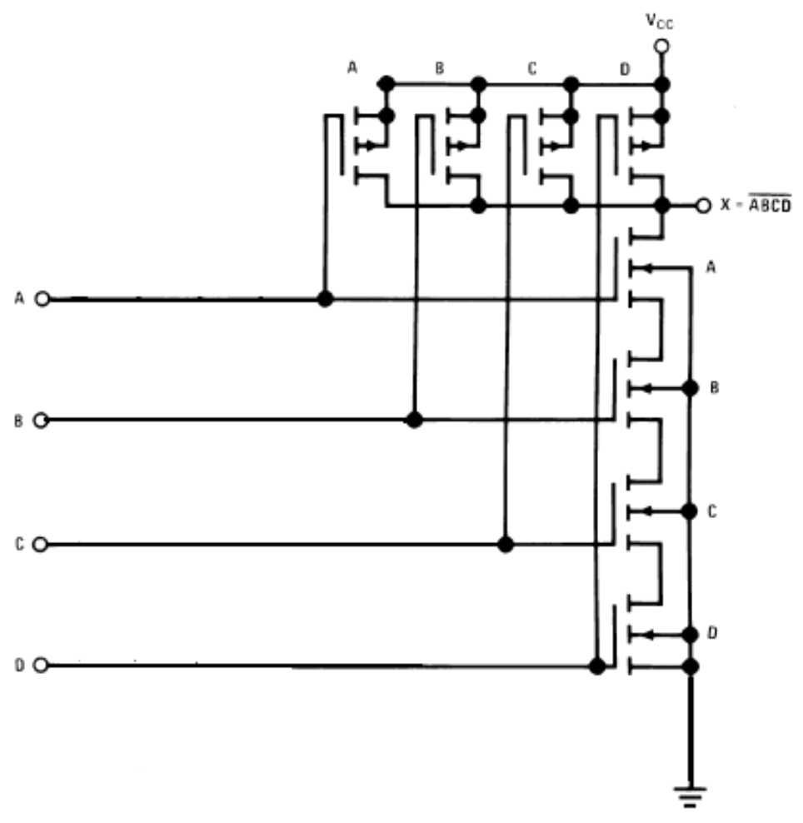
NAND Gate using
CMOS
(lower level)
Figure 2.16: Schematic diagram of a CMOS, 4-input NAND gate. From Fairchild.4
Notes:
CMOS is just one of the logic families that can realize our gate behaviours

Slide 10
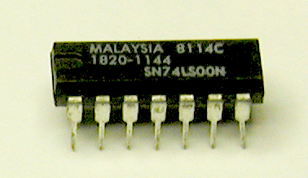
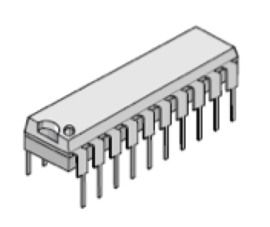
NAND gate
(higher level)
PIN 1
To 0 V
(Ground)
Pin 1
Pin 7
A
Typical NAND gate circuit
Quad, 2-input NAND gate
74LS00
Cost: ~ $0.10
Propagation delay ~ 5 nsec
14-pin Dual in-line (DIP) package
Circuits vary from 8 pin DIP packages
to over 600 pin high-density packages
B
C
D
Pin 8
Pin 14
To +3.3V (5V)
Notes:
DIP, dual inline plastics/pin
Source: Arnie Berger’s digital logic slides

Slide 11
Ramping up to Circuit Design –
Mario Kart
When first teaching someone to play this game, it is useful to show the novice a map of the board (or circuit) they’ll be travelling.
When preparing for tournament play (industry), however, our approach is different:
  The original board or circuit is well-known
  We study instead shortcuts that offer better performance than the standard, well-known paths.
    Perf in terms of seconds for Mario Kart and Integrated Circuitss
    Perf also in terms of # of gates used in our combinational circuits
XNOR will demonstrate starting with a basic circuit and
  refining that circuit, reorganizing so we can take shortcuts on the # of gates

Slide 12
On Designing Circuits for the Common Case
We’ll discuss Amdahl’s law shortly; investigate it.
We tend to consider the generic or vanilla case of a logical circuit first
  In practice, there exists tons of modifications a chip consumer might want
    Rising edge transitions, falling edge transitions, DDR3,4,5
    Low power, Positive logic, Negative logic
    2-in,3-in,4-in configurations
    Response time, Temperature range

Slide 13
Circuit Design “How To” Summary
Capture a description of the system’s requirements
  These could be in terms of output lines, and usually involve timing diagrams.
    Consider a 4-way traffic light situation
    Or an embedded automotive chip to roll up windows
Start by enumerating your circuit specific details:
  Inputs
  Outputs
  Transitions: what the outputs should do in response to the inputs
    Hints at an FSM but we’re missing something critical
Encode all of the above into a Truth Table
  Size being dependent on input lines
Derive a master Boolean Equation for each output
Design your system using a simulator (Logisim, etc)
  Wire your inputs to outputs at the gate level
Test your Combinational Circuit for all possible outcomes
  Using the simulator, and build the corresponding truth table via logging
We’ll demonstrate with XNOR
Multiple Views of the Same Design

Slide 14
On Design:
From One Gate to the Cloud
An atomic gate is part of a larger compound gate like NAND
Gates (including compound) compose combinational circuits
  Multiplexor, Demux (let one of many signals pass through)
  Decoder, Encoder
  The half-adder
    A half-adder is part of a full-adder
      A Full-Adder is part of an ALU
        An ALU is part of a core/PE
          A core is part of a CPU
            A CPU is part of a Server
              A Server is part of a Cluster/Farm
                A Farm is part of a “Backbone”, a Compute Cloud, the Enterprise LCARS, etc.
                A Backbone is part of a … //the final frontier with regards to tabs
HW1
Notes:
Highlighted terms you should be either completely familiar with, or becoming familiar with

Slide 15
From One Basic Switching Element
A gate is part of a larger compound gate like NAND
Gate combinations compose combinational circuits like the half-adder, majority function or multiplexor
A half-adder is part of an adder
An adder is part of an ALU
An ALU is part of a core/PE
A core is part of a CPU
A CPU is part of a Server
A Server is part of a Cluster/Farm
A Farm is part of a Backbone, a Compute Cloud, the Enterprise LCARS, etc.
A Backbone is part of a …
422 Hardware Course
Notes:
We may discuss Server details, but we’ll focus on on specific chip 68K for the bulk of our exploration

Slide 16
Building in Modular Layers
A gate is part of a larger compound gate like NAND
Compound gates compose combinational circuits like the half-adder, majority function or multiplexor
A half-adder is part of an adder
An Adder is part of an ALU
An ALU is part of a core/PE
A core is part of a CPU
A CPU is part of a Server
A Server is part of a Cluster/Farm
A Farm is part of a Backbone, a Compute Cloud, the Enterprise LCARS, etc.
A Backbone is part of a …
Multi-Server Cluster/Farm
Server & Multi-Chip Supercomputers
CPU or uP
Cores or PEs
ALU
Multiplexors, Decoders, Encoders, Memory (Registers, SRAM,DRAM), Adders, Control Logic
XOR, NAND, NOR, XNOR
AND, OR, NOT (CMOS transistors)
Notes:
We can go down the list or up the layered stack – same recipe of layers upon layers

Slide 17
Focusing on the Lower Layers
Multi-Server Cluster/Farm
Given an AND, OR, NOT
  Make XOR
  Make NAND
  Make NOR
Given XOR and NOT
  Make XNOR
    A comparator
Given all these gates
  Make a decoder or mux
  Make an adder
  Make a memory cell (SR, JK, D)
Given all these components
  Make one example of a typical Von Neumann Computer Architecture
Server & Multi-Chip Supercomputers
CPU or uP
Cores or PEs
ALU
Multiplexors, Decoders, Encoders, Memory (Registers, SRAM,DRAM), Adders, Control Logic
XOR, NAND, NOR, XNOR
AND, OR, NOT (CMOS transistors)

Slide 18
Building Upon Layers
Multi-Server Cluster/Farm
Given an AND, OR, NOT
  Make XOR
  Make NAND
  Make NOR
Given XOR and NOT
  Make XNOR
    A comparator
Given all these gates
  Make a decoder or mux
  Make an adder
  Make a memory cell (SR, JK, D)
Given all these components
  Make one example of a typical Von Neumann Computer Architecture
Server & Multi-Chip Supercomputers
CPU or uP
Finally
Today &
The Future
Cores or PEs
ALU
Multiplexors, Decoders, Encoders, Memory (Registers, SRAM,DRAM), Adders, Control Logic
Practice in Logisim
XOR, NAND, NOR, XNOR
AND, OR, NOT (CMOS transistors)
Finally
Notes:
What’s highlighted is our future, with Multiplexors and Decoders next

Slide 19
Each Layer is Purposefully Controlled
“Hardwired” V.S. “Programmed”
Powerful Speed V.S. Powerful Flexibility
HLL
  Hadoop
  Java, C#
  C++
  C
Multi-Server Cluster/Farm
Server & Multi-Chip (super)computers
CPU or uP
ASM Programming
  68K
  MIPS
422 Assembly
Programming Course
Cores or PEs
ALU
Microcode
422 Hardware &
Circuits Course
Multiplexors, Decoders, Encoders, Memory (Registers, SRAM,DRAM), Adders, Control Logic
Gates
XOR, NAND, NOR, XNOR
AND, OR, NOT (CMOS transistors)
Mechanisms (tools) for control evolve as you get to higher levels
Electricity on a wire -> binary -> micro-ops -> ASM -> C to C++ -> a modern HLL

Slide 20
Devilish Details:
Using Positive Logic…
0 maps to FALSE
1 maps to TRUE
We assume this logic scheme throughout this course
A | B | A AND B | A OR B
F | F | F | F
F | T | F | T
T | F | F | T
T | T | T | T
A | B | A AND B | A OR B
0 | 0 | 0 | 0
0 | 1 | 0 | 1
1 | 0 | 0 | 1
1 | 1 | 1 | 1

Slide 21
Devil in the Details:
Using Negative Logic…
0 maps to TRUE
1 maps to FALSE
A | B | A AND B | A OR B
F | F | F | F
F | T | F | T
T | F | F | T
T | T | T | T
A | B | A AND B | A OR B
1 | 1 | 1 | 1
1 | 0 | 1 | 0
0 | 1 | 1 | 0
0 | 0 | 0 | 0

Slide 22
Logical Definition
A | B | A AND B | A OR B
F | F | F | F
F | T | F | T
T | F | F | T
T | T | T | T
Positive logic or negative logic affects behavior of gates!
This can also be seen in DeMorgan’s Law
A | B | A AND B | A OR B
0 | 0 | 0 | 0
0 | 1 | 0 | 1
1 | 0 | 0 | 1
1 | 1 | 1 | 1
A | B | A AND B | A OR B
1 | 1 | 1 | 1
1 | 0 | 1 | 0
0 | 1 | 1 | 0
0 | 0 | 0 | 0
Q:?
Positive Implementation Values
Negative Implementation Values
Notes:
They use different representations, but can solve the same problems.

Slide 23
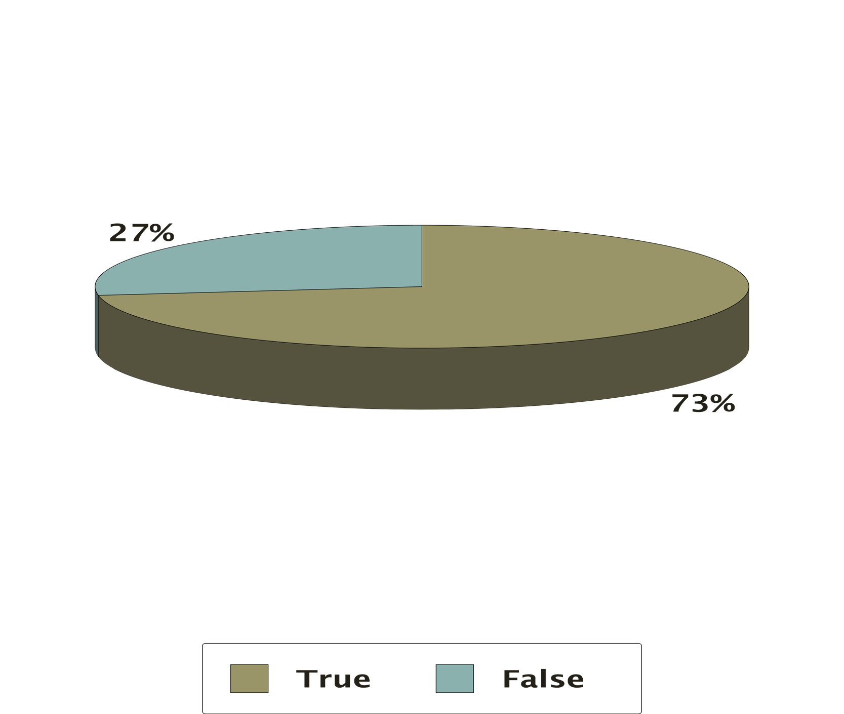
A Positive Logic AND == Negative Logic OR
True
False

Slide 24
Consider 2 Columns with different bits…
Positive logic or negative logic affects AND & OR…
This can also be seen in DeMorgan’s Law
Logical Definition
A | B | A AND B | A OR B
F | F | F | F
F | T | F | T
T | F | F | T
T | T | T | T
Binary is not identical;
But meaning is preserved
AND is AND in both schemes
Different Bits,
Same Meaning
A | B | A AND B | A OR B | NAND
0 | 0 | 0 | 0 | 1
0 | 1 | 0 | 1 | 1
1 | 0 | 0 | 1 | 1
1 | 1 | 1 | 1 | 0
A | B | A AND B | A OR B | NOR
1 | 1 | 1 | 1 | 0
1 | 0 | 1 | 0 | 1
0 | 1 | 1 | 0 | 1
0 | 0 | 0 | 0 | 1
Positive Implementation Values
Negative Implementation Values
Notes:
AND on the left doesn’t map to AND or OR on the right!
AND and OR are different with Positive and Negative Logic
See readings on the message board

Slide 25
Consider 2 Columns with the same bits…
Positive logic->negative logic flips the meaning of 0 & 1
  AND to OR
This can also be seen in DeMorgan’s Law
Logical Definition
A | B | A AND B | A OR B
F | F | F | F
F | T | F | T
T | F | F | T
T | T | T | T
Binary IS identical;
But meaning has changed
AND? or NAND?
Same Bits,
Different Meaning
A | B | A AND B | A OR B | NAND
0 | 0 | 0 | 0 | 1
0 | 1 | 0 | 1 | 1
1 | 0 | 0 | 1 | 1
1 | 1 | 1 | 1 | 0
A | B | A AND B | A OR B | NOR
1 | 1 | 1 | 1 | 0
1 | 0 | 1 | 0 | 1
0 | 1 | 1 | 0 | 1
0 | 0 | 0 | 0 | 1
Positive logic or negative changes meaning
  Even if signals on wire have the same binary pattern
Everything that can be done in positive logic could be accomplished in negative logic
  These are just different interpretations of current in a system
In a binary system, there exists only two configurations, and we’ll adopt Positive Logic
Positive Implementation Values
Negative Implementation Values
Notes:
Positive AND is Negative OR and vice versa
Positive AND and negative NOR: These columns have the same binary, but not the same T/F meanings – this is the definition of Positive and Negative logic.

Slide 26
Consider 2 Columns with the same bits…
Positive logic->negative logic flips the meaning of 0 & 1
  AND to OR
This can also be seen in DeMorgan’s Law
Logical Definition
A | B | A AND B | A OR B
F | F | F | F
F | T | F | T
T | F | F | T
T | T | T | T
Binary IS identical;
But meaning has changed
AND is AND in both schemes
BAD/BROKEN SLIDE
Same Bits,
Different Meaning
A | B | A AND B | A OR B | NAND
0 | 0 | 0 | 0 | 1
0 | 1 | 0 | 1 | 1
1 | 0 | 0 | 1 | 1
1 | 1 | 1 | 1 | 0
A | B | A AND B | A OR B | NOR
1 | 1 | 1 | 1 | 0
1 | 0 | 1 | 0 | 1
0 | 1 | 1 | 0 | 1
0 | 0 | 0 | 0 | 1
Positive Implementation Values
Negative Implementation Values
Notes:
Positive AND is Negative OR and vice versa
Positive AND and negative NOR: These columns have the same binary, but not the same T/F meanings – this is the definition of Positive and Negative logic.

Slide 27
Setup Complete! Ready for Level 0?
Combining Memory and Combinational Circuits
to make Sequential Circuits
(State Machines)
Level 3
Combining Gates to Make Memory
(RAM & ROM as SR Latch, JK FF, DF FF, …)
Level 2
Combining Gates for Combinational Circuits
(half-adders, adders, multiplexors, decoders/encoders,…)
Level 1
Fundamental, Atomic Gates
(AND, OR, NOT, XOR, NAND, NOR)
Level 0
Gates Foundation?
Notes:
Gates Foundation? And what level are you?
L0) Yesterday
L1) Today
L2) Tomorrow

Slide 28
Gates (the Alpha Level)
bill
McFadden
All logical patterns and systems are realized using digital, discrete components called gates
  In turn, gates are built (today) with transistors (2-6)
Gate Definition:
  A transistor or series of transistors
    typically from the CMOS logic family
  A hardware-level unit of digital signal propagation
  Usually, in an effort to use and transform signals that correspond to data
    Either instructions or data values
    Gates are switches, so this is binary data
  An electronic device that takes signals as input and provides some signal(s) as output

Slide 29
Atomic Gates (3)
AND
A | B | (A AND B) X_{out} | (A OR B) Y_{out} | ~A
0 | 0 | 0 | 0 | 1
0 | 1 | 0 | 1 | 1
1 | 0 | 0 | 1 | 0
1 | 1 | 1 | 1 | 0
OR
~
Lets start by giving our input and output lines identifiers, similar to variable names
Q: Map the above variables to lines
Q: Provide the Boolean Algebra Formulas for X and Y
Notes:
We’ve mastered the operation of these

Slide 30
Atomic Gates (4?)
TRI
Connected/hiZ control line
A
AND
X_{out}
B
A | B | (A AND B) X_{out} | (A OR B) Y_{out} | ~A
0 | 0 | 0 | 0 | 1
0 | 1 | 0 | 1 | 1
1 | 0 | 0 | 1 | 0
1 | 1 | 1 | 1 | 0
A
OR
Y_{out}
B
A
~
~A
X_{out}= A * B //circuits are defined via B.E.s
Y_{out}= B + A

Slide 31
Starting with AND, OR, NOT
Fundamental Gates
AND
OR
NOT
AKA: Primitives, Building Blocks, HW Units, “Atomic” HW operations
Notes:
Gates Foundation?

Slide 32
Logisim Exercise 0:
Build Up to NAND, NOR
I’ll do this for us in Logisim, to get us started
Fundamental Gates
NAND
NOR
XOR
Teams of 2 (Alt Exercise 0)
Build NAND using {AND, NOT}
Build NOR using {OR, NOT}
  Soon, just build NAND (you choose the gates)
Soon: XOR using {AND, OR, NOT}
  Use the truth table as an output guide here
AND
OR
NOT
Notes:
New teams of 2!

Slide 33
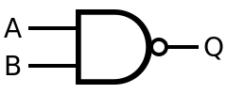
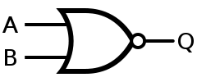
“Universal” Gates (2)
Can be used to design any other logic gate
  Requires a negation so a compound gate structure.
NANDS are the cheapest component to build
  Building a whole system with a single component prefers simplicity
NAND
  AND then NOT
NOR
  OR then NOT
TODO: Build the Truth Tables for NAND
Q: Does it agree with your Boolean Equation?

Slide 34
Exercise: Build Up to NOT With NAND, NOR
We’ll do this on the break, in paris
Fundamental Gates
AND with NAND
AND with NOR
OR with NAND
OR with NOR
NOT with NAND
NOT with NOR
XOR with NAND/NOR
XNOR
NAND
NOR
XOR
AND
OR
NOT
Build NOT with NAND (Ex0_NAND)
  See NAND truth table
Build NOT with NOR
  Also, see the NOR truth table
Build with me and you pick: AND with NAND? OR with NAND?
Build with me: XNOR – which approach should we use?
Notes:
Using the layered/black box approach, we could just borrow the XOR from the previous layer and add a NOT

Slide 35
Logic Gates (Memorized)
After today, XNOR too

Slide 36
Proof of DeMorgans, XOR Defined, Negated, etc.
A | B | A & B | !(A & B) | !A | !B | !A | !B | !(!A | !B) | A XOR B | A XNOR B
0 | 0
0 | 1
1 | 0
1 | 1

Slide 37
A | Out_{a}
0 | 1
1 | 0
A | B | C | D | A AND B
A | B | A AND B
A | B | C | A AND B
We need better tools for 3+ inputs

Slide 38
Level Up on The Multi-Layer Cake
Combining Memory and Combinational Circuits
to make Sequential Circuits
(State Machines)
Level 3
Combining Gates to Make Memory
(RAM & ROM as SR Latch, JK FF, DF FF, …)
Level 2
Combining Gates for Combinational Circuits
(half-adders, adders, multiplexors, decoders/encoders,…)
Level 1
Fundamental, Atomic Gates
(AND, OR, NOT, XOR, NAND, NOR)
Level 0
Gates Foundation?
Notes:
Gates Foundation? And what level are you?
L0) Yesterday
L1) Today
L2) Tomorrow

Slide 39
On Building Compound Circuits
Or, how do we build a digital system in general?
In previous slides we demonstrated:
  Truth tables
  Boolean algebra equations
  Even circuit designs!
These are interchangeable and can serve as the design schema for any digital system.
  We’ll see this in action in a few slides

Slide 40
Logically Equivalent Views
Truth Table
Boolean Algebra
Circuit Schema
K-Maps
These are just different views on the same data
If you have one view, you have them all
As we build circuits, watch as we go back and forth between views to understand and simplify our designs
Today: Truth Tables, corresponding B.E.s, and Circuits
  Next: Boolean Algebra and K-Maps

Slide 41
XOR Gate
XOR
Given AND and OR, make the XOR Gate
  Observe how we use this truth table to implement hardware directly!
A | B | A XOR B
0 | 0 | 0
0 | 1 | 1
1 | 0 | 1
1 | 1 | 0
X_{out}= A*~B + ~A*B //derived from the TT above, is this S.O.P. or P.O.S. form?
  Using this Boolean equation in minterm form
  Q: Do you see how we can use this equivalent formula to completely describe the table above?
    Implication: We can implement hardware directly from a formula OR truth table

Slide 42
To Start, We Need A,~A, B, ~B
XOR_Function(A,B) = A*~B + ~A*B
A
A
~
~A
B
B
~
~B
Building XOR

Slide 43
Q: Build A*~B, Then ~A*B
XOR_Function(A,B) = A*~B + ~A*B
A
A
*
~
~A
*
B
B
~
~B
+
Building XOR

Slide 44
Circuits ⬄Boolean Equations ⬄ Truth Tables
XOR_Function(A,B) = A*~B + ~A*B
A
A
A*
B
A
C= A XOR B
B
C
A
B
A *
B
B
A | B | C
0 | 0 | 0
0 | 1 | 1
1 | 0 | 1
1 | 1 | 0
B
Build Once, Then Black Box OK
C =
B
B
A *
+
A *
C = A + B
XOR
On Building XOR
(Source: Arnie Berger’s Slides on Digital Logic)

Slide 45
XNOR Gate
Build Once, Then Black Box OK
XOR
Design Choice here! Reuse?
  Given AND and OR, make the XNOR Gate
  OR, reuse your previous design and a NOT, make the XNOR
    Q: Which is the better approach?
      One might be simpler to build conceptually
      The other may require less gates – a tradeoff!
A | B | A XOR B | A NXOR B
0 | 0 | 0 | 1
0 | 1 | 1 | 0
1 | 0 | 1 | 0
1 | 1 | 0 | 1
XNOR = A*B + ~A*~B //built from the 1’s in TT above
Building XNOR
Notes:
These tradeoffs will be common hardware design decisions in this class

Slide 46
V1: Add a NOT to Produce XNOR (6 Gates)
Q: Can we reduce the gate count? Maybe?
Hint: Look at the truth table and extract a B.E.
Q: If only we had a regular method or approach to do this!
A
A
A*
B
B
~
C
A
A *
B
B
B
~C =
B
B
A *
+
A *
C = ~(A + B) //6 gates above to realize the Black Box below
Build Once, Then Black Box OK
XOR
Building XNOR
(Source: Arnie Berger’s Slides on Digital Logic)
Notes:
Things are getting complex, and if we want to reduce or optimize, we need a regular process for this (K-Maps)

Slide 47

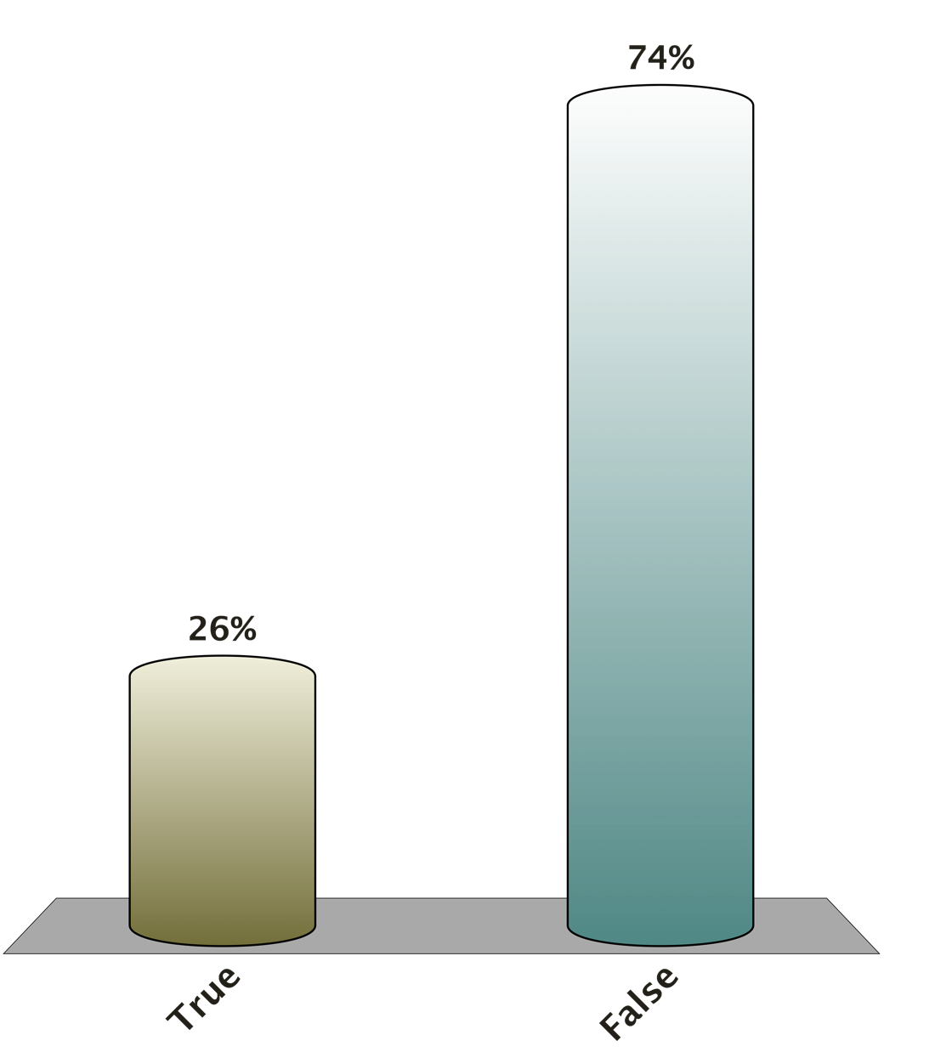
(Never too early to discuss performance (# gates affects cost, power consumption, size on die (==speed))
Q: This XNOR is in Reduced Form?
2
True
False
B
Hint: Work with the Algebra
Hint: Look at a Truth Table
~C =
B
A *
+
A *
)
C = ~(
B
B
A *
+
A *
A
A
A*
B
B
~
C
A
A *
B
B
B
Building XNOR

Slide 48
Build XNOR With Only These Gates
A
A
*
~
~A
+
B
B
~
~B
+
XNOR= (~A + B) * (A + ~B) //derive on board
//above was derived by negating the XOR Boolean Equation
Building XNOR

Slide 49
Reduced XNOR With 5 Gates
A
A
~
~A
+
(~A + B) * (A + ~B)
*
B
B
~
+
~B
XNOR= (~A + B) * (A + ~B)
XNOR = A*B + ~A*~B based on the truth table…
  So, the truth table confirms logical equality
  Q: Same amount of gates here?
Building XNOR

Slide 50
Alternate XNOR Implementation in Just 4 Gates!
A
*
B
~
B
+
+
A
Don’t edit this portion of the circuit
A*B + !A*!B == A*B + !( ? )
//hint: extract the negation in the second term
A*B + !A*!B == A*B + !( A + B ) //further BE refinement
//hint: extract the negation in the second term

Slide 51
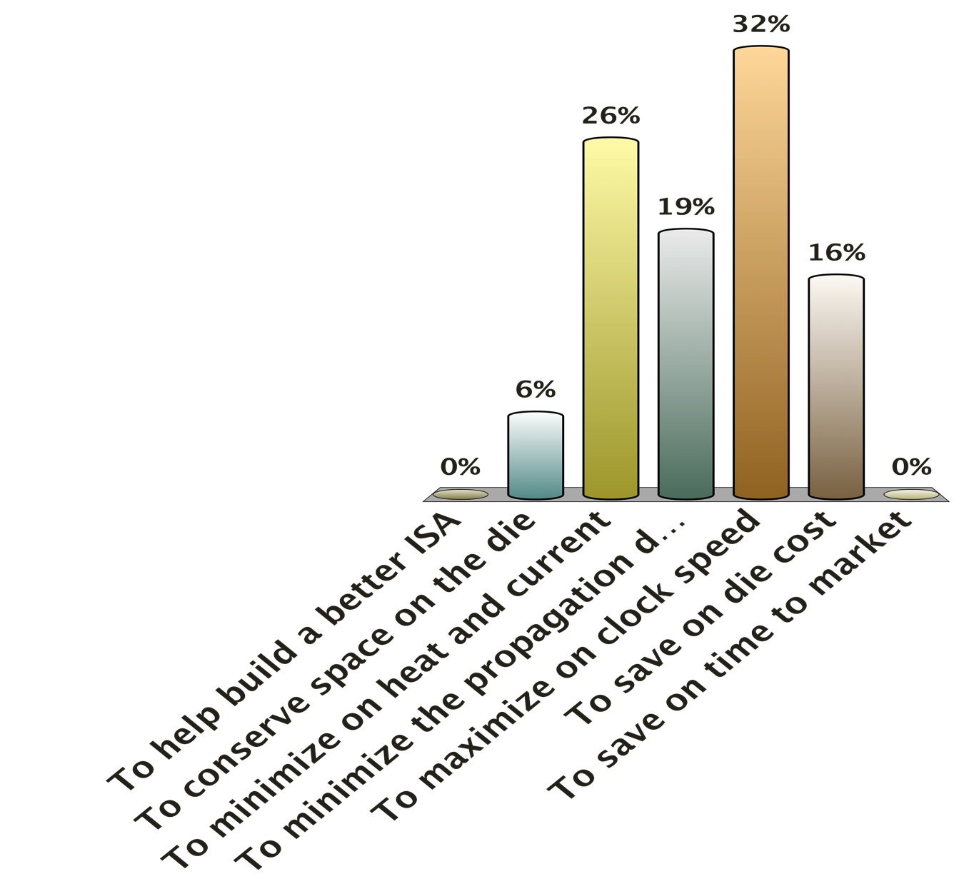
6 VS 5 VS 4 Gates – Why Care?
To help build a better ISA
To conserve space on the die
To minimize on heat and current
To minimize the propagation delay
To maximize on clock speed
To save on die cost
To save on time to market

Slide 52
6 VS 5 VS 4 Gates – Who Cares?
Space on the die
  SRAM V.S. DRAM
Heat generated
  Relates also to space on the die.
  Extra heat and wasted current.
Speed (or propagation delay) is worse

Slide 53
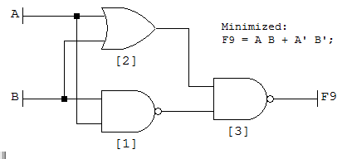
Final Approach Uses 3 Gates*
(*Note the use of compound gates)
Image Source: Wikipedia

Slide 54
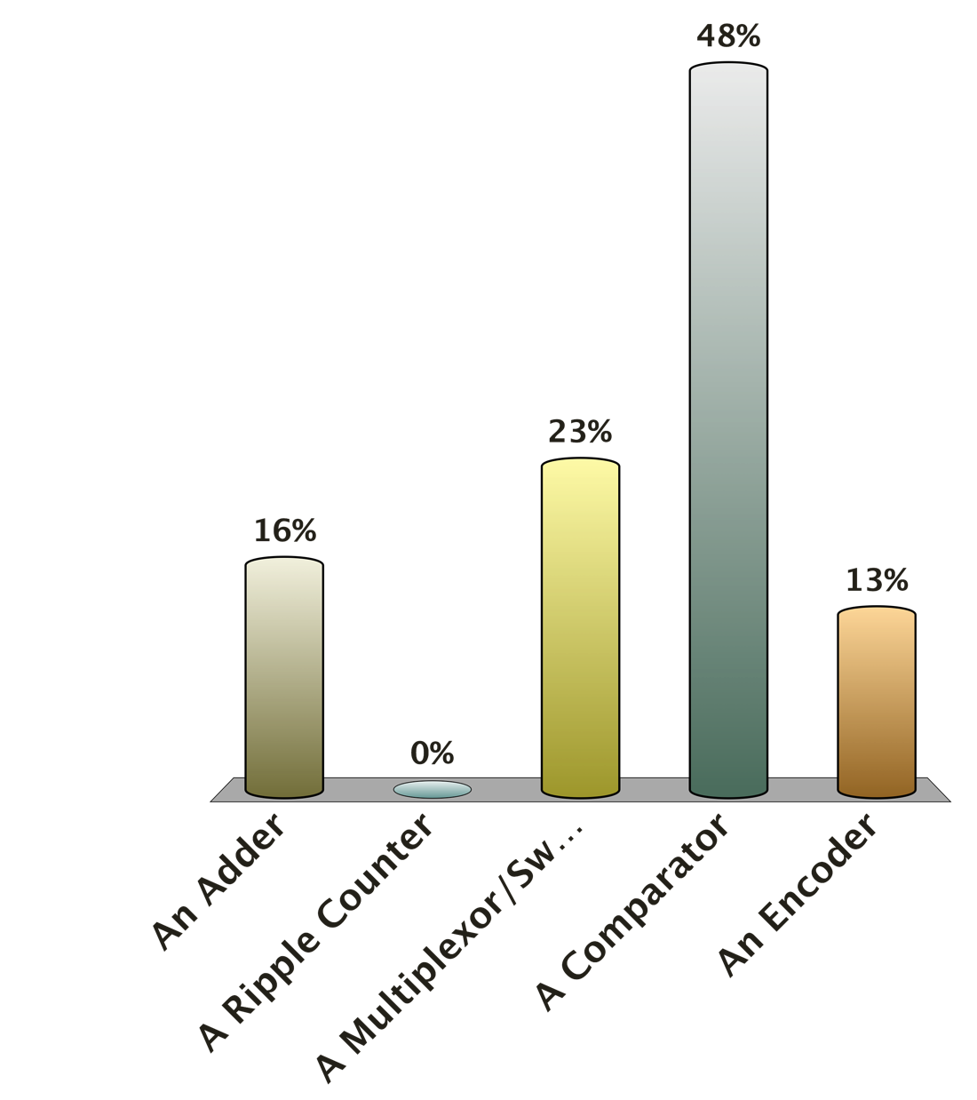
What Does the XNOR Implement?
An Adder
A Ripple Counter
A Multiplexor/Switch
A Comparator
An Encoder
A | B | A NXOR B
0 | 0 | 1
0 | 1 | 0
1 | 0 | 0
1 | 1 | 1

Slide 55
Multi-bit
XNOR Gate
XOR
Q: What if I wanted to do this to 4,8 or 32 bits?
A | B | A XOR B | A NXOR B
0 | 0 | 0 | 1
0 | 1 | 1 | 0
1 | 0 | 1 | 0
1 | 1 | 0 | 1
A0
XOR
out0
AND
B0
A1
XOR
out1
B1
“A Equals B”
A2
XOR
out2
B2
A3
XOR
out3
B3
Cut-and-Paste Black Boxes
AND together for a 4 bit Comparator

Slide 56
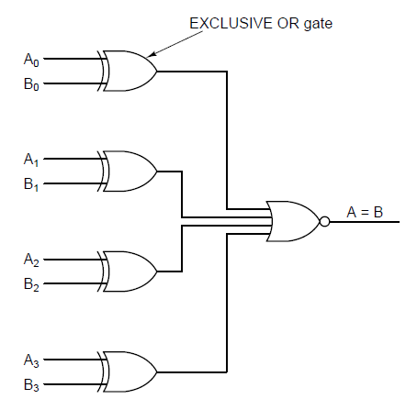
From Gates to Combinational Circuits:
The Comparator (4b) (A.K.A “equals”)
(Courtesy of Arnie Berger’s Slides)

Slide 57
Combinational Circuits are Gates:
“Equals” is The Comparator is …
We use this to determine equality and implement “==“
Q: How is this directly implemented in hardware?
  Q Again: What goes inside the black box below?
    Hint: This is how you practice
    Hint: (XNOR)
A | B | A == B
0 | 0 | 1
0 | 1 | 0
1 | 0 | 0
1 | 1 | 1
XNOR
A
B
Output
Notes:
You’ve already built this black box, so we don’t need to do it again here

Slide 58
Building Combinational Circuits
Combine two or more fundamental building blocks (gates)
  to produce heavily used logical functions such as:
    Comparators
    Counters (& Ripple Counters)
    Encoders
    Multiplexors
    Decoders
    1-bit adders->n-bit adders
      Adders/Subtractors
    Shifter Registers & Multipliers
    Memory (DRAM, SRAM, DDR, SIMM, EDO)
      SR-FF
      JK-FF
      D-FF
Practice this week
Complexity
HW 1
Week 2/3, HW 2

Slide 59
Combinational Circuits:
Clear/Reset Line
x = 0; //this is just an XOR again!
An easy way to set a signal to 0, regardless of it’s value
A | Output
0 | 0
0 | 0
1 | 0
1 | 0
A
0
XOR

Slide 60
Combinational Circuits:
Complement With Control Line
This is just an XOR again!
  And, depending on your control line “invertInput”
    This is an easy way to use the input line A or its inverse
      Look at the half-adder and use B as the control line – what happens to A?
A | invertInput (or B) | Output is now A or !A
0 | 0 | 0
0 | 1 | 1
1 | 0 | 1
1 | 1 | 0
A
XOR
A or !A
invertInput (B)

Slide 61
More Combinational Circuits:
Swap with XOR
int temp=a; a=b; b=temp; //this is just an XOR again!
A = A XOR B
B = A XOR B
A = A XOR B
A
XOR
Out1 holds B
B
XOR
A | B | Out1 | Out2
0 | 0 | 0 | 0
0 | 1 | 1 | 0
1 | 0 | 0 | 1
1 | 1 | 1 | 1
XOR
Out2 holds A

Slide 62
Combinational Circuits:
Half-Adder (is XOR)
Takes two input bits and generates a sum and carry out
  Has no carry in, the defining feature of a full-adder
A
XOR
Sum
B
A | B | Sum | Carry Out
0 | 0 | 0 | 0
0 | 1 | 1 | 0
1 | 0 | 1 | 0
1 | 1 | 0 | 1
*
Carry Out

Slide 63
Combinations of Circuits:
Full-Adder (is 2 Half-Adders)
Adds two bits but also accounts for a carry-in
Carry In
A
XOR
Sum
XOR
B
A | B | CarryIn | Sum | CarryOut
0 | 0 | 0 | 0 | 0
0 | 0 | 1 | 1 | 0
0 | 1 | 0 | 1 | 0
0 | 1 | 1 | 0 | 1
1 | 0 | 0 | 1 | 0
1 | 0 | 1 | 0 | 1
1 | 1 | 0 | 0 | 1
1 | 1 | 1 | 1 | 1
*
*
+
Carry Out

Slide 64
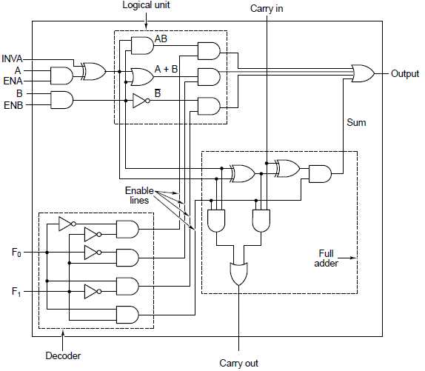
Combinational Circuit: 1-bit ALU
The Beginning
TODO
Make EX0_NAND
Then, make this!
Combinational Logic
HW1
Notes:
EnA, EnB does what? Useful for? A: If we had more inputs than A, B, we could pick amongst the inputs using a multiplexor tied to ENA, ENB?

Slide 65
Hardware Interrupt!
Servicing now.
  Missing forward requirements
    Jumping to Boolean Algebra and K-Maps.
Forward requirements:
  Mastery of Boolean Algebra laws
  Knowledge of K-Maps

Slide 66
Part 2 – More Advanced Combinations of Gates
We left off with basic Half-Adders
HW1
“Kick, Punch, it’s all in the mind.”
  Now, lets see more advanced combos?

Slide 67
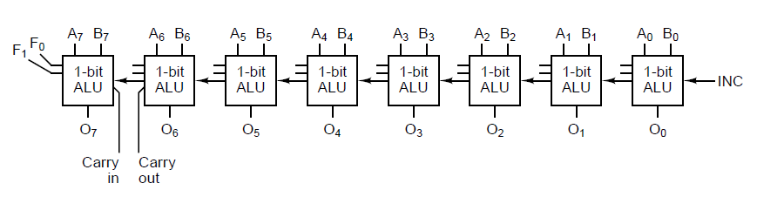
Combinational Circuits:
Ripple Carry Adders (8-bit)
8 1-bit ALUs (or Full-Adders) wired together via carry in’s and carry outs
Note the ripple comes from the propagation delay
  Slow, most adders try to improve on this
    Carry-look-ahead, carry-save, carry-select
      Parallel additions for speed
      Reducing maximum carry path
(Circuit from Arnie Berger’s Digital Logic Slides)
Notes:
Using the Adder from the previous slide

Slide 68
Combinational Circuits: Decoder
3-to-8 Example: Picks one line to assert and all others stay low
  “Launch every zig for great justice? Or, zigs 0 and 6? (000,110)”
Used to pick “one” from a set of things
  Need to pick which function your ALU should do? ADD or AND?
    Use control lines (f0 and f1 in HW1) and a decoder to enable or disable portions of your ALU chip
  Need to put something in memory? At Addr0 or Addr1?
    Use a decoder to output only to the memory cell based on an address
      Use of a decoder and AND to do this, like in HW1
  Need 8 GB of RAM?
    Use 2 separate 4GB SIMMs and a decoder as a chip select
      We build larger memories composed of smaller chips all the time!
      8GB = 2³³, and 4GB=2³², so our address is 33 bits with the MSb selecting which chip
    Turning on the 33rd wire turns on one of two memory chips

Slide 69
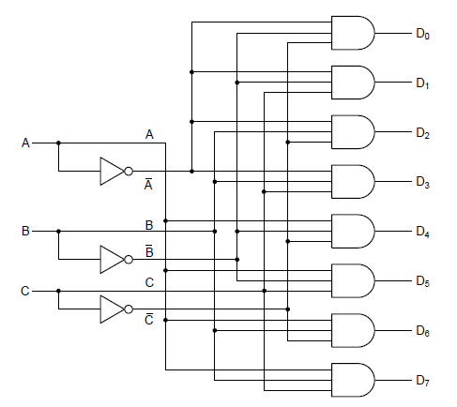
Combinational Circuits: Decoder
3 X 8 line decoder
A
B
C
(Circuit from Arnie Berger’s Digital Logic Slides)

Slide 70
Designing a 3 x 8 Line Decoder
Draw a truth table for each input combination and output combination
a | b | c | D0 | D1 | D2 | D3 | D4 | D5 | D6 | D7
0 | 0 | 0 | 1 | 0 | 0 | 0 | 0 | 0 | 0 | 0
0 | 0 | 1 | 0 | 1 | 0 | 0 | 0 | 0 | 0 | 0
0 | 1 | 0 | 0 | 0 | 1 | 0 | 0 | 0 | 0 | 0
0 | 1 | 1 | 0 | 0 | 0 | 1 | 0 | 0 | 0 | 0
1 | 0 | 0 | 0 | 0 | 0 | 0 | 1 | 0 | 0 | 0
1 | 0 | 1 | 0 | 0 | 0 | 0 | 0 | 1 | 0 | 0
1 | 1 | 0 | 0 | 0 | 0 | 0 | 0 | 0 | 1 | 0
1 | 1 | 1 | 0 | 0 | 0 | 0 | 0 | 0 | 0 | 1
    abc = 000 ---→ D0 =1
    abc = 001 ---→ D1 =1
    abc = 010 ---→ D2= 1
    abc = 011 ---→ D3= 1
    abc = 100 ---→ D4 =1
    abc = 101 ---→ D5 =1
    abc = 110 ---→ D6= 1
    abc = 111 ---→ D7= 1

Slide 71
Designing a 3 x 8 Line Decoder
Derive a Boolean equation for each output;
Attempt KMap reduction
  Per output, so 8 maps
a | b | c | D0 | D1 | D2 | D3 | D4 | D5 | D6 | D7
0 | 0 | 0 | 1 | 0 | 0 | 0 | 0 | 0 | 0 | 0
0 | 0 | 1 | 0 | 1 | 0 | 0 | 0 | 0 | 0 | 0
0 | 1 | 0 | 0 | 0 | 1 | 0 | 0 | 0 | 0 | 0
0 | 1 | 1 | 0 | 0 | 0 | 1 | 0 | 0 | 0 | 0
1 | 0 | 0 | 0 | 0 | 0 | 0 | 1 | 0 | 0 | 0
1 | 0 | 1 | 0 | 0 | 0 | 0 | 0 | 1 | 0 | 0
1 | 1 | 0 | 0 | 0 | 0 | 0 | 0 | 0 | 1 | 0
1 | 1 | 1 | 0 | 0 | 0 | 0 | 0 | 0 | 0 | 1
    D0 =
    D1 =
    D2=
    D3 =
    D4 =
    D5 =
    D6 =
    D7 =

Slide 72
Designing a 3 x 8 Line Decoder
Derive a Boolean equation for each output
a | b | c | D0
0 | 0 | 0 | 1
0 | 0 | 1 | 0
0 | 1 | 0 | 0
0 | 1 | 1 | 0
1 | 0 | 0 | 0
1 | 0 | 1 | 0
1 | 1 | 0 | 0
1 | 1 | 1 | 0
K-Map for 3 input variables
a b a b ab a b
c
c
1
    Focus only one output (D0) at a time
    Fill out the cells which have 1 only (others are zero)
    Read the cell with 1: D0 = a b c
    Note: ab is not equal to a b
    ab = a + b

Slide 73
Designing a 3 x 8 Line Decoder
Do it for each output
a | b | c | D1
0 | 0 | 0 | 0
0 | 0 | 1 | 1
0 | 1 | 0 | 0
0 | 1 | 1 | 0
1 | 0 | 0 | 0
1 | 0 | 1 | 0
1 | 1 | 0 | 0
1 | 1 | 1 | 0
K-Map for 3 input variables
a b a b ab a b
c
c
1
    D1 = ~a ~b c

Slide 74
Designing a 3 x 8 Line Decoder
Lack of 1s per column presents us with no KMap reduction possibilities
Now build it in hardware! (3 input wires, 8 output wires, transitions defined above)
a | b | c | D0 | D1 | D2 | D3 | D4 | D5 | D6 | D7
0 | 0 | 0 | 1 | 0 | 0 | 0 | 0 | 0 | 0 | 0
0 | 0 | 1 | 0 | 1 | 0 | 0 | 0 | 0 | 0 | 0
0 | 1 | 0 | 0 | 0 | 1 | 0 | 0 | 0 | 0 | 0
0 | 1 | 1 | 0 | 0 | 0 | 1 | 0 | 0 | 0 | 0
1 | 0 | 0 | 0 | 0 | 0 | 0 | 1 | 0 | 0 | 0
1 | 0 | 1 | 0 | 0 | 0 | 0 | 0 | 1 | 0 | 0
1 | 1 | 0 | 0 | 0 | 0 | 0 | 0 | 0 | 1 | 0
1 | 1 | 1 | 0 | 0 | 0 | 0 | 0 | 0 | 0 | 1
    D0 = ~a ~b ~c
    D1 = ~a ~b c
    D2 = ~a b ~c
    D3 = ~a b c
    D4 = a ~b ~c
    D5 = a ~b c
    D6 = a b ~c
    D7 = a b c

Slide 75
Designing a 3 x 8 Line Decoder
Connect inputs to outputs using logic gates (a Combination Circuit)
    D0 = ~a ~b ~c
    D1 = ~a ~b c
    D2 = ~a b ~c
    D3 = ~a b c
    D4 = a ~b ~c
    D5 = a ~b c
    D6 = a b ~c
    D7 = a b c

Slide 76
Designing a 3 x 8 Line Decoder
Final Step: Test! (Paper and Logisim)
    abc = 000 ---→ D0 =1
    abc = 001 ---→ D1 =1
    abc = 010 ---→ D2= 1
    abc = 011 ---→ D3= 1
    abc = 100 ---→ D4 =1
    abc = 101 ---→ D5 =1
    abc = 110 ---→ D6= 1
    abc = 111 ---→ D7= 1

Slide 77
More Gate Combinations: Encoders
8-to-3, output based on the single asserted line
Inverse operation of decoders; encodes selection in binary
Given a line is asserted from a set of n input lines, this produces the output p such that log₂n = p
  In our 8-to-3 example, n is 8, p is 3, and log₂8 = 3
Said another way: the encoder encodes the relative position of the input line that was asserted in the output
Modified versions:
  priority encoders
    if more than one wire is asserted, pick priority
    Uses “don’t cares”
Decoder
Notes:
Priority encoder: Larger number of inputs to a smaller number of outputs, priority here is the distance from zero to the lead bit

Slide 78
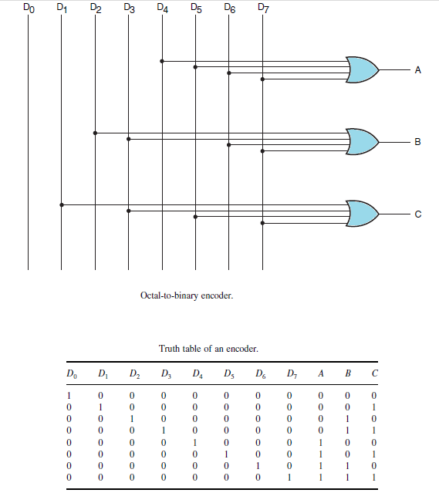
8x3
Encoder
Image source: http://www.electronicsengineering.nbcafe.in

Slide 79
Read-Only Memory (ROM)
Memory that is implemented with combinational circuits
  Combinational circuits are often referred to as “memoryless” circuits because their output depends only on their current input and no history of prior inputs is retained
Memory unit that performs only the read operation
  Binary information stored in a ROM is permanent and is created during the fabrication process
  A given input to the ROM (address input lines) always produces the same output (data output lines)
    “Hard-wired” to either ground or Vcc
  Because the outputs are a function only of the present inputs, ROM is a combinational circuit
Notes:
Combinational circuits are often referred to as “memoryless” circuits, because their output depends only on their current input and no history of prior inputs is retained. However, there is one sort of memory that is implemented with combinational circuits, namely read-only memory (ROM).
Recall that a ROM is a memory unit that performs only the read operation. This implies that the binary information stored in a ROM is permanent and was created during the fabrication process. Thus, a given input to the ROM (address lines) always produces the same output (data lines). Because the outputs are a function only of the present inputs, the ROM is in fact a combinational circuit.

Slide 80
Memory as a Logical Component (v.s. Internal Gate Logic to Build a Memory Cell (coming soon!))
A0
A2
A1
Q: How many memory location you can have if you have four input bits?
A3
Address bits
0 0 0 0
0 0 0 1
0 0 1 0
0 0 1 1
0 1 0 0
0 1 0 1
0 1 1 0
0 1 1 1
1 0 0 0
1 0 0 1
1 0 1 0
1 0 1 1
1 1 0 0
1 1 0 1
1 1 1 0
1 1 1 1
0
0
0
0
1
1
0
0
0
0
0
0
0
0
0
1
1
0
0
0
0
0
1
0
0
0
0
0
0
0
0
0
DATA BIT D1
DATA BIT D0

Slide 81
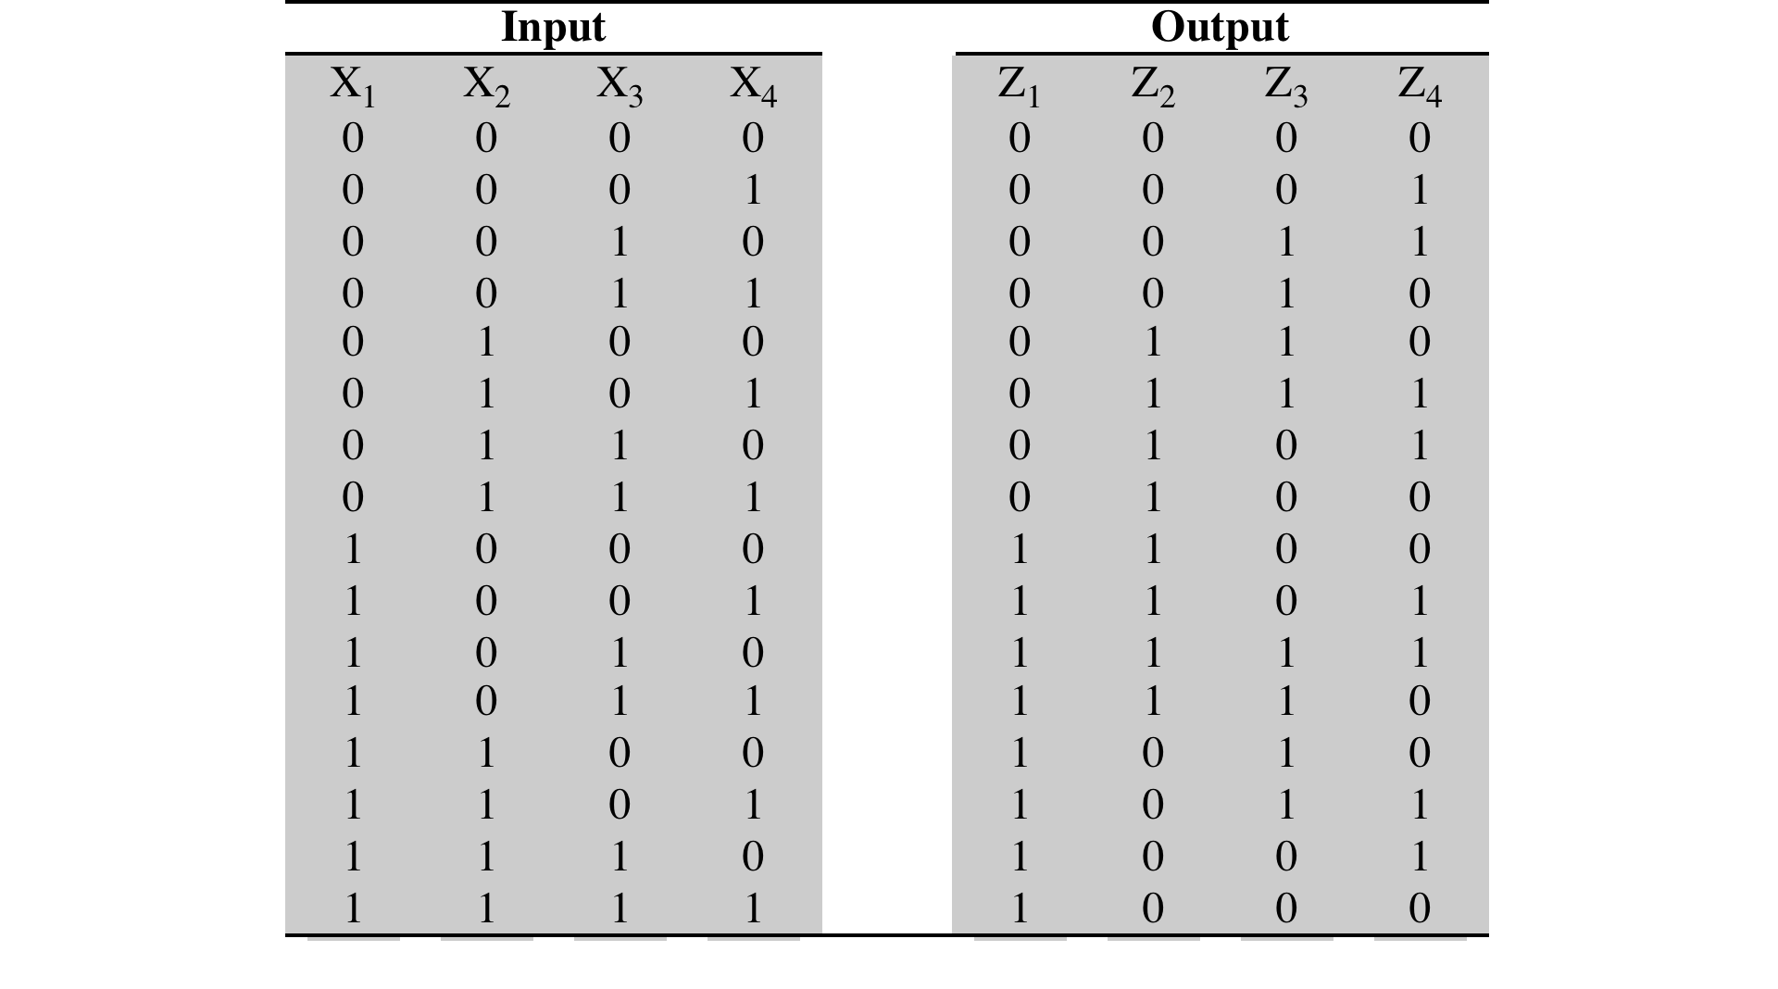
Truth Table for an Arbitrary ROM
Read-Only Memory (ROM)
A ROM can be implemented with a decoder and a set of OR gates. This can be viewed as a truth table with four inputs and four outputs. For each of the 16 possible input values, the corresponding set of values of the outputs is shown. It can also be viewed as defining the contents of a 64-bit ROM consisting of 16 words of 4 bits each. The four inputs specify an address, and the four outputs specify the contents of the location specified by the address. Figure 11.18 shows how this memory could be implemented using a 4-to-16 decoder and four OR gates. As with the PLA, a regular organization is used, and the interconnections are made to reflect the desired result.
11.8

Slide 82
Foreshadowing: Embed the Truth Table for ANY Circuit in a ROM
Made a combinational circuit?
  A discrete mapping from input signals to output response signals
  Just like an AND truth table, could you not encode this in memory?
    This is software storage of a hardware mapping
Take the truth table input lines (these are addresses)
  The output lines are the resulting values stored in that ROM
Number of inputs (x) == 2^{x} rows in the ROM
Outputs are the results the circuit would produce, stored in the ROM
Notes:
A:4x3 Memory with 4 input bits corresponding to 3 valid mappable addresses and 3 control bits for the three LED lights.

Slide 83
Another Circuit: Majority Function
Insert Trump joke here…
Outputs a 1 when more than half of the input lines are 1, 0 otherwise
  A mux that it selects from either ground or vcc
Consider the following truth table (a.k.a state table)
A | B | C | MF_{Out}
0 | 0 | 0 | 0
0 | 0 | 1 | 0
0 | 1 | 0 | 0
0 | 1 | 1 | 1
1 | 0 | 0 | 0
1 | 0 | 1 | 1
1 | 1 | 0 | 1
1 | 1 | 1 | 1

Slide 84
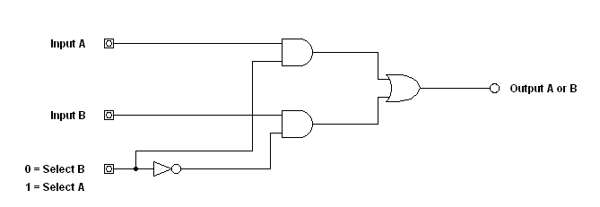
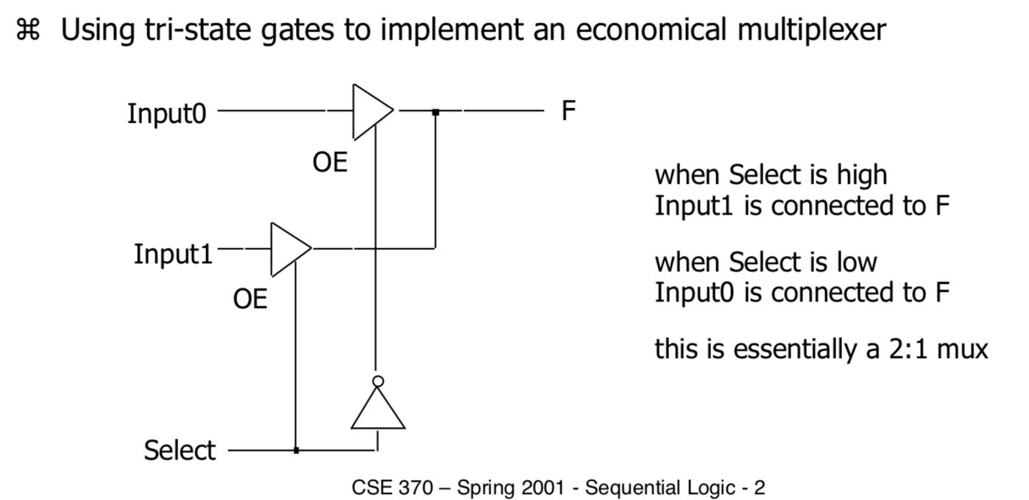
Simple Multiplexer (MUX)
(Gate-Level & Tri-State)
The MUX circuit allows one of two (or more) logical signals to be selected
Muxes have been called signal “routers”. //You will not be confused
  Decoders have been called “switches”. //You are one with the Force, and

Slide 85
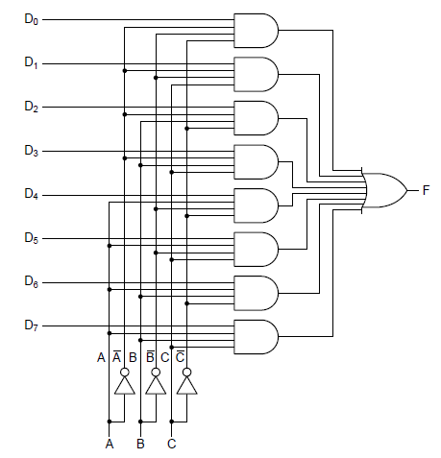
Combinational Circuits:
Multiplexors/Demultiplexors
Also called “switches” or “selectors” or “choosers”
Given a set of inputs and a control set, choose one of the inputs to be propagated to the output
  This could be a 0 or a 1
    Unlike a Decoder
Used to select one line from many
for output on a shared line
(Circuit from Arnie Berger’s Digital Logic Slides)

Slide 86
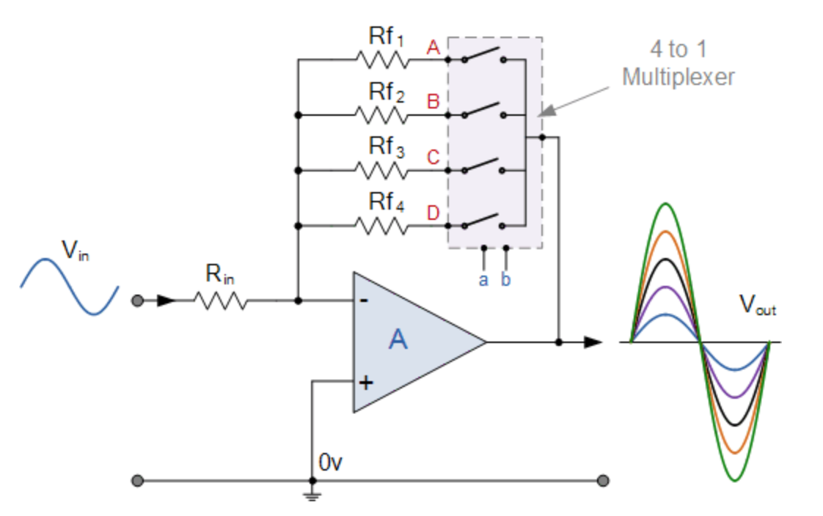
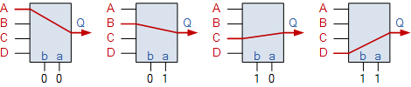
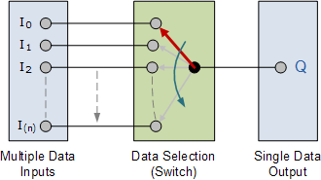
Combinational Circuits:
Multiplexors/Demultiplexors
4-In Mux Above
N-in Mux Below
A Digital Amplifier selects one of four resistances to vary the output amplitude
(controlled by a & b)
(Source: www.electronics-tutorials.ws)

Slide 87
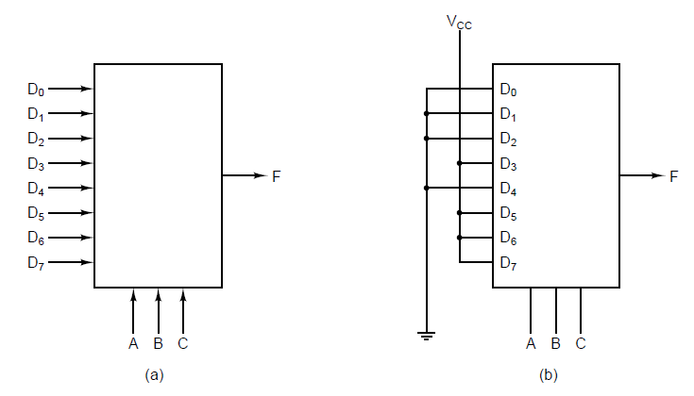
Multiplexers & Uses
An eight-input multiplexer.
The same multiplexer hardwired to compute the majority function in binary.
Notes:
Majority function is 1 if half or more bits are 1

Slide 88
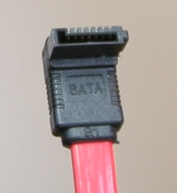
Parallel-to-Serial-to-Parallel I/O
This can be done via shift register, too
This is a Mux paired with a Demux (and no order is imposed)
Can go from an 8-bit word to a 1-wire bus (USB,Ethernet) & back
Google SATA and PATA for Serial and Parallel examples
Notes:
You can also use shift registers to accomplish this P-to-S and S-to-P

Slide 89
S and P Technologies
Serial | Parallel
USB | PCI
Ethernet | AGP
Firewire | Parallel Ports (LPT)
RS232 (COM1, COM2,…) | …
Shift Registers: Serial to Parallel or Parallel to Serial
Q: Why isn't parallel better?
A: Synchronization as signal frequency increases
A: Cheaper to build compression algs in software
A: Cross-talk

Slide 90
More Circuits:
Parity Generators & Checkers
Parity: a uniform (even or odd) number of 1s in a bit string
  Used for error detection
  Idea: including my parity bit, is the total # of ones odd?
    This is an odd parity example
      Consider the supreme court (9)
Fill out K-Map below
Build one for 3 bits in Logisim
A | B | C | Parity bit (odd)
0 | 0 | 0 | 1
0 | 0 | 1 | 0
0 | 1 | 0 | 0
0 | 1 | 1 | 1
1 | 0 | 0 | 0
1 | 0 | 1 | 1
1 | 1 | 0 | 1
1 | 1 | 1 | 0
 | ~A~B | ~AB | AB | A~B
C | ? | ? | ? | ?
~C | ? | ? | ? | ?
 | ~A~B | ~AB | AB | A~B
C |  | 1 |  | 1
~C | 1 |  | 1

Slide 91
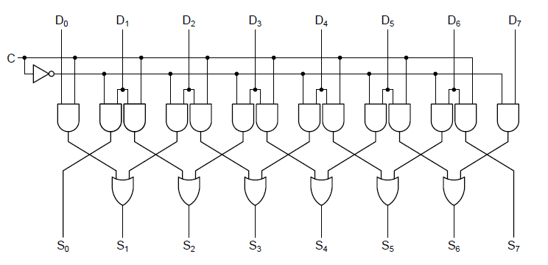
1-bit L or R Shifter
Notice no carry or wrap
What does the control line “c” do above?
Combine with a register to go from serial to parallel data transfer
  Called a shift register
Notes:
There are 8 bits here, but we shift only 1b at a time

Slide 92
Step Back: On Designing a Circuit
All systems are collections (combinations) of gates
  Gates themselves are composed of inputs, outputs, and some function.
  Gates are arranged in an order determined by what the system is to achieve
    What are we organizing this architecture for, anyways?
We are establishing procedures for…
  Collecting requirements (TTs)
  Building a naïve (V1.0) circuit, possibly with redundant logic
  Reducing the circuit to the least amount of gates (BA, K-maps)

Slide 93
Steps for Circuit Design (Summary)
Capture a description of the system’s requirements
  These could be in terms of output lines, and usually involve timing diagrams.
    Consider a 4-way traffic light situation
    Or an embedded automotive chip to roll up windows
Start by enumerating your circuits:
  Inputs
  Outputs
  What the outputs should do in response to the inputs
    Hints at an FSM but we’re missing something critical
Encode all of the above into a truth table
  Size being dependent on input lines
Derive a master Boolean Equation for each output
Design your system using a simulator (Logisim, etc)
  Wire your inputs to outputs at the gate level
Test your circuit for all possible outcomes
  Using the simulator, and build the corresponding truth table
Let’s Do Some Together!
Then you try it in HW2, Exercises, Book Problems, these Slides, etc.
Multiple Views of the Same Design

Slide 94
Example Circuit Design Problem
TSLA
An automotive firm contacts you to build an embedded processor.
  Windows should roll up based on:
    User presses the up button on the door
    The car exceeds 88 MPH
    The car’s alarm is turned on
TODO: decompose this problem into the following (previous slide):
  Enumerate IO: Q: How many inputs here? How many outputs?
  Build the truth table.
  Build Boolean Algebra formulas for each output
    Reduce using Boolean algebra laws or K-Maps (next)
  Connect inputs to outputs to the required gates for the desired output
WU = row1 + row2 + row3
row1 = U (E+!E)(O+!O) = U
row2 = E
row3 = O
(E + !E ) -> x (DC)
(U)p_Button | 88_(E)xceeded | Alarm_(O)n | Windows_Up
0 | 0 | 0 | 0
1 | x | x | 1
x | 1 | x | 1
x | x | 1 | 1
Now, you connect the circuit dots in Logisim
Notes:
When we say circuit, we mean an integrated circuit as either a combinational or sequential circuit
Note that the order of 2,3 and 4 can be swapped

Slide 95
Example #2: Coms System
(More Design Practice)
A customer calls and they need a circuit that can pick a single telephone line to ring given a set of lines based on that party’s extension.
  Details: 5 employee phones with a 8 employee cap
    Q: How many bits do we need for these “extensions”?
  Q: This is which Combinational Circuit?
    Note that we don’t want the situation where one person on the phone blocks other incoming or outgoing calls
Input₁ | Input₂ | Input₃ | Line₁ | Line₂ | Line₃ | Line₄ | Line₅
0 | 0 | 0 | 1 | 0 | 0 | 0 | 0
… | … | … | … | … | … | … | …
1 | 0 | 1 | 0 | 0 | 0 | 0 | 1
Notes:
Answer: You want a chooser here, but which?
Multiplexers choose one input from many to place on a line, while a Decoder would simply enable one phone line out of many (but not map it to an output line)

Slide 96
Building Arbitrary Combinations
Specification
We want to control a traffic light at an intersection
Assume each of the colors have a single on/off control signal
  Q: How many output lines should our circuit have?
    Asked another way, how many colors does a traffic light have?
  Q: How many different states are there for the traffic light?
      Asked another way, how many inputs to encode this? (should our circuit have?)
        Can we ever be showing the red light and the green light at the same time?
      Lets make up some arbitrary mapping that says an input of 0 maps to red, 1 to yellow, etc.
T | A | B | L | E
? | ? | ? | ? | ?
? | ? | ? | ? | ?
Circuit as a Black Box
Interchangeable
Notes:
The output lines seem to want to be the input lines for the next “transition”
Current State -> Next State

Slide 97
Building Arbitrary Circuits
Specification
We want to control a traffic light at an intersection
We assume 3 output lines, one to control each light
For 3 distinct states, we need 2 bits to encode this data (2 input lines)
    0 is Red, 1 is Yellow, 2 is Green, 3 is reserved for red blinky patterns (not used)
TODO
Build a truth table for your inputs and outputs
  Use identifiers for your IO lines corresponding to truth table columns
Build a Boolean Algebra Equation for this system.
Build a circuit (using the truth table as a map?) to complete the black box below using nothing but AND, OR, and NOT gates
T | A | B | L | E
? | ? | ? | ? | ?
? | ? | ? | ? | ?
Circuit as a Black Box
{AND, OR, NOT}

Slide 98
Building Arbitrary Circuits
Specification
We want to control a traffic light at an intersection
Assume each of the colors have a single on/off control signal
  Assume 3 output lines, one to control each light
  With 3 distinct states, we need 2 bits to encode this data, so 2 input lines
    0 is Red, 1 is Yellow, 2 is Green, 3 is reserved for red blinky patterns (not used)
F₀ | F₁ | R | Y | G
0 | 0 | 1 | 0 | 0
0 | 1 | 0 | 1 | 0
1 | 0 | 0 | 0 | 1
1 | 1 | 0 | 0 | 0
Boolean Equations
R=~F₀*~F₁
Y=~F₀*F₁
G=F₀*~F₁
Circuit as a Black Box
Q: You make this circuit in Logisim

Slide 99
1-Bit ALU & HW Circuit Review
For two inputs (A, B), a carry-in, and an op_select, you need:
  A decoder for the (2-bit) operation selection
    Q: why 2 bits? How many operations here?
    This feeds enable or control lines to ANDS, ORs, and NOT
  A set of gates for the logic section for AND, OR, and NOT (ALU)
    The logic unit
  A set of gates for the full-adder (ALU)
    The arithmetic unit
Q: What if we had two available data sources for each ALU input?
  First input could be either {A,B}
  Second input could be either {C,D}
    We need a “chooser” here, a multiplexor to select either A or B
Q: What if we wanted to add two sources that are more than 1 bit?
Q: What if we wanted to remember the results of our computation?
  We need a way to save (memory)

Slide 100
Combinational Circuit: 1-bit ALU
The Beginning
EnA, EnB does what?
Combinational Logic
(Today)
HW1
Notes:
EnA, EnB does what? Useful for? A: If we had more inputs than A, B, we could pick amongst the inputs using a multiplexor tied to ENA, ENB?

Slide 101
Combining Circuits: N-Bit ALU
From Bergers text below, 8 slices to black box an 8-b adder
  Note enables aren’t shown, and INC is carry in for b0
Q: How would we build just a 2-bit ALU? (not a black box?)

Slide 102
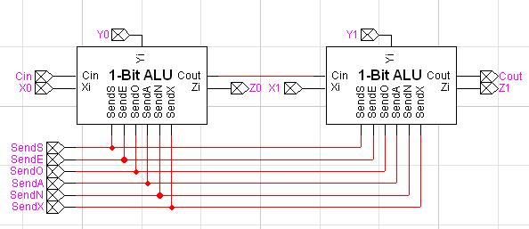
First Attempt Using Black Boxes
(Source: http://nicholasalcock.tripod.com/Comp212/Lab9/2-BitALU.JPG)

Slide 103
Drawing on the First Attempt
(Cascading is Cut-and-Paste)

Slide 104
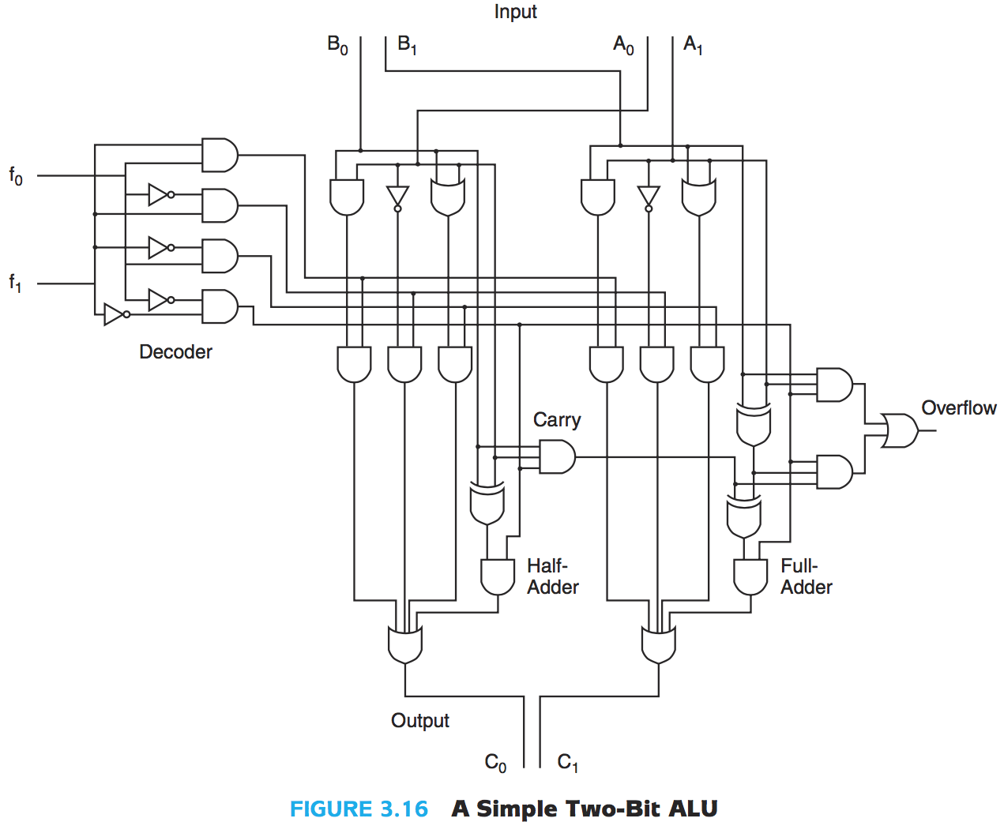
1 bit Adder
4 Sources
C
D
A
B
Exam Q: Tell me what every line does for this 2b ALU
O₁
O₂
(Image Source: Null & Lobur, Essentials of Computer Organization)

Slide 105
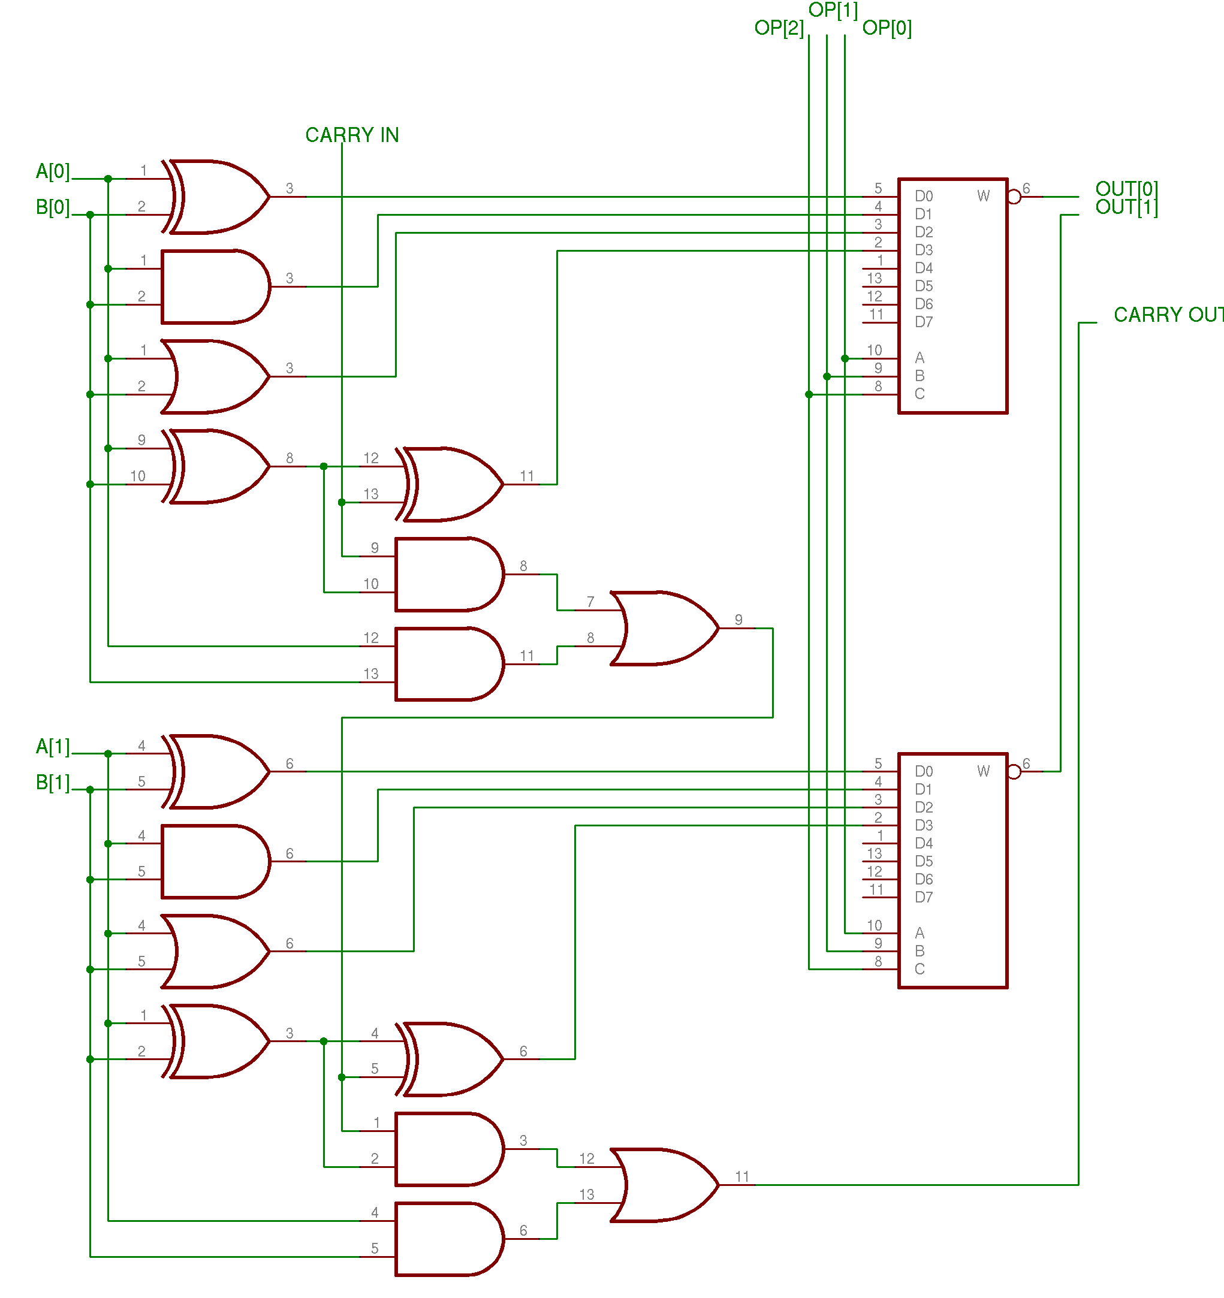
2b Adder, now with Memory!
Carry in
Exam Q: Tell me what every line does for this 2b ALU
A great place to introduce HW2

Slide 106
On Scientific Notation
“Back in the 1960s, someone decided that [because] the powers of 2 were close to the powers of 10…”
  And that we’d only need 1 KB hard drives
  And that 2 digits for a 4 digit date is ok
  And that it’s ok to name HW terms “Hot Plugging”
  And that soon your homes would each hold as many as 2 computers
    (someone stop this someone)
Summary: We use Base₂ in class, but irl “caveat emptor”

Slide 107
END of Combinational Logic
MORE to practice and memorize.
See Null’s Example 3.11 on building a weather alert system for this college

