Slide 1
Building Memory
Instructor: Rob Nash
Readings: See schedule
“Quote”

Slide 2
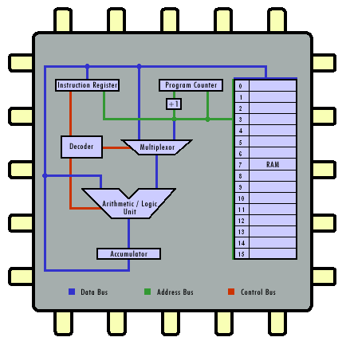
Lets Focus on smaller RAMs and How to Scale RAM
A Smaller RAM Chip
(one package of 16 D-FFs)
A Larger RAM (Set of Chips)
(16 packages of the smaller RAM)
A Simple RISC-Style Machine for Computation
Image source: http://courses.cs.vt.edu/csonline/MachineArchitecture/Lessons/CPU/cpu_circuit.gif

Slide 3
From Smaller to Larger Chips
Expanding Memory Stride
D0 D1 D2 D3 D4 D5 D6 D7 D8 D9 D10 D11 D12 D13 D14 D15
A0
W
D0
A1
D1
A2
A3
A4
D2
A5
A6
D3
A7
A8
D4
A9
A10
D5
A11
A12
D6
A13
A14
D7
OE
CE
A0
W
D0
A1
D1
A2
A3
A4
D2
A5
A6
D3
A7
A8
D4
A9
A10
D5
A11
A12
D6
A13
A14
D7
OE
CE
16-bit data bus, D0..D15
Q: How many bins (mappable locations) per chip? (word=16b)
Q: How many bytes total?
Notes:
A: 2^15
A: since both chips are in use to make a 16 bit bus, still 2^15

Slide 4
Addressable Memory
Defined
Address Space: the amount of externally accessible memory for a processor
If memory is just a matrix, the size of the address space is same as the number of rows in a matrix
  32K x 4 //32 x 2¹⁰ rows where each row holds 4 bits
  The Address space describes the number of “bins”
    The number of slots, or number of things with mappable addresses
Total Memory Capacity is determined by the data width as well as the addressable memory space
  32K x 4 ==128K bits or 16KBytes in total
  16K x 8 == 8K x 16 == 4K x 32 == same Total Memory Capacity
Address bits are connected to decoder to turn on one of many things
  So k address bits can have 2^{k} addressable bins

Slide 5
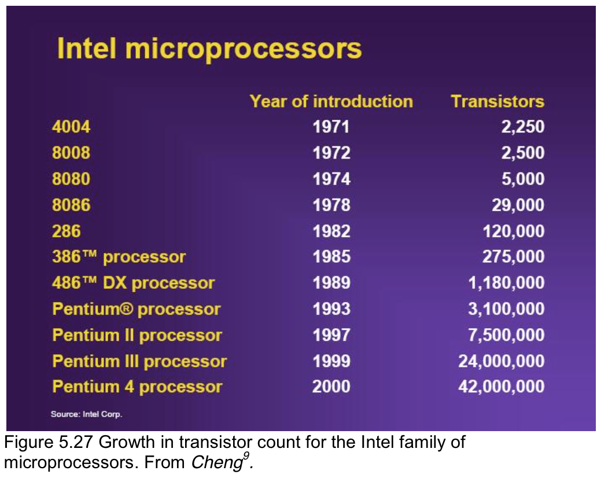
Transistor Density Increase
Q: Can anyone guess the transistor count of the 68K?

Slide 6
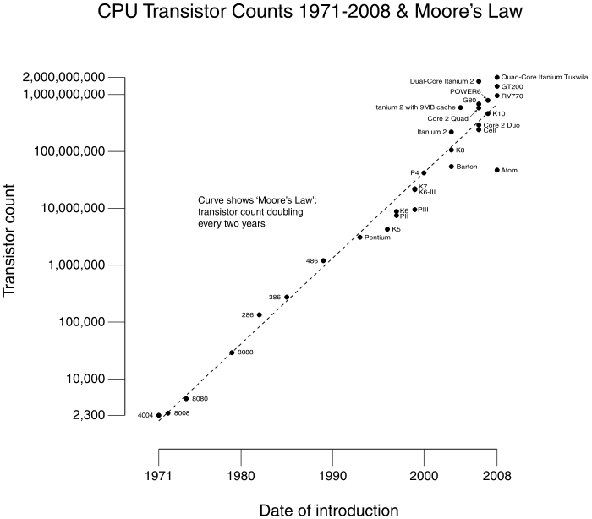
68,000
Notes:
Source: Wikipedia

Slide 7
Memory
RAM
(Volatile)
ROM
(Non-Volatile)
D
S
DRAM
(slow & small & cheap & refresh)
SRAM
(fast & large & expensive)

Slide 8
Memory
RAM
(Volatile)
ROM
(Non-Volatile)
D
S
DRAM
(slow & small & cheap & refresh)
SRAM
(fast & large & expensive)
EDO
MDRAM
(multi-bank)
FPM
(Fast-Page Mode)
Synchronized
RDRAM
(rambus)
Notes:
FPM is also just called Page Mode RAM, avoids an inefficiency in precharging a row with successive column accesses.
EDO is similar to FPM, but with an overlap (pipelining) in part of the accesses
MDRam is suitable for low end graphics cards, costs less than SRAM
RDRam lost to DDR in a standards war, even after Intel acquired Rambus (think: Beta vs VHS)

Slide 9
Memory
RAM
(Volatile)
ROM
(Non-Volatile)
D
S
DRAM
(slow & small & cheap & refresh)
SRAM
(fast & large & expensive)
EDO
MDRAM
(multi-bank)
FPM
(Fast-Page Mode)
Synchronized
RDRAM
(rambus)
Burst EDO
SDRAM
(synchronous)
SL
(Synch-Link)
DR
(direct rambus)
DDR
(double data rate)

Slide 10
Memory
RAM
(Volatile)
ROM
(Non-Volatile)
D
S
DRAM
(slow & small & cheap & refresh)
SRAM
(fast & large & expensive)
SSRAM
(synch)
AS-SRAM
(asynch)
PB
(pipeline burst)
EDO
MDRAM
(multi-bank)
FPM
(Fast-Page Mode)
Synchronized
RDRAM
(rambus)
Burst EDO
SDRAM
(synchronous)
SL
(Synch Link)
DR
(direct rambus)
DDR
(double data rate)
Notes:
Hyphens.

Slide 11
A: ROM used to mean READ ONLY, but now means Non-Volatile
Memory
RAM
ROM
(Non-Volatile)
DRAM
SRAM
PROM
(programmable via blown fuses, one time)
EPROM
(Erasable Programmable, specialized tools, erase entire chip)
EEPROM
(Electrically Erasable Programmable, no specialized tools, erase 1b at a time)
PROM Evolution over Time
Flash Memory
(Electrically Erasable Programmable, no specialized tools, block at a time, NAND and NOR)
Q: OK, Flash is a ROM?

Slide 12
Memory Device Characteristics
Address Lines to Bus
Data in/out (bidirectional) to Bus
A0 A1 A2 A3……….A15
D0 D1 D2 D3 D4 D5 D6 D7
0 == Turn chip on
A.k.a. Select this Chip
Prereq for any IO
0 == Writing to memory chip (storing)
A.k.a Inputting from the data bus
(Requires that the chip be on/selected)
(Requires data and address)
CS
W
0 == Outputting our memory to the Data Bus
A.k.a Recalling the value from our memory
(Requires that the chip be on/selected)
OE
!W, !CS, !OE live in the Control Bus
Example: 512 Kbit Total Memory Capacity organized as 64K x 8

Slide 13
Memory Device Characteristics (old)
Address is unidirectional
Used for READS or for WRITES to memory
Q: Why 16 lines?
Data in/out (bidirectional)
Typically 4, 8, 16, 32 bits wide
…
A0 A1 A2 A3……….A15
D0 D1 D2 D3 D4 D5 D6 D7
(HEX)
0000
0001
0002
0000 0000 0000 0000
0000 0000 0000 0001
0000 0000 0000 0010
CS
W
Chip Select
Active low
Master switch for device
Write Enable
Active low
Active on WRITES
OE
FFFD
FFFE
FFFF
1111 1111 1111 1101
Output Enable
Active low
Active on READS
1111 1111 1111 1110
1111 1111 1111 1111
Example: 512 Kbit device organized as 64K x 8
(Original Source: Arnie Berger)

Slide 14
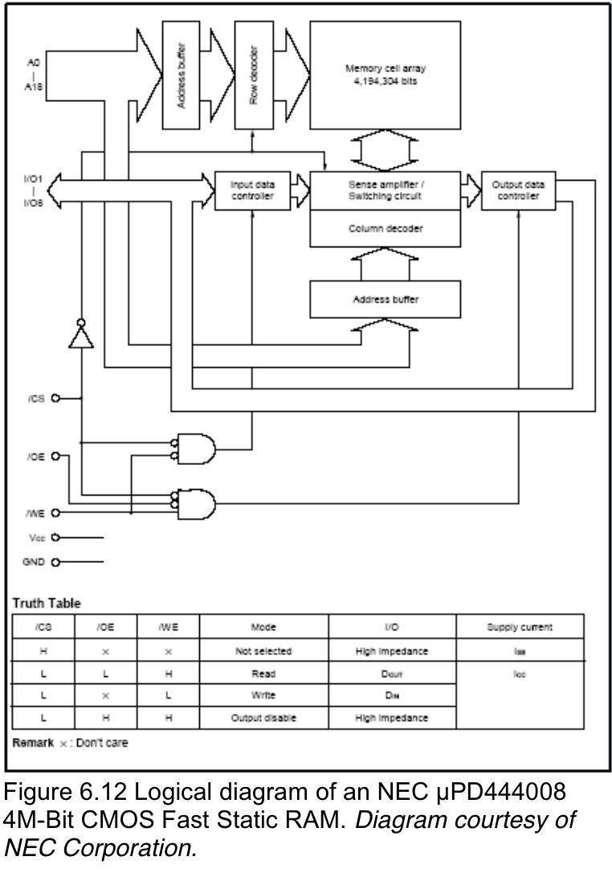
NEC SRAM
μPD444008
4Mb CMOS Static RAM
Exposed as 512Kx8
  Inside, a huge XY
Has a global !CS
Commercially available
  μPD444008-8
  μPD444008-10
  μPD444008-12
  Q: What are these?
All of this is invisible to programmers
A: Access times in nanoseconds
Notes:
From characteristics to a real memory array
Guest chip! An Embedded SRAM

Slide 15
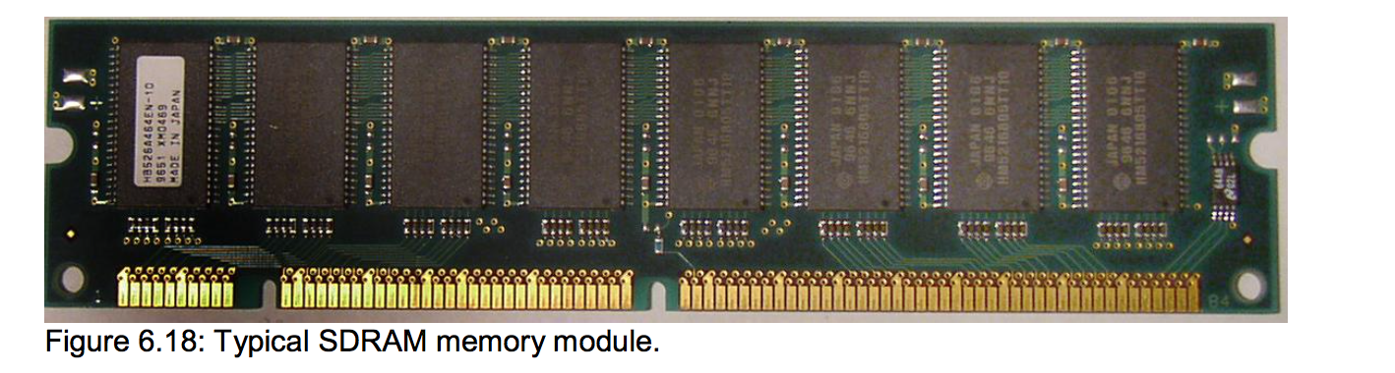
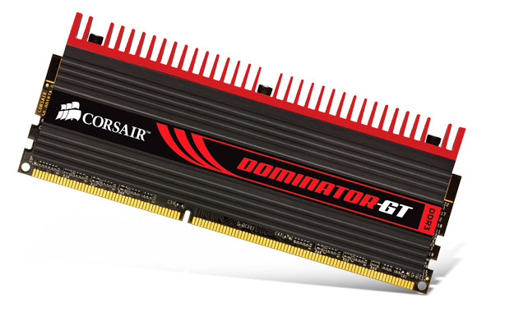
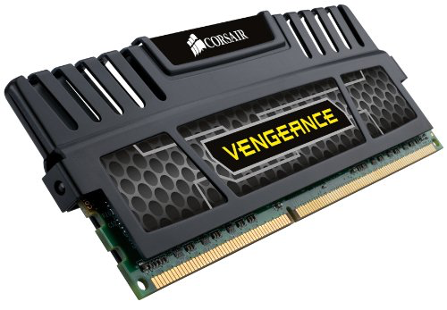
From SRAM (Embedded) to Extendable DRAM (PC)
Static over Dynamic
Architecture “hopping” here to showcase RAM similarities.
The total size above is 64MB (64M x 8b) for the master chip
Q: Notice anything below? Why the RAM “covers”?
A: heat sinks, and the master chip is composed of multiple subchips, and they may differ in stride and capacity!
A: 16 subchips that are each 1M x 32b (==2⁴ * 2²⁰ * 2² Bytes)

Slide 16
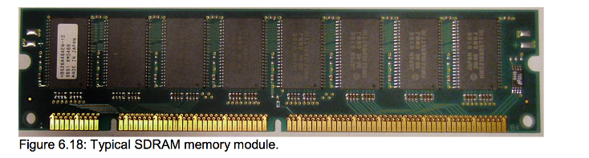
Memory Extension (XY)
Now, suppose you want to build a memory with the capacity of 32 X 8 bits
But, you have a number of 16 X 4 (nibble) memory chips
How to arrange the small chips to have a 32 X 8 memory?
16 X 4
32 X 8

Slide 17
Memory Extension (Y x X)
Y-Axis
Increase the Address Space vertically
Increase the Data Stride horizontally
X-Axis
16 X 4
?
32 X 8
Page 0
16 X 4
16 X 4
Page 1
16 X 4
16 X 4
  A: Split the chips up into pages
  A: Use the first (or last) line to select the page
    (low versus high order interleaving in Null)
Q: How can the two of the 4-bit RAMs connect to form 8 bits?
Alt-Q: How can two pairs of 4 address lines map to 5 address lines?

Slide 18
Extending Memory Addresses
Large memories can be constructed by combining smaller memory chips
Suppose you want to have a memory with the capacity of 32 X 8
  But, you have a number of 16 X 8 memory chips
  How to arrange the small chips to have a 32 X 8 memory?
You extend your systems RAM by adding more DIMMs
Q: How might a DIMM extend itself? A: The same method.
Q1: How many pins (address lines) does the smaller chip have?
Q2: The larger?
32 X 8
8
A0
16 X 8
D0
D7
A0
D0
D7
8
A4
A3
8
8
A: Fit the smaller memory into the larger.
Q3: But how would you arrange this?
A1: 4 for 16 bins
A2: 5 for 32 bins.
Notes:
Q: Or, how many address in lines does the smaller chips have?
Q: The larger chip?

Slide 19
Paging Example
Rule: if you can make it, you can black box it
Q: How can we map the outer 5 address lines (A0-A4) to the two smaller chips?
What's inside this?
A4 is Page/Chip Select
1x2
Decoder
A4
?
Address
Space
A3
Page 0 (16x8)
A3
A2
A1
A2
A0
CE
A1
A3
Page 1 (16x8)
A2
A0
A1
A0
CE
Adding Pages of chips in the Y-Axis Increases…
the # of Mappable Locations, thus Total Memory Capacity
the number of address wires to pick a page

Slide 20
Y by X Memory Dimensions
X Axis Determines Data Stride or Word Length (Data Bus)
Y
Ax
i
s
-Addr Bus
Y locations & X bits per location
Q: What is the depth & width here?
Consider various Y x X configurations:
64M x 8 //64MB
4G x 32 //16GB as 4Gx4B
16M x 16 //32MB
128K x 128 //Vector proc, VMEM
16 X 4
16 X 4
16 X 4
16 X 4
Depth(Y) x Stride(X)
Determines the depth of the Address Space thus size of the Address Bus

Slide 21
Exercise #1
Each memory chip can be expressed with its capacity (addressable spaces x data bits) in bits
Y x X capacity indicates Y addressable spaces each with X data bits
Q: How many address lines and input-output data lines are needed for each of the followings capacity of memories?
64 addressable spaces at 32 bits wide (no byte-selection here)
  Q: How many address lines?
  Q: How many IO data path lines?
A 2K X 16b chip, without byte-selection
  Q: How many address lines?
  Q: How many IO data path lines?
  Q: What if we desired byte-selection? How would that affect our busses?
11A: 2⁶ == 64, so 6 addr lines
12A: 32 bits == 32 data lines
21A: 2¹⁰ * 2¹ == 11 addr lines
22A: 16 bits == 16 data lines
23A: 2 Bytes == +1 addr line

Slide 22
Exercise #2 (is 2-Person)
Each memory chip can be expressed with its capacity (addressable spaces x data bits) in bits
Y x X capacity of memory indicates Y addressable spaces each holding X-bits of data
Q: How many data IO lines are needed for each chip below?
Q: How many address lines are needed for each chip below?
(Express answers in Y x X)
512K X 16 //no byte selection for any of these
16G X 8
32M X 32
128M X 64
A1: 2¹⁹, so 19 addr x 16 data
A2: 2³⁴, so 34 addr x 8 data
A3: 2²⁵, so 25 addr x 32 data
A4: 2²⁷, so 27 addr x 64 data

Slide 23
Null Interleaving Example
A5i: (larger) 2⁷ slots * 2² Bytes = 512 Bytes = 4Kbits
A5ii: (larger) 8 chips * 64 Bytes each = 512 Bytes
128 x 32
Nx32
16x32
Nx32
16x32
Assume a 128 x 32 bit memory (no Byte Select)
  Built using smaller N x 32 memory chips
    This is called “interleaving” memory chips in Null’s text
If we want an “8-way interleaved memory”
  Just a memory built with 8 pages in other terminologies
Assuming 8 smaller chips (one per page)…
Q1: What should their size N be to fill the larger memory?
Q2: How many address bits to you need to pick from N things?
Q3: How many page bits to pick from amongst 8 chips/pages?
Q4: What is the size of the total address space of the small chip?
Q5: What is the size of the total address space of the large chip?
Q6: How many address bits are needed for the large chip?
Nx32
16x32
Nx32
16x32
Nx32
16x32
Nx32
16x32
Nx32
16x32
Nx32
16x32
Offset(4)
Page(3)
Outer Address (7)
(Low Order Interleaving)
MSB
LSB
“Right into your memory banks”
A1: 128 slots/8 chips = 16 addressable slots per smaller chip
A2: Log₂16 = 4 address lines per smaller chip (a.k.a. offset bits)
A3: Log₂8 = 3 page bits to select one of 8 pages/chips (using a decoder)
A4: (smaller) 16 x 32b = 2⁴ slots * 2⁵ bits = 512 bits = (/8=64 Bytes)
64 Byte
A5: (larger) 128 x 32b = 2⁷ slots * 2⁵ bits = 4Kbits (/8=512Bytes)
512 Byte
A6: Log₂128 = 7 address lines (page(3) + offset(4))
Notes:
No Byte Selection Here

Slide 24
Low V.S. High Order
Dictates Access Patterns
RAM Address using High-Order Interleaving
Page bits (5)
Offset bits(7)
Byte Selector bits(1)
BS?
There are performance considerations for both configurations
Consider multiple 8 element arrays (colored indices here)
Low-order interleaving
  Consecutive addresses in memory will be stored in different memory chips/banks/pages
    Perf: we can access neighboring elements in parallel (all 8 here)
High-order interleaving
  Consecutive addresses in memory will be stored consecutively in a chip (overflow goes to the next chip)
    Perf: caches can prefetch sequentially neighboring elements.
Low
Order
High
Order
0,0,0,0
0,1,2,3
1,1,1,1
4,5,6,7
2,2,2,2
0,1,2,3
3,3,3,3
4,5,6,7
4,4,4,4
0,1,2,3
5,5,5,5
4,5,6,7
6,7,7,7
0,1,2,3
7,7,7,7
4,5,6,7
RAM Address using Low-Order Interleaving
Offset bits(7)
Page bits (5)
Byte Selector bits(1)

Slide 25
Byte Addressable V.S. Word Addressable
Bytes are the smallest addressable collection today
Words are the “default” size of your machine’s operations
  Composed one or more bytes (2 here), machine specific
More than words
Byte-Addressable Memory (x1)
Word-Addressable Memory (x2)
Address | Contents (0x)
0x0 | FA
0x1 | AA
0x2 | 10
0x3 | 1F
Address | Contents (0x)
0x0 | FA
0x1 | AA
0x2 | 10
0x3 | 1F
Addresses are issued in multiples of 2, with each word being targetable (aligned access)
Fetching the contents at 0x2 delivers the word 0x101F
  Use masks/shifting to isolate bytes
Writing to address 0x2 writes to 0x3 as well!
Fetching address 0x1 or 0x3 is nonaligned
Addresses move in multiples of 1, with every byte being targetable
Fetching the contents at 0x2 delivers the byte holding value 0x10

Slide 26
Consider 3 Lines (Address or Byte Select)
Just 3 address lines means…
A limited amount of mappable memory
A limited number of ways to subdivide this memory & it’s control logic
All address bits are used to define the max number of mappable bins, where each bin holds one byte (3 addr bits, no BS bits)
32x8
32x8
One address/page selection bit and two byte selector bits (1,2)
32x8
A mix of address/page selection bits and byte selector bits (2,1)
32x8
32x8
32x8
32x8
32x8
1
3
32x8
32x8
32x8
32x8
32x8
32x8
32x8
32x8
32x8
32x8
2
2
32x8
32x8
32x8
0
No address lines here, all 3 lines select one byte from 8
32x8
32x8
32x8
32x8
32x8
32x8
32x8
32x8
32x8
32x8
32x8
1
3
0
Same Area == Same amount of RAM
Notes:
Consider just one of the 32x8 Black boxes to dive into here

Slide 27
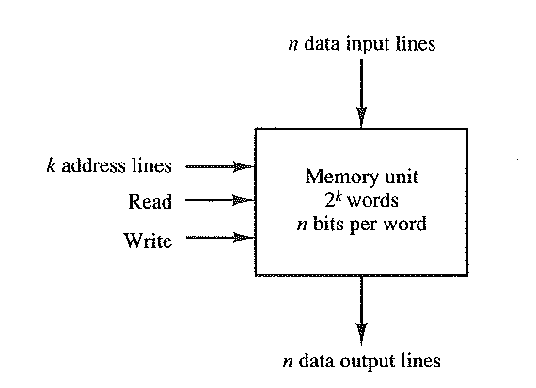
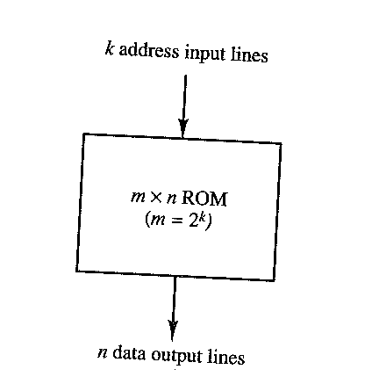
Selecting Bytes
A1: 128 slots * 4 bits == 512b total
A2: 2^7 == 128, so 7 addr lines to pick
A3: 512/8 == 2^9/2^3 == 2^6 bins/slots
A4: 6 address lines to pick from 2^6
A5: 19 addr lines, 16 data lines
A6: 19 addr lines + 1 byte select line
(Stride)
(Depth)
RAM
ROM
Example: Given a 128 x 4 bit chip….
  Q1: What’s the total storage capacity, in bits?
  Q2: What is k (# of addr lines) assuming we can nibble select?
Next, consider a chip that is 512 total bits divided into 8 data lines
  Q3: How many addressable slots for 512b total and byte-sized words?
  Q4: What is k, the number of addr lines?
Next, assume a 512K x 16b chip, and word-selection (not byte-selection).
  Q5: What's the size of the address bus? How many data bus?
  Q6: Now, same chip but with the ability to byte-select?
Notes:
\

Slide 28
High & Low Order Example
Nx8
128x8
128x8
4Kx16
Nx8
Non-matching Data Strides
Nx8
Nx8
128x8
128x8
128x8
128x8
…
…
Byte Addressable
…
…
Nx8
Nx8
128x8
128x8
Assume a 4K x 16 word memory
Build a 32-way interleaved memory
  Just a memory built with 32 pages in other terminologies
Assume we have only N x 8 chips, where you can pick N
Q: What should N be to support 32 pages of chips?
Q2: How many bits needed to pick from amongst 32 pages?
Q3: How many bits do we need if we want byte addressing?
Q4: Show the address assuming high-order interleaving
  Q: Msbs do what?
  Q: Lsb does what?
Q5: Now show the address using low-order interleaving
    Locality: consider an array: if the low-order bits specify the page, then successive elements are stored across multiple memory banks and may be accessed in parallel.
A1: N should be 4K/32 = 2⁷ or 128 addressable locations per smaller chip
A2: for 32-way interleaved memory, we need 5 page bits to select from 32 pages
A3: Each location stores 2 Bytes, so we need 1 extra address wire to control BS
RAM Address using High-Order Interleaving
Page bits (5)
Offset bits(7)
Byte selector bits(1)
Chip/Page Select
Byte Select
RAM Address using Low-Order Interleaving
Offset bits(7)
Page bits (5)
Byte selector bits(1)
Notes:
N==128, since 32*128 == 4K
Page: 5, Offset:7 BS: 1

Slide 29
Lower Order Exercise
Meta-Address Bits (no BS)
Smaller Addr Lines
Page bits
Meta-Address Bits w Byte Selection
Smaller Addr Lines
Page bits
BS
Build a 2048 X 32 memory using 256 X 8 memory chips with and without byte-selection.
  Q1: How many address lines and data lines in the 256 X 8 chips?
  Q2: How many address lines and data lines in the 2048 X 32 memory?
  Q3: What n-way interleaving is this? (i.e. How many pages?)
  Q4: How many chips per page?
  Q5: How many 256 X 8 memory chips you should have total?
    Divide larger memory bits by smaller memory bits
  Q6: Draw the smaller chips in rows inside the larger chip; how many per “row” or page?
A1: 256 = 2⁸ so 8 address lines and 8 data lines
A2: 2048= 2K = 2*2¹⁰=2¹¹ so 11 address lines and 32 data lines
…
A3: 2K/256 = 2¹¹ / 2⁸ = 2³ pages of chips, so 8 way interleaving
A4: Smaller data stride is x8 and the larger is x32, so 4 chips per page
A5: 8 pages of chips where 4 chips per page, so 32 chips total
Alt: 2¹¹*2² Bytes / 2⁸*1Byte =2¹³/2⁸=2⁵ = 32 chips
Page 0
256x8
256x8
256x8
256x8
Notes:
4 chips per page and 8 pages

Slide 30
Guest Memory Chip Characteristics
~CS
~OE
Address interface is 15 lines for 32K bins
(one-way Addr Bus)
32K x 8
A0
…
A14
Control logic is 2 lines (Active low; Control Bus)
D7
D0
(Add this later, redundant)
Smaller memory data interface is 8 lines
(attaches to the Bi-Directional Data Bus)
~W
Interfacing Smaller Memory to Larger Chips Big Ideas
Idea: Build a larger memory chip in terms of data stride. 8b->16b?
Idea: Build a larger memory with in terms of addressable bins? 32K-> 64K?
Notes:
A: CE( chip enable) OE (output enable, read vs write)
A: cut-and-paste

Slide 31
Y & X Dimensions Scale Memory
X Axis Determines Data Stride or Word Length
Y
Ax
i
s
Add
r
Consider various Y x X configurations:
64M x 8 //64MB
4G x 32 //16GB as 4Gx4B
16M x 16 //32MB
128K x 128 //Vector proc, VMEM
A0
32K x 8
…
A14
D7
D0
Depth(Y) x Stride(X)
Q1: What if we wanted our chip to have a larger data stride, such as the 16b word on the M68K (external bus)?
Determines the depth of the Address Space
Q2: What if we wanted our chip to have more addressable bins, such as the 16M locations found on the 68K?

Slide 32
Cut-and-Paste (in X)
To Expand IO Width/Stride
X Axis Determines Data Stride or Word Length
A Page
(a logical set
of chips that
increases
data stride)
A0
32K x 8
32K x 8
A0
A0
Page Interface(15)
…
…
…
A14
A14
A14
D15
D8
D7
D0
Data IO upgraded to 16b
By adding more chips in the X dimension, we upgraded our word size to 16b
We want our chip to have more than one page, so that the total RAM is 64Kx16 Q: How do we add a page here?
A: you already cut and paste in the x dimension, now do so for the y

Slide 33
Cut-and-Paste (in Y)
To Expand Address Space
A: Add a 1:2 decoder and wire to pick
Page 0
A0
A0
32K x 8
32K x 8
A0
…
…
15+
A14
A14
16+
A14
A15
?
Q: How do we pick a page/row?
(hint: decoder)
D15
D8
D7
D0
Page 1
A0
32K x 8
32K x 8
A0
…
…
A14
A14
~CS
~CS
~OE
D15
D8
D7
D0
Q: How do we control page selection (in the y) or byte selection (in the x)?

Slide 34
Outer Memory Interface:
(Inner Memory Address Wires + Control Wires)
Page 0
A0
A0
32K x 8
32K x 8
A: Add a 1:2 decoder and wire to pick
A0
…
…
17!
A14
A14
16+
A14
A15
A16
D15
D8
D7
D0
Page 1
A0
32K x 8
32K x 8
A0
…
…
A14
A14
~CS
~CS
~OE
~OE
D15
D8
D7
D0
Q: Next, how do we pick or select a byte(column)? (hint: decoder)
Q: How do we control page selection (in the y) or byte selection (in the x)?
A: We control the larger chip via 17 “address” lines ( & control);
Address offset bits for the smaller memories (A0-A14)
a Page Selector (A15, turns on a whole row of chips)
a Byte Selector (A16 here, but typically lsb)

Slide 35
Again: Decoding the Memory Space
Design the SRAM (64K x 16) memory system using 256K bit (32K x 8) SRAM chips
Address Bus: A0..A14
16
W
W
W
A0
D0
A0
D0
Map Wires for Address &
Control?
To uP
A1
A1
D1
A2
D1
A2
OE
A3
A3
A4
D2
A4
D2
A15
?
A5
A5
A6
D3
A6
D3
A7
A7
A8
D4
A8
D4
A9
A9
Different Interface
A10
D5
A10
D5
A11
A11
A12
D6
A12
D6
A13
A13
A14
D7
A14
D7
ADDRESS DECODE LOGIC
OE
CE
OE
CE
Data Bus: D0..D15
RD
2
CE0
A0
W
D0
A0
W
D0
WR
A1
D1
A1
D1
A2
A2
CE1
A3
A3
A4
D2
A4
D2
To uP
A5
A5
A6
D3
A6
D3
A7
A7
A8
D4
A8
D4
A9
A9
A10
D5
A10
D5
A11
A11
A12
D6
A12
D6
A13
A13
A14
D7
A14
D7
OE
CE
OE
CE

Slide 36
Decoding the Memory Space
Design the SRAM (64K x 16) memory system using 256K bit (32K x 8) SRAM chips
Start with Black Boxes and drill down
Address Bus: A0..A14
~CS
~OE
~CS
~OE
To uP
W
A0
W
D0
A0
W
D0
Control Line Decoder
A1
A1
32K X 8
32K X 8
A2
D1
A2
D1
OE
A3
A3
A4
D2
A4
D2
A15
?
A5
A5
A6
D3
A6
D3
A7
A7
A8
D4
A8
D4
A9
A9
A10
~CS
D5
A10
D5
~CS
~OE?
~CS?
A11
A11
A12
D6
A12
D6
Notice These Control Wires?
A13
A13
A14
D7
A14
D7
ADDRESS DECODE LOGIC
OE
CE
OE
CE
Data Bus: D0..D15
RD
?
~CS
~OE
~CS
~OE
CE0
A0
W
D0
A0
W
D0
32K X 8
32K X 8
WR
A1
D1
A1
D1
A2
A2
CE1
A3
A3
A4
D2
A4
D2
A5
A5
A6
D3
A6
D3
To uP
A7
A7
A8
D4
A8
D4
A9
~CS
A9
A10
~CS
A11
D5
A10
D5
A12
A11
A13
D6
A12
D6
Added ~W
A14
A13
D7
A14
D7
OE
CE
OE
CE
“on”, “read”, “write”
Map A0-A14 to smaller memory (offset bits)
Map A15 to page selection (Q: ~OE or ~CS or ~W?)
Map RD/WR to storing or retrieving (Q: ~OE or ~CS or ~W?)
~CS
~OE
~W

Slide 37
Decoding Memory
Design the SRAM (64K x 16) memory system using 256K bit ( 32K x 8 ) SRAM chips
Unbox Smaller Memory & drill down
Notice OE, CE, & W control lines here
Address Bus: A0..A14
To uP
W
A0
W
D0
A0
W
D0
A1
A1
D1
A2
D1
A2
OE
A3
A3
A4
D2
A4
D2
A15
?
A5
A5
A6
D3
A6
D3
A7
A7
A8
D4
A8
D4
A9
A9
A10
D5
A10
D5
What do these do?
Q:What feeds these?
A11
A11
A12
D6
A12
D6
A13
A13
A14
D7
A14
D7
ADDRESS DECODE LOGIC
OE
CE
OE
CE
Data Bus: D0..D15
RD
CE0
A0
W
D0
A0
W
D0
WR
A1
D1
A1
D1
A2
A2
CE1
A3
A3
A4
D2
A4
D2
A5
A5
A6
D3
A6
D3
To uP
A7
A7
A8
D4
A8
D4
A9
A9
A10
D5
A10
D5
A11
A11
A12
D6
A12
D6
A13
A13
A14
D7
A14
D7
OE
CE
OE
CE
~CS
~OE
~W
\
“on”, “read”, “write”

Slide 38
Decoding Memory
Notice how this example flips page axes?
Notice how we synthesize two redundant lines from one? (CE0|1)
Notice how W and OE are controlled by RD/WR?
A: This memory system cannot address individual bytes – only words!
Q: Can we access bytes in this system? If so, how?
Address Bus: A0..A14
Page 0
Page 1
To uP
W
What about this?
A0
W
D0
A0
W
D0
A1
A1
D1
A2
D1
A2
OE
A3
A3
A4
D2
A4
D2
A15
Page selection
A5
A5
A6
D3
A6
D3
A7
A7
A8
D4
A8
D4
A9
A9
A10
D5
A10
D5
What do these do?
What feeds these?
A11
A11
A12
D6
A12
D6
A13
A13
These control Data Bus IO
A14
D7
A14
D7
ADDRESS DECODE LOGIC
OE
CE
OE
CE
Data Bus: D0..D15
RD
CE0
A0
W
D0
A0
W
D0
WR
A1
D1
A1
D1
A2
A2
CE1
A3
A3
A4
D2
A4
D2
A5
A5
A6
D3
A6
D3
To uP
A7
A7
A8
D4
A8
D4
A9
A9
A10
D5
A10
D5
A11
A11
A12
D6
A12
D6
A13
A13
A14
D7
A14
D7
OE
CE
OE
CE
~CS
~OE
~W
\
“on”, “read”, “write”
Notes:
If we looked inside the address decode logic, we would see A15 controls CE0, CE1 and RD,WR controls W,OE
BUT!

Slide 39
Processor-to-Memory & Addresses
Suppose a µP has a 17-bit address bus and 16-bit wide data bus, and it has byte-addressable addressing. And this µP is connected to a memory system M which is built with 32K x 8 devices and uses high-order interleaving.
1 | 15 | 1
Page | Offset | byte
msb
lsb
17
1
Byte selection (LSb)
µP
External View
of an
Address Ignores
Control Wire V.S.
Address Wire
Distinction
15
Divide the Outer, Local
Memory Interface Into
Three Groups
{Page, Offset, BS}
1
Page selection (MSb)

Slide 40
Introduction to Assembly on the 68K
Lets become coding masters!
  Full speed ahead!

Slide 41
404 Not Found
ERROR

Slide 42
Processor-to-Memory Interface
(Disassembler Trial Groups?)
Consider a group that may end up as your Disassembler team,
  Work together, but everyone will have their own clicker answer
After 5-8 minutes, vote on each answer
If you finish early, see exercise 5 & 6 & 7
Page bits are on the low end?
Low-order interleaving.
# of addressable bins (larger)
--------------------------------------- = # of pages
# of addressable bins (smaller)
Meta-Address Bits (no BS)
Smaller Addr Lines
Page bits
# of Bytes or bits (larger)
--------------------------------------- = # of chips
# of Bytes or bits (smaller)
Meta-Address Bits w Byte Selection
Smaller Addr Lines
Page bits
BS
# of chips
----------------------------- = chips per page
# of pages
If byte-selectable on an N x 8 system: addressable bins == addressable bytes == 2^{N}
If byte-selectable on N x M where M >8 , this means:
more than one byte per page (could still be one chip per page)
# of mappable bins is less than 2^{N} as lines must now be dedicated to Byte Selection
  In this example, 2 bits for BS, so 2^{(n-2)} == 2⁸ mappable bins, each holding 4B

Slide 43
Address Space Partitioning (Group Question #1)
Build a 1GB memory (1G X 8 memory organization)
Use 4 MB memory chips.
  Q1: How many address lines (offset bits) for the smaller memory?
  Q2: How many address lines for the larger memory?
  Q3: How many 4 MB memory chips are used?
  Q4: How many chips per page?
  Q5: How many pages do you have?
  Q6: How many page selection bits?
# of addressable bins (larger)
--------------------------------------- = # of pages
# of addressable bins (smaller)
# of Bytes or bits (larger)
--------------------------------------- = # of chips
# of Bytes or bits (smaller)
# of chips
----------------------------- = chips per page
# of pages
A1: 4Mx8 == 2²², so 22 addr/offset lines
A2: 1Gx8 == 2³⁰, so 30 addr lines
A3: 1G/4M == 2³⁰/2²² = 2⁸ chips = 256
A4: One chip per page
A5: Same as the number of chips
A6: 2^{x} == Y number of pages, or log₂Y=x
Meta-Address Bits (no BS)
Smaller Addr Lines
Page bits
Meta-Address Bits w Byte Selection
Smaller Addr Lines
Page bits
BS

Slide 44
Group Exercise #2
Build a 1MB memory (1M X 8 memory organization)
Use 64KB memory chips.
  Q1: How many address lines for the larger memory?
  Q2: How many address lines for the smaller memory?
  Q3: How many 64 KB memory chips are used?
  Q4: How many pages you will have?
  Q5: How many chips per page?
  Q6: How many page selection bits you need?
  Q7: Draw the address using low-order interleaving.
A1: 1Megax8 == 2²⁰ so 20 addr lines
A2: 64Kx8 == 2¹⁶, so 16 addr lines
A3: 2²⁰/2¹⁶==2⁴, so 16 chips
A4: 16 pages
A5: 1 chip per page, since both are x8
A6: 4 page bits for 16 pages
Meta-Address Bits (no BS)
Smaller Addr Lines
Page bits
Meta-Address Bits w Byte Selection
Smaller Addr Lines
Page bits
BS

Slide 45
Processor and Memory #3
Suppose a µP has a 17-bit address bus and 16-bit wide data bus, and has no byte-addressable addressing. And this µP is connected to a memory system M which is built with 32K x 8 devices.
  Q1: How many address lines and data lines at µP?
  Q2: What is the total capacity of the µP? (the total number of bytes to fill the address space)
  Q3: How many address lines and data lines in the smaller memory? (How many address lines and data lines per 32K x 8 chip?)
  Q4: How many page selection bits in the memory system M?
  Q5: How many byte selection bits in the memory system M?
  Q6: How many of the smaller memory chips are in the µP?
  Q7: Draw the larger memory as pages of smaller memories.
A1: 17-bit address bus, so 17x16
A2: 2¹⁷ bins, each holding 2 Bytes == 256KB
A3: 32K == 2¹⁵, so 15 address lines
A4: 17-15 == 2 page bits. Or 128K/32K == 4 pages
A5: None, by definition
A5: 2 chip per page to match the x16 data stride
A6: 4 pages with 2 chips per page == 8
# of Bytes or bits (larger)
--------------------------------------- = # of chips
# of Bytes or bits (smaller)
# of addressable bins (larger)
--------------------------------------- = # of pages
# of addressable bins (smaller)
# of chips
---------------- = chips per page
# of pages
If byte-selectable on an N x 8 system: addressable bins == addressable bytes == 2^{N}
If byte-selectable on N x M where M >8 , this means:
more than one byte per page (could still be one chip per page)
# of mappable bins is less than 2^{N} as lines must now be dedicated to Byte Selection
  In this example, 2 bits for BS, so 2^{(n-2)} == 2⁸ mappable bins, each holding 4B

Slide 46
Color Blind Example #4
A µP has 10-bit address bus and 32-bit wide data bus. Assume that you are accessing a memory system that has been built using 128 x 8 memory chips. The µP is byte-addressable.
  How many bits do you need for byte selection?
  How many offset bits do you need?
  How many pages do you have?
  Divide the 10-bit address lines into page number bits, offset bits and byte address bits.
  How many 128 x 8 memory chips do you need to completely fill the memory space of this processor?
  How much memory total does the processor have, in Bytes?
  Draw the configuration.
A1: 4 Bytes, so 2 BS bits
A2: log₂128 = 7 offset bits
A3: 10-2-7 = 1 page bit for 2 pages or 2¹⁰/2⁷ =2³ chips and if 4 chips/page, 2 pages
# of addressable bins (larger)
--------------------------------------- = # of pages
# of addressable bins (smaller)
# of Bytes or bits (larger)
--------------------------------------- = # of chips
# of Bytes or bits (smaller)
# of chips
----------------------------- = chips per page
# of pages
A4: (1)(7)(2)
page(1) | offset(7) | byte(2)
A5: 4 per page & 2 pages = 8 chips
A6: 4 chips per row/page and 2 rows
Page 0
128x8
128x8
128x8
128x8
If byte-selectable on an N x 8 system: addressable bins == addressable bytes == 2^{N}
If byte-selectable on N x M where M > 8, this means:
more than one byte per page (could still be one chip per page)
# of mappable bins is less than 2^{N} as lines must now be dedicated to Byte Selection
  In this example, 2 bits for BS, so 2^{(n-2)} == 2⁸ mappable bins, each holding 4B

Slide 47
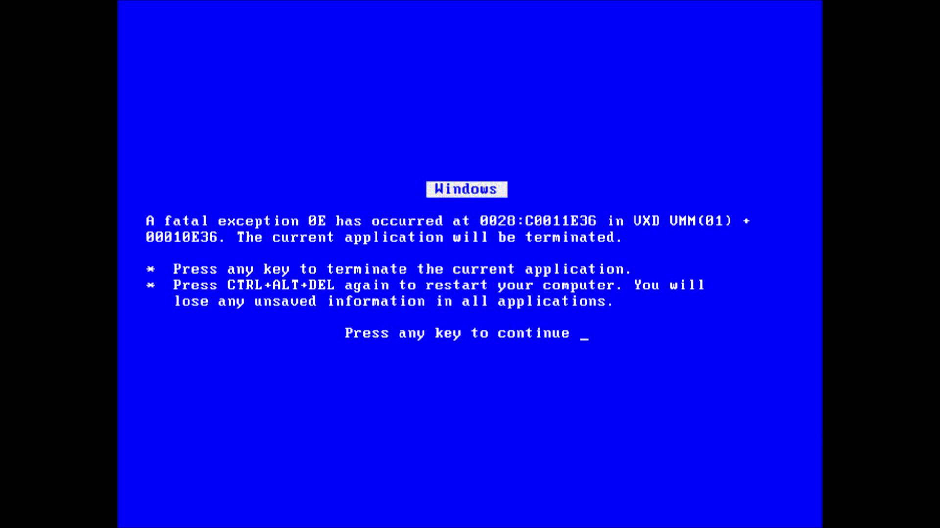
Page : Offset
What else?

Slide 48
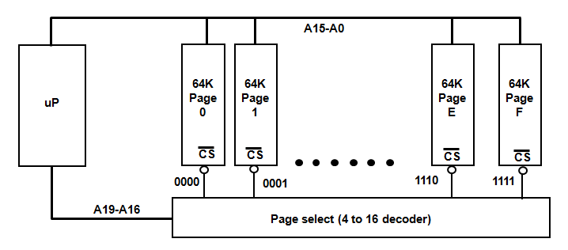
Paging
Processors with smaller address spaces can still manipulate larger memory arrays with techniques such as Paging
  Special memory or I/O location used to swap in and out memory pages
Hardware paging should not be confused with virtual addresses & VPaging
In the figure below, writing a data value to the page select register will cause a page swap to occur
Page Select
Register

Slide 49
Paging
Suppose a larger memory chip has 32 X 8 capacity.
An inner memory chip has 16 addressable spaces
You need 2 smaller pages to build the larger chip
How could we address data at 14 and 30?
  Method 1: Read an absolute address
  Address 14 = 01110
  Address 30 = 11110
  Method 2: Read with page number and offset, (assuming that 0 to 15 at the 0th page, 16-31 on the next page.)
    Address 14 = 0 1110 (page 0 : offset 1110)
    Address 30 = 1 1110 (page 1 : offset 1110)
Address Data
0
1
2
3
4
5
6
7
8
9 10 11 12 13
14
15
16
17
18
19
20
21
22
23
24
25
26
27
28
29
30
31
0
1
2
3
4
5
6
7
8
9 10 11 12 13
14
15
Page 0
Programmer View,
Absolute Address
0
1
2
3
4
5
6
7
8
9 10 11 12 13
14
15
Page 1
Hardware Addressing subdivides bits
Page #
Offset

Slide 50
Address Space Partitioning Exercise
Using 1 KB master memory module built with a 128 x 8 chips
? bits for page selection.
? bits for offset (each page)
Page Selector (?-bits. Binary) | Offset Address (? bits. Binary) | Comments | Absolute Address (Dec)
 |  | First address: Page 0
 |  | Last address: Page 0
 |  | First address: Page 1
 |  | Last address: Page 1
 |  | First address: Page 2
 |  | Last address: Page 2
 |  | First address: Page 3
 |  | Last address: Page 3
… | … | … | …
Page 0
Page 1
Page 2
Page 3

Slide 51
Partitioning Exercise
Using 1 KB master memory module built with a 128 x 8 chips
3 bits for page selection.
7 bits for offset (each page)
Page Selector (3-bits. Binary) | Offset Address (7 bits. Binary) | Comments | Absolute Address (Dec)
000 | 0000000 | First address: Page 0 | 0
? | ? | Last address: Page 0 | ?
? | ? | First address: Page 1 | ?
? | ? | Last address: Page 1 | ?
 |  | First address: Page 2
 |  | Last address: Page 2
 |  | First address: Page 3
 |  | Last address: Page 3
… | … | … | …
Complete Address
Page 0
Page 1
Page 2
Page 3

Slide 52
Partitioning Exercise
Using 1 KB master memory module built with a 128 x 8 chips
3 bits for page selection. 7 bits for offset (each page)
Page Selector (3 bits. Binary) | Offset Address (7 bits. Binary) | Comments | Absolute Address (Dec) | Binary to Hex (R-to-L)
000 | 000 0000 | First address: Page 0 | 0 | 0x000
000 | 111 1111 | Last address: Page 0 | 127 | 0x07F
? | ? | First address: Page 1 | 128 | 0x080
? | ? | Last address: Page 1 | ?
 |  | First address: Page 2
 |  | Last address: Page 2
 |  | First address: Page 3
 |  | Last address: Page 3
… | … | … | …
Page 0
+7F
+1
Page 1
001
000 0000
+7F
001
111 1111
255
+1
Page 2
010
000 0000
256
+7F
010
111 1111
383
Page 3
011
000 0000
384
011
111 1111
511
?
?
?

Slide 53
More Partitioning Exercises
Using 1 GB memories (30 bits) with a 4 MB chips (22 bits)
Page selector: (? bits)
Offset (the # address lines for each chip/page): ? bits
Page Selector (?-bits. Binary) | Offset Address (?-bits. Binary) | Comments | Absolute Address (Hex)
? | 00 0000 0000 0000 0000 0000 | First address: Page 0 | 00000000
? | 11 1111 1111 1111 1111 1111 | Last address: Page 0 | ?
? | 00 0000 0000 0000 0000 0000 | First address: Page 1
? | 11 1111 1111 1111 1111 1111 | Last address: Page 1
? | 00 0000 0000 0000 0000 0000 | First address: Page 2
? | 11 1111 1111 1111 1111 1111 | Last address: Page 2
. . | . . | . .
 | 00 0000 0000 0000 0000 0000 | First address: Page FF
 | 11 1111 1111 1111 1111 1111 | Last address: Page FF
Page 0
Page 1
Page 2
Page 255

Slide 54
Address Space Partitioning
Using 1 GB memories (30 bits) with a 4 MB chips (22 bits)
Page selector: (8 bits)
Offset (the # address lines for each chip/page): 22 bits
Page Selector (8-bits. Binary) | Offset Address (22-bits. Binary) | Comments | Absolute Address (Hex)
00 0000 00 | 00 0000 0000 0000 0000 0000 | First address: Page 0 | 00000000
00 0000 00 | 11 1111 1111 1111 1111 1111 | Last address: Page 0 | ?
? | 00 0000 0000 0000 0000 0000 | First address: Page 1
? | 11 1111 1111 1111 1111 1111 | Last address: Page 1
? | 00 0000 0000 0000 0000 0000 | First address: Page 2
? | 11 1111 1111 1111 1111 1111 | Last address: Page 2
. . | . . | . .
 | 00 0000 0000 0000 0000 0000 | First address: Page FF
 | 11 1111 1111 1111 1111 1111 | Last address: Page FF
Page 0
Page 1
Page 2
Page 255

Slide 55
Address Space Partitioning
Using 1 GB memories (30 bits) with a 4 MB chips (22 bits)
Page selector: 8 bits
Offset (the # address lines for each chip/page): 22 bits
Page Selector (8-bits. Binary) | Offset Address (22-bits. Binary) | Comments | Absolute Address (Hex)
00 0000 00 | 00 0000 0000 0000 0000 0000 | First address: Page 0 | 00000000
00 0000 00 | 11 1111 1111 1111 1111 1111 | Last address: Page 0 | 003FFFFF
00 0000 01 | 00 0000 0000 0000 0000 0000 | First address: Page 1 | ?
00 0000 01 | 11 1111 1111 1111 1111 1111 | Last address: Page 1 | ?
? | 00 0000 0000 0000 0000 0000 | First address: Page 2
? | 11 1111 1111 1111 1111 1111 | Last address: Page 2
. . | . . | . .
 | 00 0000 0000 0000 0000 0000 | First address: Page FF
 | 11 1111 1111 1111 1111 1111 | Last address: Page FF
Page 0
Page 1
Page 2
Page 255

Slide 56
Address Space Partitioning
Using 1 GB memories (30 bits) with a 4 MB chips (22 bits)
Page selector: 8 bits
Offset (the # address lines for each chip/page): 22 bits
Page Selector (8-bits. Binary) | Offset Address (22-bits. Binary) | Comments | Absolute Address (Hex)
00 0000 00 | 00 0000 0000 0000 0000 0000 | First address: Page 0 | 00000000
00 0000 00 | 11 1111 1111 1111 1111 1111 | Last address: Page 0 | 003FFFFF
00 0000 01 | 00 0000 0000 0000 0000 0000 | First address: Page 1 | 00400000
00 0000 01 | 11 1111 1111 1111 1111 1111 | Last address: Page 1 | 007FFFFF
00 0000 10 | 00 0000 0000 0000 0000 0000 | First address: Page 2 | 00800000
00 0000 10 | 11 1111 1111 1111 1111 1111 | Last address: Page 2 | ?
. . | . . | . . | . .
? | 00 0000 0000 0000 0000 0000 | First address: Page FF | ?
? | 11 1111 1111 1111 1111 1111 | Last address: Page FF | ?
Page 0
Page 1
Page 2
Page 255

Slide 57
Address Partitioning Done
Using 1 GB memories (30 bits) with a 4 MB chips (22 bits)
Page selector: 8 bits
Offset (the # address lines for each chip/page): 22 bits
Page Selector (8-bits. Binary) | Offset Address (22-bits. Binary) | Comments | Absolute Address (Hex)
00 0000 00 | 00 0000 0000 0000 0000 0000 | First address: Page 0 | 00000000
00 0000 00 | 11 1111 1111 1111 1111 1111 | Last address: Page 0 | 003FFFFF
00 0000 01 | 00 0000 0000 0000 0000 0000 | First address: Page 1 | 00400000
00 0000 01 | 11 1111 1111 1111 1111 1111 | Last address: Page 1 | 007FFFFF
00 0000 10 | 00 0000 0000 0000 0000 0000 | First address: Page 2 | 00800000
00 0000 10 | 11 1111 1111 1111 1111 1111 | Last address: Page 2 | 00BFFFFF
. . | . . | . . | . .
11 1111 11 | 00 0000 0000 0000 0000 0000 | First address: Page FF | 3FC00000
11 1111 11 | 11 1111 1111 1111 1111 1111 | Last address: Page FF | 3FFFFFFF
Page 0
Page 1
Page 2
Page 255

Slide 58
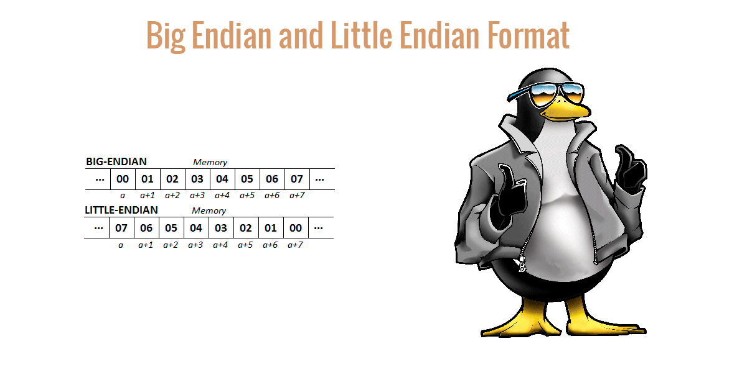
Aside: Hard-Boiled Eggs
Image Source: http://lehacker.com/big-endian-little-endian-formats/

Slide 59
Byte Addressing – Big Endian
Q: Where do we start reading for a given row? (For BS == 0)
A: From the “MSB” //consider an array of ascending values
Page (A16) | Word Address (A16..A0) | D15…D8 | D7..D0
0 | 0x00000 | 0x00000 | 0x00001
 | 0x00002 | 0x00002 | 0x00003
 | 0x00004 | 0x00004 | 0x00005
 | .. | … | …
 | 0x0FFFE | 0x0FFFE | 0x0FFFF
1 | 0x10000 | 0x10000 | 0x10001
 | 0x10002 | 0x10002 | 0x10003
 | 0x10004 | 0x10004 | 0x10005
 | … | … | …
 | 0x1FFFE | 0x1FFFE | 0x1FFFF
1 | 15 | 1
Page | Offset | byte
16 data bits – 8 data bits/use
8 data bits
8 data bits
8 data bits
8 data bits
This is a big-endian processor. Regardless, Word addresses will always be an even number:

Slide 60
Byte Addressing – Little Endian
Q: Where do we start reading for a given row? (For BS == 0)
A: From the “LSB” //consider an array of ascending values
Page (A16) | Word Address (A16..A0) | D15…D8 | D7..D0
0 | 0x00000 | 0x00001 | 0x00000
 | 0x00002 | 0x00003 | 0x00002
 | 0x00004 | 0x00005 | 0x00004
 | .. | … | …
 | 0x0FFFE | 0x0FFFF | 0x0FFFE
1 | 0x10000 | 0x10001 | 0x10000
 | 0x10002 | 0x10003 | 0x10002
 | 0x10004 | 0x10005 | 0x10004
 | … | … | …
 | 0x1FFFE | 0x1FFFF | 0x1FFFE
1 | 15 | 1
Page | Offset | byte
16 data bits – 8 data bits/use
8 data bits
8 data bits
8 data bits
8 data bits
This is a little-endian processor. Regardless, Word addresses will always be an even number:

Slide 61
Byte Packing – Big Endian
D31
D23
“Read from the BIG side (MSB)”
D7
D0
Longword
Address
000000
Byte 0 – Address 000000
Byte 1 – Address 000001
Byte 2 – Address 000002
Byte 3 – Address 000003
000004
Byte 0 – Address 000004
Byte 1 – Address 000005
Byte 2 – Address 000006
Byte 3 – Address 000007
000008
Byte 0 – Address 000008
Byte 1 – Address 000009
Byte 2 – Address 00000A
Byte 3 – Address 00000B
00000C
Byte 0 – Address 00000C
Byte 1 – Address 00000D
Byte 2 – Address 00000E
Byte 3 – Address 00000F
000010
Byte 0 – Address 000010
Byte 1 – Address 000011
Byte 2 – Address 000012
Byte 3 – Address 000013
Read from Left to Right, or from the “Big End” of the Egg first
FFFFF0
Byte 0 – Address FFFFF0
Byte 1 – Address FFFFF1
Byte 2 – Address FFFFF2
Byte 3 – Address FFFFF3
FFFFF4
Byte 0 – Address FFFFF4
Byte 1 – Address FFFFF5
Byte 2 – Address FFFFF6
Byte 3 – Address FFFFF7
FFFFF8
Byte 0 – Address FFFFF8
Byte 1 – Address FFFFF9
Byte 2 – Address FFFFFA
Byte 3 – Address FFFFFB
FFFFFC
Byte 0 – Address FFFFFC
Byte 1 – Address FFFFFD
Byte 2 – Address FFFFFE
Byte 3 – Address FFFFFF
Byte Packing Definition: When the size of the data element (byte) is smaller than the width of the available memory (2B+), we use byte packing to save space

Slide 62
Byte Packing – Little Endian
D31
D23
“Read from the LITTLE side (LSB)”
D7
D0
Longword
Address
000000
Byte 3 – Address 000003
Byte 2 – Address 000002
Byte 1 – Address 000001
Byte 0 – Address 000000
000004
Byte 3 – Address 000007
Byte 2 – Address 000006
Byte 1 – Address 000005
Byte 0 – Address 000004
000008
Byte 3 – Address 00000B
Byte 2 – Address 00000A
Byte 1 – Address 000009
Byte 0 – Address 000008
00000C
Byte 3 – Address 00000F
Byte 2 – Address 00000E
Byte1– Address 00000D
Byte 0 – Address 00000C
000010
Byte 3 – Address 000013
Byte 2 – Address 000012
Byte 1 – Address 000011
Byte 0 – Address 000010
Read from Right to Left, or from the “Little End” of the Egg first.
FFFFF0
Byte 3 – Address FFFFF3
Byte 2 – Address FFFFF2
Byte 1 – Address FFFFF1
Byte 3 – Address FFFFF0
FFFFF4
Byte 3 – Address FFFFF7
Byte 2 – Address FFFFF6
Byte 1 – Address FFFFF5
Byte 3 – Address FFFFF4
FFFFF8
Byte 3 – Address FFFFFB
Byte 2 – Address FFFFFA
Byte 1 – Address FFFFF9
Byte 3 – Address FFFFF8
FFFFFC
Byte 3 – Address FFFFFF
Byte 2 – Address FFFFFE
Byte 1 – Address FFFFFD
Byte 3 – Address FFFFFC
Byte-Packing Definition: When the size of the data element (byte) is smaller than the width of the available memory, we use this to optimize on space

Slide 63
Memory Organization & “Endian-ness”
Memory organization depends upon the width of the processor data bus
  The 68000 is a 32-bits for data internally
    But a 16-bit external data bus: can read 16-bits at a time
  All addresses are 32-bits internally, with 24-bits external (16M)
Little
Big
Bit
Bit
Bit
7
0
15
8
15
8
7
0
0x0000
7
0
0x00001
0x00000
0x000000
0x000001
S
Byte Addressable
memory for an
8-bit processor
with a 16-bit
addressing range
?
?
Byte Addressable
memory for a
16-bit processor
with a 20-bit
addressing range
Intel 80186
Little Endian
?
?
Byte Addressable
memory for a
16-bit processor
with a 24-bit
addressing range
MC68000
Big Endian
T
?
?
?
?
R
?
?
?
?
I
N
G
0xFFFE
0xFFFF
0xFFFFF
0xFFFFE
0xFFFFFE
0xFFFFFF
R2000 can post to either Big or Little Endian

Slide 64
Memory Organization in 68K, x86, R2000, StrongARM
Little
Big
Bit
Bit
Bit
7
0
15
8
7
0
15
8
0x0000
0x00001
7
0
0x00000
0x000000
0x000001
S
Byte Addressable
memory for an
8-bit processor
with a 16-bit
addressing range
T
S
Byte Addressable
memory for a
16-bit processor
with a 20-bit
addressing range
Intel 80186
Little Endian
S
T
Byte Addressable
memory for a
16-bit processor
with a 24-bit
addressing range
MC68000
Big Endian
T
I
R
R
I
R
G
N
N
G
I
N
G
0xFFFE
0xFFFF
0xFFFFF
0xFFFFE
0xFFFFFE
0xFFFFFF

