Slide 1
EECS767 Final project:
KU Information Retrieval System
Xi Chen, Yang Tian, Yuanwei Wu
Instructor: Prof. Bo Luo
5-3-2016

Slide 2
Contents:
Architecture
Web Crawler
Preprocessing
Inverted Index, Boolean Model and Vector Space Model
Words Locationing
Term Proximity
Relevance Feedback
Demo Time
Q & A

Slide 3
1. Architecture
1.1 Programming language: Python, PHP, HTML and CSS
1.2 The architecture of our search engines: three versions
Search Engine 2
Search Engine 1
Search Engine 3
Fig 1. Architecture of our search engines

Slide 4
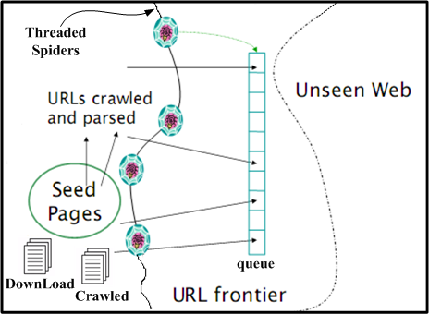
2. Web Crawler
2.1 seed = 'http://www.ku.edu‘, domain name: ku.edu
2.2 page fetches and parses:
a). Urls are normalized to absolute urls
b). Urls filtering: remove the unwanted urls (without the domain name in urls, with “mailto”, “tel:”, “.pdf” in urls)
2.3 Threaded spiders:
Fig 2. The topology of web crawler
Source:
EECS767 IR course document: web
Notes:
a). The urls to crawl are stored in queue
b). The crawled urls are stored in Crawled
c). For crawled urls, the page source is
downloaded and url is stored in DownLoad
Crawled 1029 web pages, and feed using 401 valid web pages to the search engine.

Slide 5
3. Preprocessing
3.1 Tokenization for each Document (provided 91 files and crawled 401 files):
a). Remove the HTML tags
b). Excluding punctuations and special characters
c). Convert into lower case
d). Using NLTK package to remove words in a stop list and do Porter stemming
3.2 Preprocessing for Query
b) c) and d).

Slide 6
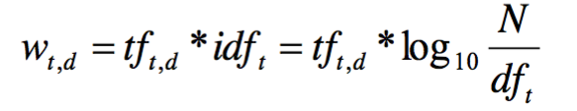
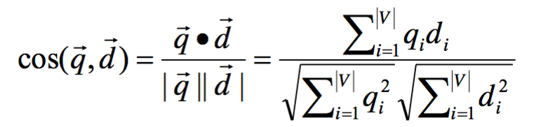
4. Inverted Index, Boolean Model and Vector Space Model
4.1 Inverted Index & Boolean model
4.1.1 Build the inverted index: DF dictionary and TF dictionary.
4.1.2 Build a Boolean table which is used to select the candidate documents which contain at least one term in the query.
4.2 Vector space model
4.2.1 Build the TF-IDF table based on inverted index built in last step.
4.2.2 The document and query vectors are calculated using equation (1):
4.2.3 The similarity score between document and query is calculated using equation (2):
(1)
(2)

Slide 7
5. Words Locationing
5.1 Words Locationing is done based on processed documents.
5.2 Only executed when results are shown on the webpage.
5.2.1 First, get all matches in each document.
5.2.2 Second, calculate the midpoint for all matched index and show up to 100 words around the midpoint.
5.2.3 Third, use all matched index got in the first step to do highlighting.

Slide 8
6. Term Proximity
6.1 Search engine 2 is implemented by adding term proximity into the scoring mechanism of our basic version.
Total Score = a * Similarity + b * Term proximity
6.2 Smallest window algorithm
A window contains all terms in query and with minimum length
term proximity score = 1/(the length of minWindow)
score = 0 if the document does not contain the query

Slide 9
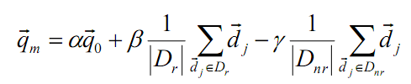
7. Relevance Feedback
7.1 The Rocchio Algorithm shown in equation (3) is used in the implementation of relevance feedback.
7.2 Search engine 3 is implemented by adding the relevance feedback user option to search engine 2.
(3)

Slide 10
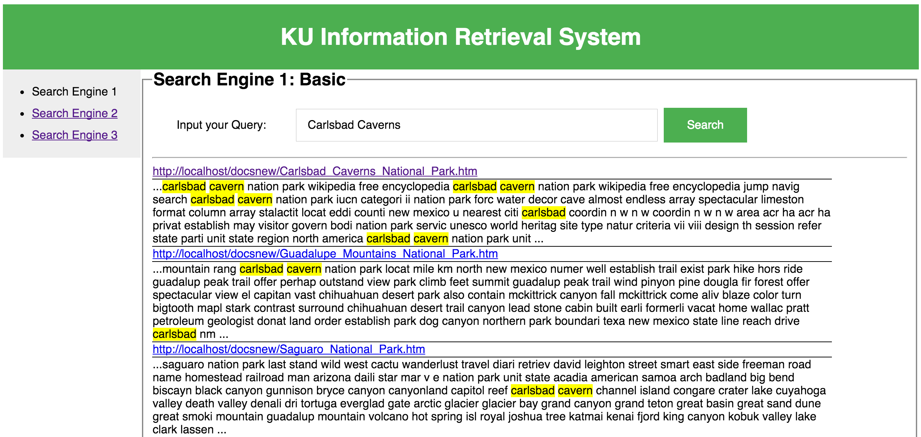
8. Demo

Slide 11
9. Q&A
Thank you!

