Slide 1
EECS767 Final project:
KU Information Retrieval System
Xi Chen, Yang Tian, Yuanwei Wu
Instructor: Prof. Bo Luo
5-3-2016

Slide 2
Contents:
Architecture
Preprocessing
Web Crawler
Boolean Model & Vector Space Model
Term Proximity
Relevance Feedback
Demo Time
Q & A

Slide 3

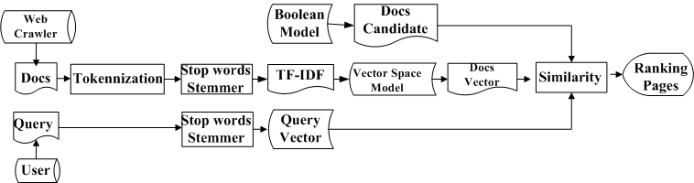

1. Architecture
1.1 Programming language: Python & PHP
1.2 The architecture of our search engine: three versions
Search Engine 2
Search Engine 1
Search Engine 3
Fig 1. Architecture of our search engines

Slide 4
2. Preprocessing
2.1 Tokenization for each Document (provided 91 files and crawled 401 files):
a). Remove the HTML tags
b). Excluding spaces and punctuations
c). Convert into lower case
d). Using NLTK package to remove stop list and do Porter stemming
2.2 Preprocessing for Query
Remove stop list and do Porter stemming

Slide 5
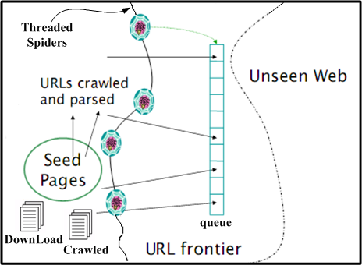
3. Web Crawler
3.1 seed = 'http://www.ku.edu‘, domain name: ku.edu
3.2 page fetches and parses:
a). Urls normalization to get absolute urls
b). Urls filtering: remove the unwanted urls
(e.g. without the domain name in urls,
with “mailto”, “tel:”, “.pdf” in urls)
3.3 Threaded spiders:
a). The urls to crawl are stored in queue
b). The crawled urls are stored in Crawled
c). For crawled urls, the page source is
downloaded and url is stored in DownLoad
Download 1029 web pages, and feed using 401 valid web pages to the search engine.
Fig 2. The topology of web crawler
Source:
EECS767 IR course document: web

Slide 6
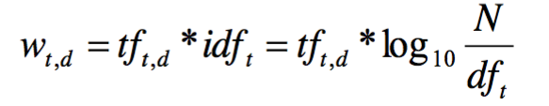
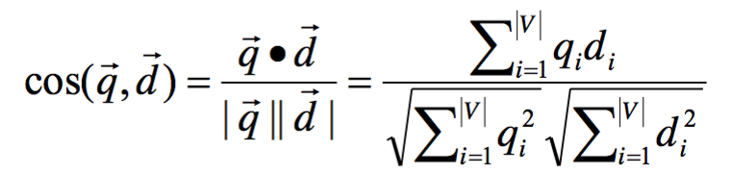
4. Boolean Model & Vector Space Model
4.1 Boolean model
4.1.1 Build the inverted index: dictionary and posting lists
4.1.2 It is used to select the candidate documents which contain at least one term in the query.
4.2 Vector space model
4.2.1 Build the TF-IDF table
4.2.2 The document and query vectors are calculated using equation (1):
4.2.3 The similarity score between document and query is calculated using equation (2):
(1)
(2)

Slide 7
5. Term Proximity
5.1 The formula of term proximity:?
Xi Chen adds the formula here
5.2 Search engine 2 is implemented by adding term proximity into the scoring mechanism of our basic version.

Slide 8
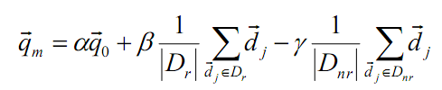
6. Relevance Feedback
6.1 The Rocchio Algorithm shown in equation (3) is used in the implementation of relevance feedback.
6.2 Search engine 3 is implemented by adding the relevance feedback to search engine 2.
(3)

Slide 9
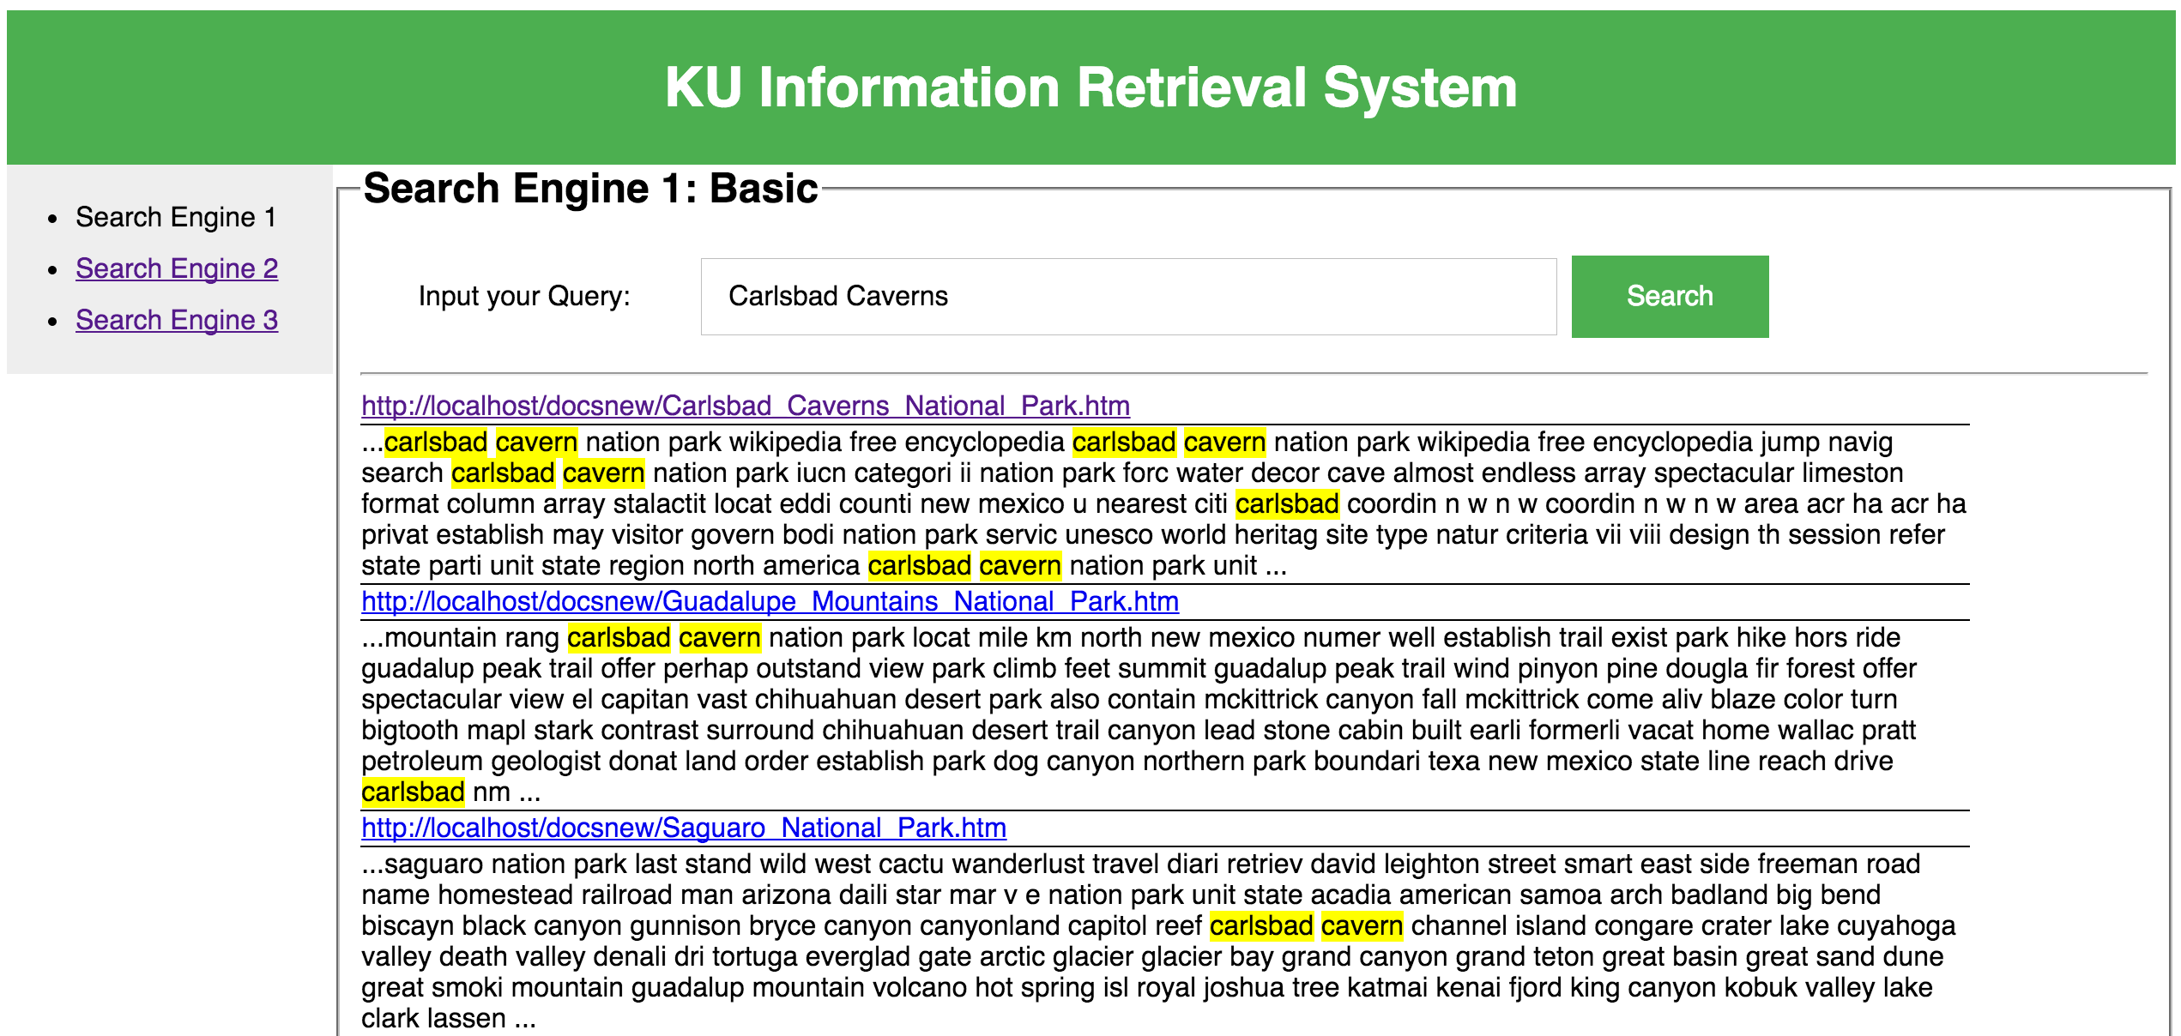
7. Demo Time

Slide 10
Q&A

