Slide 1

CS Bridge, Lecture 12 The Mouse

Slide 2
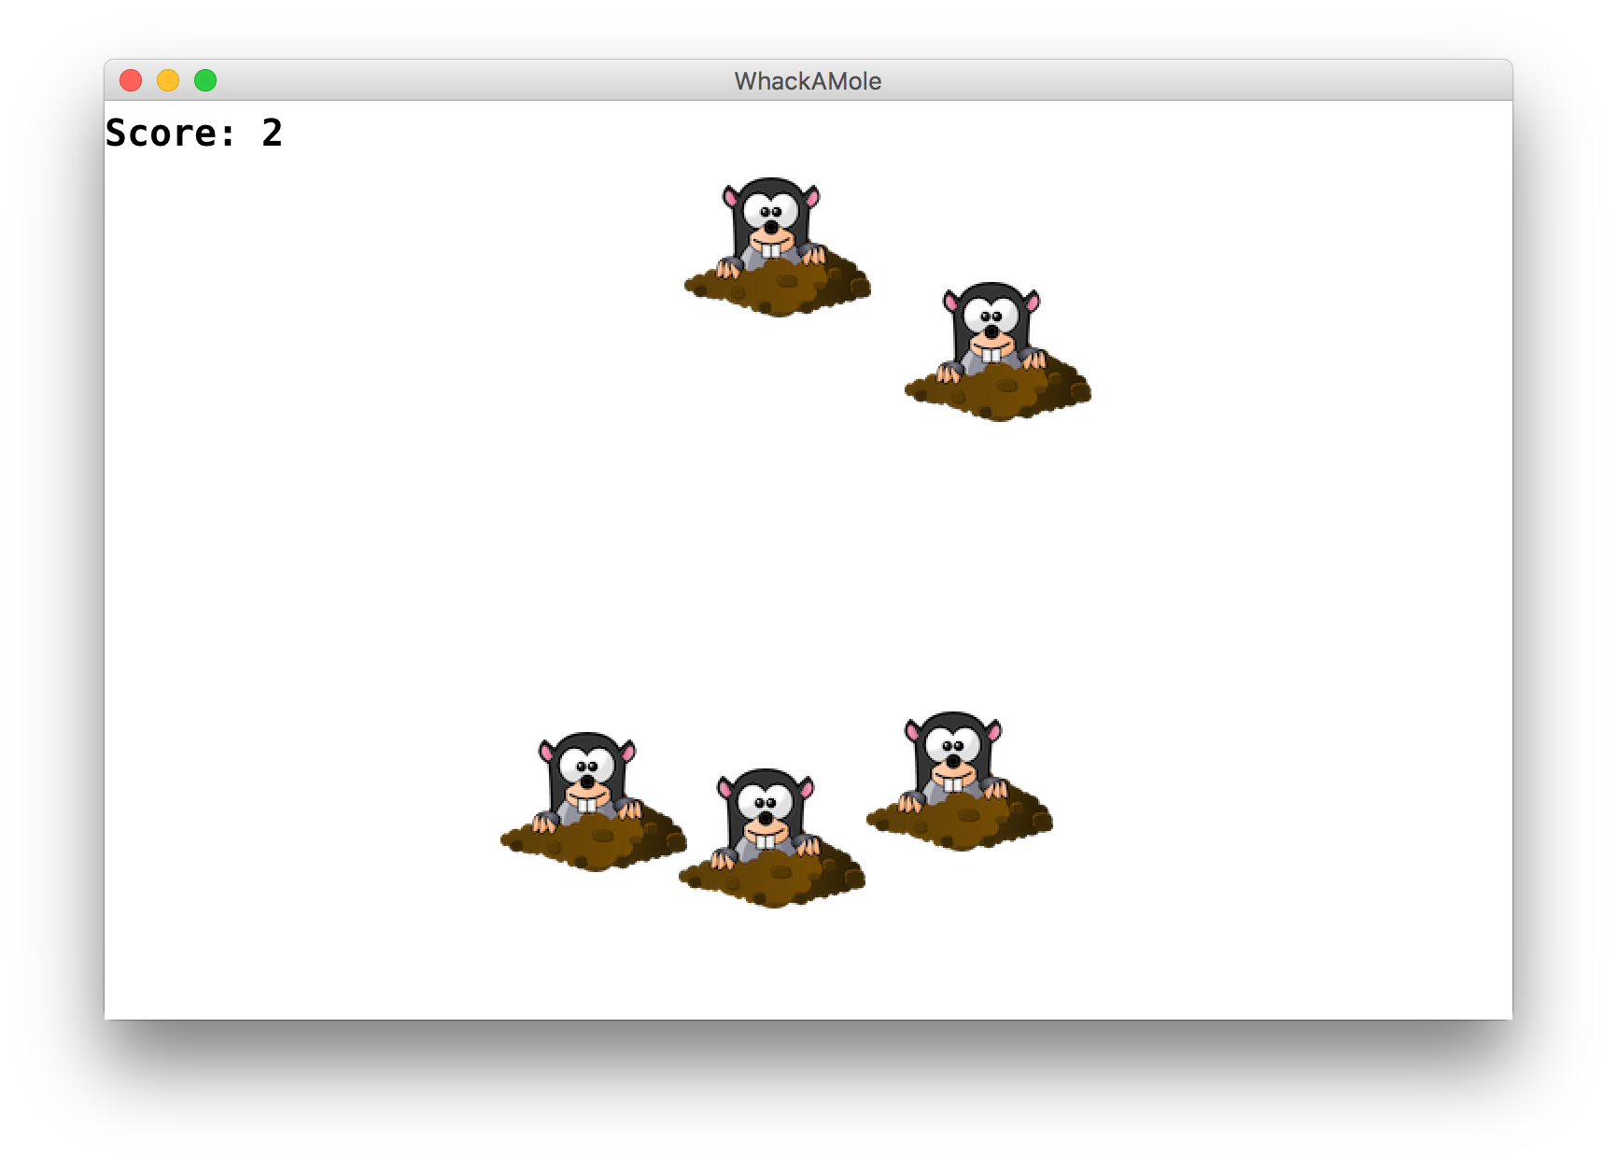
Learning Goals
Learn to respond to mouse events in graphics programs
Notes:
DEMO

Slide 3
Plan for Today
Mouse Location
Demo: Doodler
Mouse Clicks
Demo: Polka Dots
find_element_at
Demo: Whack-a-Mole

Slide 4
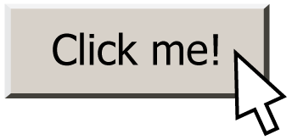
Responding To The Mouse
event: Some external stimulus that your program can respond to.

Slide 5
Events
Mouse clicking
Keyboard keys pressed
Etc.

Slide 6
Events
In our programs, we can ask the canvas if any events have occurred since the last time we asked.
If there are, then we do something.
If there are not, we do nothing and check again later.
while True:
# Handle any new mouse events
# ...
canvas.update()

Slide 7
Plan for Today
Mouse Location
Demo: Doodler
Mouse Clicks
Demo: Polka Dots
find_element_at
Demo: Whack-a-Mole

Slide 8
Mouse Location
At any time, we can ask the canvas for the current location of the mouse.
mouse_x = canvas.get_mouse_x()
mouse_y = canvas.get_mouse_y()

Slide 9
Plan for Today
Mouse Location
Demo: Doodler
Mouse Clicks
Demo: Polka Dots
find_element_at
Demo: Whack-a-Mole

Slide 10
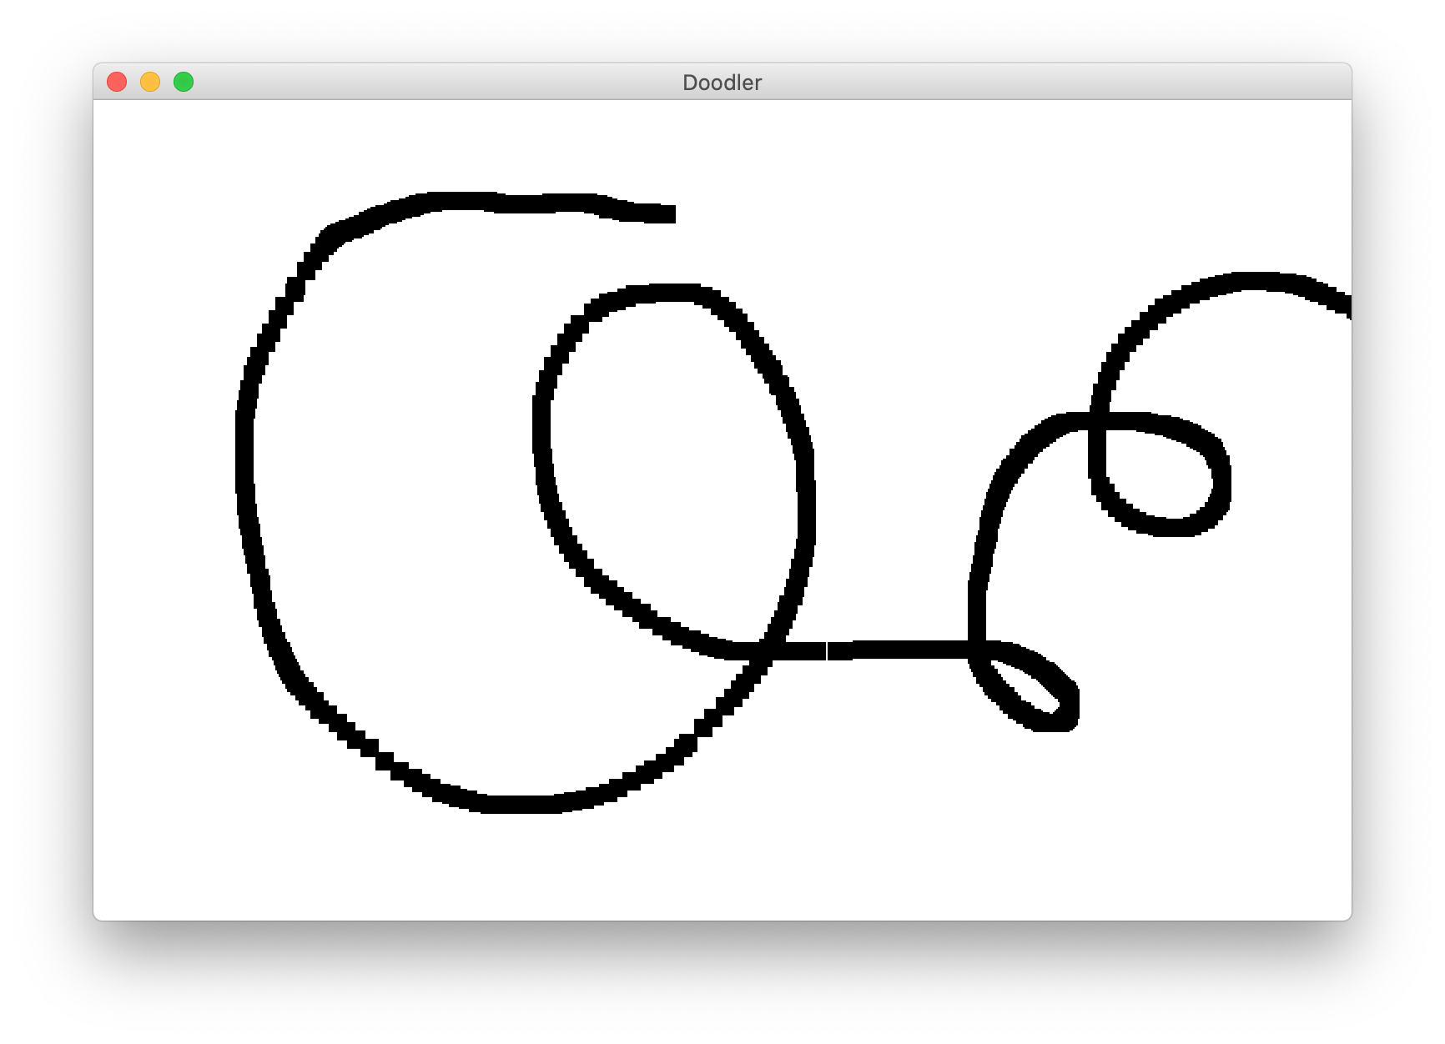
Doodler
Notes:
DEMO

Slide 11
Doodler
SQUARE_SIZE = 10
...
while True:
# Get the mouse location
mouse_x = canvas.get_mouse_x()
mouse_y = canvas.get_mouse_y()
# Create a black rectangle at this location
rect = canvas.create_rectangle(mouse_x, mouse_y,
mouse_x + SQUARE_SIZE,
mouse_y + SQUARE_SIZE)
canvas.set_color(rect, 'black')
canvas.update()
Notes:
Let’s step through

Slide 12
Doodler
SQUARE_SIZE = 10
...
while True:
# Get the mouse location
mouse_x = canvas.get_mouse_x()
mouse_y = canvas.get_mouse_y()
# Create a black rectangle at this location
rect = canvas.create_rectangle(mouse_x, mouse_y,
mouse_x + SQUARE_SIZE,
mouse_y + SQUARE_SIZE)
canvas.set_color(rect, 'black')
canvas.update()
Notes:
Let’s step through

Slide 13
Doodler
SQUARE_SIZE = 10
...
while True:
# Get the mouse location
mouse_x = canvas.get_mouse_x()
mouse_y = canvas.get_mouse_y()
# Create a black rectangle at this location
rect = canvas.create_rectangle(mouse_x, mouse_y,
mouse_x + SQUARE_SIZE,
mouse_y + SQUARE_SIZE)
canvas.set_color(rect, 'black')
canvas.update()
Notes:
Let’s step through

Slide 14
Doodler
SQUARE_SIZE = 10
...
while True:
# Get the mouse location
mouse_x = canvas.get_mouse_x()
mouse_y = canvas.get_mouse_y()
# Create a black rectangle at this location
rect = canvas.create_rectangle(mouse_x, mouse_y,
mouse_x + SQUARE_SIZE,
mouse_y + SQUARE_SIZE)
canvas.set_color(rect, 'black')
canvas.update()
Notes:
Let’s step through

Slide 15
Doodler
SQUARE_SIZE = 10
...
while True:
# Get the mouse location
mouse_x = canvas.get_mouse_x()
mouse_y = canvas.get_mouse_y()
# Create a black rectangle at this location
rect = canvas.create_rectangle(mouse_x, mouse_y,
mouse_x + SQUARE_SIZE,
mouse_y + SQUARE_SIZE)
canvas.set_color(rect, 'black')
canvas.update()
Notes:
Let’s step through

Slide 16
Plan for Today
Mouse Location
Demo: Doodler
Mouse Clicks
Demo: Polka Dots
find_element_at
Demo: Whack-a-Mole

Slide 17
Mouse Clicks
At any time, we can ask the canvas for a list of mouse clicks that have happened since the last time we asked.
clicks = canvas.get_new_mouse_clicks()

Slide 18
Mouse Clicks
Each element in the list has an x and y coordinate of where that click happened.
clicks = canvas.get_new_mouse_clicks()
for click in clicks:
print(click.x, click.y)

Slide 19
Events
Pattern: we make a loop (like for animation), and each time through the loop we check for new mouse clicks, and act on them.
while True:
# Handle any new mouse clicks
# ...
canvas.update()

Slide 20
Plan for Today
Mouse Location
Demo: Doodler
Mouse Clicks
Demo: Polka Dots
find_element_at
Demo: Whack-a-Mole

Slide 21
Example: Polka Dots
while True:
clicks = canvas.get_new_mouse_clicks()
# Add a circle each time the user clicks
for click in clicks:
circle = canvas.create_oval(0, 0,
CIRCLE_SIZE, CIRCLE_SIZE)
canvas.set_color(circle, 'blue')
canvas.update()

Slide 22
Example: Polka Dots 2
while True:
clicks = canvas.get_new_mouse_clicks()
# Add a circle each time the user clicks
for click in clicks:
circle = canvas.create_oval(click.x, click.y,
click.x + CIRCLE_SIZE,
click.y + CIRCLE_SIZE)
canvas.set_color(circle, 'blue')
canvas.update()

Slide 23
Example: Polka Dots 2
while True:
clicks = canvas.get_new_mouse_clicks()
# Add a circle each time the user clicks
for click in clicks:
circle = canvas.create_oval(click.x, click.y,
click.x + CIRCLE_SIZE,
click.y + CIRCLE_SIZE)
canvas.set_color(circle, 'blue')
canvas.update()

Slide 24
Revisiting Doodler
What if we wanted the same square to track the mouse, instead of making a new one each time?

Slide 25
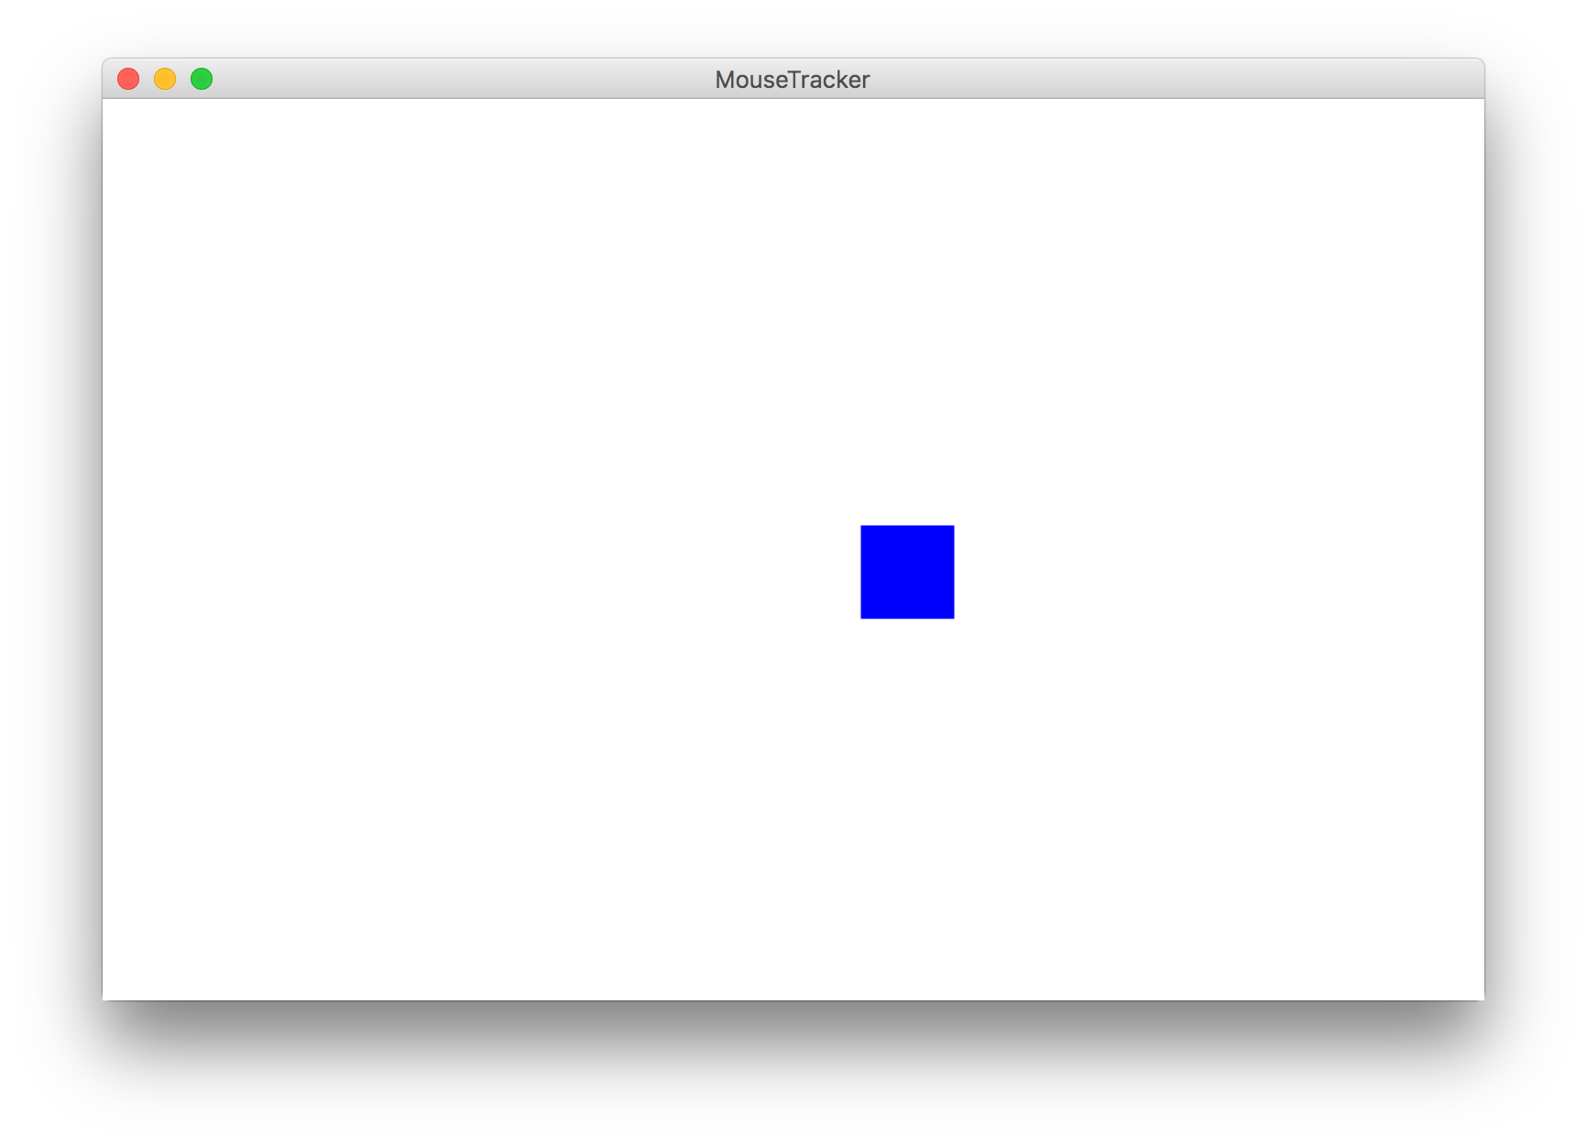
Example: Mouse Tracker

Slide 26
Plan for Today
Mouse Location
Demo: Doodler
Mouse Clicks
Demo: Polka Dots
find_element_at
Demo: Whack-a-Mole

Slide 27
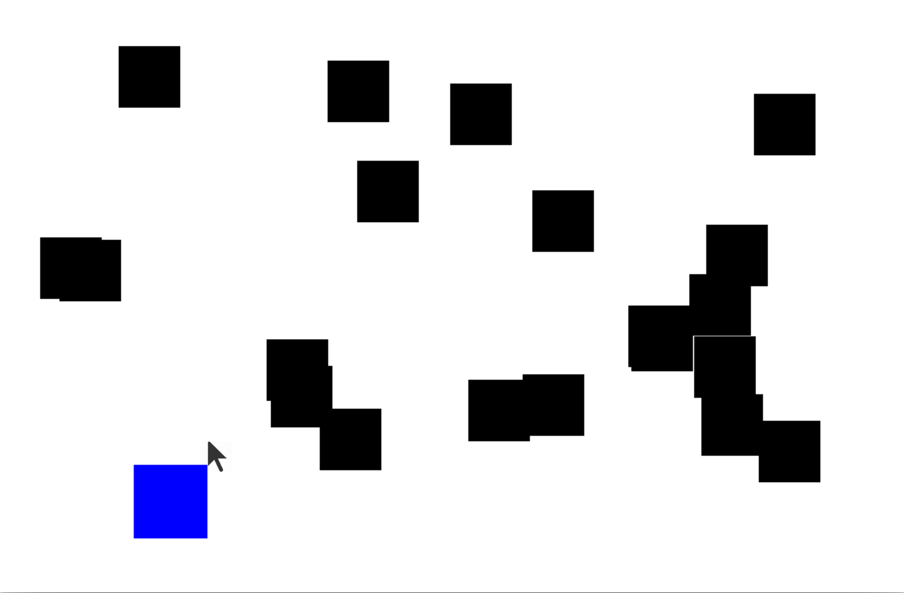
find_element_at

Slide 28
find_element_at
find_element_at returns the object at this location on the canvas.
object_here = canvas.find_element_at(x, y)
Notes:
What is there is no object? How can we check that?

Slide 29
find_element_at
find_element_at returns the object at this location on the canvas.
object_here = canvas.find_element_at(x, y)
if object_here:
// do something with object_here
else:
// nothing at that location
Notes:
This is how we can finish dribbleCastle!

Slide 30
Putting it all together

Slide 31
Plan for Today
Mouse Location
Demo: Doodler
Mouse Clicks
Demo: Polka Dots
find_element_at
Demo: Whack-a-Mole

Slide 32
Whack-A-Mole
Let’s make Whack-A-Mole!
Moles should appear at random locations on the screen over time
If the user clicks a mole, remove it

Slide 33
Recap
Mouse Location
Demo: Doodler
Mouse Clicks
Demo: Polka Dots
find_element_at
Demo: Whack-a-Mole

