Slide 1


Data Structure - Dictionaries

Slide 2
Today’s questions
How can I organize my data so it’s easier to use?

Slide 3
How can I organize my data so it’s easier to use?

Slide 4
Think/Share:
Store names of habitat animals and their corresponding diet
Notes:
Active learning exercise callout

Slide 5
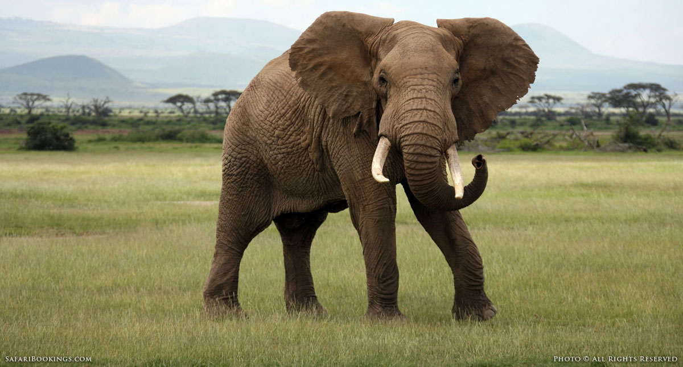
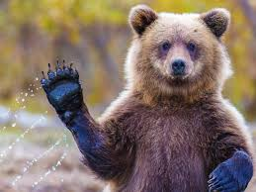
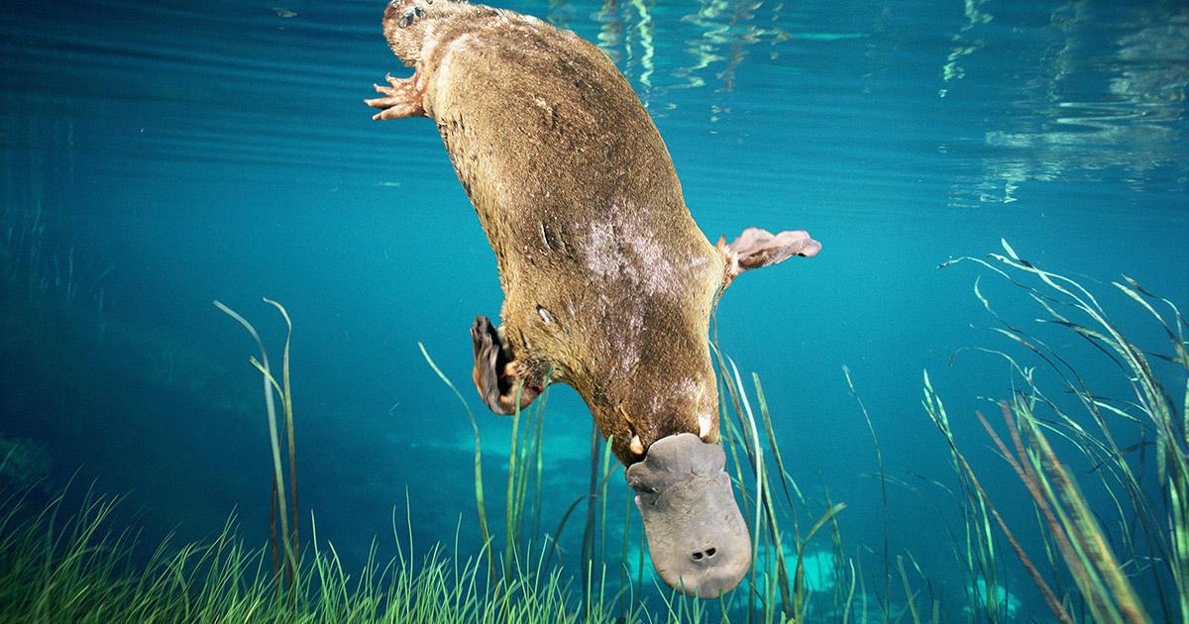
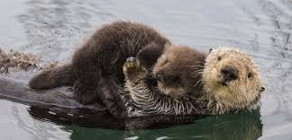
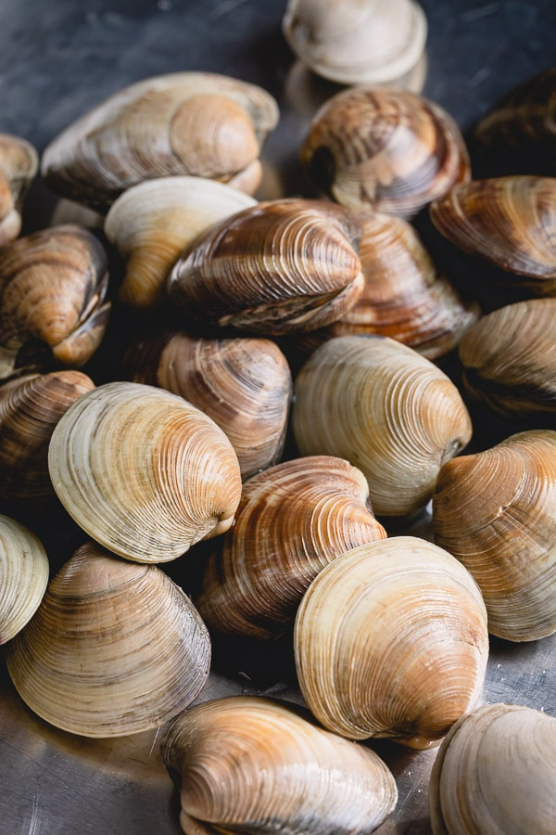
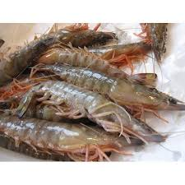
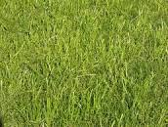
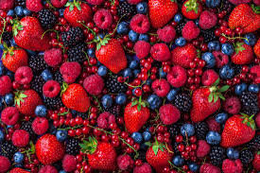
elephant bear otter platypus
clams grass shrimp berries
Notes:
Woodchuck tongue twister

Slide 6
Task - Relating data with each other
['elephant', ‘bear', ‘otter', ‘platypus']
['grass', ‘berries', ‘clams’, ‘shrimp']
Notes:
Woodchuck tongue twister

Slide 7

Task - Relating data with each other
['elephant', ‘bear', ‘otter', ‘platypus']
['grass', ‘berries', ‘clams’, ‘shrimp']
These pieces of information are linked!
Notes:
Woodchuck tongue twister

Slide 8
Task - Relating data with each other
['elephant', ‘bear', ‘otter', ‘platypus']
['grass', ‘berries', ‘clams’, ‘shrimp']
These pieces of information are linked!
Can we store them so they’re associated with each other?

Slide 9
Dictionaries!

Slide 10
Definition
Dictionary
A container data type that maps “keys” to their associated “values”.

Slide 11
Anatomy of a Dictionary
name_of_dic = {}
name_of_dic = {'elephant': 'grass', 'bear': ‘berries', 'otter': ‘clams’, 'platypus': ‘shrimp'}

Slide 12
Anatomy of a Dictionary
name_of_dic = {'elephant': 'grass', 'bear': ‘berries', 'otter': ‘clams’, 'platypus': ‘shrimp'}
This is a dictionary literal

Slide 13
Anatomy of a Dictionary
name_of_dic = {'elephant': 'grass', 'bear': ‘berries', 'otter': ‘clams’, 'platypus': ‘shrimp'}
It is easier to visualize it this way:
dict
keys
values
‘elephant'
‘bear'
‘otter'
‘platypus'
‘grass’
‘berries'
‘clams’
shrimp’

Slide 14
Anatomy of a Dictionary
dict
keys
values
‘elephant'
‘bear'
‘otter'
‘platypus'
‘grass’
‘berries'
‘clams'
‘shrimp’
Each key can store one value

Slide 15
Anatomy of a Dictionary
dict
keys
values
>>> d[‘elephant’]
‘elephant'
‘bear'
‘otter'
‘platypus'
‘grass’
‘berries'
‘clams'
‘shrimp’
Each key can store one value

Slide 16
Anatomy of a Dictionary - Get/Set
dict
keys
values
>>> d[‘elephant’]
‘elephant'
‘bear'
‘otter'
‘platypus'
‘grass’
‘berries'
‘clams'
‘shrimp’
This operation is called ‘‘get’’

Slide 17
Anatomy of a Dictionary - Get/Set
dict
keys
values
>>> d[‘elephant’]
‘elephant'
‘bear'
‘otter'
‘platypus'
‘grass’
‘berries'
‘clams'
‘shrimp’
This operation is called ‘‘get’’

Slide 18
Anatomy of a Dictionary - Get/Set
dict
keys
values
>>> d[‘elephant’]
‘grass’
‘elephant'
‘bear'
‘otter'
‘platypus'
‘grass’
‘berries'
‘clams'
‘shrimp’

Slide 19
Anatomy of a Dictionary - Get/Set
dict
keys
values
>>> d[‘elephant’]
‘grass’
‘elephant'
‘bear'
‘otter'
‘platypus'
‘grass’
‘berries'
‘clams'
‘shrimp’

Slide 20
Anatomy of a Dictionary - Get/Set
dict
keys
values
>>> d[‘elephant’]
‘grass’
>>> d[‘elephant’] = ‘leaves’
‘elephant'
‘bear'
‘otter'
‘platypus'
‘grass’
‘berries'
‘clams'
‘shrimp’
This operation is called ‘‘set’’

Slide 21
Anatomy of a Dictionary - Get/Set
dict
keys
values
>>> d[‘elephant’]
‘grass’
>>> d[‘elephant’] = ‘leaves’
‘elephant'
‘bear'
‘otter'
‘platypus'
‘leaves’
‘berries'
‘clams'
‘shrimp’
This operation is called ‘‘set’’

Slide 22
Anatomy of a Dictionary - Get/Set
dict
keys
values
>>> d[‘elephant’]
‘grass’
>>> d[‘elephant’] = ‘leaves’
>>> d[‘cat’]
‘elephant'
‘bear'
‘otter'
‘platypus'
‘leaves’
‘berries'
‘clams'
‘shrimp’

Slide 23
Anatomy of a Dictionary - Get/Set
dict
keys
values
>>> d[‘elephant’]
‘grass’
>>> d[‘elephant’] = ‘leaves’
>>> d[‘cat’]
‘elephant'
‘bear'
‘otter'
‘platypus'
‘leaves’
‘berries'
‘clams'
‘shrimp’
KeyError

Slide 24
Anatomy of a Dictionary - Get/Set
dict
keys
values
>>> d[‘elephant’]
‘grass’
>>> d[‘elephant’] = ‘leaves’
>>> d[‘cat’]
‘elephant'
‘bear'
‘otter'
‘platypus'
‘leaves’
‘berries'
‘clams'
‘shrimp’
“get” errors if the key is not in the dict

Slide 25
Dictionary - in
dict
keys
values
>>>‘elephant’ in d
‘elephant'
‘bear'
‘otter'
‘platypus'
‘leaves’
‘berries'
‘clams'
‘shrimp’

Slide 26
Dictionary - in
dict
keys
values
>>>‘elephant’ in d
True
‘elephant'
‘bear'
‘otter'
‘platypus'
‘leaves’
‘berries'
‘clams'
‘shrimp’

Slide 27
Dictionary - in
dict
keys
values
>>>‘elephant’ in d
True
>>>‘cat’ not in d
True
‘elephant'
‘bear'
‘otter'
‘platypus'
‘leaves’
‘berries'
‘clams'
‘shrimp’

Slide 28
Dictionary - in
dict
keys
values
>>>‘elephant’ in d
True
>>>‘cat’ not in d
True
‘elephant'
‘bear'
‘otter'
‘platypus'
‘leaves’
‘berries'
‘clams'
‘shrimp’
Common pattern: Check if key is present. If it is, do something. If it isn’t, do something else.

Slide 29
Building a dictionary
>>> d = {}

Slide 30
Building a dictionary
>>> d = {}
Create an empty dictionary

Slide 31
Building a dictionary
>>> d = {}
>>> d[‘elephant’] = ‘grass’

Slide 32
Building a dictionary
>>> d = {}
>>> d[‘elephant’] = ‘grass’
We can add keys using ‘‘set’’

Slide 33
Building a dictionary
>>> d = {}
>>> d[‘elephant’] = ‘grass’
>>> d
We can add keys using ‘‘set’’

Slide 34
Building a dictionary
>>> d = {}
>>> d[‘elephant’] = ‘grass’
>>> d
{‘elephant’: ‘grass'}
We can add keys using ‘‘set’’

Slide 35
Building a dictionary
>>> d = {‘elephant’: ‘grass’}

Slide 36
Types of Dictionaries
So far, we’ve seen dictionaries mapping from strings to ints
This is not the only type of dictionary!
You can map from string/int/float to string/int/float...

Slide 37
Think/Share:
Store names of CS lecturers and their ages
Notes:
Active learning exercise callout

Slide 38
Accessing a Dictionary’s Keys
>>> d = {‘Ayca’: 34, ‘Nick’: 28, ‘Ondrej’: 30, ‘Chris’= 29’}

Slide 39
Building a dictionary
>>> d = {‘Ayca’: 34}
>>> d[‘Ayca’] += 2

Slide 40
Building a dictionary
>>> d = {‘Ayca’: 34}
>>> d[‘Ayca’] += 2
we can get/set on the same line!
(same as d[‘Ayca’] = d[‘Ayca] + 2)

Slide 41
Building a dictionary
>>> d = {‘Ayca’: 34}
>>> d[‘Ayca’] += 2
>>> d[‘Ayca’]
{‘Ayca’: 36}
we can get/set on the same line!
(same as d[‘Ayca’] = d[‘Ayca] + 2)

Slide 42
Accessing a Dictionary’s Keys
>>> d = {‘Ayca’: 34, ‘Nick’: 28, ‘Ondrej’: 30, ‘Chris’= 29’}
>>> d.keys()

Slide 43
Accessing a Dictionary’s Keys
>>> d = {‘Ayca’: 34, ‘Nick’: 28, ‘Ondrej’: 30, ‘Chris’= 29’}
>>> d.keys()
dict_keys([‘Ayca’, ‘Nick’, ‘Ondrej’, ‘Chris’])
Iterable collection of all the keys.
Iterable means it can be used in foreach

Slide 44
Accessing a Dictionary’s Keys
>> d = {‘Ayca’: 34, ‘Nick’: 28, ‘Ondrej’: 30, ‘Chris’= 29’}
>>> list(d.keys())
[‘Ayca’, ‘Nick’, ‘Ondrej’, Chris]
we are using list() to convert d.keys() into a list

Slide 45
Accessing a Dictionary’s Values
>> d = {‘Ayca’: 34, ‘Nick’: 28, ‘Ondrej’: 30, ‘Chris’= 29’}

Slide 46
Accessing a Dictionary’s Values
>> d = {‘Ayca’: 34, ‘Nick’: 28, ‘Ondrej’: 30, ‘Chris’= 29’}
>>> list(d.values())

Slide 47
Accessing a Dictionary’s Values
>> d = {‘Ayca’: 34, ‘Nick’: 28, ‘Ondrej’: 30, ‘Chris’= 29’}
>>> list(d.values())
we are using list() to convert d.values() into a list

Slide 48
Accessing a Dictionary’s Values
>> d = {‘Ayca’: 34, ‘Nick’: 28, ‘Ondrej’: 30, ‘Chris’= 29’}
>>> list(d.values())
[34,28,30,29]
we are using list() to convert d.values() into a list

Slide 49
Looping over a Dictionary’s Keys
>> d = {‘Ayca’: 34, ‘Nick’: 28, ‘Ondrej’: 30, ‘Chris’= 29’}

Slide 50
Looping over a Dictionary’s Keys
>> d = {‘Ayca’: 34, ‘Nick’: 28, ‘Ondrej’: 30, ‘Chris’= 29’}
>>> for name in d.keys():

Slide 51
Looping over a Dictionary’s Keys
>> d = {‘Ayca’: 34, ‘Nick’: 28, ‘Ondrej’: 30, ‘Chris’= 29’}
>>> for name in d.keys():
... print(name)

Slide 52
Looping over a Dictionary’s Keys
>> d = {‘Ayca’: 34, ‘Nick’: 28, ‘Ondrej’: 30, ‘Chris’= 29’}
>>> for name in d.keys():
... print(name)
Ayca
Nick
Ondrej
Chris

Slide 53
Looping over a Dictionary’s Keys
>> d = {‘Ayca’: 34, ‘Nick’: 28, ‘Ondrej’: 30, ‘Chris’= 29’}
>>> for name in d.keys():
... print(name)
Ayca
Nick
Ondrej
Chris
we can use foreach on the dictionary’s keys!

Slide 54
Looping over a Dictionary’s Values
>> d = {‘Ayca’: 34, ‘Nick’: 28, ‘Ondrej’: 30, ‘Chris’= 29’}

Slide 55
Looping over a Dictionary’s Values
>> d = {‘Ayca’: 34, ‘Nick’: 28, ‘Ondrej’: 30, ‘Chris’= 29’}
>>> for age in d.values():

Slide 56
Looping over a Dictionary’s Values
>> d = {‘Ayca’: 34, ‘Nick’: 28, ‘Ondrej’: 30, ‘Chris’= 29’}
>>> for age in d.values():
... print(age)

Slide 57
Looping over a Dictionary’s Values
>> d = {‘Ayca’: 34, ‘Nick’: 28, ‘Ondrej’: 30, ‘Chris’= 29’}
>>> for age in d.values():
... print(age)
34
28
30
29

Slide 58
Looping over a Dictionary’s Values
>> d = {‘Ayca’: 34, ‘Nick’: 28, ‘Ondrej’: 30, ‘Chris’= 29’}
>>> for age in d.values():
... print(age)
34
28
30
29
we can use foreach on the dictionary’s values!

Slide 59
Looping over a Dictionary’s Keys and Values
>> d = {‘Ayca’: 34, ‘Nick’: 28, ‘Ondrej’: 30, ‘Chris’= 29’}

Slide 60
Looping over a Dictionary’s Keys and Values
>> d = {‘Ayca’: 34, ‘Nick’: 28, ‘Ondrej’: 30, ‘Chris’= 29’}
>>> for name, age in d.items():

Slide 61
Looping over a Dictionary’s Keys and Values
>> d = {‘Ayca’: 34, ‘Nick’: 28, ‘Ondrej’: 30, ‘Chris’= 29’}
>>> for name, age in d.items():
items() gives us key, value pairs

Slide 62
Looping over a Dictionary’s Keys and Values
>> d = {‘Ayca’: 34, ‘Nick’: 28, ‘Ondrej’: 30, ‘Chris’= 29’}
>>> for name, age in d.items():
... print(name, ‘is’, age, ‘years old.’)
items() gives us key, value pairs

Slide 63
Looping over a Dictionary’s Keys and Values
>> d = {‘Ayca’: 34, ‘Nick’: 28, ‘Ondrej’: 30, ‘Chris’= 29’}
>>> for name, age in d.items():
... print(name, ‘is’, age, ‘years old.’)
Ayca is 34 years old.
Nick is 28 years old.
Ondrej is 30 years old.
Chris is 29 years old.
items() gives us key, value pairs

Slide 64
Looping over a Dictionary’s Keys and Values
>> d = {‘Ayca’: 34, ‘Nick’: 28, ‘Ondrej’: 30, ‘Chris’= 29’}
>>> for name, age in d.items():
... print(name, ‘is’, age, ‘years old.’)
Ayca is 34 years old.
Nick is 28 years old.
Ondrej is 30 years old.
Chris is 29 years old.
print() will automatically concatenate args separated by commas!

Slide 65
Printing with sep=
>> d = {‘Ayca’: 34, ‘Nick’: 28, ‘Ondrej’: 30, ‘Chris’= 29’}
>>> for name, age in d.items():
... print(name, age, sep=‘: ’)

Slide 66
Printing with sep=
>> d = {‘Ayca’: 34, ‘Nick’: 28, ‘Ondrej’: 30, ‘Chris’= 29’}
>>> for name, age in d.items():
... print(name, age, sep=‘: ’)
sep is an optional argument like end!

Slide 67
Printing with sep=
>> d = {‘Ayca’: 34, ‘Nick’: 28, ‘Ondrej’: 30, ‘Chris’= 29’}
>>> for name, age in d.items():
... print(name, age, sep=‘: ’)
Ayca: 34
Nick: 28
Ondrej: 30
Chris: 29
sep is an optional argument like end!

Slide 68
Printing with sep=
>> d = {‘Ayca’: 34, ‘Nick’: 28, ‘Ondrej’: 30, ‘Chris’= 29’}
>>> for name, age in d.items():
... print(name, age, sep=‘: ’)
Ayca: 34
Nick: 28
Ondrej: 30
Chris: 29
the separating string will be printed between the arguments you pass into print()

Slide 69
Printing with sep=
>> d = {‘Ayca’: 34, ‘Nick’: 28, ‘Ondrej’: 30, ‘Chris’= 29’}
>>> for name, age in d.items():
... print(name, age, sep=‘: ’)
Ayca: 34
Nick: 28
Ondrej: 30
Chris: 29
the default is sep=‘ ’ (insert space)

Slide 70
Getting a Sorted List of Keys
>> d = {‘Ayca’: 34, ‘Nick’: 28, ‘Ondrej’: 30, ‘Chris’= 29’}

Slide 71
Getting a Sorted List of Keys
>> d = {‘Ayca’: 34, ‘Nick’: 28, ‘Ondrej’: 30, ‘Chris’= 29’}
>>> sorted(d.keys())

Slide 72
Getting a Sorted List of Keys
>> d = {‘Ayca’: 34, ‘Nick’: 28, ‘Ondrej’: 30, ‘Chris’= 29’}
>>> sorted(d.keys())
[‘Ayca’, ‘Chris’, ‘Nick’, ‘Ondrej’]

Slide 73
Getting a Sorted List of Keys
>> d = {‘Ayca’: 34, ‘Nick’: 28, ‘Ondrej’: 30, ‘Chris’= 29’}
>>> sorted(d.keys())
[‘Ayca’, ‘Chris’, ‘Nick’, ‘Ondrej’]
sorted() returns a list in alphabetical order!

Slide 74
Getting a Sorted List of Keys
>> d = {‘Ayca’: 34, ‘Nick’: 28, ‘Ondrej’: 30, ‘Chris’= 29’}
>>> sorted(d.keys())
[‘Ayca’, ‘Chris’, ‘Nick’, ‘Ondrej’]
>>> d

Slide 75
Getting a Sorted List of Keys
>> d = {‘Ayca’: 34, ‘Nick’: 28, ‘Ondrej’: 30, ‘Chris’= 29’}
>>> sorted(d.keys())
[‘Ayca’, ‘Chris’, ‘Nick’, ‘Ondrej’]
>>> d
[‘Ayca’: 34, ‘Nick’: 28, ‘Ondrej’: 30, ‘Chris’= 29’]

Slide 76
Sorting a Dictionary’s Values
>> d = {‘Ayca’: 34, ‘Nick’: 28, ‘Ondrej’: 30, ‘Chris’= 29’}

Slide 77
Sorting a Dictionary’s Values
>> d = {‘Ayca’: 34, ‘Nick’: 28, ‘Ondrej’: 30, ‘Chris’= 29’}
>>> sorted(d.values())

Slide 78
Sorting a Dictionary’s Values
>> d = {‘Ayca’: 34, ‘Nick’: 28, ‘Ondrej’: 30, ‘Chris’= 29’}
>>> sorted(d.values())
[28, 29, 30, 34]

Slide 79
Sorting a Dictionary’s Values
>> d = {‘Ayca’: 34, ‘Nick’: 28, ‘Ondrej’: 30, ‘Chris’= 29’}
>>> sorted(d.values())
[28, 29, 30, 34]
sorted() returns a list in numerical order!

Slide 80
Retrieving Min/Max Values
>> d = {‘Ayca’: 34, ‘Nick’: 28, ‘Ondrej’: 30, ‘Chris’= 29’}

Slide 81
Retrieving Min/Max Values
>> d = {‘Ayca’: 34, ‘Nick’: 28, ‘Ondrej’: 30, ‘Chris’= 29’}
>>> min(d.values())

Slide 82
Retrieving Min/Max Values
>> d = {‘Ayca’: 34, ‘Nick’: 28, ‘Ondrej’: 30, ‘Chris’= 29’}
>>> min(d.values())
returns the smallest element!

Slide 83
Retrieving Min/Max Values
>> d = {‘Ayca’: 34, ‘Nick’: 28, ‘Ondrej’: 30, ‘Chris’= 29’}
>>> min(d.values())
28
returns the smallest element!

Slide 84
Retrieving Min/Max Values
>> d = {‘Ayca’: 34, ‘Nick’: 28, ‘Ondrej’: 30, ‘Chris’= 29’}
>>> min(d.values())
28
>>> max(d.values())
returns the smallest element!

Slide 85
Retrieving Min/Max Values
>> d = {‘Ayca’: 34, ‘Nick’: 28, ‘Ondrej’: 30, ‘Chris’= 29’}
>>> min(d.values())
28
>>> max(d.values())
returns the smallest element!
returns the biggest element!

Slide 86
Retrieving Min/Max Values
>> d = {‘Ayca’: 34, ‘Nick’: 28, ‘Ondrej’: 30, ‘Chris’= 29’}
>>> min(d.values())
28
>>> max(d.values())
34
returns the smallest element!
returns the biggest element!

Slide 87
What’s next?

Slide 88
Think/Share:
Implement a phone book using dictionaries
Notes:
Active learning exercise callout

Slide 89
Nested Data Structures
We can nest data structures!
Lists in lists
grid/game board
Lists in dicts
animals to feeding times
Dicts in dicts
your phone’s contact book
... and so on!

Slide 90
Think/Share:
Make a dictionary of habitat animals and the number of times each animal has been fed.
Notes:
Active learning exercise callout

Slide 91
Animal – Feedings Dictionary
animal name ⟶ number of feedings
string ⟶ int
dict
keys
values
‘hansa’
‘kandula’
‘lumpy’
‘surus’
3
2
1
4

Slide 92
Recall: Animal – Feedings Dictionary
animal name ⟶ number of feedings
string ⟶ int
dict
keys
values
‘hansa’
‘kandula’
‘lumpy’
‘surus’
3
2
1
4
What if we wanted to store the times that the animals were fed?

Slide 93
Attempt #1: Animal – Feeding Times Dictionary
animal name ⟶ feeding times
string ⟶ string
dict
keys
values
‘hansa’
‘kandula’
‘lumpy’
‘surus’
‘12:00,3:00,9:00’
‘8:00,1:00’
‘11:00’
‘5:00,3:00,9:00,2:00’
What if we wanted to store the times that the animals were fed?

Slide 94

Attempt #1: Animal – Feeding Times Dictionary
animal name ⟶ feeding times
string ⟶ string
dict
keys
values
‘hansa’
‘kandula’
‘lumpy’
‘surus’
‘12:00,3:00,9:00’
‘8:00,1:00’
‘11:00’
‘5:00,3:00,9:00,2:00’
What if we wanted to store the times that the animals were fed?
Times are not easily accessible!

Slide 95
Attempt #1: Animal – Feeding Times Dictionary
animal name ⟶ feeding times
string ⟶ string
dict
keys
values
‘hansa’
‘kandula’
‘lumpy’
‘surus’
‘12:00,3:00,9:00’
‘8:00,1:00’
‘11:00’
‘5:00,3:00,9:00,2:00’
What if we wanted to store the times that the animals were fed?
But those times look like a data type we know of......

Slide 96
Attempt #2: Animal – Feeding Times Dictionary
animal name ⟶ feeding times
string ⟶ list[string]
dict
keys
values
‘hansa’
‘kandula’
‘lumpy’
‘surus’
[‘12:00’,‘3:00’,‘9:00’]
[‘8:00’,‘1:00’]
[‘11:00’]
[‘5:00’,‘3:00’,‘9:00’,‘2:00’]
What if we wanted to store the times that the animals were fed?

