Slide 1

CS Bridge, Lecture 3 More Karel Control Flow

Slide 2
Lecture Plan
Review: Karel and Control Flow
If/Else Statements
Practice: Hurdle Jumper
Decomposition and Top-Down Design
Practice: Double Beepers

Slide 3
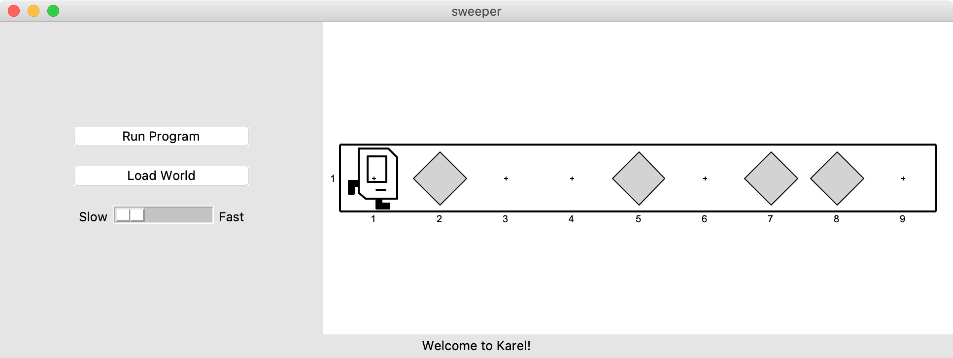
If Statements
I want to make Karel clean up all beepers in front of it until it reaches a wall. How do I do this?

Slide 4
If Statements
Will this work?
while front_is_clear():
move()
pick_beeper()
No. This may crash, because Karel cannot pick up beepers if there aren’t any. We don’t always want Karel to pick up beepers; just when there is a beeper to pick up.

Slide 5
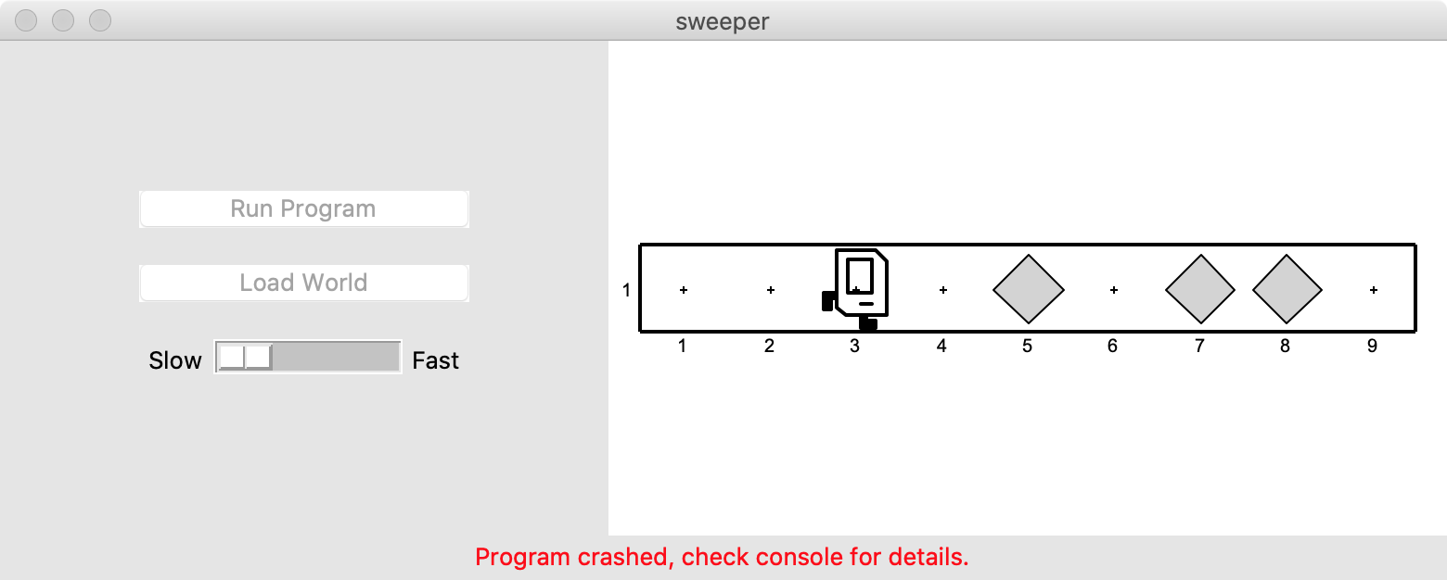

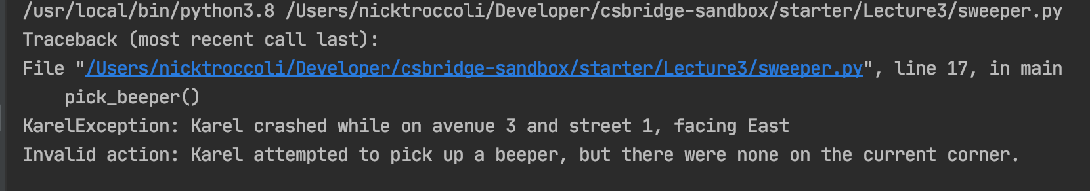
If Statements

Slide 6
If Statements
Instead, use an if statement:
if condition:
statement
statement
...
Runs the statements in the body once if condition is true. These are the same conditions you can use for while loops!
Notes:
Karel can ask some questions about its world / surroundings

Slide 7
If Statements
Now we can say:
while front_is_clear():
move()
if beepers_present():
pick_beeper()
Karel won’t crash because it will only pick up a beeper if there is one.

Slide 8
If Statements and Indentation
if condition:
statements # note indenting
def safe_pick_up():
if beepers_present():
pick_beeper() # note indenting

Slide 9
If/Else Statements
What if we want to do one thing if some condition is true, and another otherwise? We can add an else statement:
if condition:
statement
statement
...
else:
statement
statement
...
This will run the first group of statements if condition is true; otherwise, it runs the second group of statements.

Slide 10
If/Else Statements
What does this code do?
def main():
if beepers_present():
pick_beeper()
else:
put_beeper()

Slide 11
If/Else Statements and Indentation
if condition:
statements # note indenting
else:
statements # note indenting
def invert_beepers():
if beepers_present():
pick_beeper() # note indenting
else:
put_beeper() # note indenting

Slide 12
Karel and Control Flow
Congratulations! You’ve learned all of control flow in Karel.
Control Flow lets us control the “flow” of our Karel program. For example, repeat something more than once, or only do something in certain cases.
Want to repeat something? Use a for or while loop.
- for if we know how many times
- while if we don’t know how many times
Want to conditionally do something? Use if (with an optional else)

Slide 13
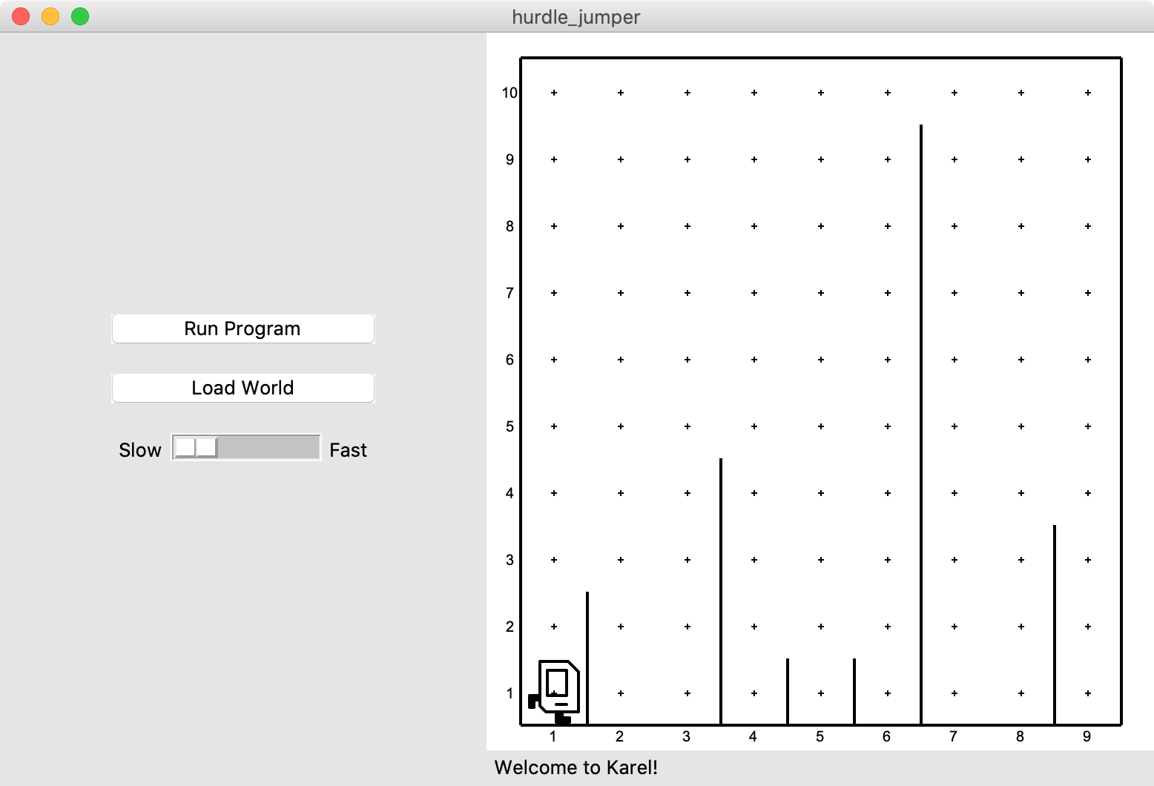
Hurdle Jumper
Karel is in the Olympics! We want to write a Karel program that hops hurdles.
Karel starts at (1,1) facing East and should end up at the end of row 1 facing east.
The world has 9 columns.
There are an unknown number of ”hurdles” (walls) of varying heights that Karel must ascend and descend to get to the other side.

Slide 14
Hurdle Jumper
Demo

Slide 15
Hurdle Jumper
Precondition: something you assume is true at the start of a function or code block
Postcondition: something you promise is true at the end of a function or code block
Pre/post-conditions should be documented using comments.
def jump_hurdle(): """ Karel jumps over one hurdle of arbitrary height. Pre-condition: Karel is facing east next to a hurdle. Post-condition: Karel is facing east at the bottom of the other side of the hurdle. """ ascend_hurdle() move() descend_hurdle()

Slide 16
Hurdle Jumper
Precondition: something you assume is true at the start of a function or code block
Postcondition: something you promise is true at the end of a function or code block
Pre/post-conditions should be documented using comments.
def main(): for i in range(8):
# What do we assume is true here?
if front_is_clear():
move()
else:
jump_hurdle()
# Does the postcondition match?

Slide 17
Decomposition
Breaking down problems into smaller, more approachable sub-problems (e.g. our own Karel commands)
Each piece should solve one problem/task (< ~ 20 lines of code)
Descriptively-named
Well-commented!
E.g. getting up in the morning:
Wake up
Brush teeth
Put toothpaste on toothbrush
Insert toothbrush into mouth
Move toothbrush against teeth
…
…

Slide 18
Top-Down Design
Start from a large task and break it up into smaller pieces
Ok to write your program in terms of commands that don’t exist yet
E.g. Hurdle Jumper

