Slide 1
For Loops, Deconstructed
Notes:
[1:0]

Slide 2

Chat Netiquette Experiment
ask question with voice, or
post question in the chat
resist answering questions of other students (unless you are a SL)
do answer my questions in the chat
do not stop using chat 😊

Slide 3
Review
Notes:
[0:20; 1-2]

Slide 4
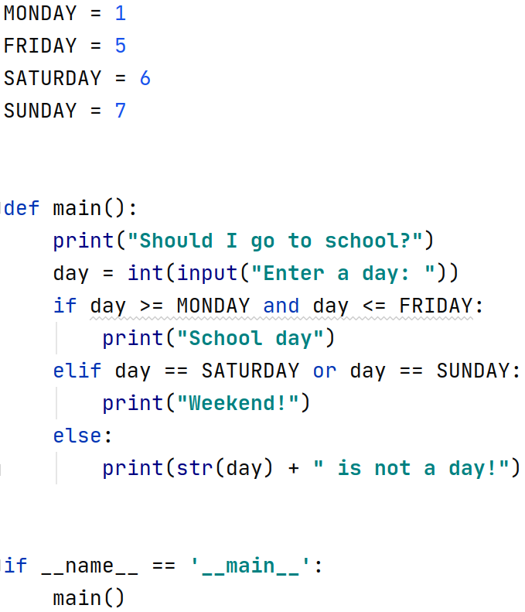

Slide 9
Operator | Example | Result
not | not (2 == 3) | True
and | (2 == 3) and (-1 < 5) | False
or | (2 == 3) or (-1 < 5) | True
Notes:
udělat komplikovanou složenou podmínku

Slide 10
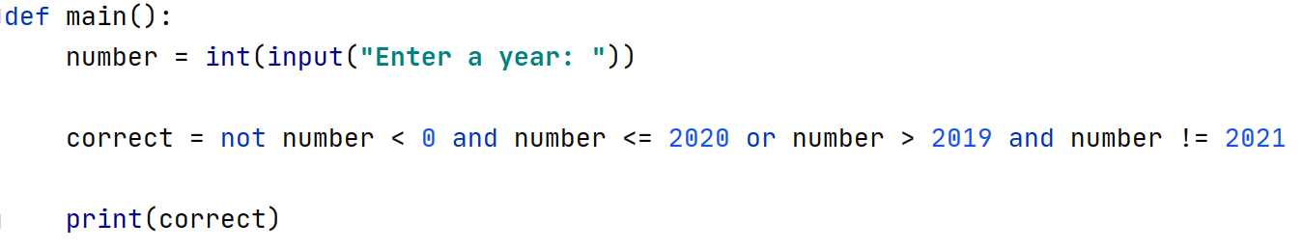
Notes:
2021?
-5?
2020?
15?

Slide 11
number = 2021
Notes:
2021?
-5?
2020?
15?

Slide 12
number = -5
Notes:
2021?
-5?
2020?
15?

Slide 13
number = 2020
Notes:
2021?
-5?
2020?
15?

Slide 14
number = 15
Notes:
2021?
-5?
2020?
15?

Slide 16
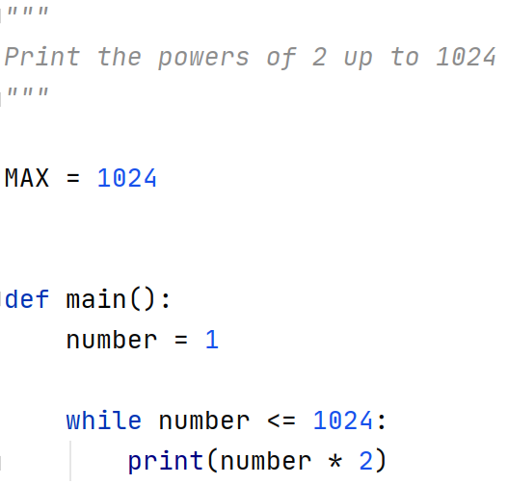

Slide 17


Slide 18
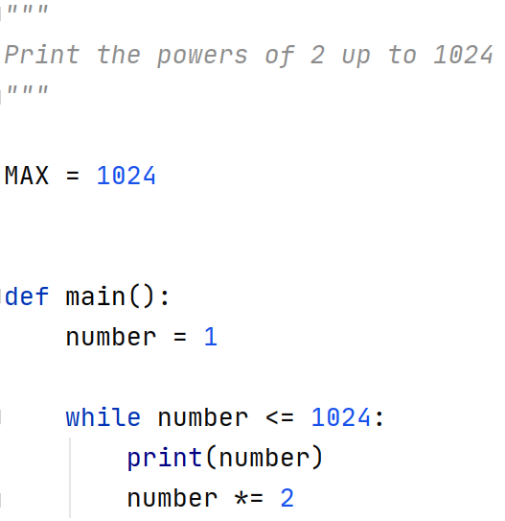
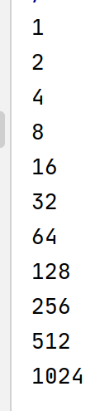

Slide 19
For Loops
Notes:
[0:30; 7-8]

Slide 20

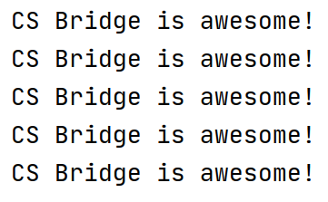
Notes:
[0:30; 8-9]
fixed number of repeats
for loop is much more powerful

Slide 21
index variable
Notes:
[0:30; 9-10]
variable
different name

Slide 22

Notes:
[0:30; 10-11]
any variable name is ok. Let’s stick with i.
what is the value of the variable?

Slide 23
What is the value of the index variable?
Notes:
[0:30; 10-11]
any variable name is ok. Let’s stick with i.
what is the value of the variable?

Slide 24

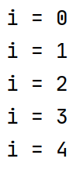
Notes:
[1:30; 11-12]
the 5 is not among the values
it starts from zero
ends before 5

Slide 25
Can the range be an expression?
Notes:
[1:30; 11-12]
the 5 is not among the values
it starts from zero
ends before 5

Slide 26
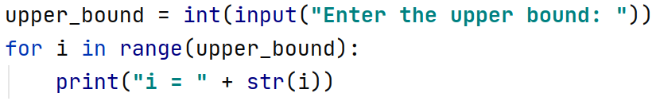
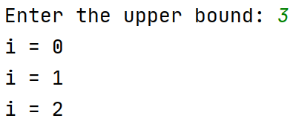
Notes:
[1:0; 12-13]
the range can also contain a variable
we can ask the user to enter the upper bound

Slide 27
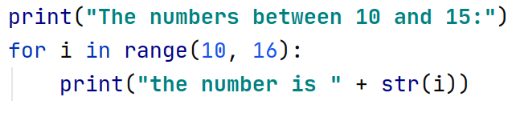
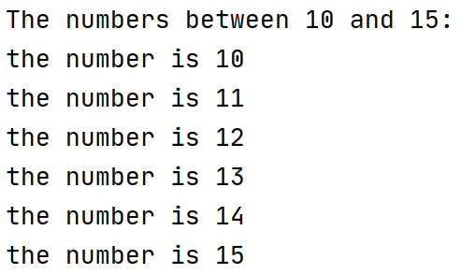
Notes:
[1:0; 13-14]
print the numbers between 10 and 15
we need to start from 10, not from 0
range: two arguments
comma
16 not 15

Slide 28
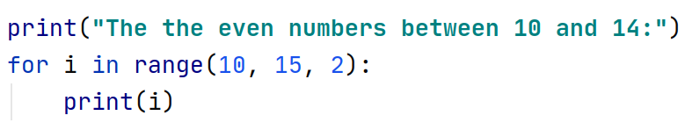
Notes:
[1:0; 14-15]
let’s trace it

Slide 29
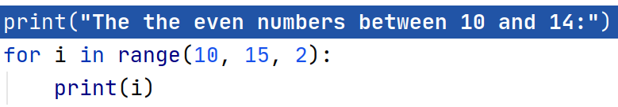
Notes:
[0:15; 15-16]

Slide 30
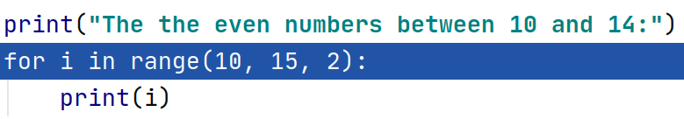
Notes:
[0:15; 15-16]

Slide 31
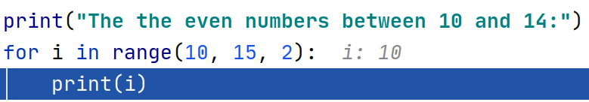
Notes:
[0:15; 15-16]

Slide 32
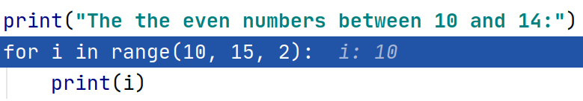

Notes:
[0:15; 16-17]

Slide 33
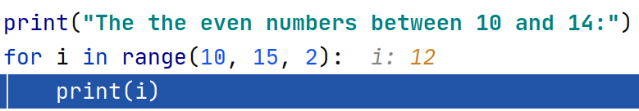
Notes:
[0:15; 16-17]

Slide 34

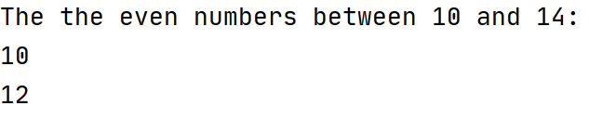
Notes:
[0:15; 16-17]

Slide 35

Notes:
[0:15; 17-18]

Slide 36

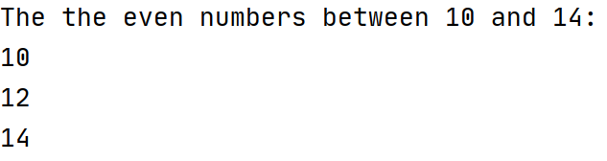
Notes:
[0:15; 17-18]

Slide 37
What about the odd numbers between 10 and 14?
Notes:
[0:15; 18-19]

Slide 38
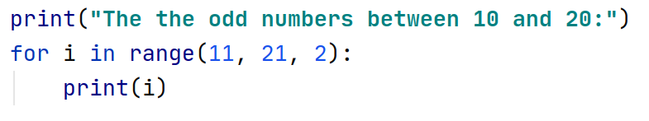
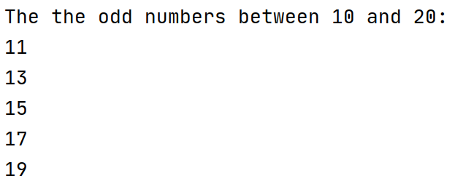
Notes:
[1:0; 19-20]

Slide 39
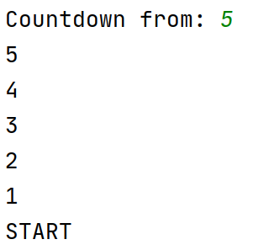
How to do a countdown?
Notes:
[2:0; 20-22]
More complex program
think about it for 1 minute

Slide 40
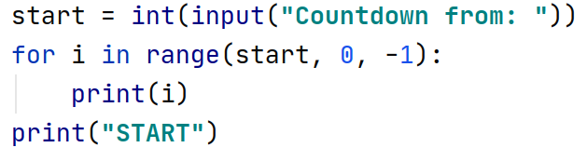
Notes:
[1:0; 22-23]

Slide 41

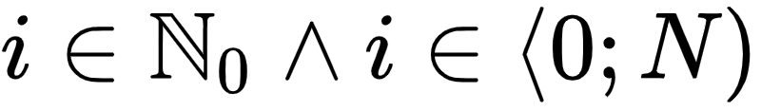
i = 0, 1, 2, …, N−1
Notes:
[1:0; 23-24]

Slide 42

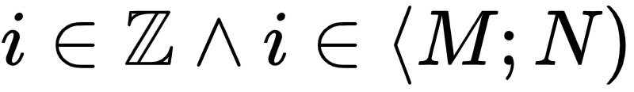
i = M, M+1, M+2, …, N−1
Notes:
[0:30; 24-25]

Slide 43

i = M, M+S, M+2S, M+3S, …
i < N
Notes:
[1:0; 25-26]

Slide 44
