Slide 1


ArrayLists

Slide 2
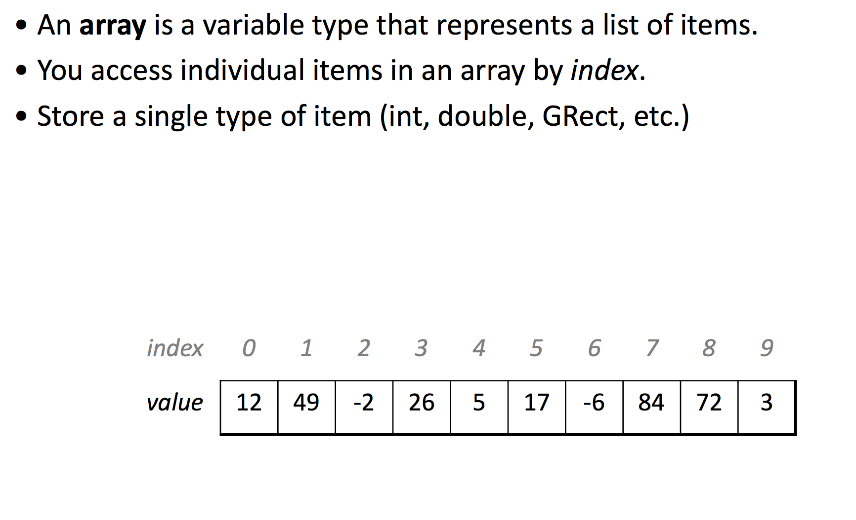
Previously…
Source: The Hobbit

Slide 3
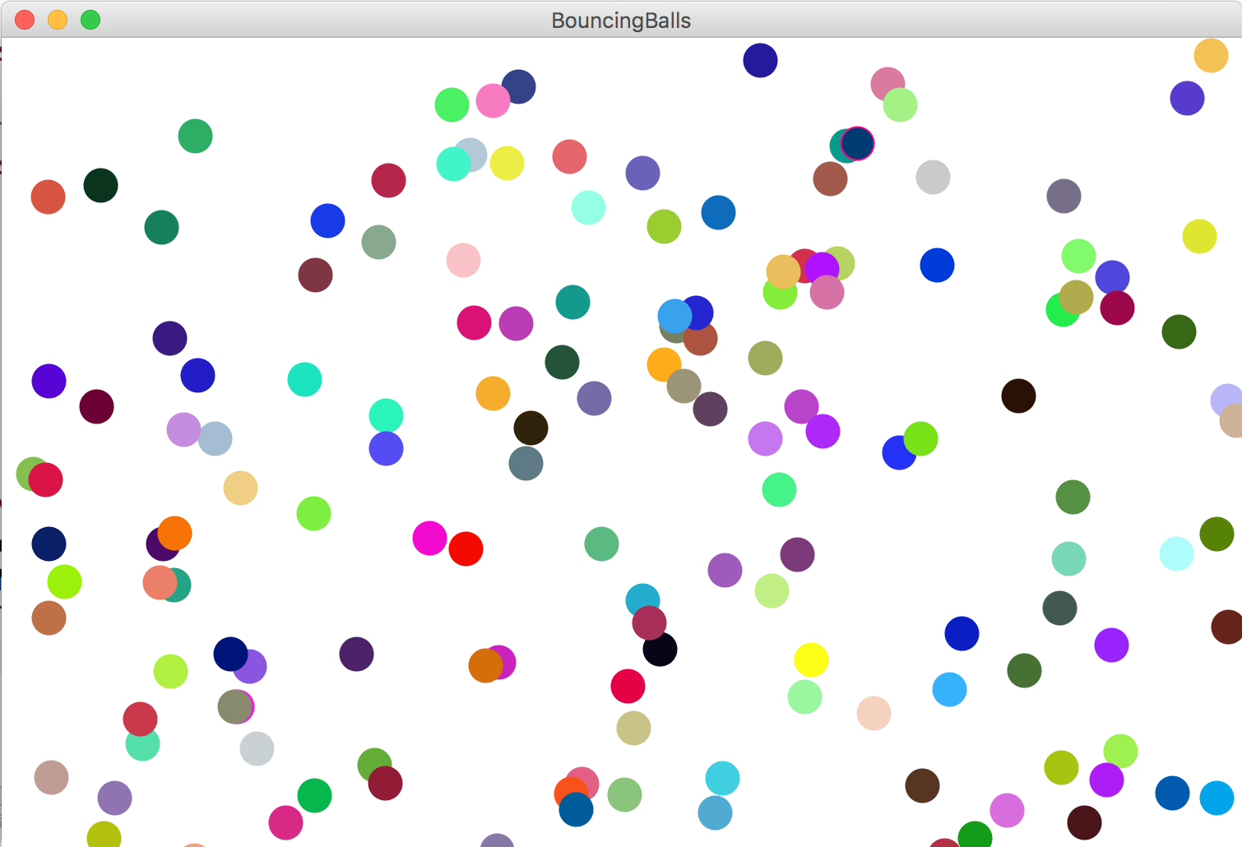
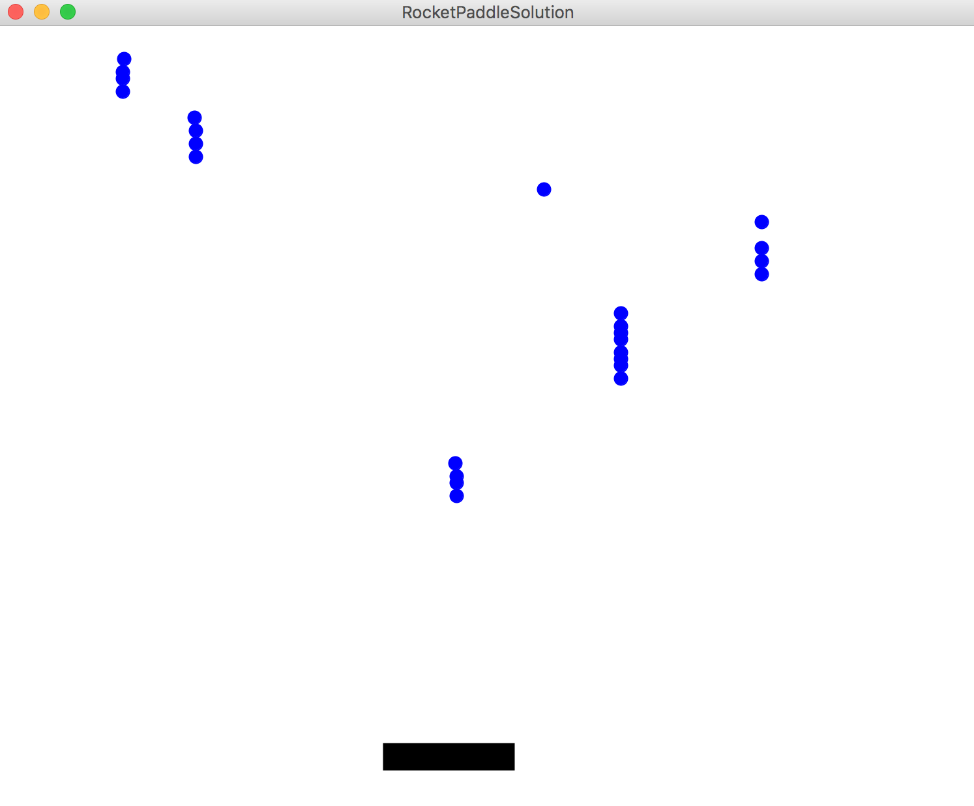
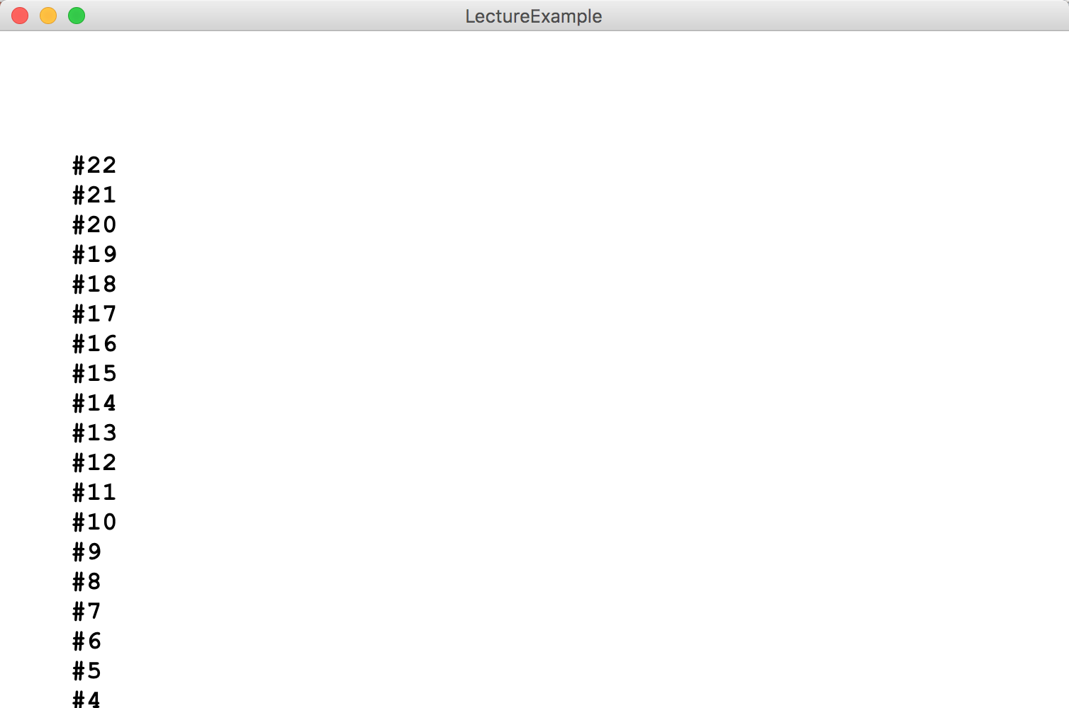
After this lecture!
Source: The Hobbit

Slide 4

Learning Goals
Know how to store data in and retrieve data from an ArrayList

Slide 5

Meet ArrayLists
A variable type that represents a list of items.
You access individual items by index.
Store a single type of object (String, GRect, etc.)
Resizable – can add and remove elements
Has helpful methods for searching for items
Wow! Nice to meet you!

Slide 6
What do you look like ArrayList?
ArrayList <Integer> myArrayList = new ArrayList<Integer>();

Slide 7
ArrayList
// Create an (initially empty) list
ArrayList <Integer> list = new ArrayList<Integer>();
// Add an element to the back
list.add(16); // now size 1
list.add(42); // now size 2

Slide 8
ArrayList
// Create an (initially empty) list
ArrayList <Integer> list = new ArrayList<Integer>();
// Add an element to the back
list.add(16); // now size 1
list.add(42); // now size 2
// Access elements by index (starting at 0!)
println(list.get(0)); // prints 16
println(list.get(1)); // prints 42

Slide 9
ArrayList
// Access elements by index (starting at 0!)
for (int i = 0; i < list.size(); i++) {
println(list.get(i));
}

Slide 10
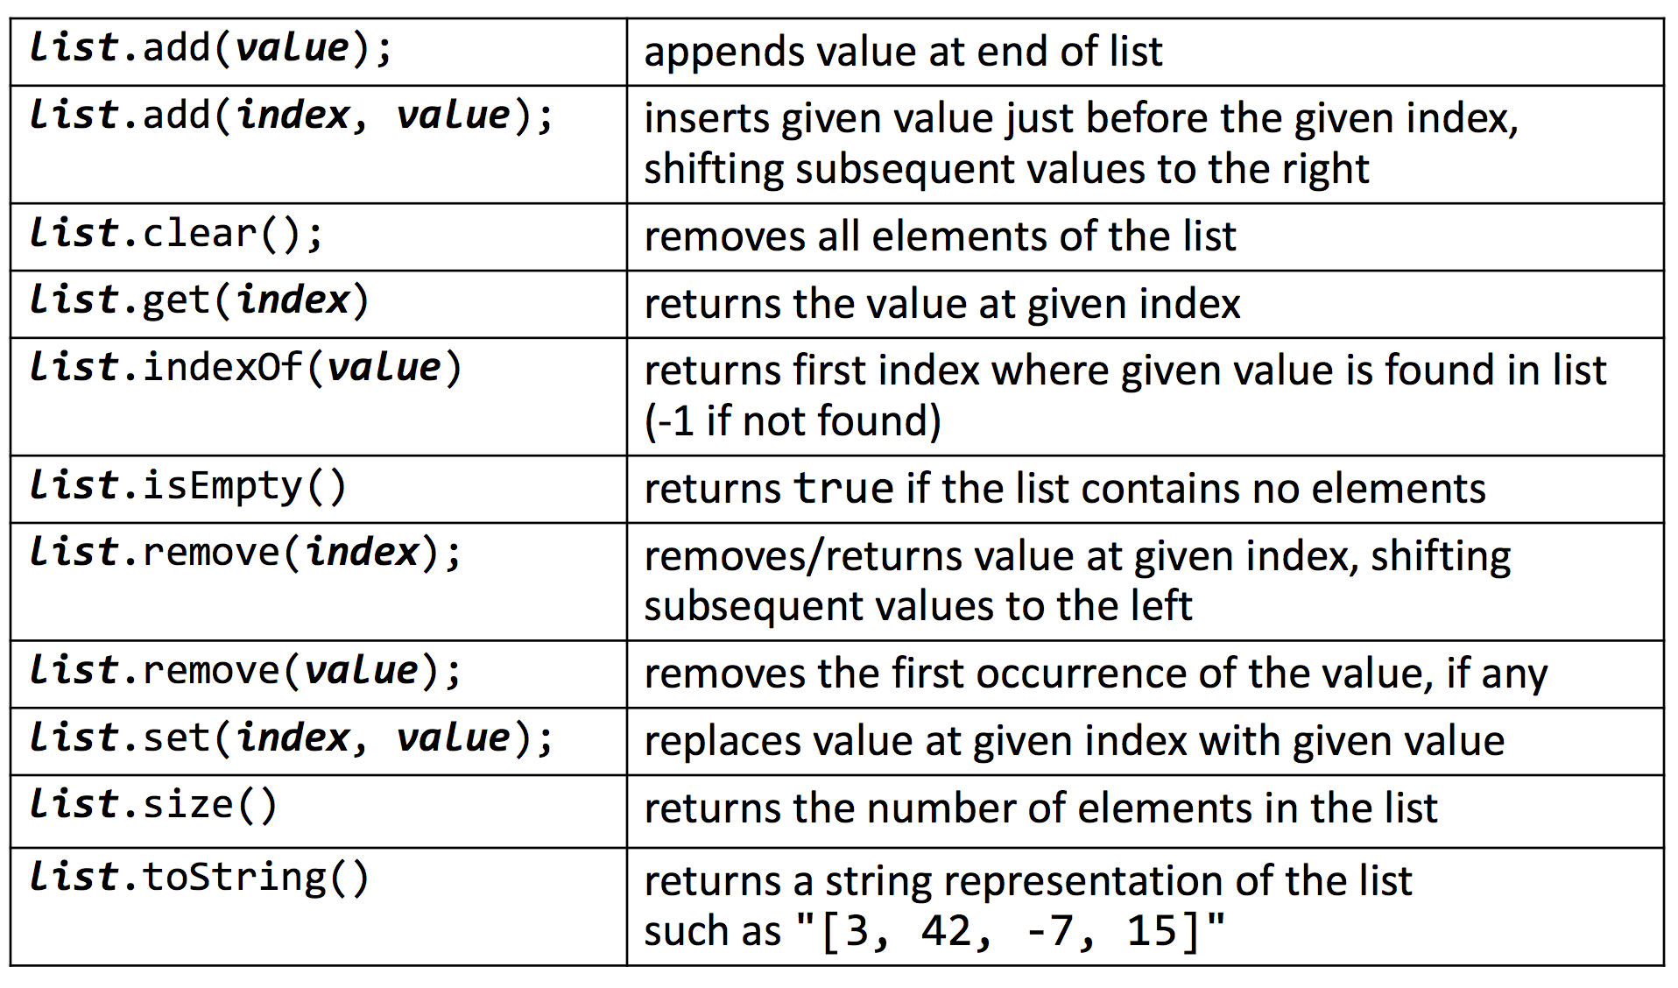
ArrayList Methods

Slide 11
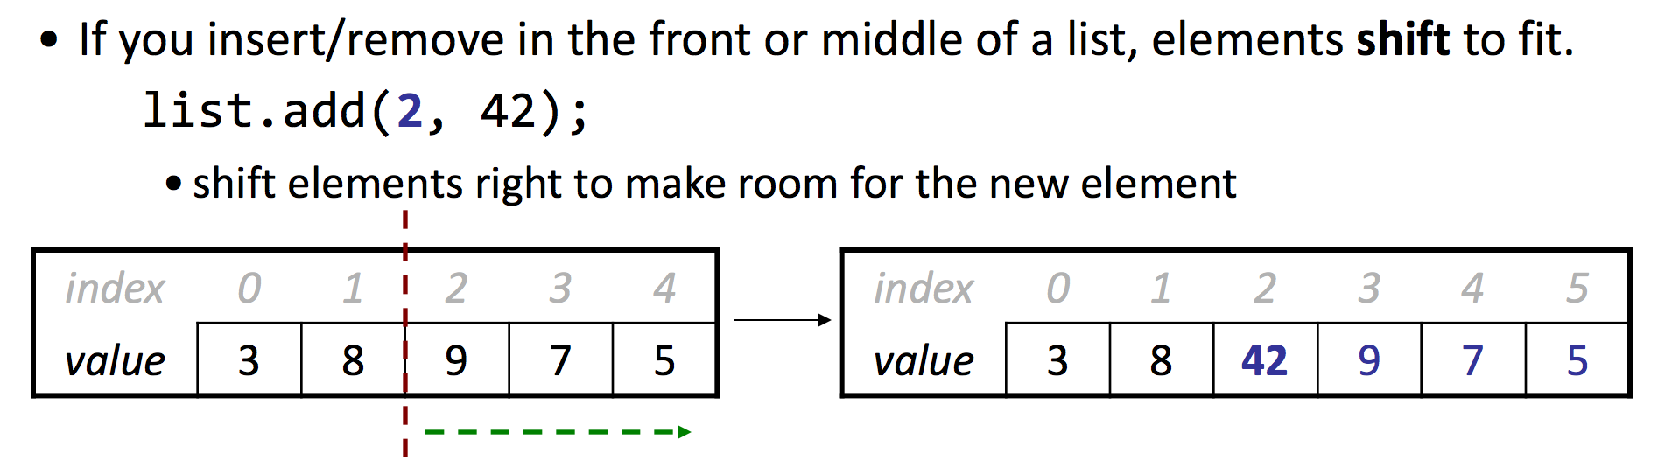
Insert/Remove

Slide 12
Example

Slide 13
Rocket Paddle

Slide 14
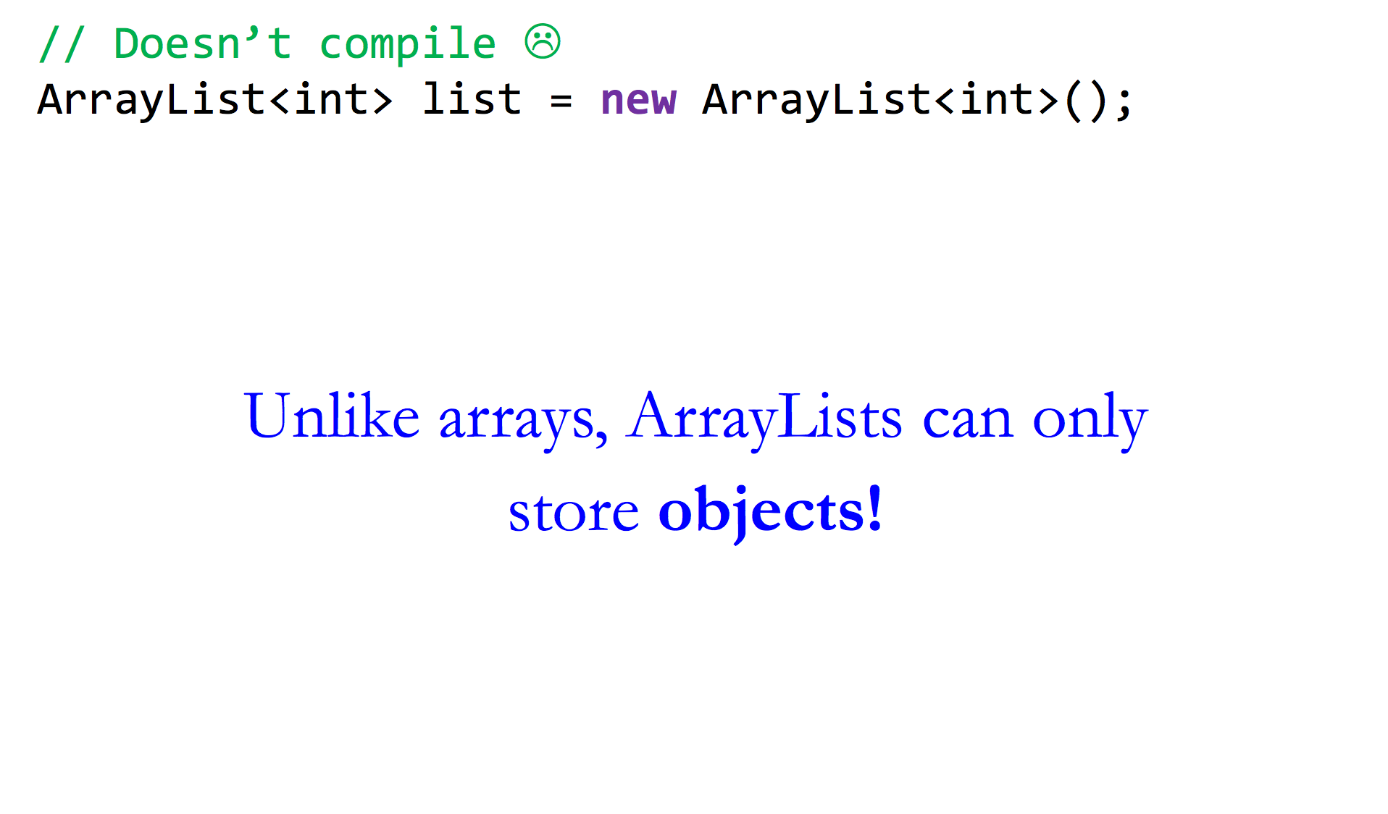

ArrayLists and Primitives

Slide 15
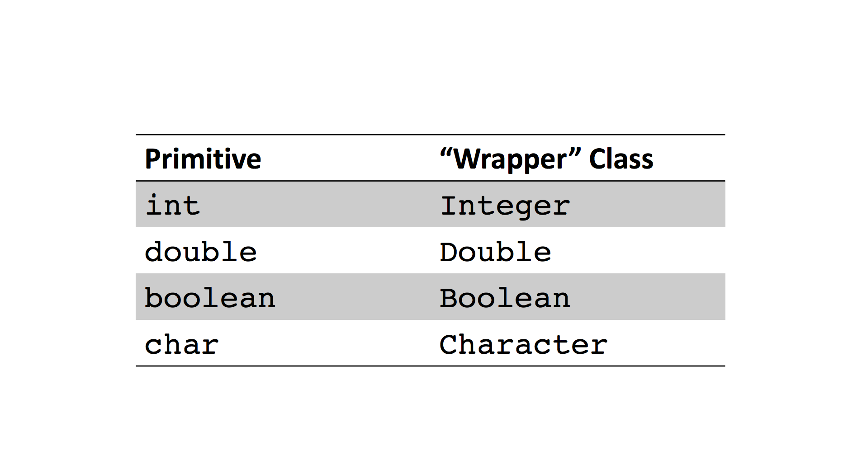
ArrayLists and Primitives

Slide 16
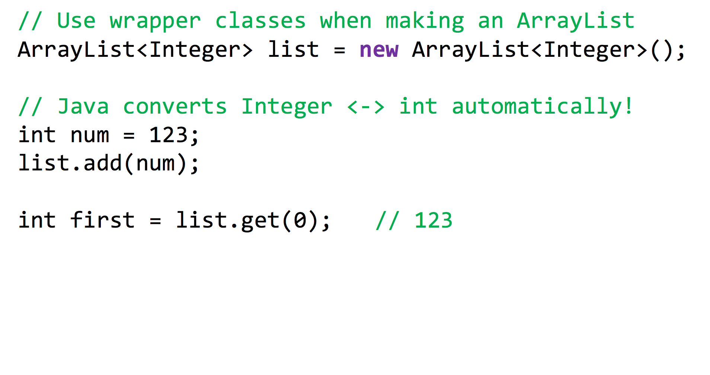
ArrayLists and Primitives

Slide 17
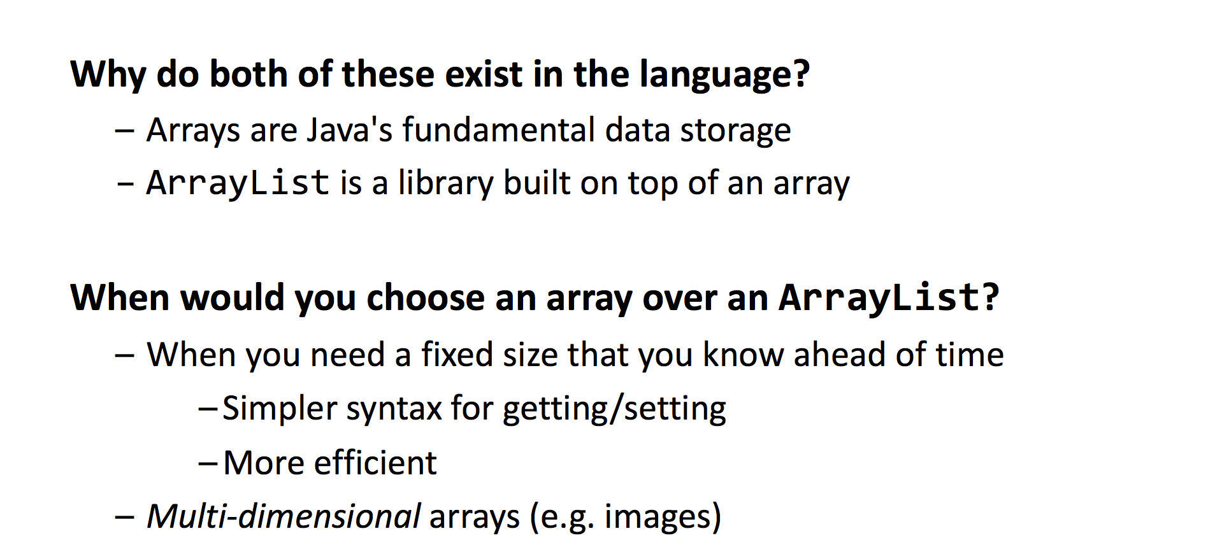
ArrayLists vs. Arrays

