Slide 1
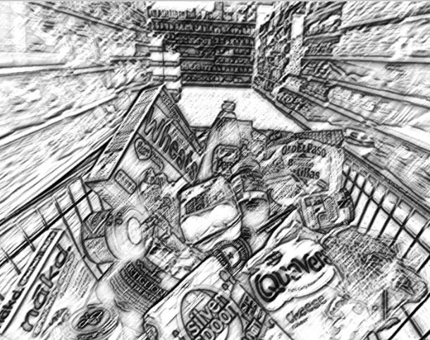



Slide 2
Under Construction… Available soon..

