Slide 1
Git & GitHub For Design (and some other people)
To unify and simplify how design assets are managed and hosted.
I even used git to create this presentation!
There might be something cool if you check it out…
https://github.com/RyanCopley/git-for-designers

Slide 2
What is git?
Git is a file versioning system.
You overwrite the same file as a new version, then push your changes to a central server, which houses everything
Versions are known as commits, which create change history
Change = Additions + Deletions
If two people are working on the same file, the work can be automatically merged together. Merging two peoples work creates a merge commit
Pull Requests (PR) are a request for approval from your manager. Once they accept the Pull Request, the work is considered complete.
I will show real world examples of this stuff.

Slide 3
What is GitHub?
A website that manages your git repositories.
Has managed access controls
You will not need to use much command line stuff, because excellent GUI tools exist.
GitHub is what made git awesome for designers.
You can access it at: http://github.com

Slide 4
How does this help designers?
Hosting for your design assets, yay ☺
Unlimited undo's, even from other designers undo history
(Sort of, but trust me, it’s awesome)
Branching
It is very easy to link a JIRA ticket in git, associating your work with JIRA
Allows any designer to work on any project, since PSDs will be centrally stored.
It’s free for us (Thank Gannett Digital)

Slide 5
What advantages does this have over JIRA, ZIPs, dropbox
All design assets are centrally located
A very clear understanding of what assets are approved
No more file size upload restrictions (JIRA)
Zipping stuff takes time, and causes confusion
This zip only has a subsection, that zip has the whole thing, this zip is named final_2.zip, etc
You can’t see “inside” a zip unless you download and extract it
There are file ownership issues with DropBox
We can’t see inside your dropbox easily ☹
All of Gannett Digital uses it for code and configurations, so design is the next step! ☺

Slide 6
History
“undo” history, but built into git!
Can span between days, between Photoshop crashing, etc
Is as simple as pushing a button (and maybe a description)
When you push the button, the work you’ve done is “written” into the history of the repository, and you can go back to this point at any time
History is attached to your name, so we can see who did what work
Don’t be paranoid ☺
Attribution is good

Slide 7
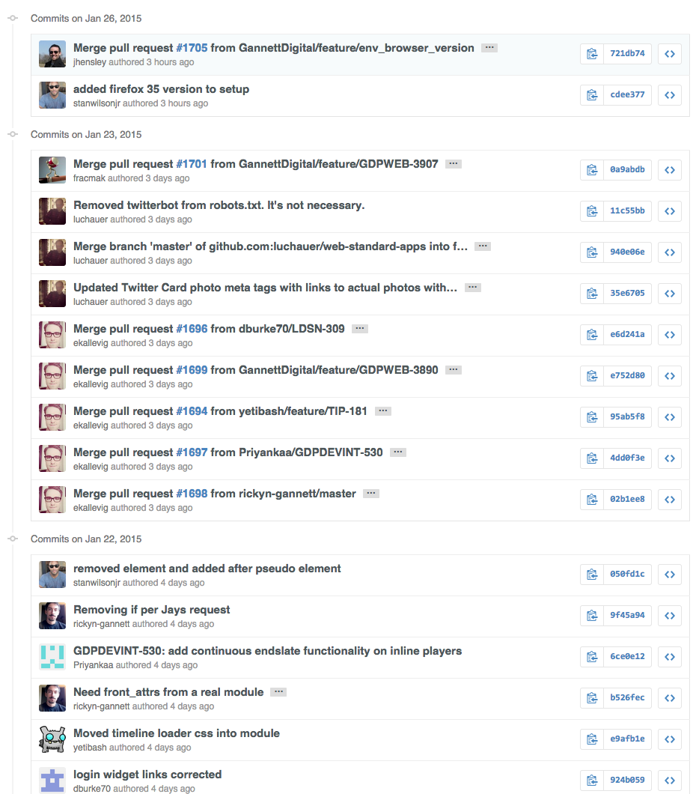
Real world example

Slide 8
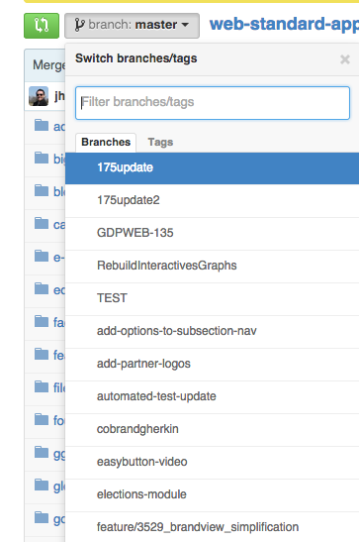
Branching
Branching
Side by side versions, which stem from a common parent
Allows you to make MULTIPLE versions of the same file to present
Useful when you don’t have concrete ideas and need some room for creative freedom

Slide 9

Real world example of branching
Context: We have a splash screen which is currently RED, and has been approved and is in the master repo.
PM: “I know you made a red splash screen, but I want to see orange and brown to see if they’re better. Can you do both and let me see?”
Two branches, an ORANGE branch, and a BROWN branch, which are parents of RED, which has already been approved (master)
You do the work… Show the PM…
PM: “I think I like BROWN, lets use that one”
BROWN would then be merged (By management) into the (RED) master repo, signaling approval.
BROWN and ORANGE branches could be deleted once the work is approved. (Optional)

Slide 10
And it integrates with JIRA!
Just add the issue number to your commit message and you’re good to go

Slide 11
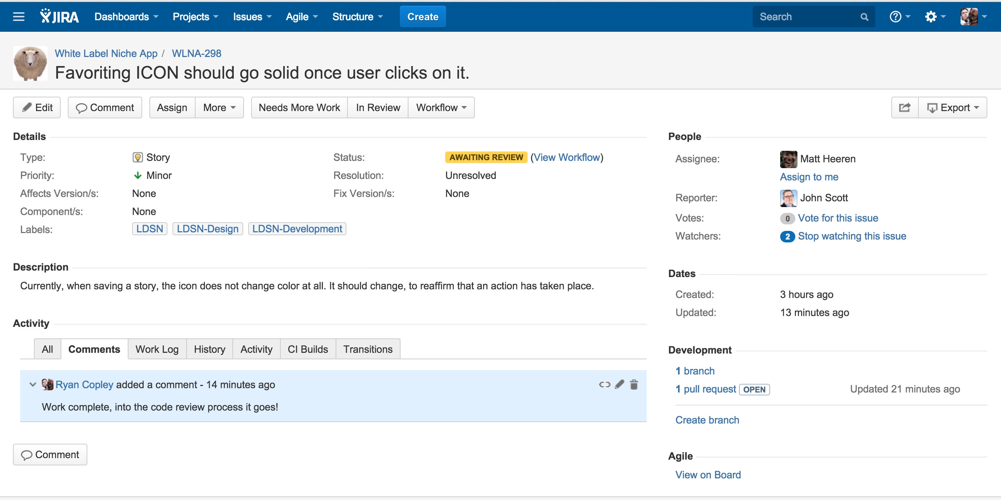
Real world example

Slide 12
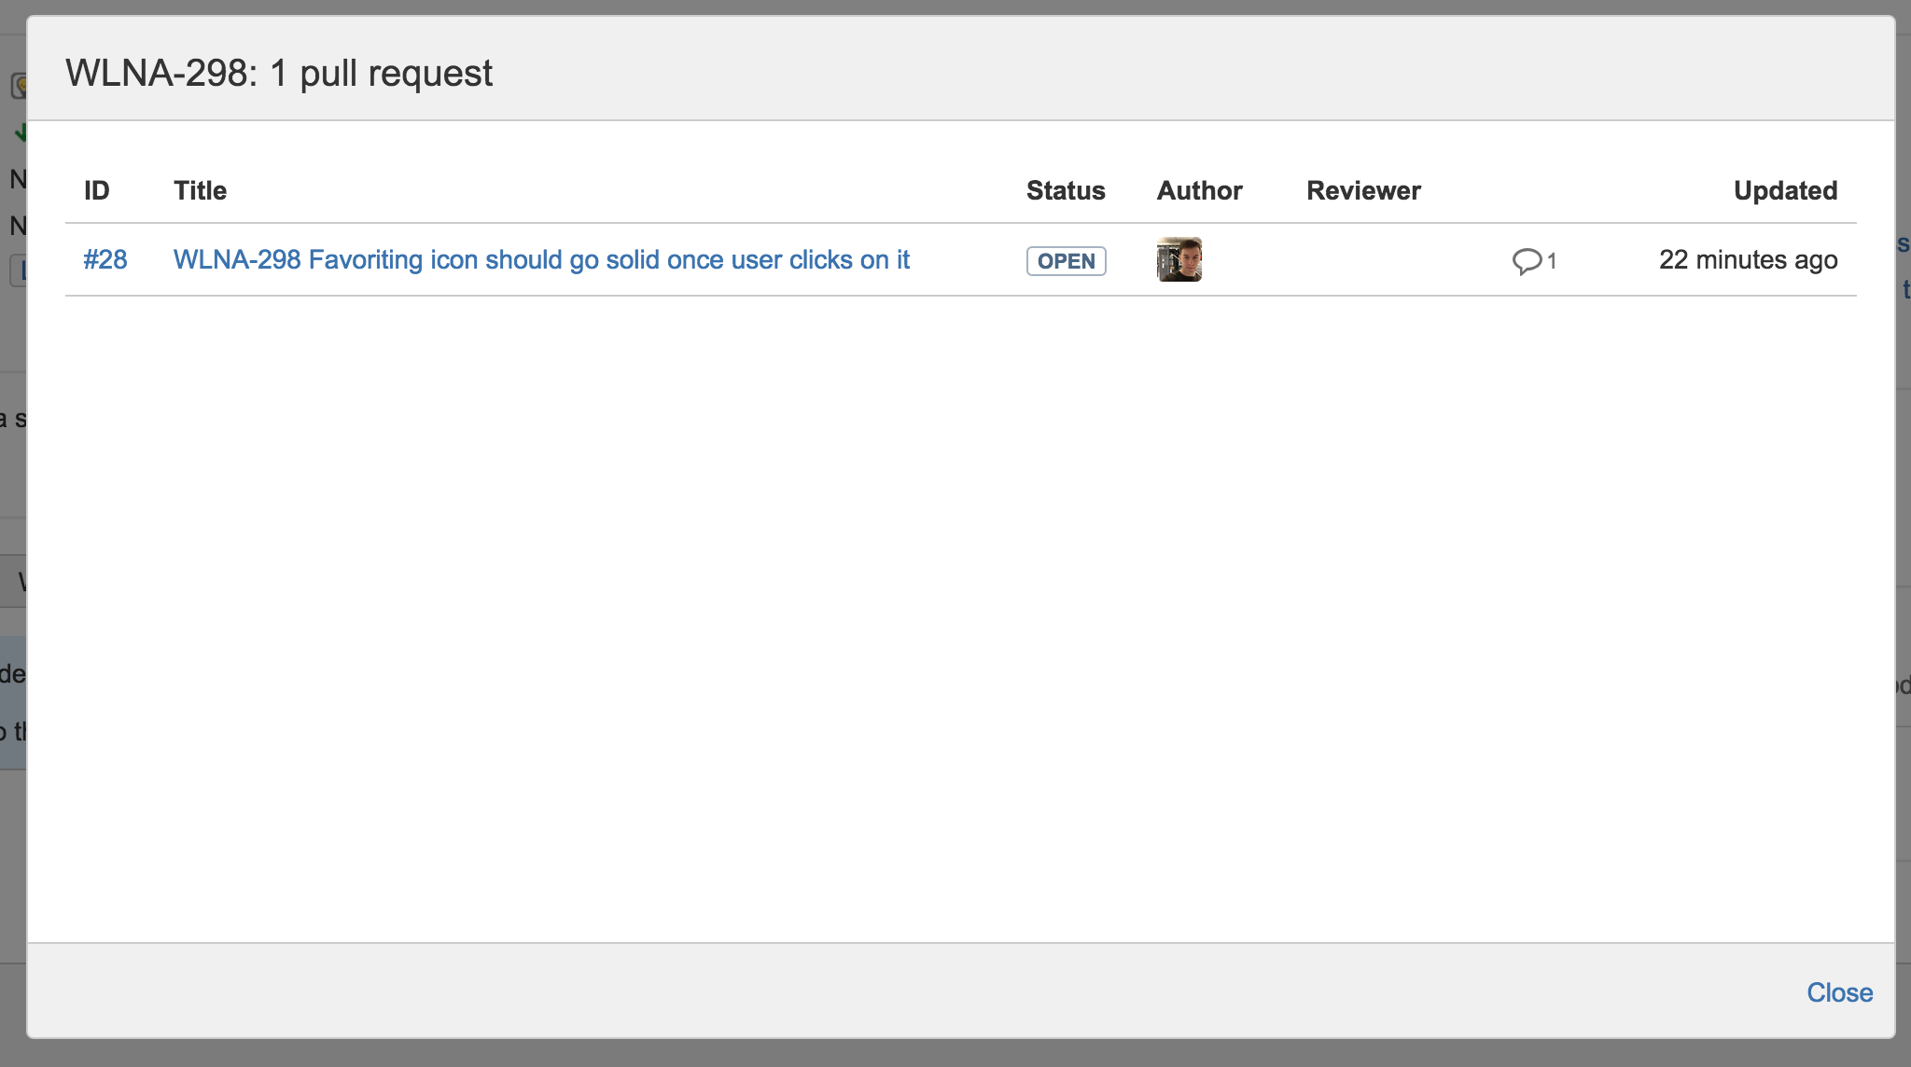
Real world example

Slide 13
Exercise time! (15 minutes)
https://try.github.io/levels/1/challenges/1
Work your way through the challenges, it will give you a basic understanding of git
You will not need to use the command line for day to day work ☺ This is just an exercise to understand git.
When you’re done, download:
https://mac.github.com/ (If you use Windows please let me know)

Slide 14
Exercise time!
Fork my repository
https://github.com/RyanCopley/images-work-great
Look at the difference between two commits in this repo
Make sure you look at
2-up
Swipe
Onion skin
Change the orange text in kentucky-1024x1024.png to your favorite color
Open a pull request against the main repository
Contact Ryan so he can close out your PR

Slide 15
Exercise time!
Extends from the former exercise (Fork Ryan's repo)
Create a ticket in
https://jira.gannett.com/browse/ TO BE DETERMINED
Edit the image again (Your choice!)
Tag your commit with the ticket, for example,
TO BE DETERMINED
Push the changes to your local fork
Open a pull request on GitHub
Monitor the ticket for your commit to be attached to the ticket

Slide 16
Exercise time!
Create a repository
Create an image in the repository
Commit it, and publish it
Branch that image twice, create two different versions
Pretend to be a PM and pick one you like, and merge it to your master branch
Delete excess branches

