Slide 1
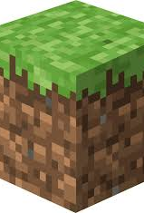
Team 9 - Minecraft
By: Brandon Conway , Ryan Coplien , Kasey Tippelt

Slide 2
What did we use?
Our RDBMS of choice was PostgreSQL
We decided to use Visual Basic.NET for easy Database connection and UI design

Slide 3
Application - Description
The application selects, inserts, updates, and virtually deletes data based around the popular game of Minecraft.
Stores data of the blocks, biomes, mobs, mob, drops, items, etc.

Slide 4
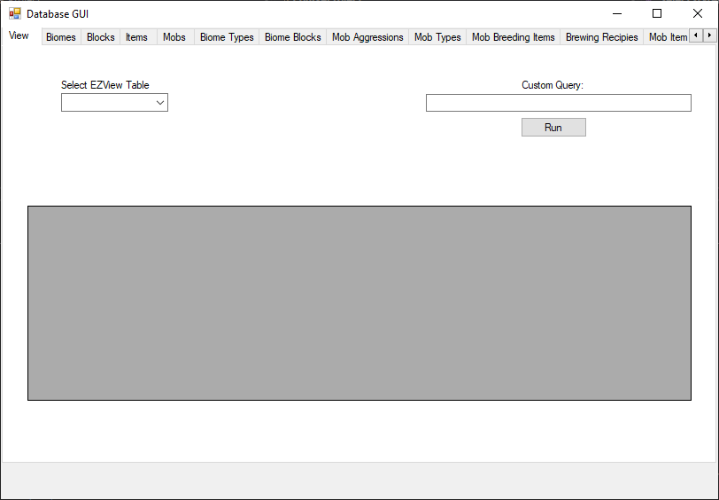
Application - GUI

Slide 5
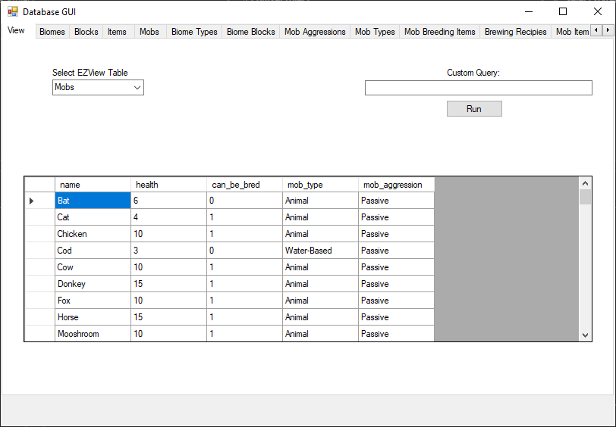
Application - GUI

Slide 6
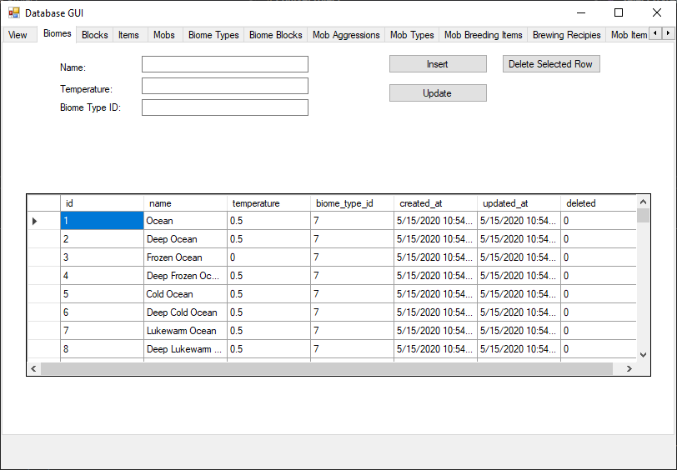
Application - GUI

Slide 7
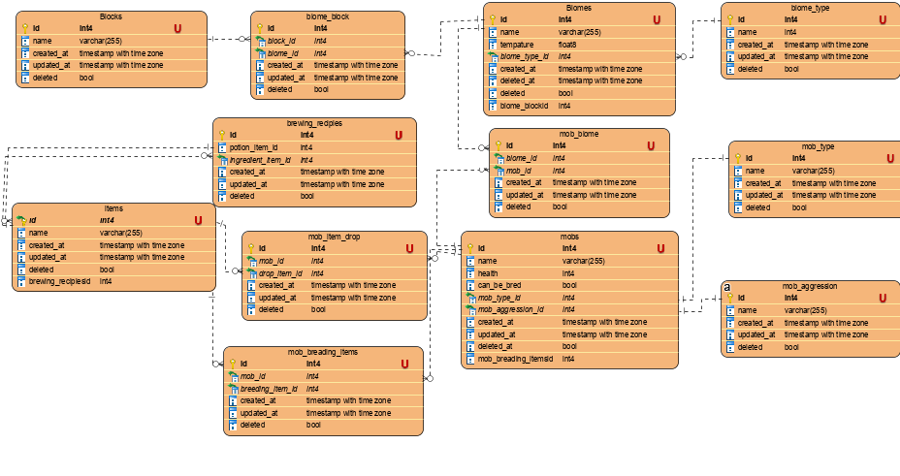
ER-Diagram

