Slide 1
Learning objectives
Know what a tree actually means.
Learn some of the jargon of evolutionary biology.
Instinctively cringe when someone talks about a “basal taxon” based on itsposition.

Slide 2
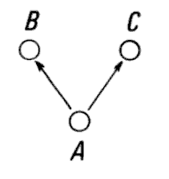
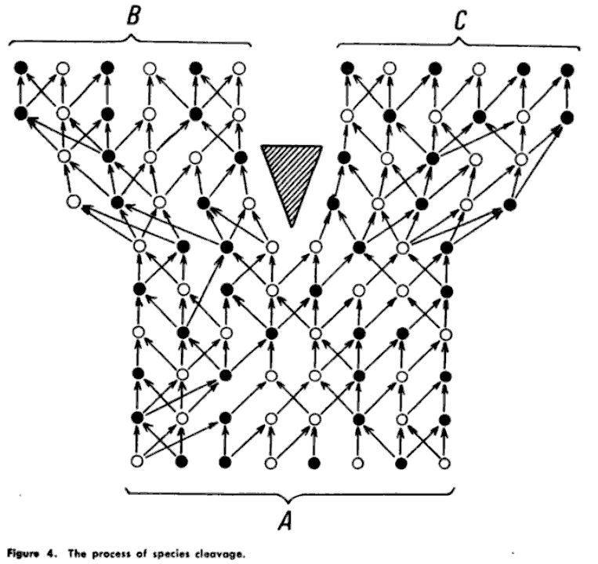

Willi Hennig, Phylogenetic Systematics, 1966. p. 19

Slide 3
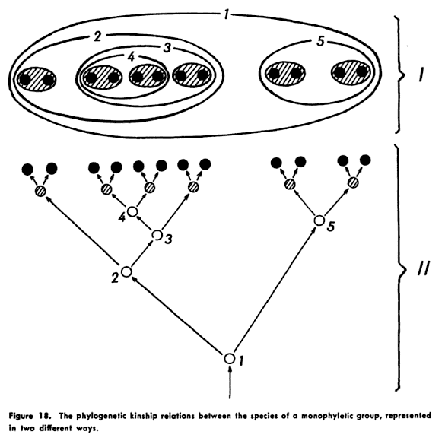
Willi Hennig, Phylogenetic Systematics, 1966. p. 71
Notes:
This history of splitting creates a series of nestings. We typically show this as a tree, but other ways of showing this nesting are possible.

Slide 4
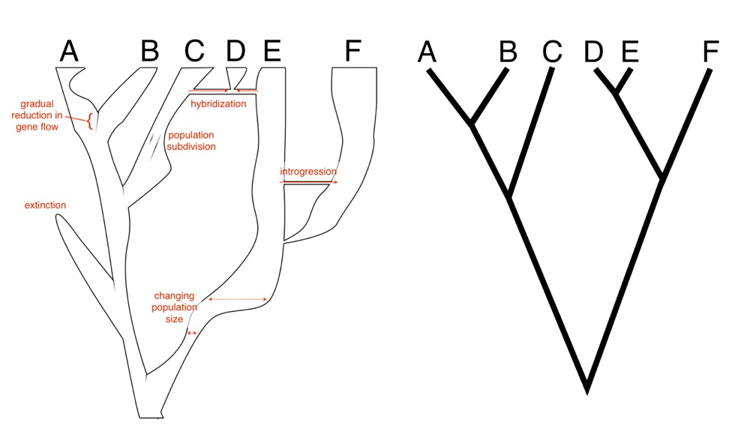

Slide 5


Tree = phylogeny = cladogram (if no branch lengths) = connected graph with no cycles

Slide 6
Taxon = OTU (operational taxon unit) = Leaf = Terminal = Terminal Node

Slide 7
Taxon = OTU (operational taxon unit) = Leaf = Terminal = Terminal Node
Taxa are often extant (living) organisms, but they need not be. Fossils can be taxa, viruses sampled at different times, etc. and so not all taxa need occur at the same time.

Slide 8
Branch = edge

Slide 9
Branch = edge
May have length, which may correspond to time, amount of character change, probability of character change, etc.

Slide 10
[Internal] Node

Slide 11
[Internal] Node
Where different edges meet. If all have just two descendant branches, tree is “bifurcating” or “fully-resolved” or “dichotomous”. Nodes with more branches are “polytomies” or “multichotomies”

Slide 12
Root [node]

Slide 13
A rooted tree (most common) has a node that represents the most recent common ancestor (MRCA, or LCA (least common ancestor)) of all the taxa. A rooted tree (directed graph) shows the direction of time.
Root [node]

Slide 14
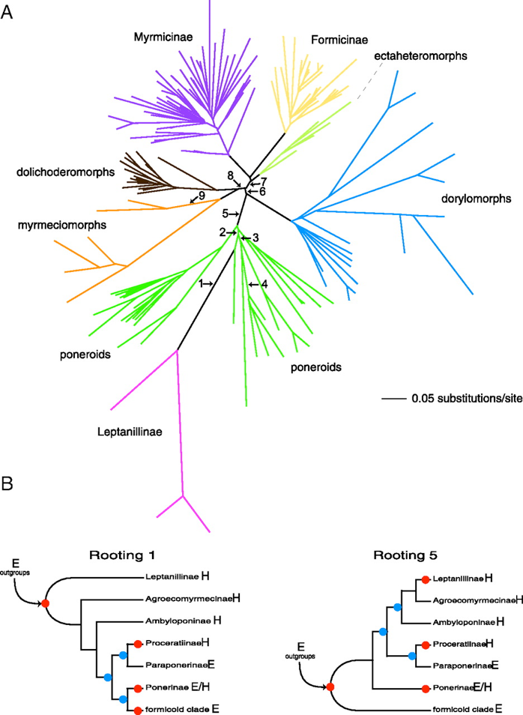
Brady S.G., T. R. Schultz, B.L. Fisher, and P.S. Ward. 2006. “Evaluating alternative hypotheses for the early evolution and diversification of ants” PNAS 103:18172-18177

Slide 15
Clade: ancestor and all its descendants (a “monophyletic” group”)
Notes:
Plot from core pretest. phylum comes from greek for tribe or race

Slide 16
Paraphyletic group: ancestor and some but not all its descendants

Slide 17
Polyphyletic group: even worse
Notes:
In practice, you can’t really tell paraphyletic from polyphyletic from just a set of taxa (rule of thumb: if the group of taxa is a clade except a few subclades (maybe just one) are missing, it’s “paraphyletic”; if a lot of things are missing, it’s “polyphyletic”). You can tell if branches are included in the definition (ancestor included or not -> para vs poly). But basically, monophyletic groupings good, others bad (in terms of being “natural groups”)

Slide 18
Notes:
If you can’t compare genera, what can you compare? Sister groups: a pair of clades descending from the same node. They’ve had the same time to evolve and started from the same ancestor. You’ll learn other ways to make phylogenetically-correct comparisons with Darrin. But just remember to think of species, genera, or any other group like people in a small town. If half of them have blue eyes, it might be due to inheritance from a blue-eyed ancestor, rather than some adaptive significance of blue eyes in that town. You must take relationships into account.

Slide 19
Notes:
Taxa sister to the focal group (and sometimes taxa sister to the focal group and its closest relative) are sometimes called “outgroups”. They help root the tree (show you which way is down)

Slide 20
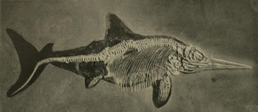
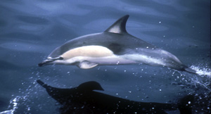
Characters
Homology: Similarity due to shared ancestry (i.e., humans, birds, and turtles all having four limbs)
Homoplasy: Similarity, but not due to shared ancestry (i.e., convergence of dolphins and ichthyosaurs on similar shape)

Slide 21
Characters
Plesiomorphy: An ancestral (“primitive”) character state (with reference to another, derived, state)
Symplesiomorphy: Plesiomorphy shared by ≥ 2 taxa
Apomorphy: A derived (“advanced”) character state (with reference to another, ancestral, state)
Synapomorphy: Apomorphy shared by ≥ 2 taxa
Autapomorphy: Apomorphy possessed by one taxon
Ex: Sharks living in water (compared to tetrapods living on land)
Ex: Whales living in water (compared to other tetrapods living on land)
Definitions from Futuyma, Evolutionary Biology, 1998

Slide 22
Characters
Plesiomorphy: An ancestral (“primitive”) character state (with reference to another, derived, state)
Symplesiomorphy: Plesiomorphy shared by ≥ 2 taxa
Apomorphy: A derived (“advanced”) character state (with reference to another, ancestral, state)
Synapomorphy: Apomorphy shared by ≥ 2 taxa
Autapomorphy: Apomorphy possessed by one taxon
Note correct plural!
Definitions from Futuyma, Evolutionary Biology, 1998

Slide 23





Advanced and primitive
Icons ©Wellcome Trust

Slide 24
Advanced and primitive
Icons ©Wellcome Trust

Slide 25




Advanced and primitive
Icons ©Wellcome Trust
Notes:
Position on the tree alone does not tell you about “primitive” or “advanced” taxa -- in two different but both valid trees, humans appear at completely different positions. Pruning, whether by extinction or just by not including certain taxa on a tree, can make the tree have a particular form, but all extant organisms are tips on the tree and have had the same amount of evolutionary time from the root of the tree (also called their most recent common ancestor, or MRCA). Some have had more shared time together than others. And they often are a mixture of new and ancient traits. Some taxa may more closely resemble hypothetical ancestors than others, but they are not ancestral to other extant taxa, and just position on the tree cannot tell you how similar they are to their ancestors. Just the same, people often make this mistake.

Slide 26
Summary
Jargon: Clade, monophyletic, taxon, paraphyletic.
Avoid primitive thinking.

