Slide 1
Learning objectives
Understand why there are so many trees.
Understand why a tree search is a difficult problem.

Slide 2
a
b
b
a
=
After Figure 3.3 of Felsenstein 2004
Notes:
First, a discussion of the scale of the problem. Why is it hard?

Slide 3
a
b
c
After Figure 3.3 of Felsenstein 2004
Notes:
Where can we add taxon C to this tree?

Slide 4
a
b
c
a
c
b
After Figure 3.3 of Felsenstein 2004
Notes:
Where can we add taxon C to this tree?

Slide 5
a
b
c
a
c
b
a
c
b
After Figure 3.3 of Felsenstein 2004
Notes:
Where can we add taxon C to this tree?

Slide 6
a
b
c
a
c
b
a
c
b
a
b
c
After Figure 3.3 of Felsenstein 2004
Notes:
Where can we add taxon C to this tree?

Slide 7
a
b
a
c
b
a
c
b
a
b
c
After Figure 3.3 of Felsenstein 2004
Notes:
That’s where.

Slide 8
a
b
a
c
b
a
c
b
a
b
c
After Figure 3.3 of Felsenstein 2004
Notes:
So, taxon C would could add to three places. The next taxon, we could add to 5 places.

Slide 9
a
b
2 taxa: 1 rooted, bifurcating tree
3 taxa: 3 rooted, bifurcating trees
4 taxa: 15=3x5 rooted, bifurcating trees
5 taxa: 105=3x5x7 rooted, bifurcating trees
n taxa: 3x5x7x9x11x…x(2n-3) rooted, bifurcating trees =
(2n-3)!! = (2n-3)!/[2^{n-1}(n-1)!]
a
c
b
a
c
b
a
b
c

Slide 10
N | 2^{N} | 10^{N} | Trees
1 | 2 | 10 | 1
2 | 4 | 100 | 1
3 | 8 | 1,000 | 3
4 | 16 | 10,000 | 15
5 | 32 | 100,000 | 105
6 | 64 | 1,000,000 | 945
7 | 128 | 10,000,000 | 10,395
8 | 256 | 100,000,000 | 135,135
9 | 512 | 1,000,000,000 | 2,027,025
10 | 1,024 | 10,000,000,000 | 34,459,425
15 | 3E+04 | 1E+15 | 2E+14
20 | 1E+06 | 1E+20 | 8E+21
30 | 1E+09 | 1E+30 | 5E+38
60 | 1E+18 | 1E+60 | 6E+96
×2
×10
×1
×2
×10
×3
×2
×10
×5
×2
×10
×7
×2
×10
×9
×2
×10
×11
×2
×10
×13
×2
×10
×15
×2
×10
×17

Slide 11
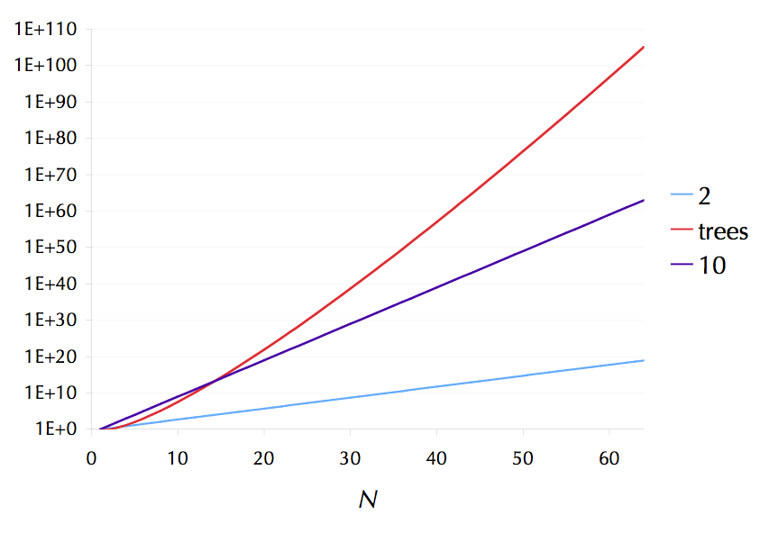
Number of atoms in the universe
N
N
>1 million species
Notes:
Remember this is a log scale, so the number of trees rises faster than exponentially with the number of taxa. This becomes a problem when searching for trees. I’m involved with a project (iPlant) attempting to deal with trees of tens of thousands to hundreds of thousands of taxa.

Slide 12
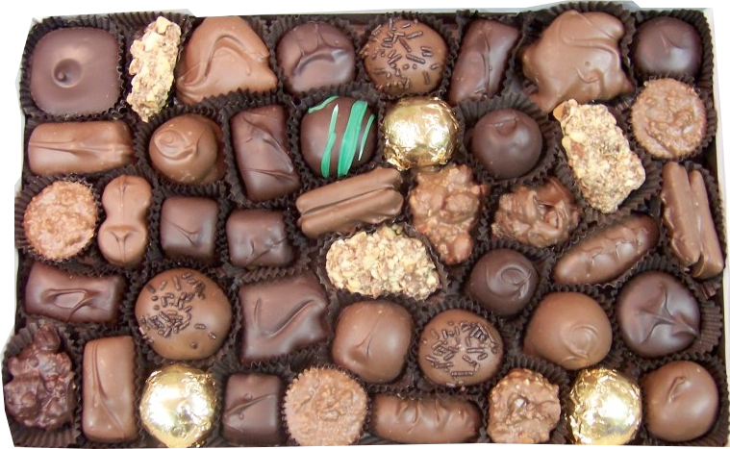
Tree search
Notes:
Imagine the space of trees as a box of chocolates

Slide 13
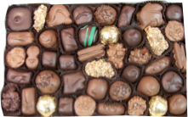
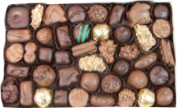
Which is your favorite?
Notes:
Remember, for just 50 taxa, that’s more trees than atoms in the universe. Imagine how many trees are possible for 5,000 taxa. What about 1M taxa? Now, you might hope for an easy solution, but...

Slide 14
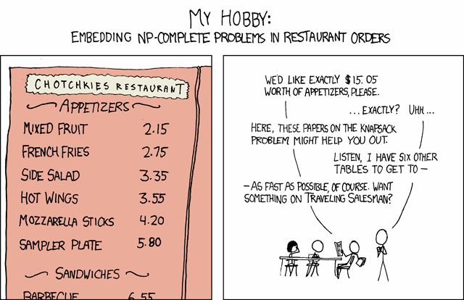
http://xkcd.com/287/

Slide 15
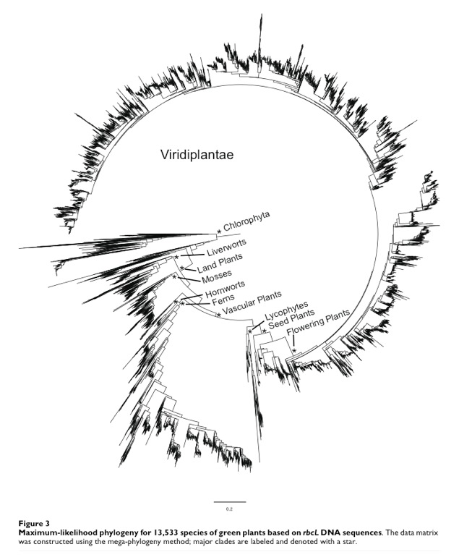
13,533 species
Needed 32 GB of RAM to run
Smith et al. 2009

Slide 16
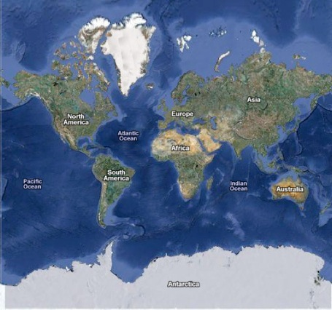
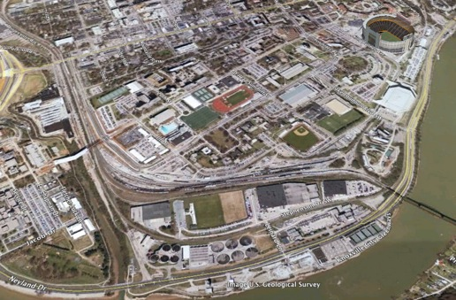
Number of atoms in the universe
N
N
Notes:
Remember this is a log scale, so the number of trees rises faster than exponentially with the number of taxa. This becomes a problem when searching for trees. Adding two more species to the 13,533 species dataset shown earlier means increasing the search space of possible topologies by 183 million-fold. This is the same magnitude of changing the search space for an object from “around campus” (about a square mile) to “anywhere on the planet” -- and it’s just adding two species.

Slide 17
Summary
There are many, many trees.
Finding the right one is very difficult problem.

