Slide 1
Learning objectives
Be able to provide concrete examples of what can be learned through phylogenetics
Explain some costs of ignoring phylogenies

Slide 2
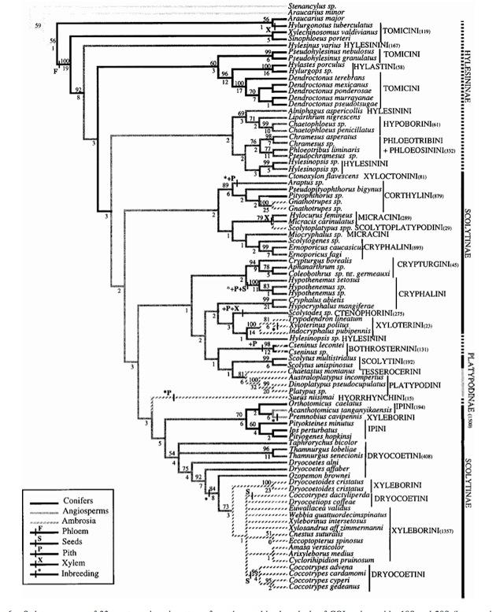
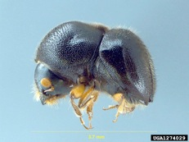
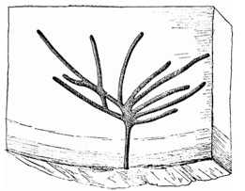
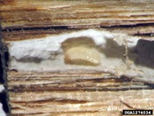
7 origins of agriculture
© Doug Stone
Angiosperm | Conifer
5200 | 180
119 | 11
1500 | 195
8 origins of inbreeding
© Doug Stone
The evolution of agriculture in beetles (Curculionidae: Scolytinae and Platypodinae). 2001.BD Farrell, AS Sequeira, BC O'Meara, BB Normark, JH Chung, BH Jordal
Evolution 55 (10), 2011-2027

Slide 3
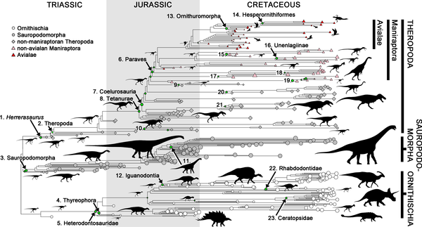
Benson RBJ, Campione NE, Carrano MT, Mannion PD, Sullivan C, et al. (2014) Rates of Dinosaur Body Mass Evolution Indicate 170 Million Years of Sustained Ecological Innovation on the Avian Stem Lineage. PLoS Biol 12(5): e1001853. doi:10.1371/journal.pbio.1001853

Slide 4
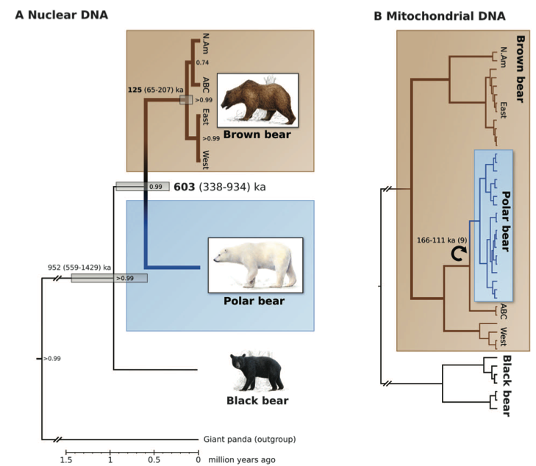
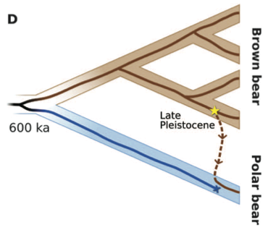
Hailer, F., V. E. Kutschera, B. M. Hallstroem, D. Klassert, S. R. Fain, J. A. Leonard, U. Arnason, and A. Janke. 2012. Nuclear Genomic Sequences Reveal that Polar Bears Are an Old and Distinct Bear Lineage. Science 336:344-347

Slide 5
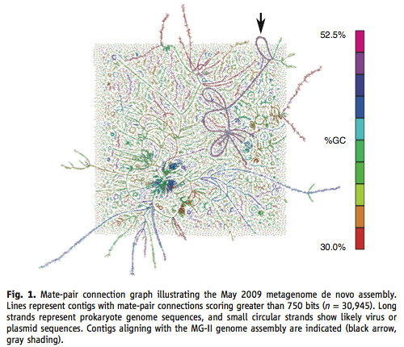
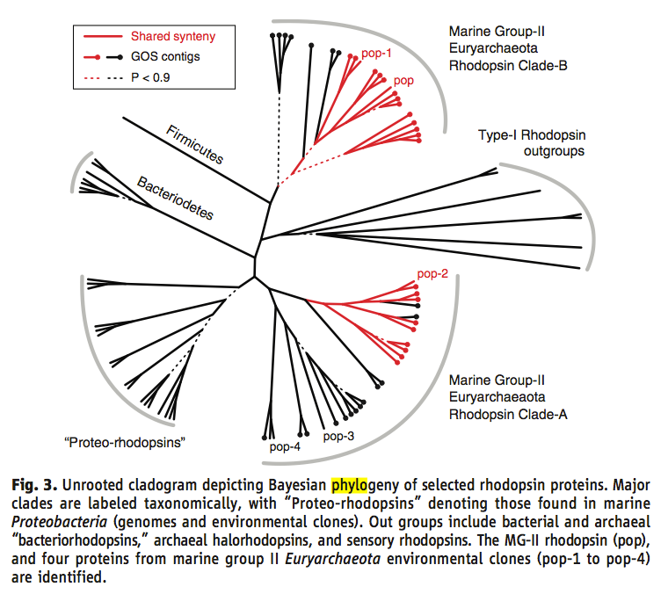
Iverson, V., R. M. Morris, C. D. Frazar, C. T. Berthiaume, R. L. Morales, and E. V. Armbrust. 2012. Untangling Genomes from Metagenomes: Revealing an Uncultured Class of Marine Euryarchaeota. Science 335:587-590.

Slide 6
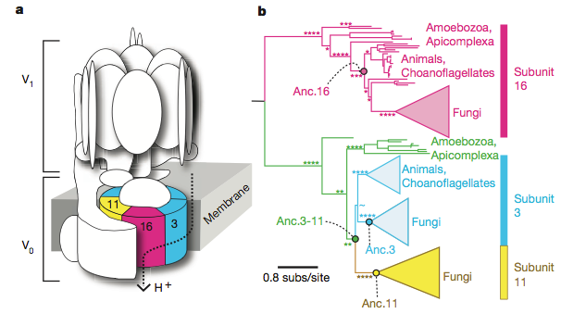
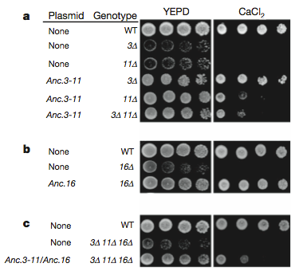
Finnigan, G. C., V. Hanson-Smith, T. H. Stevens, and J. W. Thornton. 2012. Evolution of increased complexity in a molecular machine. Nature 481:360-U143.
Notes:
Actually reconstructed ancestral proteins and stuck them in yeast. WT=wild type, 3 delta = knockout

Slide 7
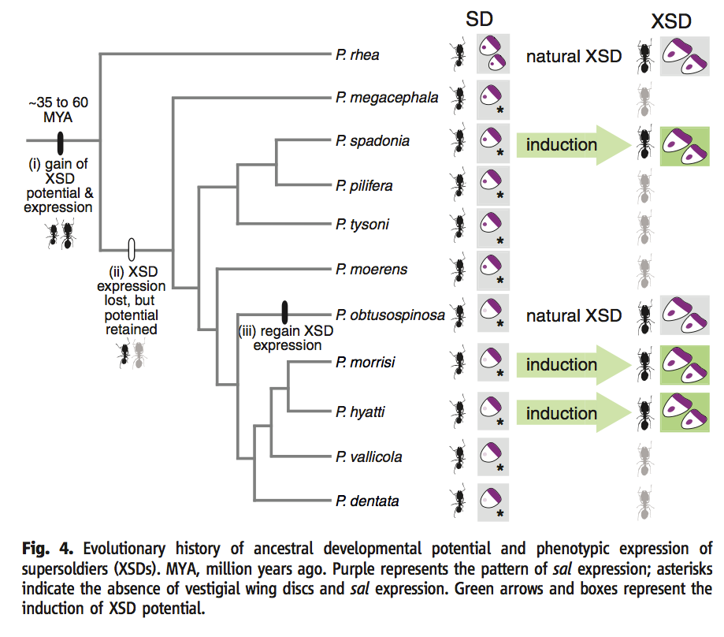
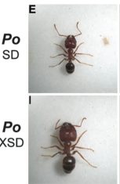
Rajakumar, R., D. San Mauro, M. B. Dijkstra, M. H. Huang, D. E. Wheeler, F. Hiou-Tim, A. Khila, M. Cournoyea, and E. Abouheif. 2012. Ancestral Developmental Potential Facilitates Parallel Evolution in Ants. Science 335:79-82.
Notes:
Evolution of super soldiers based on old pathways

Slide 8
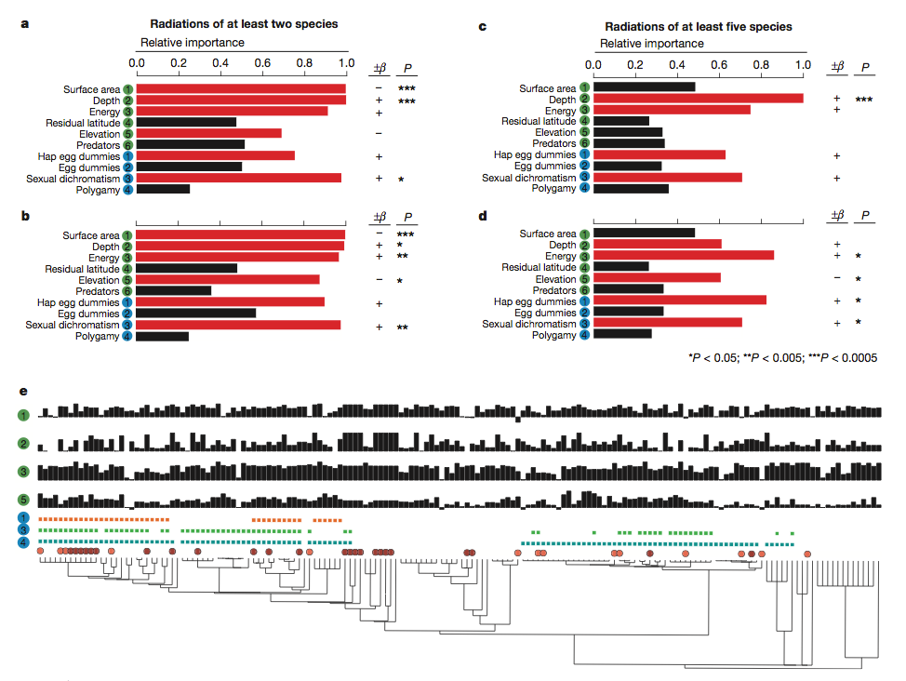
Wagner, C. E., L. J. Harmon, and O. Seehausen. 2012. Ecological opportunity and sexual selection together predict adaptive radiation. Nature 487:366-U124.

Slide 9
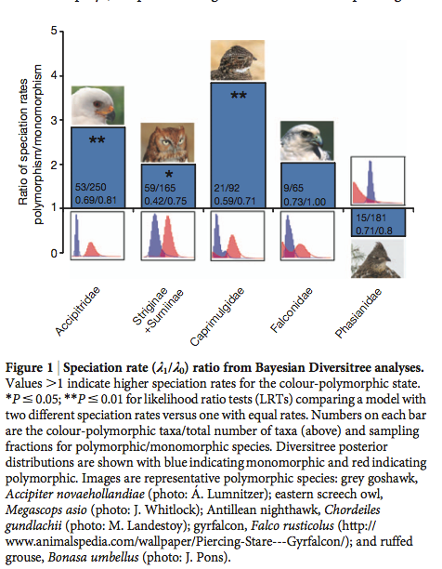
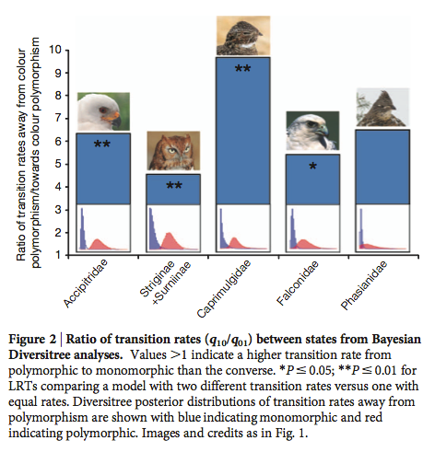
Hugall, A. F., and D. Stuart-Fox. 2012. Accelerated speciation in colour-polymorphic birds. Nature 485:631-+.

Slide 10
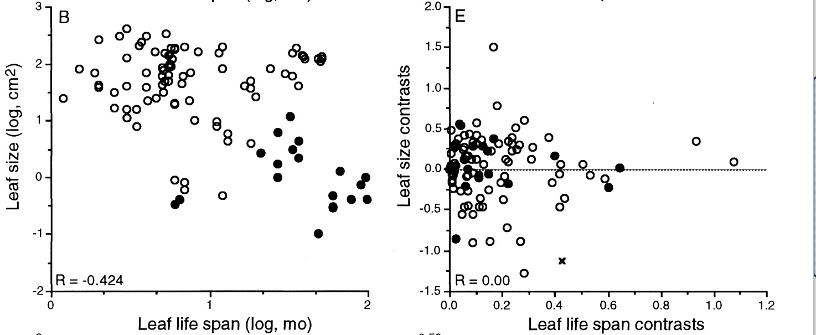
Ackerly and Reich. Convergence and correlations among leaf size and function in seed plants: a comparative test using independent contrasts. Am. J. Bot. (1999) vol. 86 (9) pp. 1272-1281
Notes:
What’s wrong with this? This should feel deeply wrong to you.

Slide 11
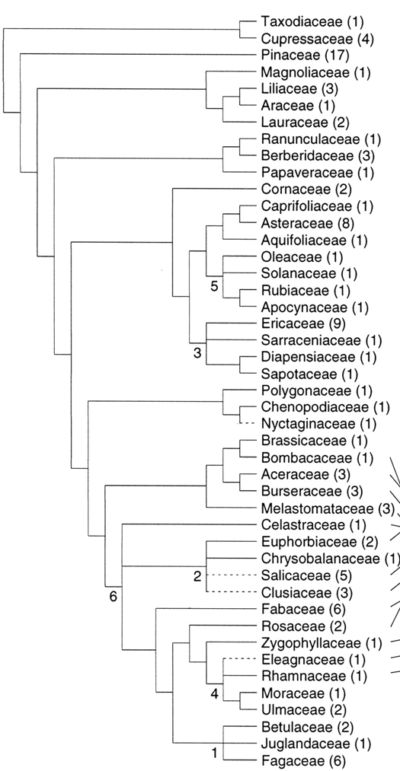
+
Angiosperms ( )
Conifers ( )
Angiosperms vs Conifers ( )
Ackerly and Reich. Convergence and correlations among leaf size and function in seed plants: a comparative test using independent contrasts. Am. J. Bot. (1999) vol. 86 (9) pp. 1272-1281
Notes:
Correcting for non-independence.

Slide 12
Phylogenies can be used to reveal:
Ancestral states
Differential diversification (speciation and extinction)
Potentially informative new experiments
Character correlations
Evolutionary history
(and much more)

