Slide 1
Motivation
We are developing cost curves for marine energy mooring components
However, typically developers and end users do not know all the information needed for those cost curves
Solution: tool that takes user inputs and selects appropriate component sizes to calculate costs

Slide 2
New Proposed SAM modeled costs
Three levels of user inputs. A small description of each would be provided next to each one with the info button:
User choose library of mooring configurations (catenary, semi-taut, taut, tension) and provide the soil type and design load
Users provide line material, diameter, length, anchor loading direction, number of anchors, and soil type. In other words, users give the mooring line information and SAM figures out the other values.
User provide all design sizes, including line diameter and length, anchor mass, connection mass, and buoyancy. All SAM does is take these values and input them to the cost curves.

Slide 3
Instructions
To use the tool, execute the user_interface_draft2.py file in the command line.
This ppt lays out the potential menu options for SAM that the tool walks through. It also includes lists of the assumptions made for each menu choice.
Notes:
The tool coefficients are incomplete. We still need a full set of cost curves and holding capacity.
This tool is currently dependent on MoorPy for anchor sizing. Discussion is needed to determine how we bring that over for implementation into SAM
Note: in the following slides ‘:’ indicates an option users select, ‘=’ indicates the value the option has been set to

Slide 4
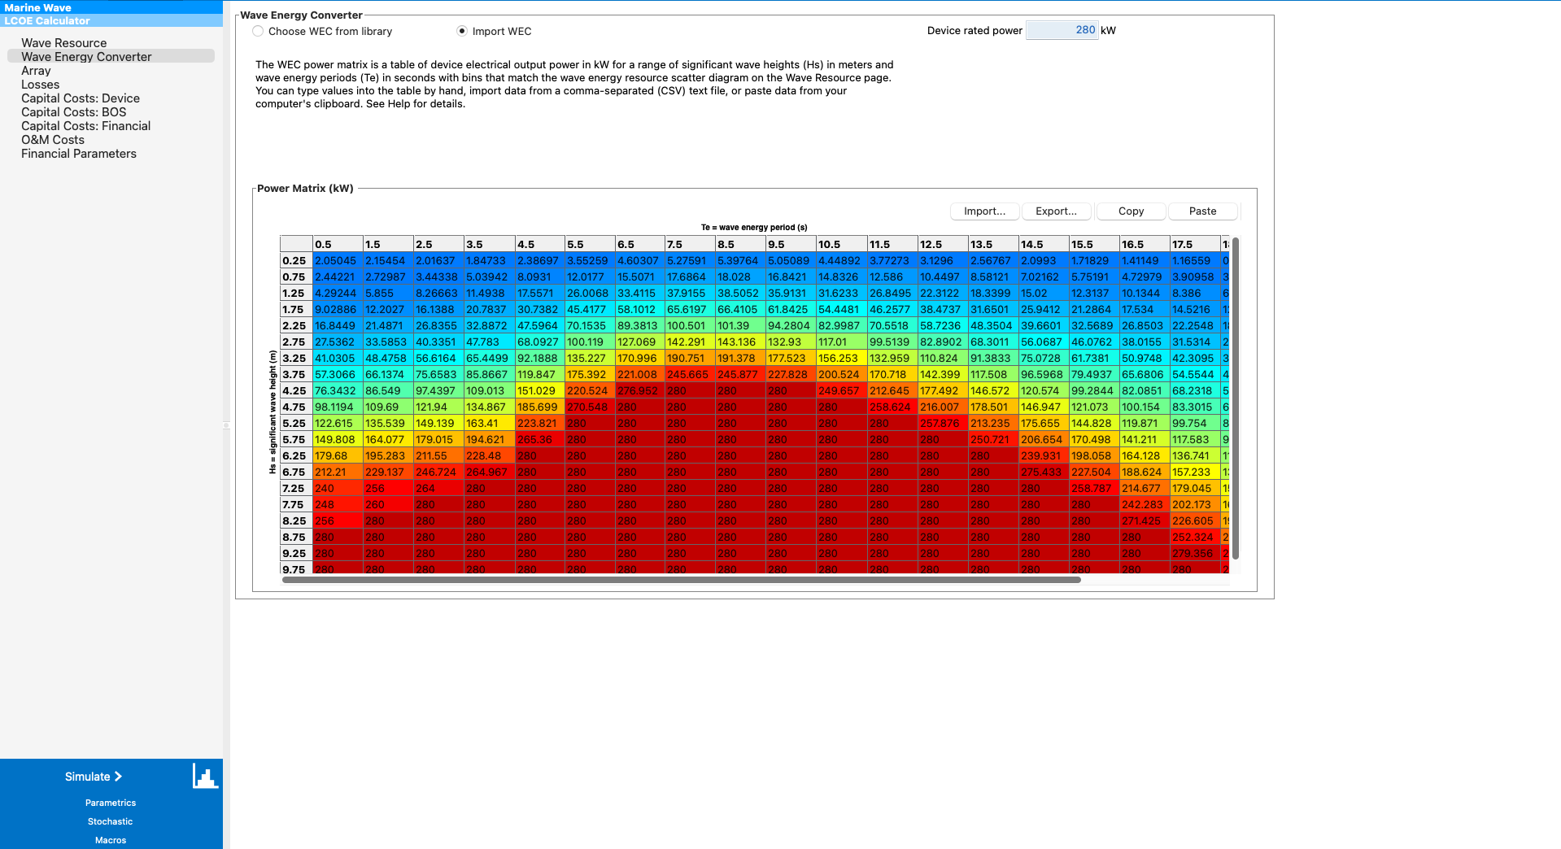
Implementation of new modeled costs
This would be added on the wave energy converter or tidal energy converter tab under the existing power calculations if import WEC was selected
Foundation type drop down menu: Floating, Bottom fixed, etc. ←Whatever the existing SAM foundation types are
Notes:
Note: Shared moorings are not yet supported

Slide 5
If (Import WEC) & (If floating)
Users choose which level of input they want to give
Foundation type drop down menu = Floating
Input: depth
Level of input drop down: mooring library, line data, full mooring data

Slide 6
Input Level A1: If (Import WEC) & If (floating) & If (mooring library)
Foundation type drop down menu = Floating
Level of input drop down = Mooring library
Choose one mooring configuration: catenary, semi-taut, taut, tension
Input: soil type, mooring design load (max tension expected * safety factor)
Table: User provides number of rows in table for different buoys (similar to Photovoltaic LCOE inverter tab)
Number of these buoys | Buoyancy
… | …

Slide 7
Input Level A2: If (Import WEC) & If (floating) & If (line data)
Foundation type drop down menu = Floating
Level of input drop down = line data
Table: User provides number of rows in table for number of line types (similar to Photovoltaic LCOE inverter tab)
Number of these lines | Line material (chain, polyester, nylon, wire, hmpe) | Diameter (m) | Length (m) | Anchor load direction (none, horizontal, both, vertical) | number of anchors per line
… | … | … | … | … | …
Input: Soil type
Table: User provides number of rows in table for different buoys (similar to Photovoltaic LCOE inverter tab)
Number of these buoys | Buoyancy
… | …
Notes:
Note for users: mooring profile is used to determine best anchor type for attached anchors. It is only necessary if the line has attached anchors.

Slide 8
Input Level A3: If (Import WEC) & If (floating) & If (full mooring data)
Foundation type drop down menu = Floating
Level of input drop down = full mooring data
Table: User provides number of rows in table for different line types (similar to Photovoltaic LCOE inverter tab)
Number of these lines | Line material (chain, polyester, nylon, wire, hmpe) | Diameter (m) | Length (m)
… | … | … | …
Table: User provides number of rows in table for different anchor types (similar to Photovoltaic LCOE inverter tab)
Number of these anchors | Anchor type (drag-embedment, congrav, steelgrav, VLA, SEPLA, suction) | Mass kg | Soil type (soft clay, medium clay, hard clay, sand)
… | … | … | …
Table: User provides number of rows in table for different buoys (similar to Photovoltaic LCOE inverter tab)
Number of these buoys | Buoyancy
… | …
Inputs: Connection hardware mass (auto populates based on line diam, can be overwritten)

Slide 9
A1 Assumptions
# Line values (based on shape, depth, and design load)
Diameter: Diameter for design load using MoorProps
If catenary:
Number of line types = 1
Number of these lines = 3
Material = chain
P = ((21.9 * 10^3 * diameter^2) - (pi/4) * (1.89 * diameter)^2 * 1025) * 9.81 # Wet weight per meter (N/m). MoorProps for R4 sudlink chain
Line Length = 15 + depth * sqrt(2*(design load/(P*depth))-1) # where P is the wet weight per meter. Assuming 15m on seabed. Eqn 5.15 from https://www.sciencedirect.com/book/9780128185513/mooring-system-engineering-for-offshore-structures
Number of Anchors = 1
Anchor Load direction = horizontal
If semi-taut:
Number of lines = 2
1 Number of these lines = 3
1 Material = polyester
1 Length = sqrt(2* depth^2) # Assuming 45 deg hang off, straight to seabed
1 Number of anchors per line = 0
1 Anchor load direction = none
2 Number of these lines = 3
2 Material = chain
2 Length = 15 # assuming 15m of chain on the seabed
2 Number of anchors per line = 1
2 Anchor load direction = horizontal
If taut:
Number of line types = 1
Number of these lines = 3
Material = polyester
Length = sqrt(2* depth^2) # Assuming 45 deg hang off
Number of anchors per line= 3
Anchor load direction= both
If tension:
Number of line types = 1
Number of these lines = 8
Material = hmpe
Length = depth
Number of anchors per line = 1
Anchor load direction= vertical
Anchor and Connection Value assumptions follow A2 but using design load from here for all anchors

Slide 10
A2 Assumptions
Line Design Load = Line MBL calculated from diameter using MoorProps values # This is unique to each line, allowing for different sized anchors for different lines
# Anchor and connection values
For each line type:
Anchor size and type = choose anchor from design load, anchor load direction, and soil type
if horizontal load direction:
horizontal load = line design load
vertical load = 0.0
Default anchor type = Drag embedment
if both load directions: # 45 deg hang off angle, forces split 50/50
Vertical and horizontal load = sqrt(2* line design load^2)
Default anchor type = concrete gravity anchor
if vertical load direction
horizontal load = 0.0
vertical load = line design load
Default anchor type = concrete gravity anchor
if drag embedment, VLA, SEPLA, or suction:
mass = MoorPy getAnchorMass function
if gravity anchor:
mass = max(2 * vertical load / g , 1.65 * horizontal load / g) # 2x safety factor for vertical 1.6x for horizontal per API standards. Use the larger value
Number of these anchors = Number of anchors per line* number of lines
Connection Mass += 10^-5 * design load # rough guess based on TidGen chain MBL and connection hardware mass

Slide 11
A3 Assumptions
No assumptions for lines and anchors. Sizes passed directly to cost curves.
If connection mass not provided:
For each line:
Line Design Load = Line MBL calculated from diameter using MoorProps values
Connection Mass += 10^-5 * line design load # rough guess based on TidGen chain MBL and connection hardware mass

Slide 12
Notes

Slide 13
SAM Mooring Cost Breakdown Structure (Capital Costs Device) - These are our end goals
These can be filled in by the user, if they don’t use the modeled costs. Otherwise, they will be auto populated with the modeled costs.
Mooring lines - $
Anchors and piles - $
Connecting hardware - $
Messenger lines and buoys - $
…
Other mooring, found., and substructure costs - $

Slide 14
Mooring Data in WEC Library (only shown if users use a default WEC, RM3-5-6)
This is the information shown to users when the select a WEC from the library. It is likely this is stored in SAM already, which would make using the code easier.
Mooring Type
We would need to add the component data from each reference model in here (from report). These can give us the costs. The costs from SAM will be different than the report, but that is because we will have updated cost models from the simple ones for the report. Need to make a note of this somewhere

Slide 15
Existing SAM inputs for modeled costs
These inputs are used with a general $/kw mooring cost curve, that is continuously updated based on spreadsheets maintained by Elena
kW (Wave Energy Converter)
Depth (Array)

Slide 16
LineTypes Struct
Id: id number of the type
MP_data: outputs of mp.getLineProps
Design load: design load in N (safety factor?)
Num: number of this line type
Length: the length of the
nAnch: number of anchors attached to this line
aLoadDir: Direction of the load on the anchors (none if no anchors)

