Slide 1
Comparing the Computational Efficiency of Prime Sieves

Slide 2
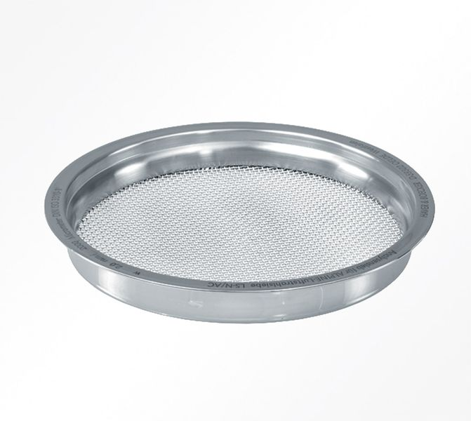
What is a Prime Sieve?
How do we find primes?
Analytical methods for finding primes:
  Wilson’s theorem, Mills formula, Wrights formula, ect..
  All are not exhaustive and complete
A prime sieve “shakes” out all the composite numbers.
Used in encryption and hashing

Slide 3
Our Method
Create a method/function for three common prime sieves and time them for over an increasing range of numbers.
  Sieve of Eratosthenes
  Sieve of Atkin
  Sieve of Sundaram

Slide 4
Trial Division – Anything is an improvement..
Find some maximum number n to find all primes up to.
Begin with 2. Divide 2 by everything below 2 and if it divides evenly, toss it out.
Extremely slow.
Number of computations is (1 + 2 + 3 + … + n - 1)

Slide 5
Sieve of Eratosthenes
Most simple prime sieve to understand!
  Take some max number n to find all primes up to.
  Find the √(n) and round up
  For every number below √(n), beginning at 2, mark off all natural number multiples of that number.
  If a number is marked off already, it is skipped.
Vast improvement over trial division.
As the maximum number to find primes up to increases, the square root of n grows much slower.

Slide 6
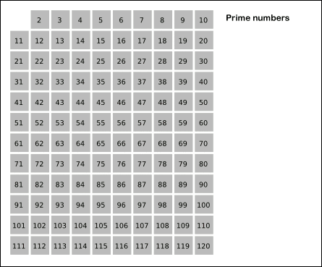
Gif for clarity. ₁

Slide 7
Sieve of Sundaram
A lot like the Sieve of Eratosthenes, but it doesn’t even consider even numbers.
  Finds all numbers of the form i + j + 2ij, where i and j are natural numbers, and j is always bigger than I, then eliminates them.
  All remaining numbers are doubled and have 2 added to them.
  The remaining list is prime.
An odd integer is of the form 2k + 1, so...

Slide 8
Sundaram cont.
Odd integers are of the form 2k+1
k, in this case, is (i + j + 2ij)
Behold!
  = 2k + 1
  = 2(i + j + 2ij) + 1
  = 2i + 2j + 4ij + 1
  = (2i + 1)(2j + 1)
    If i and j are integers, both factors are odd integers, meaning they cannot be prime.

Slide 9
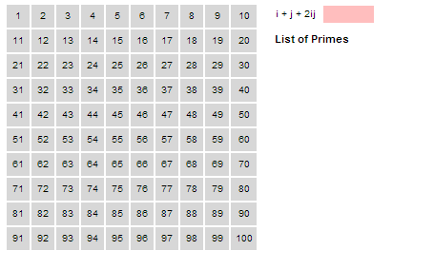
Gif for clarity.

Slide 10
Sieve of Atkin
Much more complicated than both other sieves.
  For every number up to the maximum number to search to,
  Create a true/false list for all numbers.
  Find the remainder of that number when divided by 60.
  That remainder will sort it into one of four groups, each group has a quadtratic equation for which r may have solutions.
  Flip the true/false value of that number’s location in the list based on how many solutions to the equation it has.
Once this list is completed, look for all squares of true elements in the list and mark them off.
The remaining list is prime… just believe us.

Slide 11
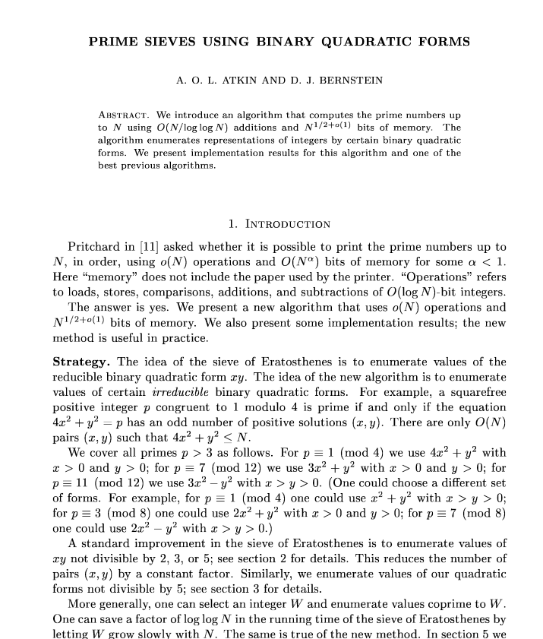
We can’t full explain this one here.
There is a fairly dense paper on it that goes for 6 pages, we can’t explain it fully even in 10 minutes.

Slide 12
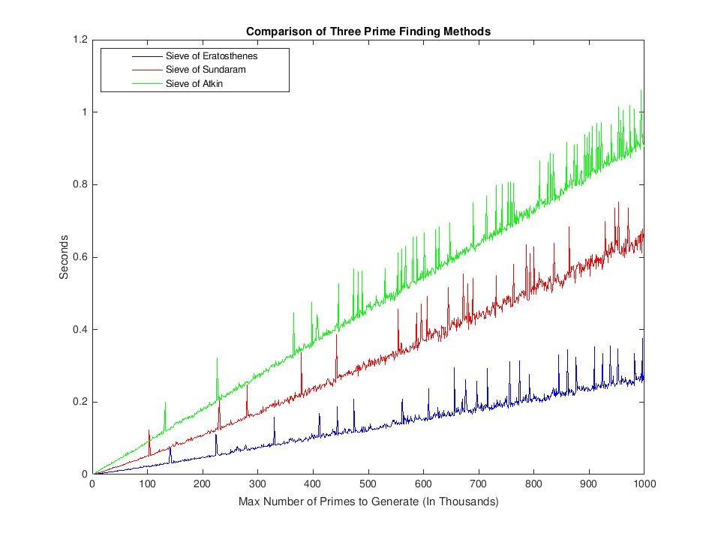
Our results: Not What We Expected.

Slide 13
Possible Testing Errors.
My code sucks.
I didn’t test enough numbers
Something is inherently wrong with the way I tested this.

Slide 14
Sources
https://upload.wikimedia.org/wikipedia/commons/b/b9/Sieve_of_Eratosthenes_animation.gif
https://en.wikipedia.org/wiki/Sieve_of_Eratosthenes#Algorithmic_complexity
https://en.wikipedia.org/wiki/Sieve_of_Atkin
http://cr.yp.to/papers/primesieves-19990826.pdf

