Slide 1
Language Interpreters
How does your computer run Python?

Slide 2
C/C++
C++
64-bit x86 Linux
#include <iostream>
int main()
{
std::cout << "Hello World!"; }
...
.LFB975:
.cfi_startproc
pushq %rbp
.cfi_def_cfa_offset 16
.cfi_offset 6, -16
movq %rsp, %rbp
.cfi_def_cfa_register 6
subq $16, %rsp
movl %edi, -4(%rbp)
movl %esi, -8(%rbp)
cmpl $1, -4(%rbp)
jne .L3
cmpl $65535, -8(%rbp)
jne .L3
movl $_ZStL8__ioinit, %edi
call _ZNSt8ios_base4InitC1Ev
movl $__dso_handle, %edx
movl $_ZStL8__ioinit, %esi
movl $_ZNSt8ios_base4InitD1Ev, %edi
call __cxa_atexit
.L3:
leave
.cfi_def_cfa 7, 8
ret
.cfi_endproc
...
g++ hello.cpp -S
Notes:
Just an excerpt of generated assembly. Actual file is 81 lines

Slide 3
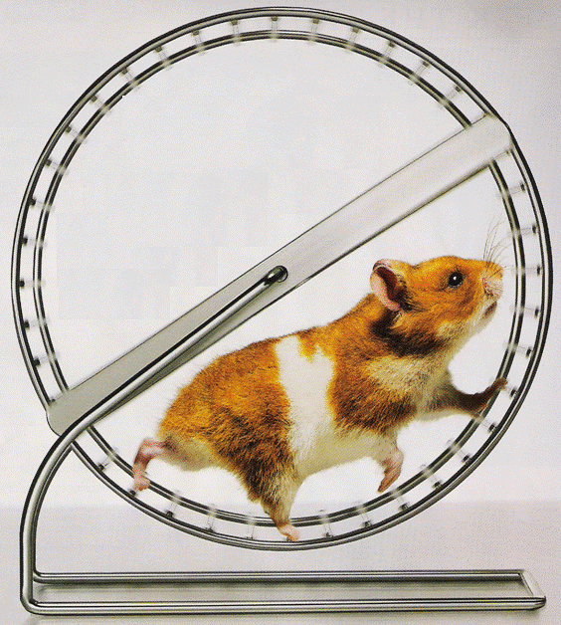
Python?
Python
Something runs
print “Hello World”
?
Notes:
Just an excerpt of generated assembly. Actual file is 81 lines

Slide 4
Interpreters
No “compilation”
Then how?
How can Python run on nearly any computer?
Python makes its own virtual computer
Notes:
Any time you run a python code, the interpreter

Slide 5
CPython
Reference Python Implementation
Likely the one you have
Written in C
Fun aside—check out PyPy, which is written in Python

Slide 6
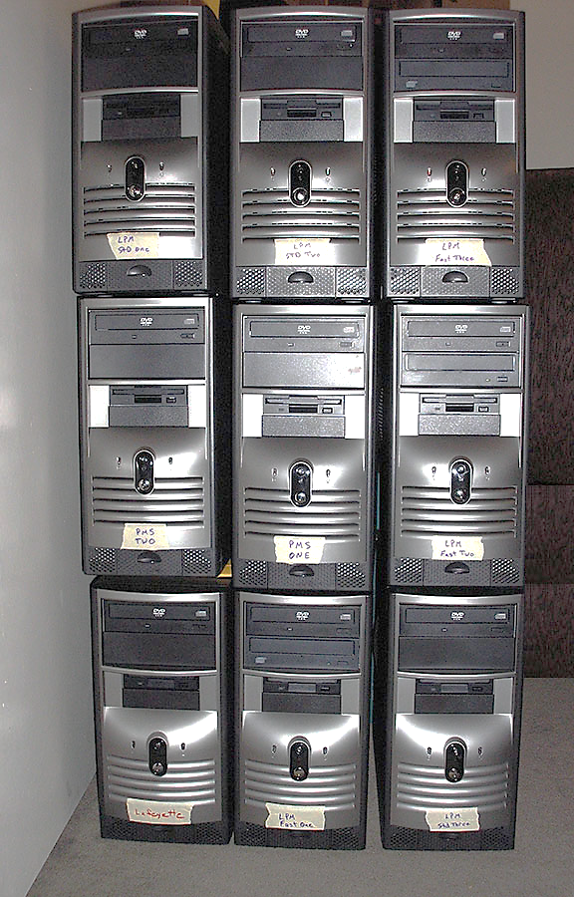
Stack Machine
Counterpoint to register machine
Uses stacks a primary memory, not addressable registers

Slide 7
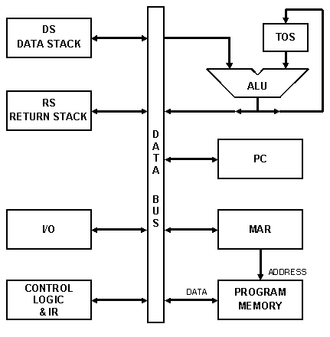
Diagram
Similar components
LIFO Stacks
Top two elements of data stack are always the inputs to the ALU
Notes:
Memory

Slide 8

Performance Comparison
$x + y =z$ $x+y∗z+u$
MIPS Register Machine
add $z, $x, $y
Pseudo-MIPS Stack Machine
push x_addr push y_addr add pop z_addr
Pseudo-MIPS Stack Machine
push x push y push z mult add push u add

Slide 9

Function/Subroutine Calls
Register Machine
Save/restore every register
Stack Machine
Just add new stuff to the stack
Notes:
That’s why Cpython uses a stack machine. Why?

Slide 10
ceval.c
Main interpreter loop lives here
Increments a pointer to the next instruction
Giant switch statement
switch(opcode) {
OPCODE1 {
/* how to do opcode 1 */
}
OPCODE2 {
/* how to do opcode 1 */
}
...
}

Slide 11
Binary AND
TARGET_NOARG(BINARY_AND)
{
w = POP();
v = TOP();
x = PyNumber_And(v, w);
Py_DECREF(v);
Py_DECREF(w);
SET_TOP(x);
if (x != NULL) DISPATCH();
break;
}

Slide 12
Instruction Set
{'CALL_FUNCTION': 131,
'DUP_TOP': 4,
'INPLACE_FLOOR_DIVIDE': 28,
'MAP_ADD': 147,
'BINARY_XOR': 65,
'END_FINALLY': 88,
'RETURN_VALUE': 83,
'POP_BLOCK': 87,
'SETUP_LOOP': 120,
'BUILD_SET': 104,
'POP_TOP': 1,
'EXTENDED_ARG': 145,
'SETUP_FINALLY': 122,
'INPLACE_TRUE_DIVIDE': 29,
'CALL_FUNCTION_KW': 141,
'INPLACE_AND': 77,
'SETUP_EXCEPT': 121,
'STORE_NAME': 90,
'IMPORT_NAME': 108,
'LOAD_GLOBAL': 116,
'LOAD_NAME': 101,
'FOR_ITER': 93,
'EXEC_STMT': 85,
'DELETE_NAME': 91,
'BUILD_LIST': 103,
'COMPARE_OP': 107,
'BINARY_OR': 66,
'INPLACE_MULTIPLY': 57,
'STORE_FAST': 125,
'CALL_FUNCTION_VAR': 140,
'SET_ADD': 146,
'LOAD_LOCALS': 82,
'CONTINUE_LOOP': 119,
'PRINT_EXPR': 70,
'DELETE_GLOBAL': 98,
'GET_ITER': 68,
'STOP_CODE': 0,
'UNARY_NOT': 12,
'BINARY_LSHIFT': 62,
'LOAD_CLOSURE': 135,
'IMPORT_STAR': 84,
'INPLACE_OR': 79,
'BINARY_SUBTRACT': 24,
'STORE_MAP': 54,
'INPLACE_ADD': 55,
'INPLACE_LSHIFT': 75,
'INPLACE_MODULO': 59,
'STORE_ATTR': 95,
'BUILD_MAP': 105,
'SETUP_WITH': 143,
'BINARY_DIVIDE': 21,
'INPLACE_RSHIFT': 76,
'PRINT_ITEM_TO': 73,
'UNPACK_SEQUENCE': 92,
'BINARY_MULTIPLY': 20,
'PRINT_NEWLINE_TO': 74,
'NOP': 9,
'LIST_APPEND': 94,
'INPLACE_XOR': 78,
'STORE_GLOBAL': 97,
'INPLACE_SUBTRACT': 56,
'INPLACE_POWER': 67,
'ROT_FOUR': 5,
'DELETE_SUBSCR': 61,
'BINARY_AND': 64,
'BREAK_LOOP': 80,
'MAKE_FUNCTION': 132,
'DELETE_SLICE+1': 51,
'DELETE_SLICE+0': 50,
'DUP_TOPX': 99,
'CALL_FUNCTION_VAR_KW': 142,
'LOAD_ATTR': 106,
'BINARY_TRUE_DIVIDE': 27,
'ROT_TWO': 2,
'IMPORT_FROM': 109,
'DELETE_FAST': 126,
'BINARY_ADD': 23,
'LOAD_CONST': 100,
'STORE_DEREF': 137,
'UNARY_NEGATIVE': 11,
'UNARY_POSITIVE': 10,
'STORE_SUBSCR': 60,
'BUILD_TUPLE': 102,
'BINARY_POWER': 19,
'BUILD_CLASS': 89,
'UNARY_CONVERT': 13,
'BINARY_MODULO': 22,
'DELETE_SLICE+3': 53,
'DELETE_SLICE+2': 52,
'WITH_CLEANUP': 81,
'DELETE_ATTR': 96,
'POP_JUMP_IF_TRUE': 115,
'JUMP_IF_FALSE_OR_POP': 111,
'PRINT_ITEM': 71,
'RAISE_VARARGS': 130,
'SLICE+0': 30,
'SLICE+1': 31,
'SLICE+2': 32,
'SLICE+3': 33,
'POP_JUMP_IF_FALSE': 114,
'LOAD_DEREF': 136,
'LOAD_FAST': 124,
'JUMP_IF_TRUE_OR_POP': 112,
'BINARY_FLOOR_DIVIDE': 26,
'BINARY_RSHIFT': 63,
'BINARY_SUBSCR': 25,
'YIELD_VALUE': 86,
'ROT_THREE': 3,
'STORE_SLICE+0': 40,
'STORE_SLICE+1': 41,
'STORE_SLICE+2': 42,
'STORE_SLICE+3': 43,
'UNARY_INVERT': 15,
'PRINT_NEWLINE': 72,
'INPLACE_DIVIDE': 58,
'BUILD_SLICE': 133,
'JUMP_ABSOLUTE': 113,
'MAKE_CLOSURE': 134,
'JUMP_FORWARD': 110}
Python bytecodes
.pyc files
Machine agnostic
Meant only for interpreter
import dis
dis.opmap

Slide 13
Questions?

Slide 14
References
[1] “java - Compiled vs. Interpreted Languages - Stack Overflow.” [Online]. Available: http://stackoverflow.com/questions/3265357/compiled-vs-interpreted-languages. [Accessed: 15-Dec-2015].
[2] “Stack Machine.” [Online]. Available: http://www.cp.eng.chula.ac.th/~piak/teaching/ca/stack.htm. [Accessed: 14-Dec-2015].
[3] “Stack machine - Wikipedia, the free encyclopedia.” [Online]. Available: https://en.wikipedia.org/wiki/Stack_machine. [Accessed: 15-Dec-2015].
[4] Y. Shi, K. Casey, M. A. Ertl, and D. Gregg, “Virtual machine showdown: Stack versus registers,” Acm Trans. Archit. Code Optim., vol. 4, no. 4, p. 21, 2007.
[5] “Stack Computers: 6.2 ARCHITECTURAL DIFFERENCES FROM CONVENTIONAL MACHINES.” [Online]. Available: https://users.ece.cmu.edu/~koopman/stack_computers/sec6_2.html. [Accessed: 14-Dec-2015].
[6] Python 2.7.11. Python Software Foundation, 2015.
[7] “python - What is the purpose of Py_DECREF and PY_INCREF? - Stack Overflow.” [Online]. Available: http://stackoverflow.com/questions/24444667/what-is-the-purpose-of-py-decref-and-py-incref. [Accessed: 15-Dec-2015].
[8] “32.12. dis — Disassembler for Python bytecode — Python 2.7.11 documentation.” [Online]. Available: https://docs.python.org/2/library/dis.html. [Accessed: 15-Dec-2015].
http://austincomputerlabs.com/images/custom/stack.jpg

