Slide 1
Fault-coverage Maximizing March Tests for Memory Testing
Presenter: Sandeep Gupta
Author: Feng Yun, Yunkun Lin
Ming Hsieh Department of Electrical and Computer Engineering
University of Southern California
Los Angeles, California, 90089, USA
{fengyun, yunkunli, yunfeilo, leig, vgera, boxuanl, vennelac, pharande, kunalche, thommond, gye, sandeep}@usc.edu

Slide 2
Introduction
March Tests are used to test the possible faults in memories
Some well-known march tests: March C-, March AB1, ..
All well-known march tests were generated to efficiently achieve 100% coverage of a target set of fault types
E.g., March C- generated to achieve 100% coverage for {SAF, TF, RDF, IRF, CFin, CFid, CFst, CFtr, CFrd, CFir }
What to do if 100% FC of the given target set of fault types (say, SFTx) cannot be achieved under tight constrains on test cost?
That is, what to do when the test length constraint is such that it is not possible to achieve 100% coverage for all fault instances in SFTx?

Slide 3
set of fault types Used
SFT Name | Types of faults in SFT | Source
SFT_10 | SAF, TF, WDF, RDF, IRF, DRDF, CFin, CFid, CFst, CFds, CFtr, CFwd, CFrd, CFdrd, CFir | March MSS
SFT_9 | SAF, TF, WDF, RDF, IRF, DRDF, CFin, CFid, CFst, CFds, CFtr, CFwd, CFrd, CFir | March SC16x
SFT_8 | SAF, TF, WDF, RDF, IRF, DRDF, CFin, CFst, CFtr, CFwd, CFrd, CFir | March SC15x
SFT_SR | SAF, TF, RDF, IRF, DRDF CFin, CFid, CFst, CFtr, CFrd, CFir | March SR
SFT_7 | SAF, TF, RDF, IRF, CFin, CFid, CFst, CFtr, CFrd, CFir | March C-
SFT_6 | SAF, TF, WDF, RDF, IRF, DRDF, CFin, CFst, CFtr, CFrd, CFir | March SC14x
SFT_5 | SAF, TF, RDF, IRF, DRDF, CFin, CFst, CFtr, CFrd, CFir | March 1/0
SFT_4 | SAF, TF, WDFs, RDF, IRF, DRDF, CFin, CFst, CFrd, CFir | March SC10x
SFT_3 | SAF, TF, RDF, IRF, CFin, CFid, CFst | March A
SFT_2 | SAF, TF, RDF, IRF, CFin, | March X
SFT_AB1 | SAF, TF, WDF, RDF, IRF, DRDF | March AB1
SFT_1 | SAF, RDF, IRF | MATS_OR

Slide 4
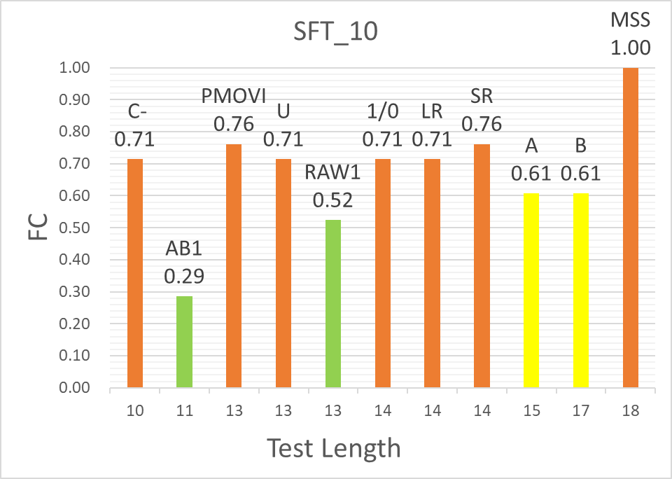
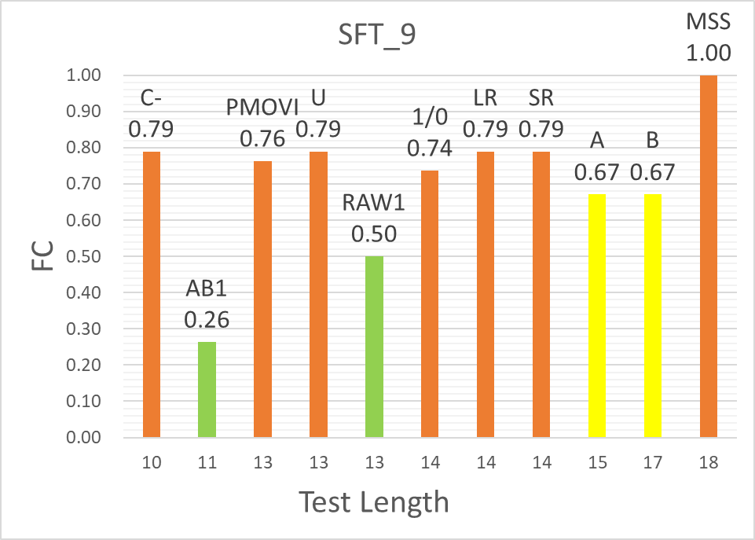
Fault Coverage of well-known march Tests for SFT10 and SFT9

Slide 5
One Approach: Use an existing march Test
If we are targeting SFT10 but test length constraint is 13N, then we cannot achieve 100% coverage
One approach
Find a well-known 13N march test, e.g., PMOVI
This provides 100% coverage for the set fault types targeted by PMOVI: {SAF, TF, RDF, IRF, DRDF, CFin, CFst, CFtr, CFrd, CFir}
For our target set of fault types, this doesn’t provide 100% coverage for {WDF, CFid, CFds, CFwd, CFdrd}
Does this approach maximize fault coverage for SFT10?

Slide 6
Introduction
Most of the well-known tests do not provide high coverage for fault types which the tests were not designed to cover
For example, 15N test March A is designed to cover linked CFin and Cfid
Provides low faults coverage for SFT_10 and SFT_9
This coverage is lower compared to the 14N tests March SR
This and many other examples show that many well-known tests do not achieve maximum fault coverage possible for their test lengths
An alternative approach: For the original target set of fault types, generate a march test that maximizes the fault coverage under the given tight constraint on test length

Slide 7
A Completely SCALABLE FAULT SIMULATOR FOR MEMORY
Partition fault instances into equivalence classes
Simulating one class in each equivalence class is sufficient to compute coverage
For every type of one-cell static fault, faults in different locations are equivalent
For every type of two-cell static fault
All faults with aggressor cells at lower address than their victim cells are equivalent
All faults with aggressor cells at higher address than their victim cells are equivalent
For every two-cell dynamic fault, faults can be divided into a maximum of 14 equivalence classes
This approach provides a completely-scalable fault simulator, i.e., with complexity completely independent of memory size, that will not miss any corner cases
We use this simulator extensively in our fault coverage maximizing test generator

Slide 8
new march test generator
Step1: Create a seed set of march tests
Our method starts by enumerating the set of all possible kN march tests for k=2
Step2: Use our scalable simulator and select only those kN march tests that provide the highest and second highest fault coverage
Step 3: If k == m_max, output the set of highest fault coverage providing m_max N march tests and exit; otherwise continue to the next step
Step 4: Grow each of the kN tests selected above to obtain a comprehensive set of (k+1)N march tests
a) extract the sequence of operations
b) grow each of the above sequence of operations by inserting one instance of every possible operation (i.e., W0, W1, R0, and R1) into every location in the sequence.
c) create all possible march tests for each of the above sequence of operations.

Slide 9
new march test generator
Example: Target fault set is SFT10; test length constraint is 13N
Step1: Create a seed set of march tests
All possible 2N march tests: (↑w0 r0); (↑ w0, ↑r0); (↑w0, ↓ r0); (↑w0 w0); (↑w0, ↑w0);... ...
Step2: Use our scalable simulator and select only those kN march tests that provide the highest and second highest fault coverage
Select (↑ w0, ↑ r0); (↓ w0, ↑ r0);
Step 3: If k == m_max, output the set of highest fault coverage providing m_max N march tests and exit; otherwise continue to the next step
Step 4: Grow each of the kN tests selected above to obtain a comprehensive set of (k+1)N march tests
a) extract the sequence of operations
e.g., for the test (↑ w0, ↑ r0) the sequence of operations is (w0 r0)
b) grow each of the above sequence of operations by inserting one instance of every possible operation into every location
e.g., for above sequence we obtain (w0 w0 r0) and (w0 r0 r0) and (w1 w0 r0) and (w0 r0 w0) ... ...
c) create all possible march tests for each of the above sequence of operations
e.g., for above, we obtain 3N tests (↑ w0 w0 r0) and (↑ w0 w0, ↑ r0) and so on
Eventually we obtain 13N march tests that maximize fault coverage for SFT10

Slide 10
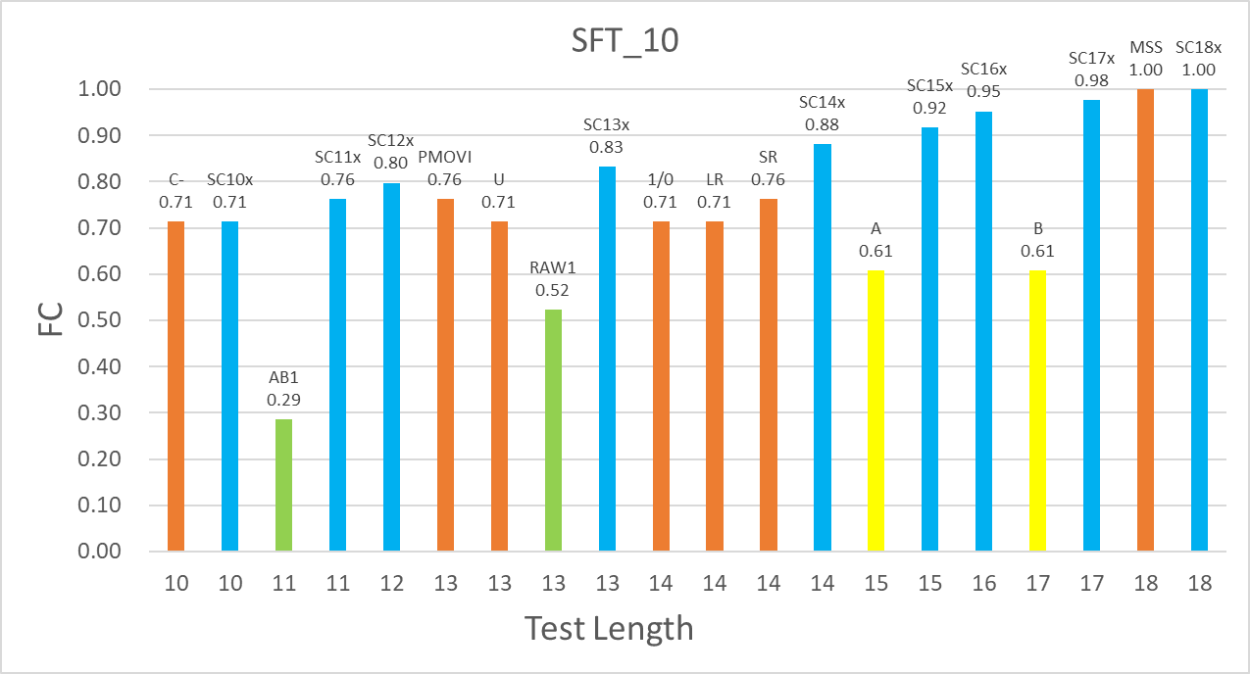
New march tests that maximize fault coverage
The graph shows the fault coverage result of our new march tests which target SFT_10 with lengths from 10N to 18N
Our new tests provide much higher fault coverage, e.g., for 13N coverage increases from 76% to 83%
Also, we generate tests for test lengths for which few well-known tests exists
With our new march tests, fault coverage decreases gracefully with increasingly tight constraints on test length

Slide 11

Comparison with Method from [CF. wu and CW. Wu, IEEE Transactions 2002]
Their method and ours both develop $kN$ tests by inserting operations into $(k−1)N$ tests in a step-by-step manner
In absence of run-time constraints, our method will generate all possible tests while theirs may miss some
However, practical run-time constraints require both methods to perform the insertion step only for selected $\left(k−1\right)N$ tests
A comparison shows that for many of our SFTs both methods provide similar coverage while for SFT8 our method provides higher coverage for most test lengths, and shorter test length for 100% fc

Slide 12
Conclusion and Future Research
Our goal was to determine if it is possible to reduce memory test costs by trading-off a small decrease in coverage.
To enable this, we developed a fault simulator for memory cell faults that is completely scalable.
Study of fault coverage of well-known march tests provided a major surprise: many of the march tests provide low collateral fault coverage. This motivated us to develop a march test generator that maximizes fault coverage for a given constraint on test length.
We used this to generate a family of march tests that provide significantly higher fault coverage than well-known tests with graceful reduction in fault coverage as increasingly tighter constraints on test lengths.
Ongoing and future research: basic questions about fault coverage-oriented testing, such as how do we compute fault coverage for fault types (one-/two-cell; single/double) that differ dramatically in the numbers of faults and related issues in computing probabilities of occurrence of various faults. We are also developing systematic algorithms for fault coverage maximizing memory test generation.

Slide 13
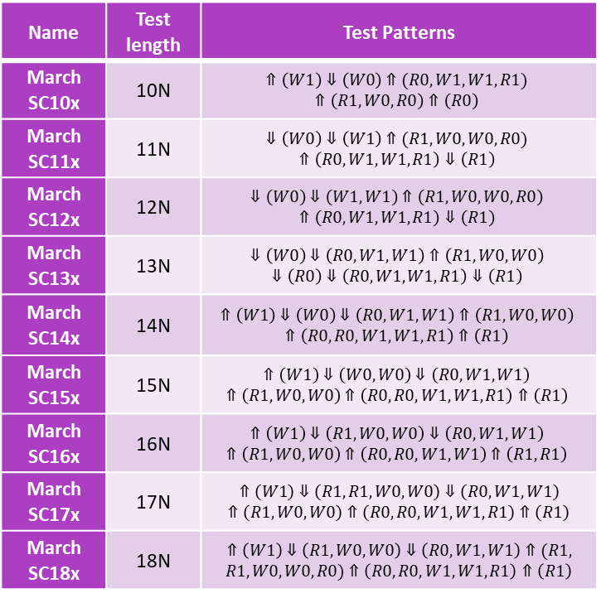
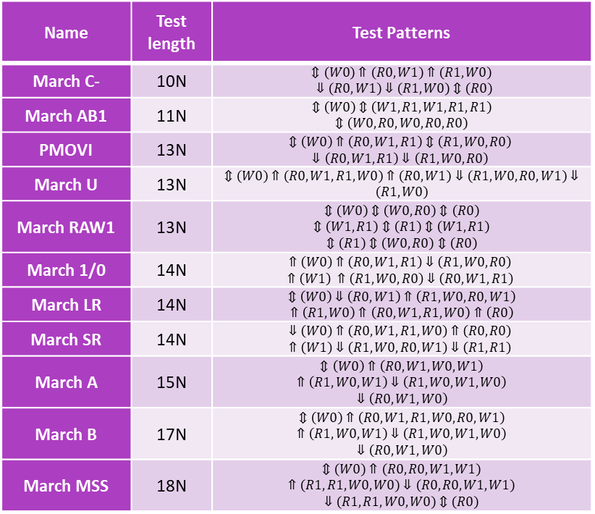
Appendix
Name | Test length | Test Patterns
March C- | 10N | $$⇕\left(W0\right)⇑\left(R0,W1\right)⇑\left(R1,W0\right)$$ $⇓\left(R0,W1\right)⇓\left(R1,W0\right)⇕\left(R0\right)$
March AB1 | 11N | $$⇕\left(W0\right)⇕\left(W1,R1,W1,R1,R1\right)$$ $⇕\left(W0,R0,W0,R0,R0\right)$
PMOVI | 13N | $$⇕\left(W0\right)⇑\left(R0,W1,R1\right)⇕\left(R1,W0,R0\right)$$ $$⇓\left(R0,W1,R1\right)⇓\left(R1,W0,R0\right)$$
March U | 13N | $⇕\left(W0\right)⇑\left(R0,W1,R1,W0\right)⇑\left(R0,W1\right)⇓\left(R1,W0,R0,W1\right)⇓\left(R1,W0\right)$
March RAW1 | 13N | $$⇕\left(W0\right)⇕\left(W0,R0\right)⇕\left(R0\right)$$ $$⇕\left(W1,R1\right)⇕\left(R1\right)⇕\left(W1,R1\right)$$ $⇕\left(R1\right)⇕\left(W0,R0\right)⇕\left(R0\right)$
March 1/0 | 14N | $$⇑\left(W0\right)⇑\left(R0,W1,R1\right)⇓\left(R1,W0,R0\right)$$ $$⇑\left(W1\right) ⇑\left(R1,W0,R0\right)⇓\left(R0,W1,R1\right)$$
March LR | 14N | $$⇕\left(W0\right)⇓\left(R0,W1\right)⇑\left(R1,W0,R0,W1\right)$$ $⇑\left(R1,W0\right)⇑\left(R0,W1,R1,W0\right)⇑\left(R0\right)$
March SR | 14N | $$⇓\left(W0\right)⇑\left(R0,W1,R1,W0\right)⇑\left(R0,R0\right)$$ $$⇑\left(W1\right)⇓\left(R1,W0,R0,W1\right)⇓\left(R1,R1\right)$$
March A | 15N | $$⇕\left(W0\right)⇑\left(R0,W1,W0,W1\right)$$ $$⇑\left(R1,W0,W1\right)⇓\left(R1,W0,W1,W0\right)$$ $⇓\left(R0,W1,W0\right)$
March B | 17N | $$⇕\left(W0\right)⇑\left(R0,W1,R1,W0,R0,W1\right)$$ $$⇑\left(R1,W0,W1\right)⇓\left(R1,W0,W1,W0\right)$$ $⇓\left(R0,W1,W0\right)$
March MSS | 18N | $$⇕\left(W0\right)⇑\left(R0,R0,W1,W1\right)$$ $$⇑\left(R1,R1,W0,W0\right)⇓\left(R0,R0,W1,W1\right)$$ $⇓\left(R1,R1,W0,W0\right)⇕\left(R0\right)$
Name | Test length | Test Patterns
March SC10x | 10N | $$⇑\left(W1\right)⇓\left(W0\right)⇑(R0,W1,W1,R1)$$ $$⇑\left(R1,W0,R0\right)⇑\left(R0\right)$$
March SC11x | 11N | $$⇓\left(W0\right)⇓\left(W1\right)⇑(R1,W0,W0,R0)$$ $$⇑\left(R0, W1, W1, R1\right)⇓\left(R1\right)$$
March SC12x | 12N | $$⇓\left(W0\right)⇓\left(W1,W1\right)⇑\left(R1, W0, W0, R0\right)$$ $$⇑\left(R0, W1, W1, R1\right)⇓\left(R1\right)$$
March SC13x | 13N | $$⇓\left(W0\right)⇓\left(R0,W1,W1\right)⇑\left(R1, W0, W0\right)$$ $$⇓\left(R0\right)⇓\left(R0, W1, W1, R1\right)⇓\left(R1\right)$$
March SC14x | 14N | $$⇑\left(W1\right)⇓\left(W0\right)⇓\left(R0, W1, W1\right)⇑\left(R1, W0, W0\right)$$ $$⇑\left(R0,R0, W1, W1, R1\right)⇑\left(R1\right)$$
March SC15x | 15N | $$⇑\left(W1\right)⇓\left(W0,W0\right)⇓\left(R0, W1, W1\right)$$ $$⇑\left(R1, W0, W0\right)⇑\left(R0,R0, W1, W1,R1\right)⇑\left(R1\right)$$
March SC16x | 16N | $$⇑\left(W1\right)⇓\left(R1,W0,W0\right)⇓\left(R0, W1, W1\right)$$ $$⇑\left(R1, W0, W0\right)⇑\left(R0,R0, W1, W1\right)⇑\left(R1,R1\right)$$
March SC17x | 17N | $$⇑\left(W1\right)⇓\left(R1,R1,W0,W0\right)⇓\left(R0, W1, W1\right)$$ $⇑\left(R1, W0, W0\right)⇑\left(R0,R0, W1, W1,R1\right)⇑\left(R1\right)$
March SC18x | 18N | $$⇑\left(W1\right)⇓\left(R1, W0, W0\right)⇓\left(R0,W1,W1\right)⇑(R1,$$ $R1,W0,W0,R0)⇑\left(R0,R0,W1,W1,R1\right)⇑\left(R1\right)$
Well-known march tests used in our studies
Our FC maximizing march test for SFT10

