Slide 1
Major work
Latest Progress link fault error in table
Install CUDA
2. Learn some basic concept about GPU and CUDA
3. Learn basic CUDA function
4. Run code on CUDA
5. Matrix multiplication on CUDA

Slide 2
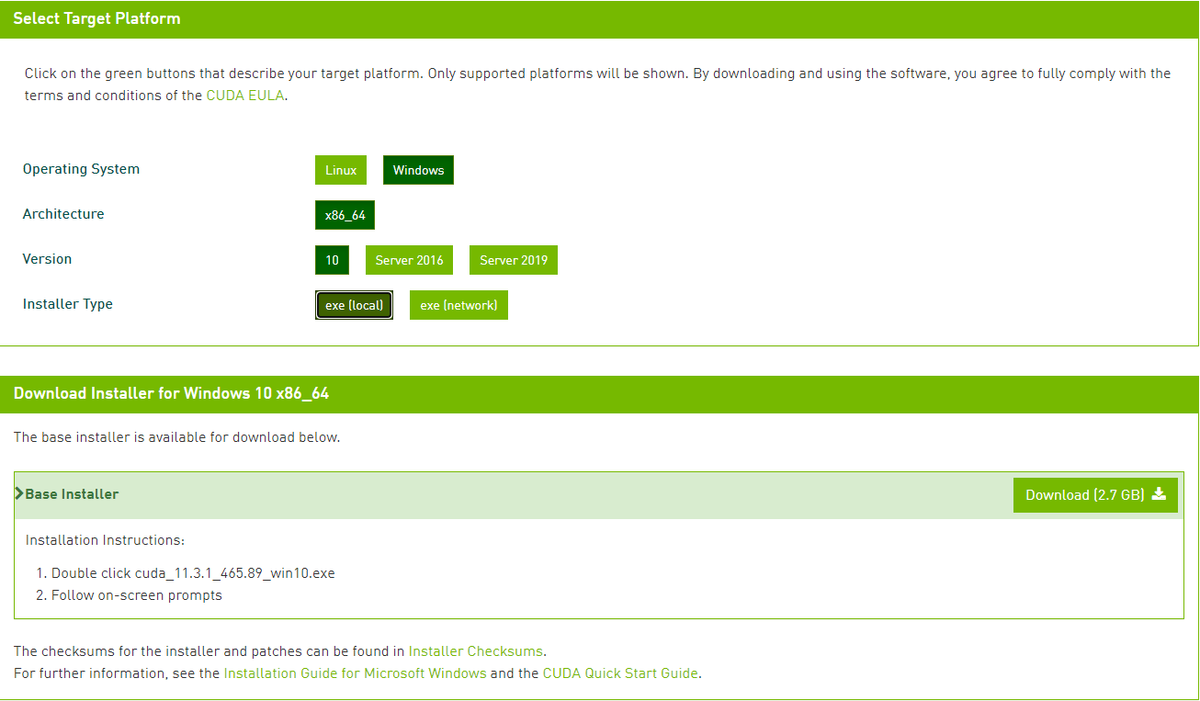
Major work
Latest Progress link fault error in table
1. Install CUDA

Slide 3
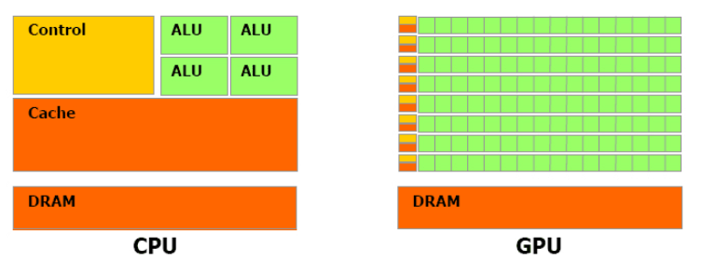
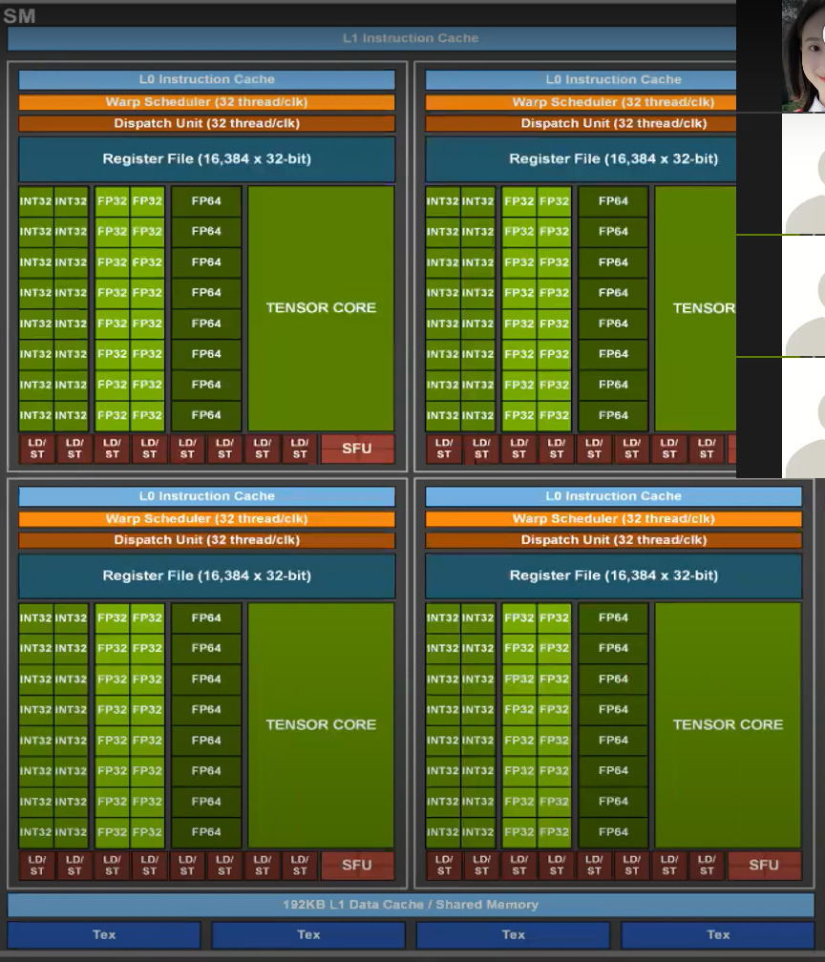
Major work
Latest Progress link fault error in table
2. Learn some basic concept about GPU and CUDA
GPU has larger bandwidth
More execute unit
Lower frequency
No help when deal with high dependence work
Lower accuracy when deal with float calculation

Slide 4
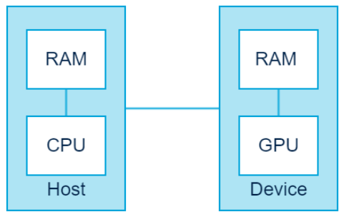
Major work
Latest Progress link fault error in table
2. Learn some basic concept about GPU and CUDA

Slide 5
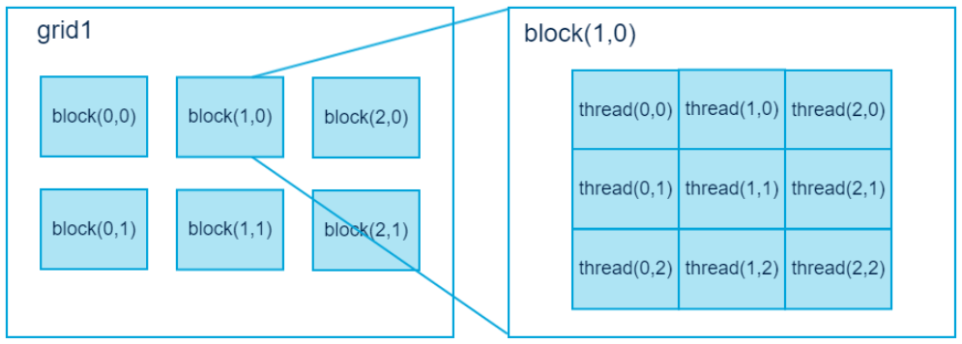
Major work
Latest Progress link fault error in table
2. Learn some basic concept about GPU and CUDA
Minimum execution unit is thread
Serval threads consist one block
Threads in one block has one share cache
All share one global memory, constant memory, and texture memory

Slide 6
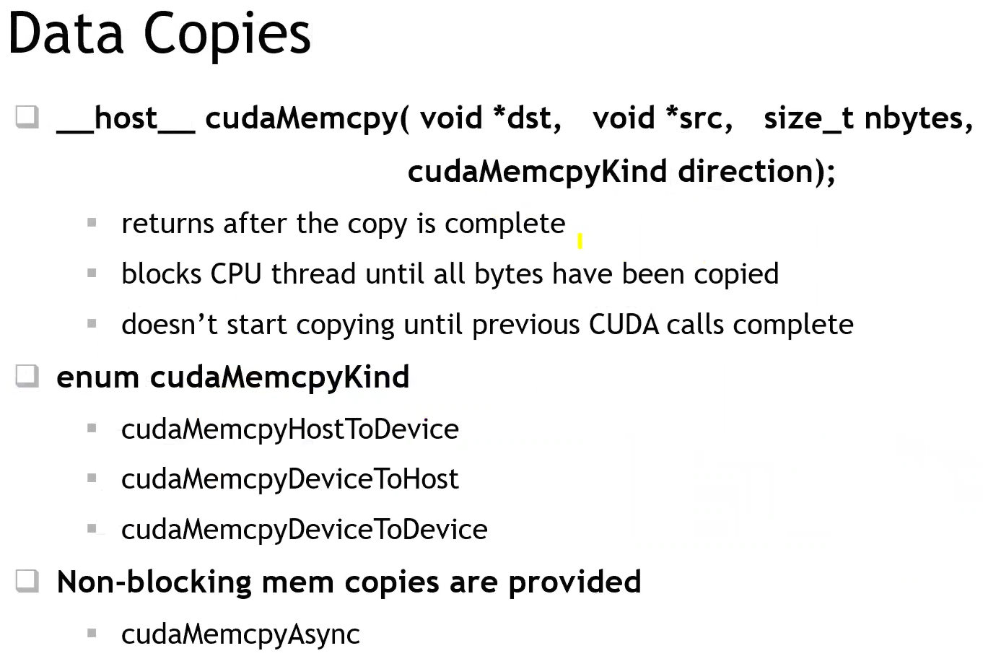
Major work
Latest Progress link fault error in table
3. Basic CUDA function

Slide 7
Major work
Latest Progress link fault error in table
4. Run code on CUDA
Allocate memory on GPU, usually use cudaMalloc
Copy useful data to GPU, usually use cudaMemcpy
Functionname<<<block number, thread number, share memory size>>>(variable…)
Copy back data from GPU to CPU, still use cudaMemcpy
Release meomory on both GPU and CPU

Slide 8
Major work
Latest Progress link fault error in table
4. Matrix multiplication on CUDA

