Slide 1
Major work
Latest Progress link fault error in table
Share memory in CUDA
2. Finish normal sparse matrix multiply
3. Finish improve sparse matrix multiply

Slide 2
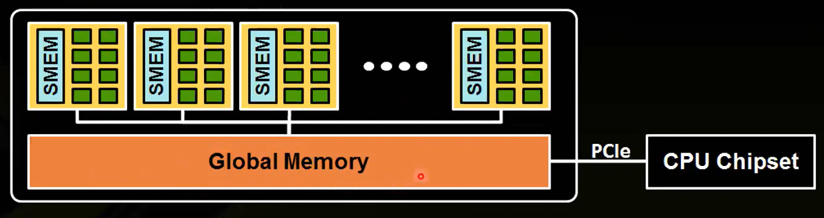
Major work
Latest Progress link fault error in table
SM: A set of cuda cores. Registers/shared memory/L1 cache

Slide 3
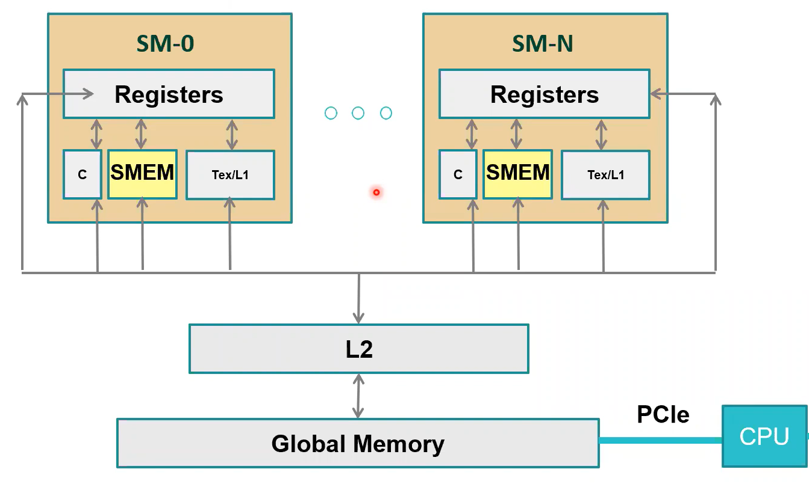
Major work
Directly read data from registers
Automatically use Tex/L1
Constant memory cache, compiler will try to use it.

Slide 4
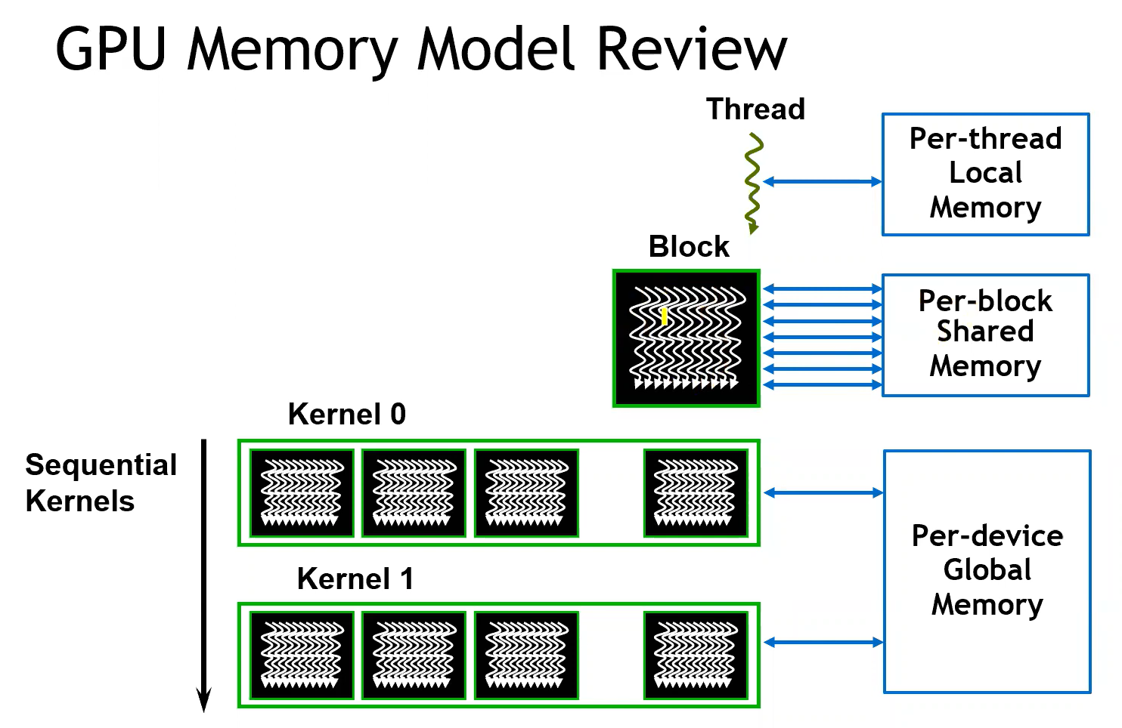
Major work
Latest Progress link fault error in table
Malloc by compiler, programmer cannot control it
Each block can have many threads, which can be allocated by programmer.
Each block can have share memory (cache), defined only once, cannot access by other blocks
Many blocks consists of grid. It uses global memory (cudamalloc()). Blocks of a grid execute across multiple SMs. It’s asynchronies.

Slide 5
Major work
Block
(0,0,0)
Block
(1,0,0)
Block
(2,0,0)
Grid
dim grid(3,2,1), block(3,3,1);
kernal<<<grid,block>>>(…);
Block
(0,1,0)
Block
(1,1,0)
Block
(2,1,0)
Idx=blockIdx.x*blockDim.x+threadIdx.x
Block
(1,1,0)
Thread
(0,0,0)
Thread
(1,0,0)
Thread
(2,0,0)
Thread
(0,1,0)
Thread
(1,1,0)
Thread
(2,1,0)
Thread
(0,2,0)
Thread
(1,2,0)
Thread
(2,2,0)

Slide 6
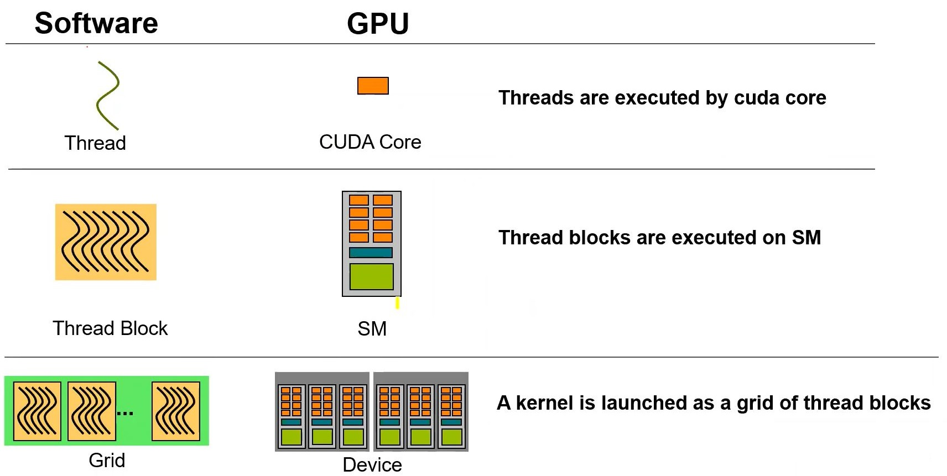
Major work
Latest Progress link fault error in table
GPU and Programming Model

Slide 7
Major work
Latest Progress link fault error in table
Share memory in CUDA

