Slide 1
Major work
Latest Progress link fault error in table
Read the website
2. Change the timer
3. Try to use cuSPARSELt

Slide 2
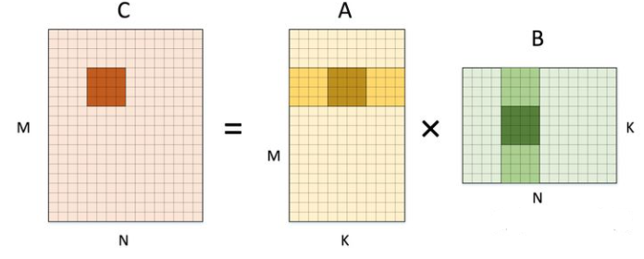
GEMM: General Matrix Multiplication

Slide 3


Slide 4
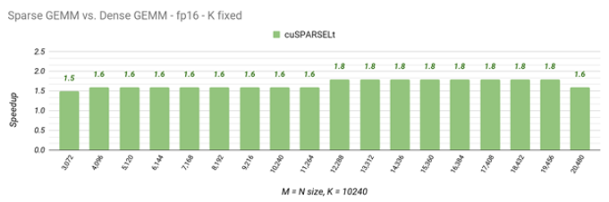
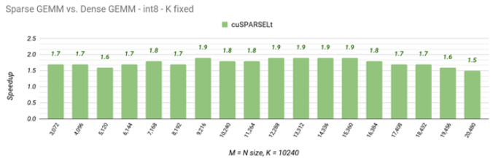
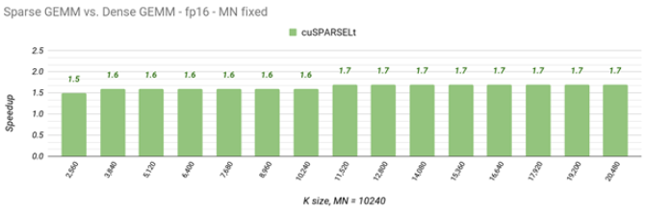
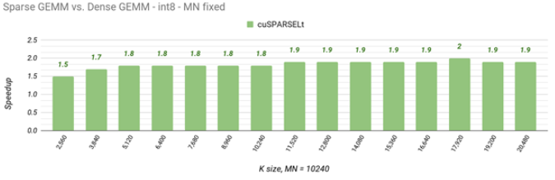
MxK, KxM, MxN

Slide 5
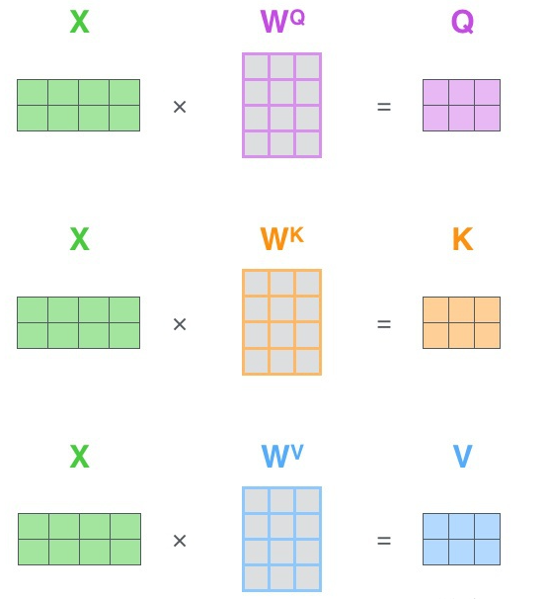
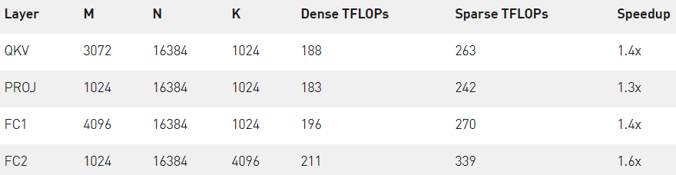
Coordinate transformation

Slide 6
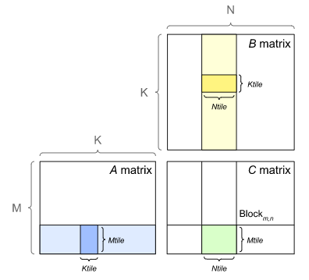
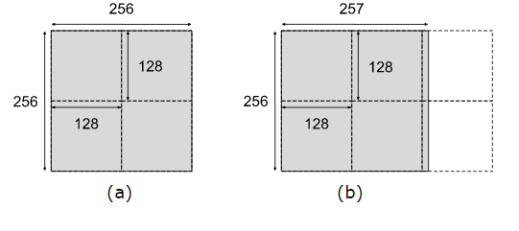
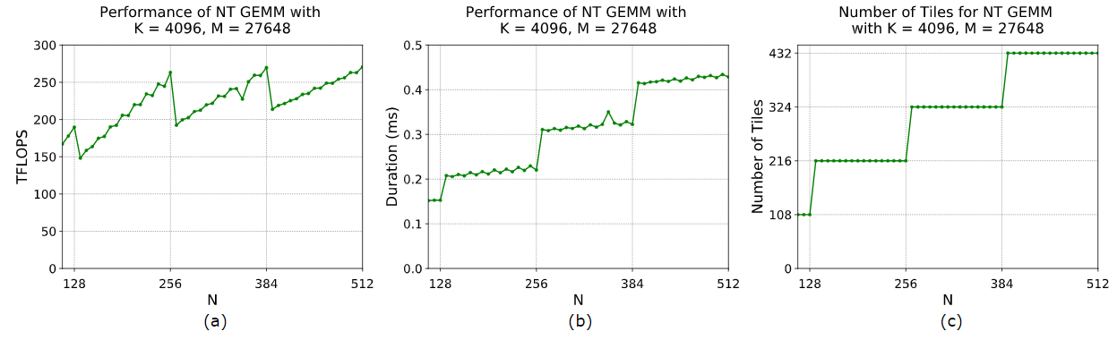

Slide 7
Major work
Latest Progress link fault error in table
Size | Normal(us) | Improve(us)
4 | 4.768 | 4.725
8 | 4.768 | 4.26
16 | 5.456 | 4.752
32 | 5.253 | 4.528
64 | 5.632 | 4.816
128 | 6.144 | 5.307
256 | 8.347 | 7.109
512 | 28.085 | 15.440
1024 | 172.251 | 68.645

