Slide 1
Major work
Latest Progress link fault error in table
Read several papers relate to convert matrix convolution to matrix multiplication
Try to write to code

Slide 2
Major work
Latest Progress link fault error in table
Matrix convolution

Slide 3
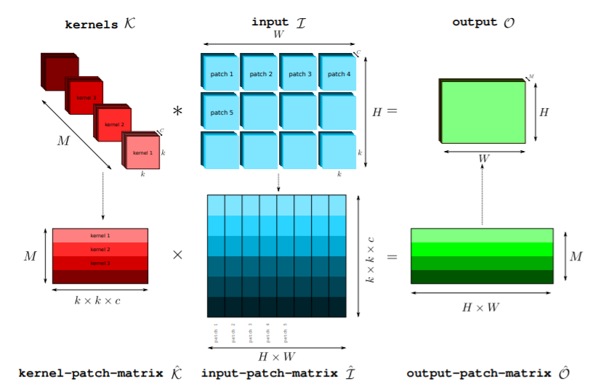
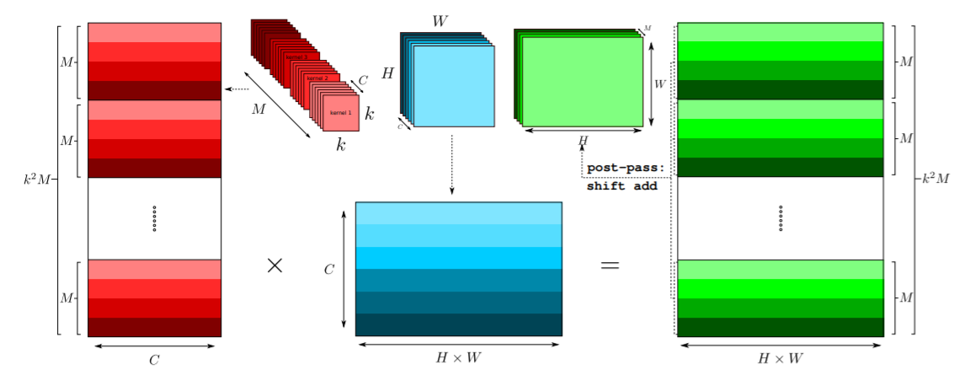
Major work
Latest Progress link fault error in table
Matrix convolution

Slide 4
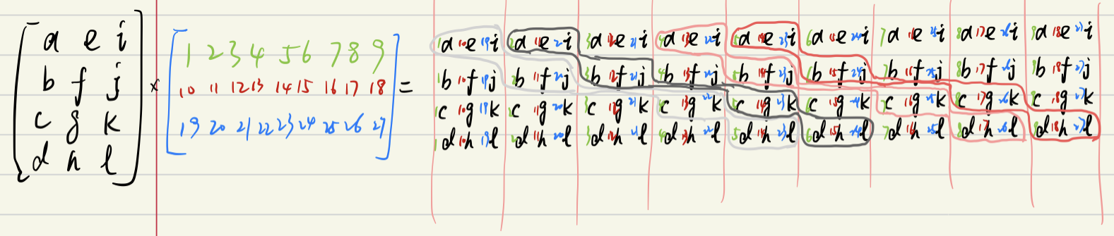
Major work
Latest Progress link fault error in table
Matrix convolution

Slide 5
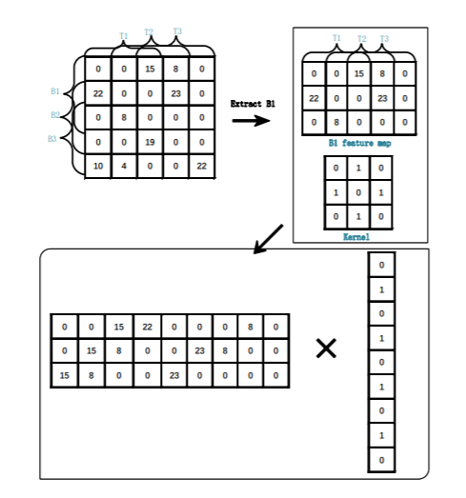
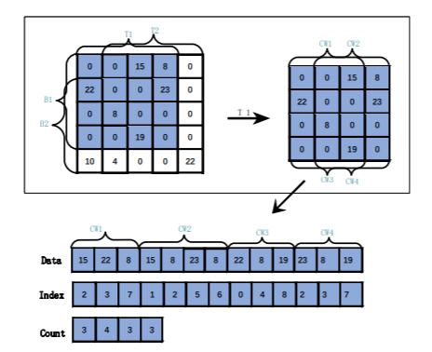
Major work
Latest Progress link fault error in table
Matrix convolution

Slide 6
Major work
Latest Progress link fault error in table
Matrix convolution
https://ieeexplore.ieee.org/stamp/stamp.jsp?tp=&arnumber=8852012
https://ieeexplore.ieee.org/stamp/stamp.jsp?tp=&arnumber=7995254
https://arxiv.org/pdf/1909.09927.pdf
https://arxiv.org/pdf/1709.03395.pdf

