Slide 1
Major work
Latest Progress link fault error in table
Implement conv to matrix multiplication code

Slide 2
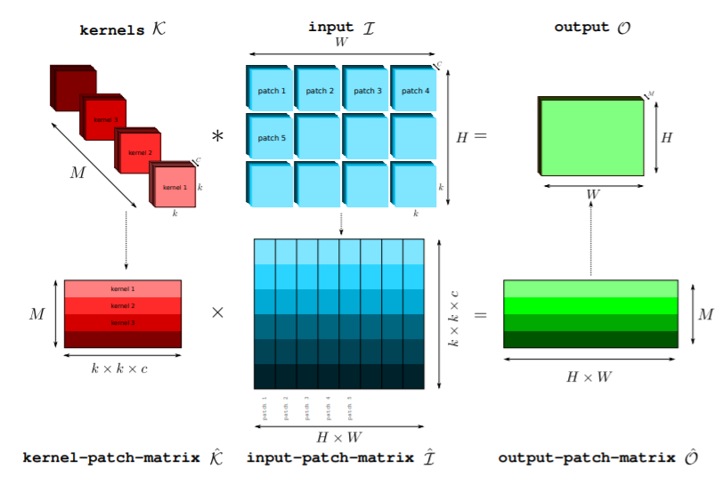
Major work
Latest Progress link fault error in table
Matrix convolution
1. create a con_mul class to store input and kernel info.
2. Random kernels are created as the format on the left, input is initialized to the matrix format on the second row. The output_tmp’s format is shown on the second row.
3. transform the kernels to the preferred format
4. Execute multiplication. Store the result to output_tmp. Then reshape is to the preferred format.

Slide 3
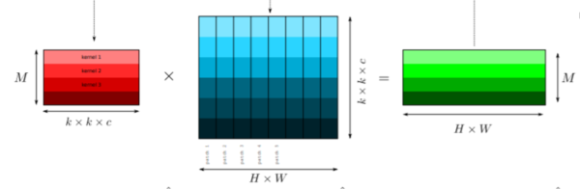
Major work
Latest Progress link fault error in table
Matrix convolution
Normal matrix convolution is finished.
CPU execute
For loop
Threads in one block
threadId(0) will do the addition
GPU execute
Blocks in one grid

