Slide 1
FINN CODE
Latest Progress link fault error in table
There are major Four Classes and one Function that we use in our code
WidthAdjustedInpurStream
WidthAdjustedOutputStream
ConvolutionInputGenerator
Matrix_Vector_Activate_Stream_Batch

Slide 2
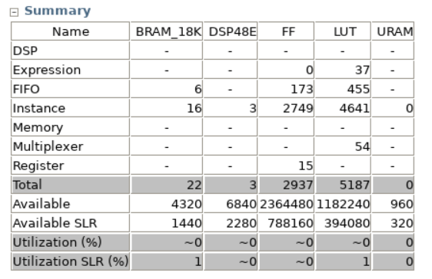
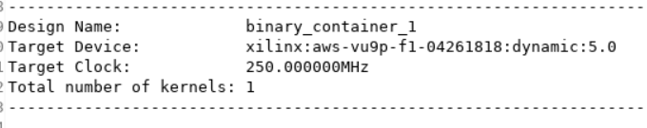
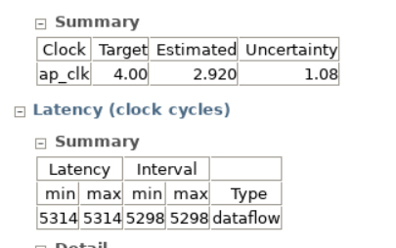
Major work
Latest Progress link fault error in table
1. Resource usage

Slide 3
Major work
Latest Progress link fault error in table
2. Two Layer
When I adjust some the parameters, errors shows up.
Not satisfy our Vgg16 each layer’s size right now

