Slide 1

Overview
Our final design
we have guidance for stream buffer size and PE array size
no need to wait three columns all ready
control logic becomes eaiser
we combine both DNN and FINN advantages
More complex way to organize data both in software side and hardware side, but we can overcome it after weeks of discuss
Off-chip Memory
Input feature map
duplicated weights data
weight stream buffer 2
layer1
weight stream buffer 1
layer2
control
control
reshape stream buffer
InputGenerator
PE unit for layer 1
reshape stream buffer
InputGenerator
PE unit for layer 2
output stream
...

Slide 2
Current Work
Testbench(host.cpp)
SW side
Hardware design(*.cpp *.h)
HW side
reshape
Opencl
read and store in stream(buffer)
Create both filters and IFM
padding
create PE array
repeat for serval times
repeat for serval times
conv
control and conv
pooling
pooling & padding
results
compare
results
Opencl
DONE
feedback
feedback
complier and script

Slide 3
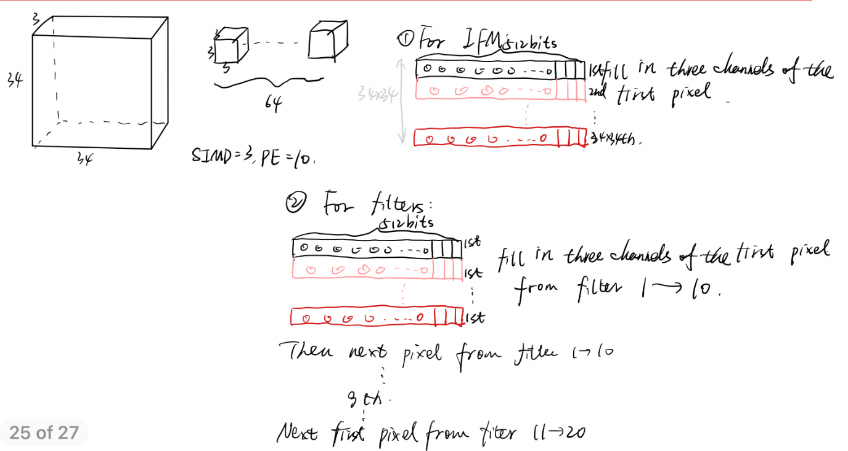

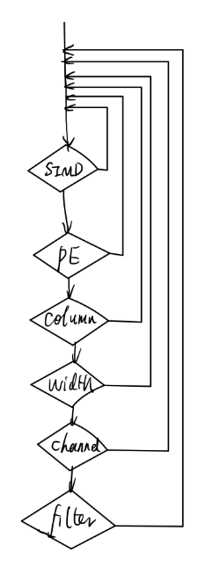
Overview
Our final design

Slide 4
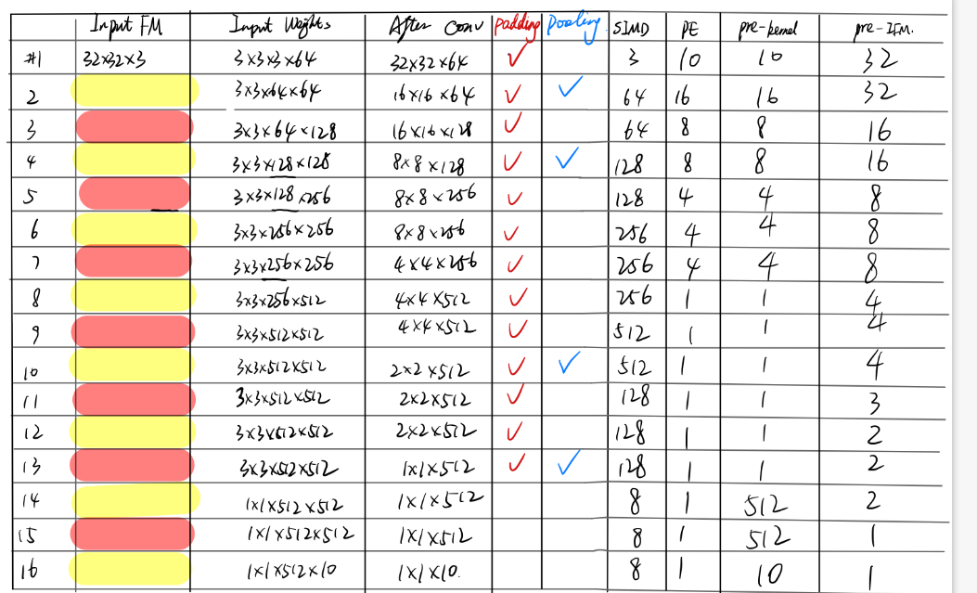
Overview
Our final design

Slide 5
In software side, we use the input_data constructor create all 16 layers of filters, and first layer’s IFM.
Take the first layer for example:
After construct the W1, the data structure will be 3(row)x3(column)x3(channel)x64(filter)x16(bit width), which is the original format
Then member function organize() will reshape it to 576(row)x48(bit width). We pact the data in channel direction first, so three data become one, hence the new data width will be 3*16=48bits. So each filter cube will need 9 of above 48bits to store. We put first filter’s row#1 column#1 3 channel to the first row of the new format. Then first filter’s row#2 column#1 3 channel to the second row of the new format. Then first filter’s row #3 column #1 3 channel, then first filter’s row #1 column #2, row #2 column #2..., till row #3 column #3. Then with the same method go over second filter, until 64th filter row#3 column#3’s 3 channel being stored in the 576 row of the new format.
Then we call member function duplicate() to repeat the above 576 row for 1024 times(32x32). That’s because each filter will be reused for 32x32 times, based on the IFM 34x34 and output Feature map is 32*32.
We do the same thing to W2, W3, ..., W16. And connect the head of W2 to the tail of W1, and the head of W3 to the tail of W2, till W16.
Then send this super deep data structure to hardware side.
As for the IFM, we use the same method pact its data. Make 3 channel data into one 48bits data, then go over first column’s each row, then second column’s each row, till 34th column. And send this array to hardware directly without duplicate.
Please read member function code carefully! You will understand what it is doing.
And for some layers, the filter’s channel is larger than 32, which will be larger than 512 bits. In our design, the data width shouldn’t larger than 512bits, because it will decrease the data transfer ability. Hence, we separate it to multiple 512 bits. Read the organize() function carefully, it shows how I deal with it. This problem also occurs on the hardware side. And that’s why I use many precompiled codes in the hardware side(#if....#else...#endif)

Slide 6
In hardware side, we have two arrays. One is the super deep data structure which stores weight. Another stores the reshaped IFM.
We need to create 16 weight streams. Each stream is like a tube, this tube is connected to the source, which is the super deep weight. Since this super deep weight structure contains all 16 layer’s filter, and we want to separate them to correspondent tube. Hence, this tube has special filter on it, which is the read_weight function. After connect the tube to the weight source, we also need one more tube connect to the IFM source.
Since each data in the IFM array will be used for multiply times during convolution, we need to make this new tube be the special one. It should not only connect the source, but also create source, which is our input_generator function.
After weight stream and IFM stream are well prepared, these data should be sent to PE array to get the multiplication results.
Then pooling and padding the result, and use a new tube sends to next layer.

Slide 7
What you should do?
Finish the needed code on the last slides I posted on the slack. The requirements are shown in it.
Test the Input_generator. We need to make sure that the Input_generator is correct, then we can move on to the next step. Otherwise, it will be very difficult to debug if the results not match the software side.
If you have any question, please let me know as soon as possible. And please finish the software coding no later than next week.

