Slide 1
Major work
Latest Progress link fault error in table
Try to run code on the server
2. Read Mmult-8Bit code
3. Read papers

Slide 2
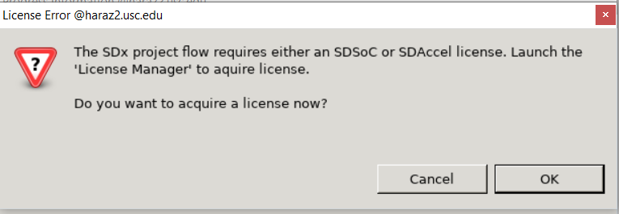
Major work
Latest Progress link fault error in table
1. run code on server

Slide 3
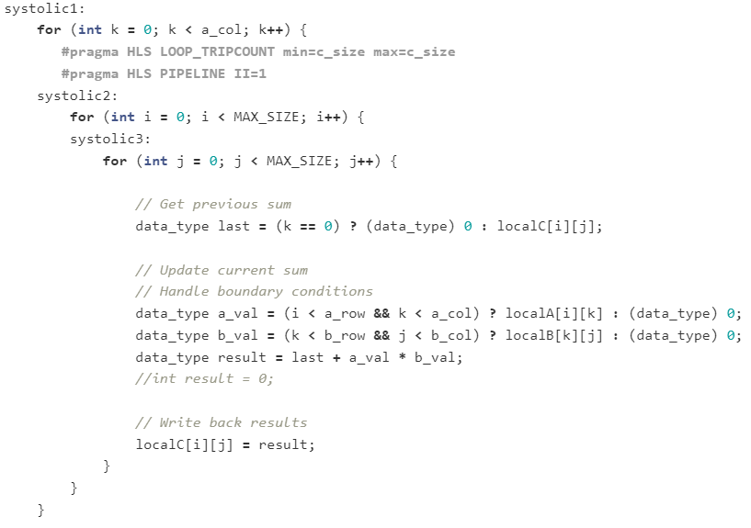
Major work
Latest Progress link fault error in table
2. Read Mmult-8Bit code
There are three major steps when doing matrix multiplication based on HLS
Burst reads from global memory
Doing the caculation
Burst write to global memory

Slide 4
Major work
Latest Progress link fault error in table
Read papers.
I still need some time to fully understand TPGA and F2N2
on-chip memory ⬄ external buffer
determine accelerators’ memory interface
map accelerators to different dies

