Slide 1
Major work
Latest Progress link fault error in table
Write python script for Nulla one layer
Debug the FINN one layer

Slide 2
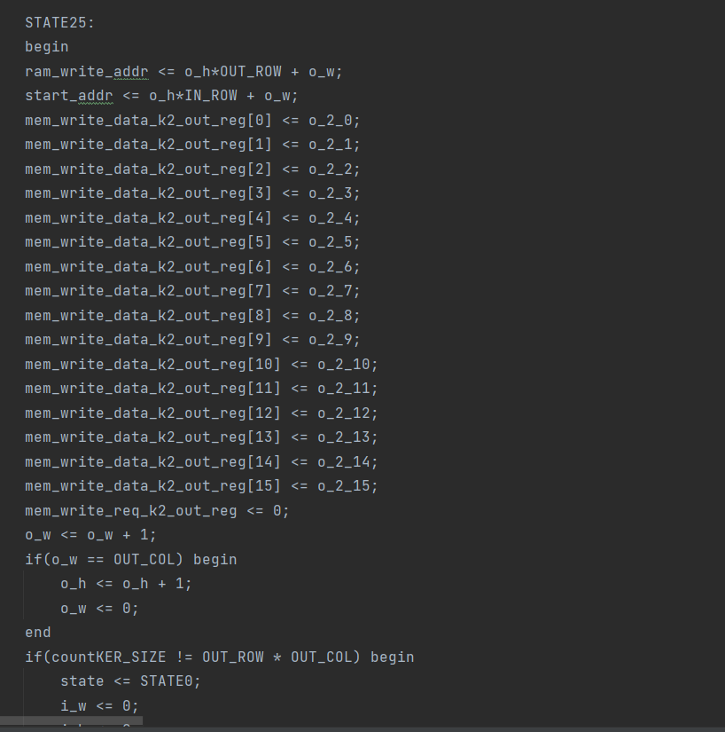
Major work
Latest Progress link fault error in table
1. Python script
Right now, it can generate all most all the Verilog lines we want for one layer

Slide 3
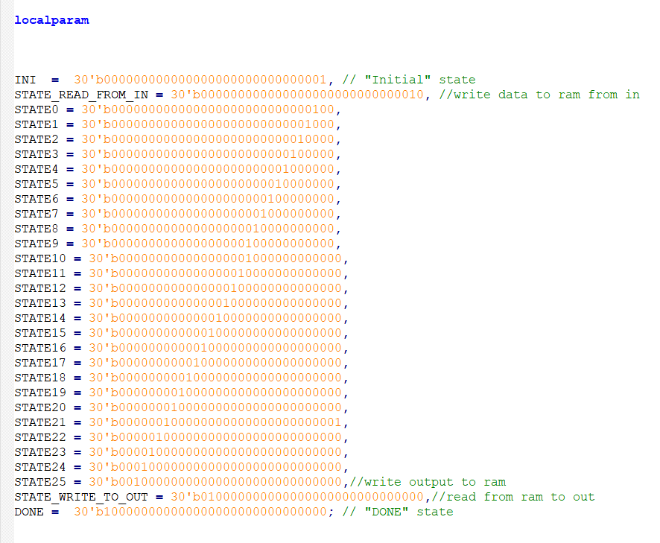
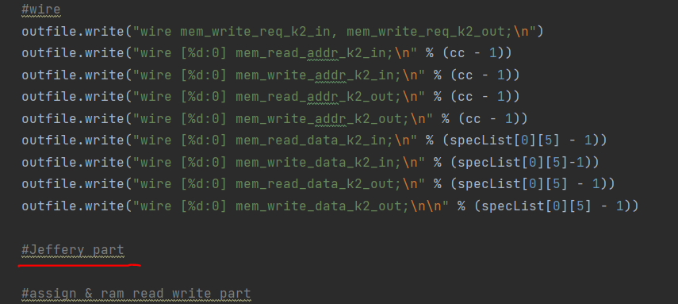
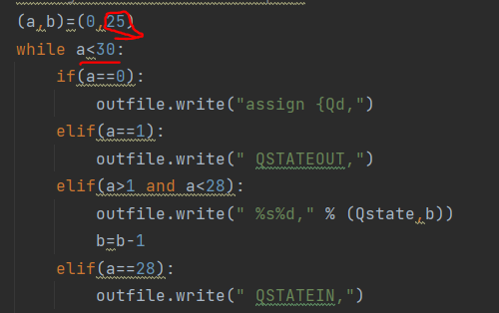
Major work
Latest Progress link fault error in table
1. Python script
Problems this script have:
①Some numbers are const
②One part is not finished

Slide 4
Major work
Latest Progress link fault error in table
2. FINN one layer on SDx

