Slide 1
Major work
Latest Progress link fault error in table
Debug One_layer HW and generate resource usage info
Try to implement two layer

Slide 2
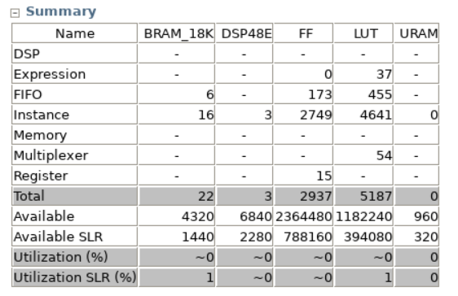
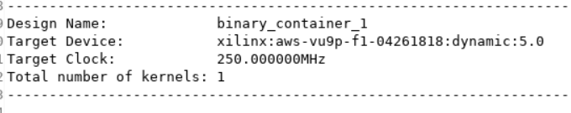
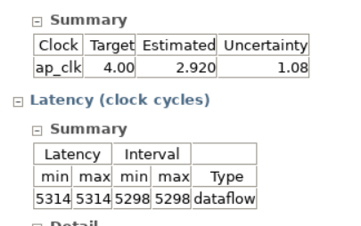
Major work
Latest Progress link fault error in table
1. Resource usage

Slide 3
Major work
Latest Progress link fault error in table
2. Two Layer
When I adjust some the parameters, errors shows up.
Not satisfy our Vgg16 each layer’s size right now

