Slide 1
Major work
Latest Progress link fault error in table
Solve the current bug
Try to write script

Slide 2
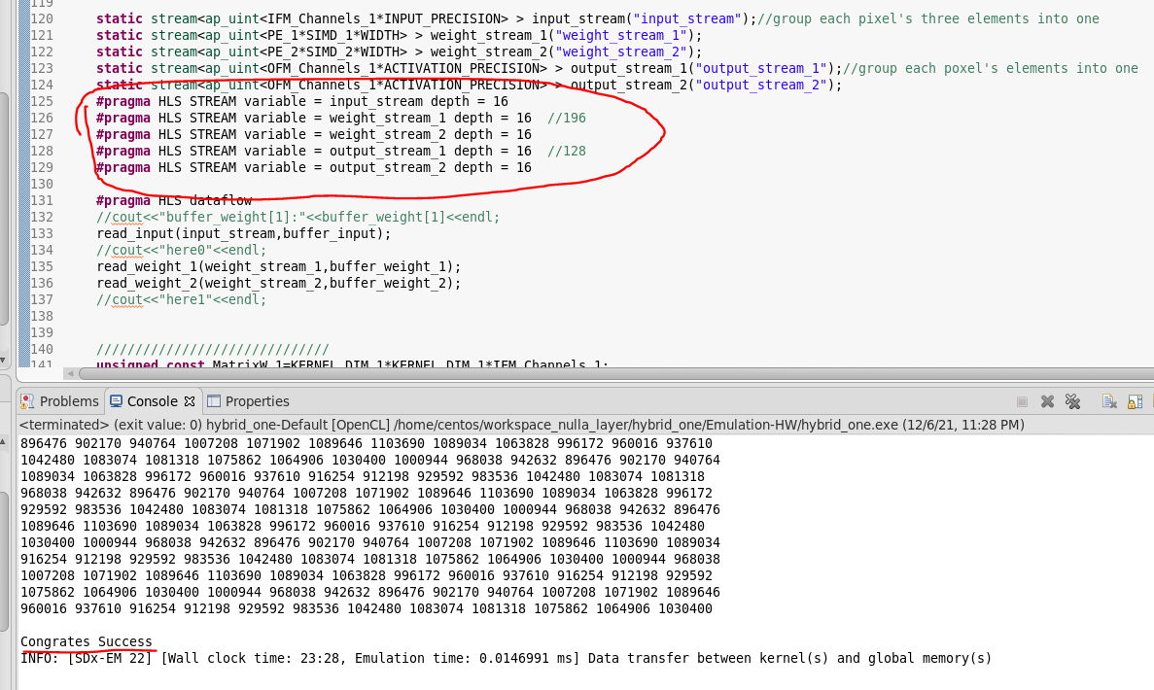
Major work
Latest Progress link fault error in table

Slide 3
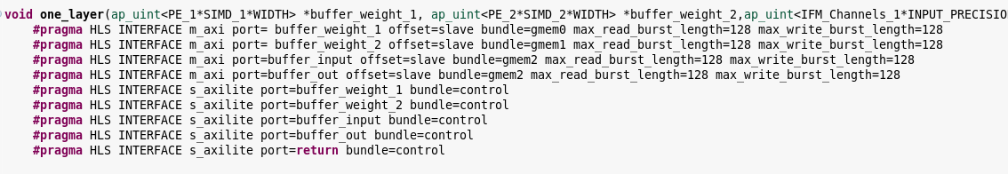

Major work
Latest Progress link fault error in table
Use two memory banks to solve the bug

