Slide 1
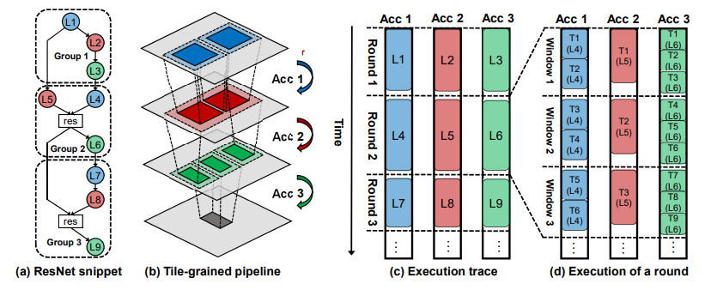
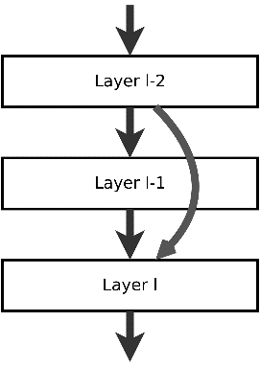
Major work
Latest Progress link fault error in table
About TPGA Algorithm

Slide 2
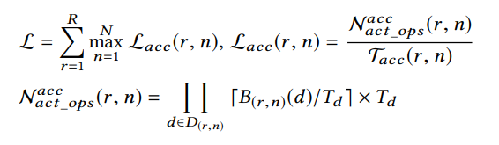
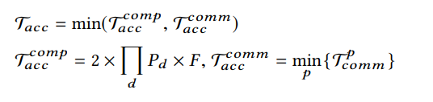
Major work
Latest Progress link fault error in table
About TPGA Algorithm
① Latency model
As a key criterion for resource allocation
denominator is actual operations # for processing a layer
computation latency and communication latency
nominator is
latency τ

Slide 3
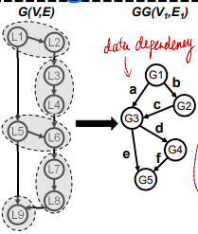
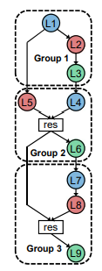
Major work
Latest Progress link fault error in table
About TPGA Algorithm
② Optimization algorithm
Generate a directed acyclic graph
Every vertex represent buffer size(on-chip)
the needed size to store the padded output feature map
accumulate the stream buffer sizes across all groups
At the beginning, each edge is initialized by their start vertex

Slide 4

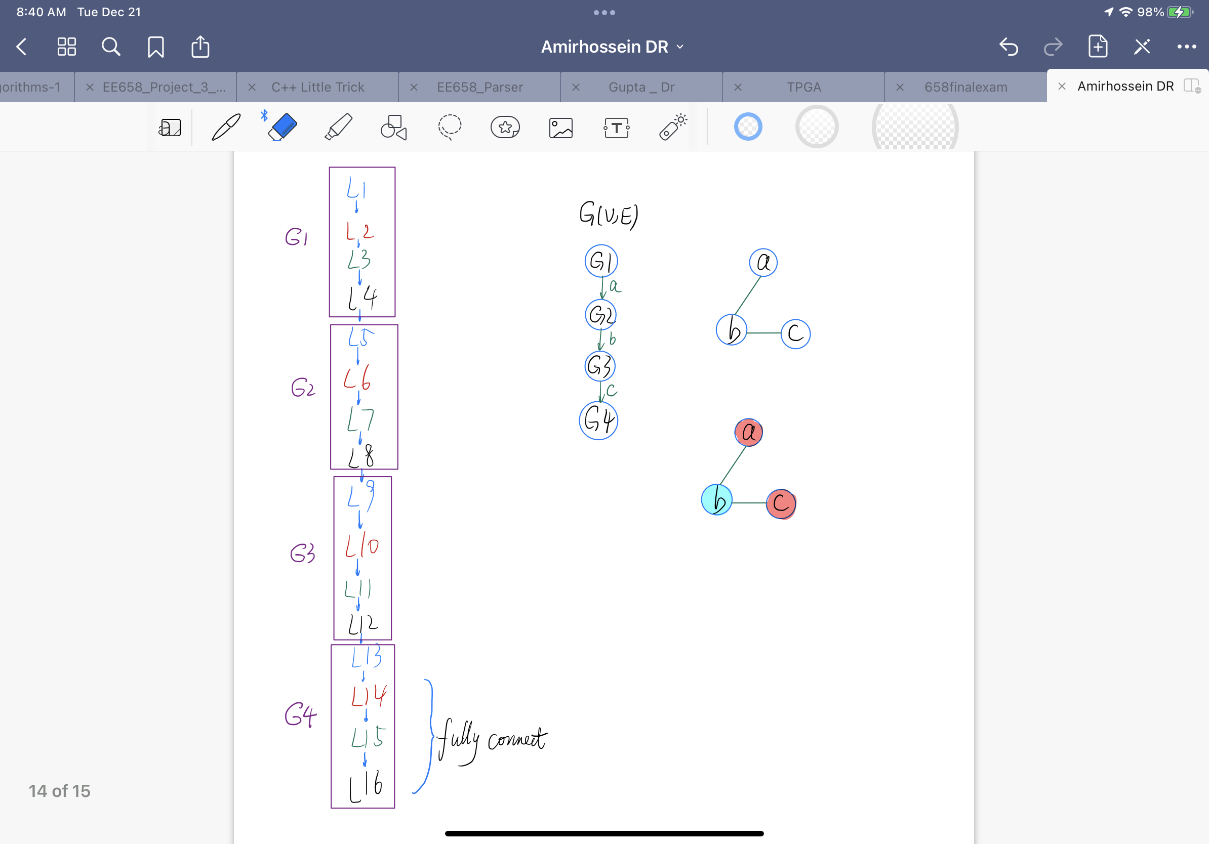
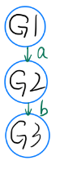

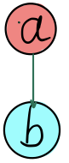
Major work
Latest Progress link fault error in table
About TPGA Algorithm
② Optimization algorithm
build && color
each color has a weight value denoting the on-chip buffer size
build
color

Slide 5
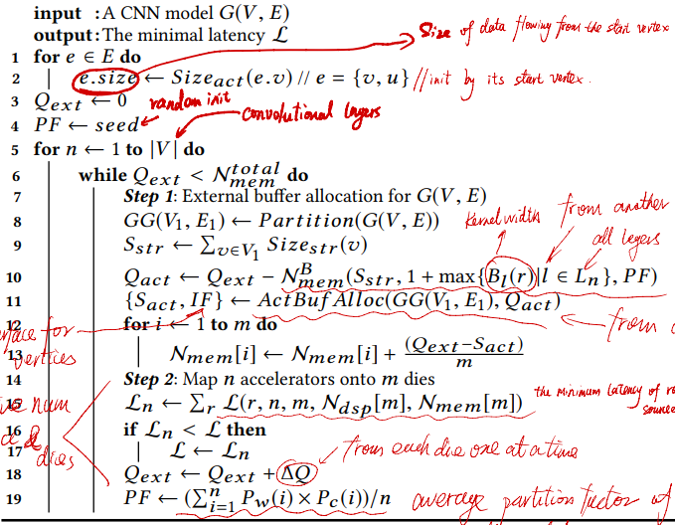
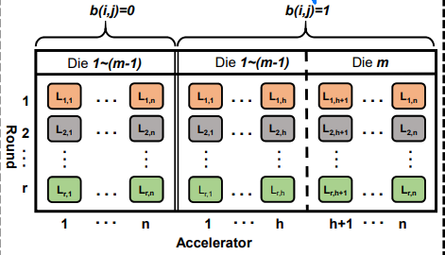
Major work
Latest Progress link fault error in table
About TPGA Algorithm
① Optimization algorithm
update latency
find the minimum latency for each round and sum
How does die affect latency?
①i th acc n j th die (short latency)
②i th acc on the die before j th(long latency)
So only consider i th acc on j th die

