Slide 1
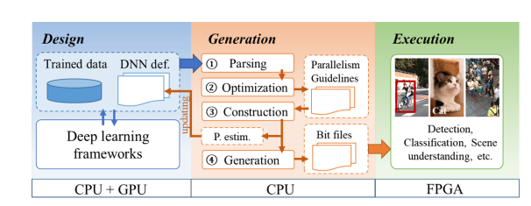
DNNBuilder
Latest Progress link fault error in table
Key Procedure

Slide 2
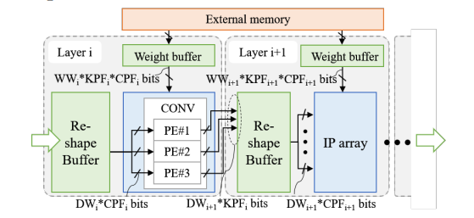
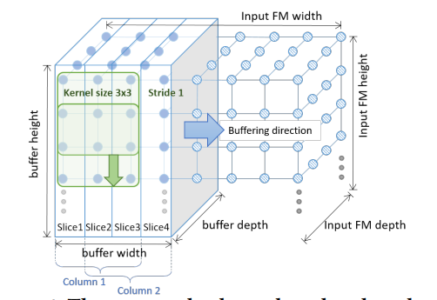
DNNBuilder
Latest Progress link fault error in table
HW Architecture

Slide 3
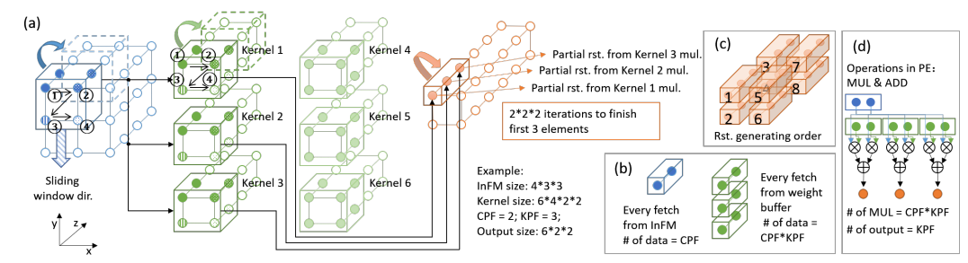
DNNBuilder
Latest Progress link fault error in table
PE Design

Slide 4
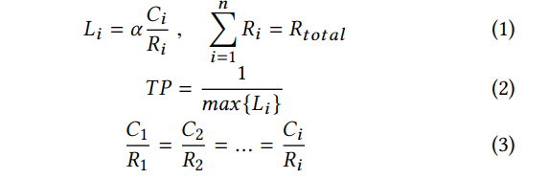
DNNBuilder
Latest Progress link fault error in table
Computation Resource Allocation Guideline

Slide 5
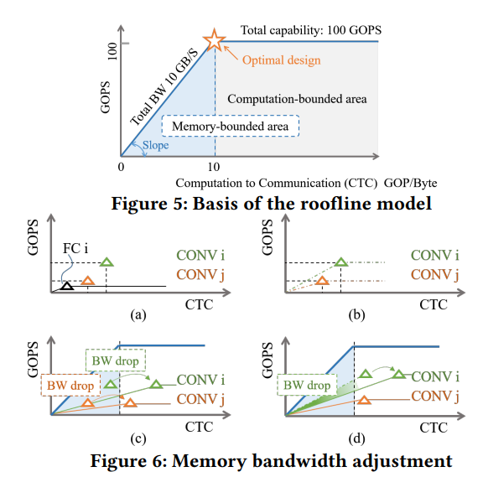
DNNBuilder
Latest Progress link fault error in table
Memory and Bandwidth Resource Allocation Guideline

Slide 6
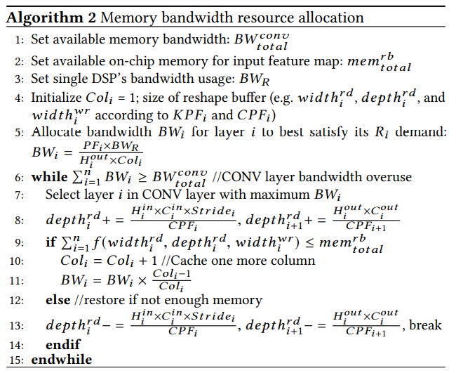
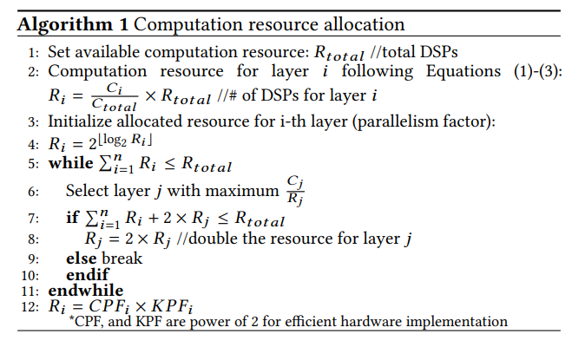
DNNBuilder
Latest Progress link fault error in table
Two Guideline Algorithms

Slide 7
Connection and Difference
Latest Progress link fault error in table
connection
They all try to find a way to allocate memory. And use their own model to achieve highest throughput.
difference
HW architecture is different Resource Allocation method is different

Slide 8
About the Difference
Latest Progress link fault error in table
Based on TGPA, the number of DNN accelerator is equal to the layer number
They both need to store temporary data, but DNN needs more
TGPA try to find best solution based on latency, DNN try to find a best way to use up memory bandwidth and DSP
TGPA tiles the input feature map in width direction, but DNN tiles the input feature map in high direction

Slide 9
Pros and Cons
Latest Progress link fault error in table
TPGA algorithm is way more complex and not easy to understand Meanwhile, HW design is more complex(reshape and store temp data) and delicate, but it’s more compatible to different nets TPGA doesn’t consider the memory read/write bandwidth TPGA is more like a random test(increase acc, PE, on-chip mem) to find the best solution
DNN algorithm is easy to understand and realize.
DNN takes bandwidth into consideration. DNN might have(maybe) lower throughput than TPGA. DNN is more power friendly
What if use TGPA HW architecture and based on DNN method to guide us?

