Slide 1
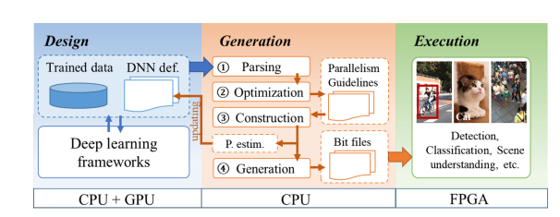
DNNBuilder
Latest Progress link fault error in table
Key Procedure

Slide 2
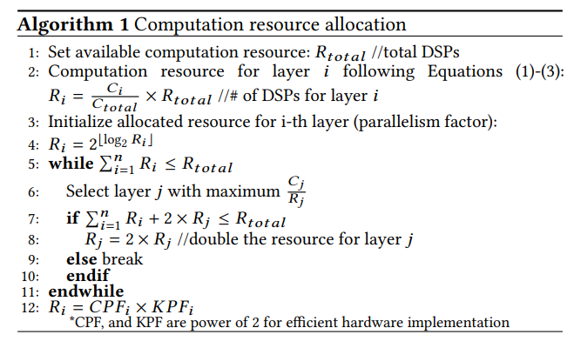
DNNBuilder
Latest Progress link fault error in table
Algorithm 1
Some modifications:
After running algorithm 1, there may still remain some DSPs.
find the layers that have less or equal DSPs than the remaining DSP
find the maximum c/r ratio layer and double its DSP
repeat step 2 until the remaining DSP numbers less than the number of DSPs in each layer
Benefits :
1. use more DSPs
2. increase the through put

Slide 3
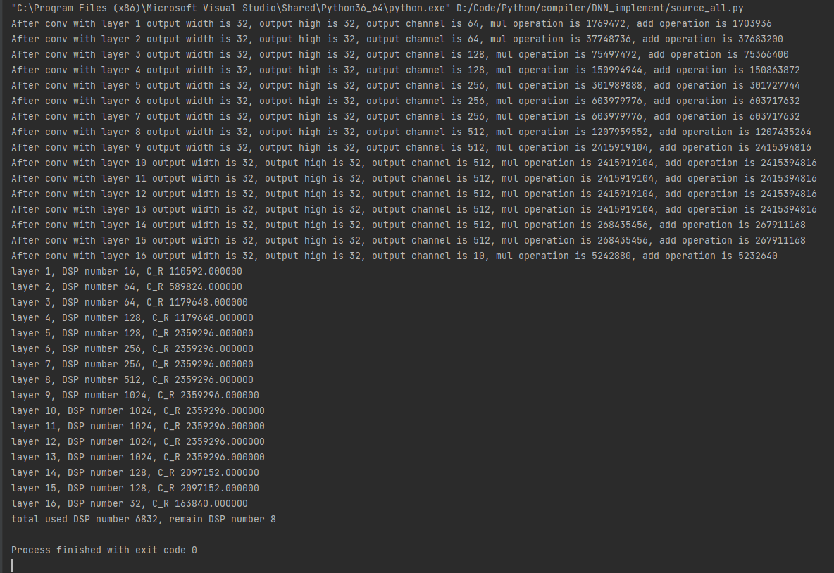
DNNBuilder
Latest Progress link fault error in table
Algorithm 1 is finished

Slide 4
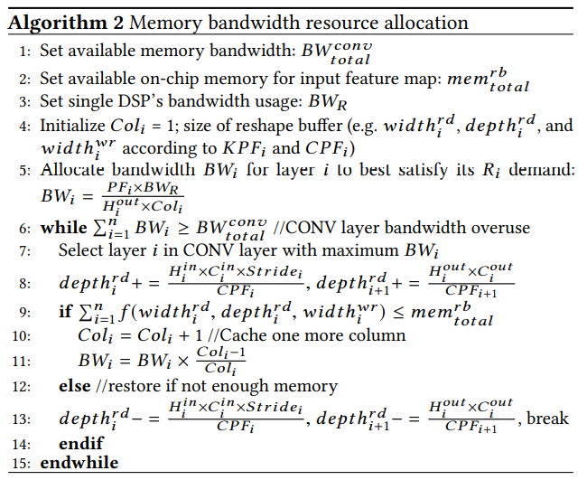
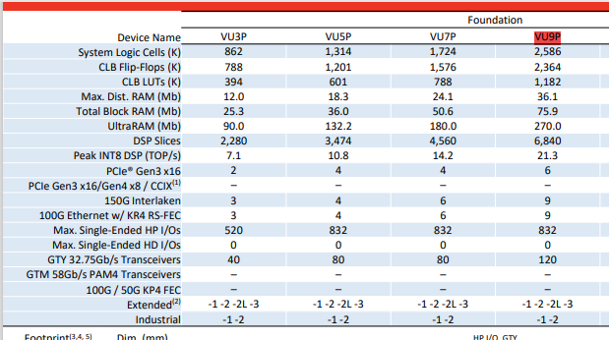
DNNBuilder
Latest Progress link fault error in table
Algorithm 2
mem bandwidth:
on-chip mem:75.9Mb?
DSP bandwidth: 21.3TOP/s ?
GTY, GTM Transceivers

