Slide 1


Streaming Architecture
Instructor：Prof. Pedram
Mentor: Arash, Amirhossein
Present by: Ryan

Slide 2


Streaming Arch
My Current Work
Next Step
CONTENTS

Slide 3

Streaming Arch
complete Two-layer HW design:
①Verified that some of FINN’s code can be used in our design
②Relatively low consumption of hardware resources

Slide 4
Streaming Arch
Our current design with FINN
Off-chip Memory
Input feature map
duplicated weights data
weight stream buffer 2
layer1
weight stream buffer 1
layer2
reshape stream buffer
PE unit for layer 1
reshape stream buffer
PE unit for layer 2
output stream

Slide 5
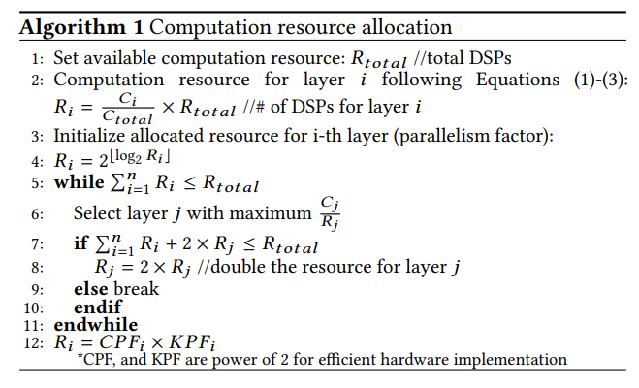
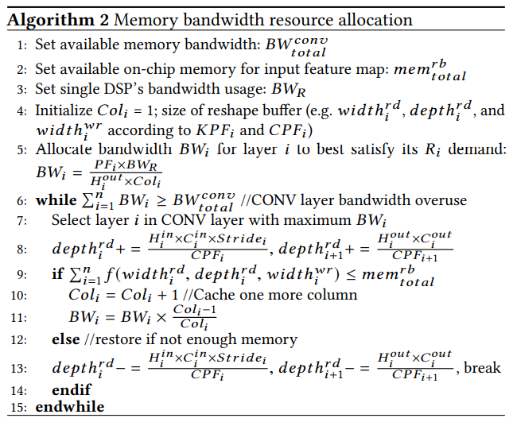
Algorithm
Streaming Arch
After completing the two-layer design, I am working on the compiler.
  ①Read the DNNbuilder paper
  ②Implement the two algorithms from the paper (Computation Resource Allocation Algorithm and Memory and Bandwidth Resource Allocation Algorithm) to allocate HW resources (DSPs, on chip memory, bandwidth), to each layer

Slide 6
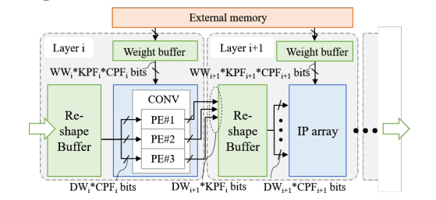
HW Architecture
This is their HW architecture, which is pretty similar to our two-layer design
Reshape Buffer: store input feature map for each layer
Weight buffer: store kernels for each layer
External memory: Other date that exceeds the size of on chip memory
Repeat the above structure until 16 layers (vgg16) of convolution are completed

Slide 7
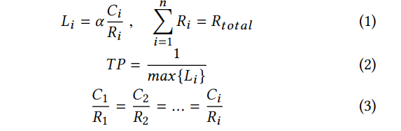
Computation model
Computation Resource Allocation Guideline
----- determine how many DPS each layer will have
We have 16 stage pipelines (Vgg16), so when each stage has similar latency after distributing the DSPs, the throughput can maximize

Slide 8
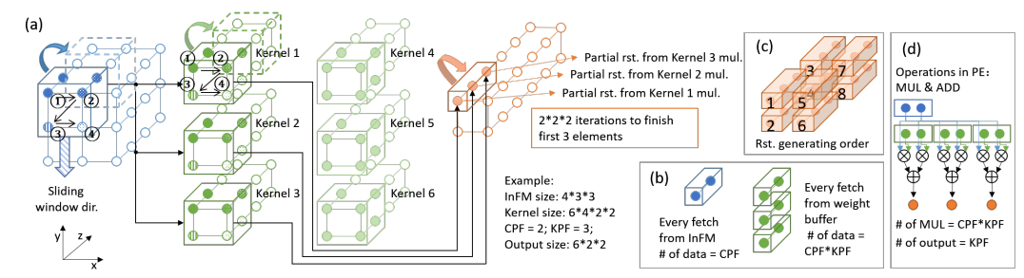
Mapping DSPs
Parallel in the part of channel and the part of height dimension. This is a preliminary map method, we may need to adjust it, based on the DSP number we get, when we implement the HW.

Slide 9
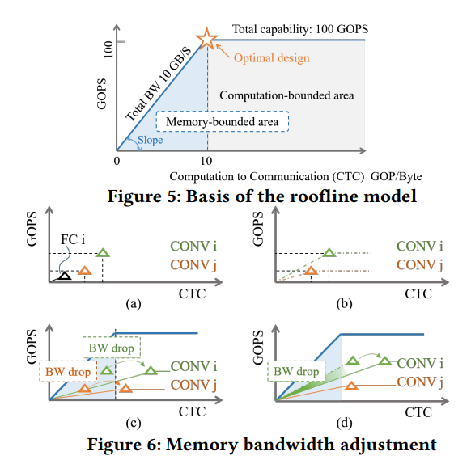
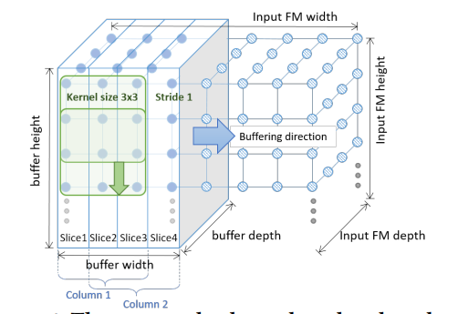
Computation model
Memory and Bandwidth Resource Allocation Guideline:
-----determine each layer’s on chip memory size
In order to best use all HW resources, our CONV layer should be at an optimal design point.(Assign fully connect layer all the resources we have)

Slide 10
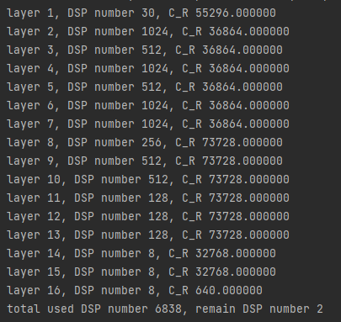
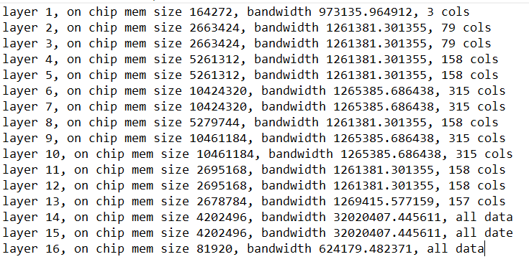
Preliminary results
Right now, only one kernel(A filter consists of kernels) and cols of the input feature map of each layer are stored in the on-chip memory. In order to solve this problem and maximize the use of on-chip memory, we plan to store more kernels in the on-chip memory

Slide 11
Next Step
Finish the compiler and write a script to generate the synthesizable C++ code for the hardware

Slide 12


