Slide 1
DNNBuilder
Latest Progress link fault error in table
Previous two-layer design

Slide 2
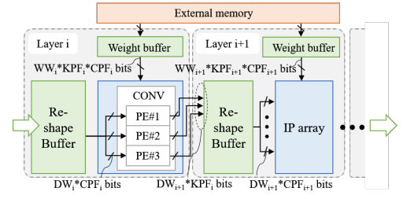
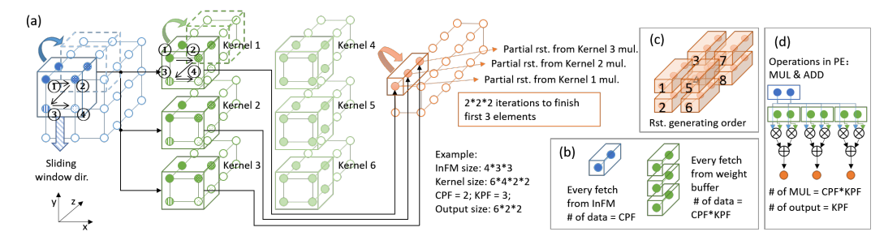
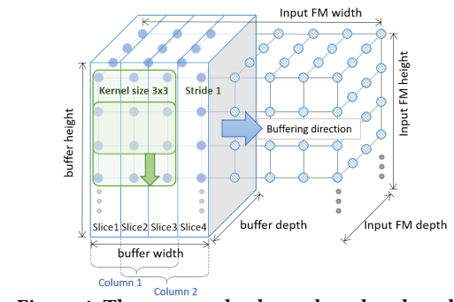
DNNBuilder
Latest Progress link fault error in table
Current design
How to deal with the Input generator for each layer’s output?

